Slide 1
Geometriya
11-sinf
Mavzu:
Hajm tushunchasi. Parallelepipedning hajmi

Slide 2
Reja
Hajm tushunchasi
Parallelepipedning hajmi
Kubning hajmi
Mavzuga oid masalalar yechish

Slide 3
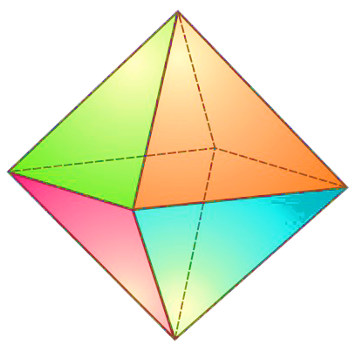
$175$-masala (157-sahifa)
Oktaedr bitta yog‘ining yuzi $5,5 {cm}^{2}$ bo‘lsa, uning to‘la sirtini toping.
Berilgan:
Masalaning yechimi:
$$S=5,5 {cm}^{2}$$
$$S_{to‘la}=8∙S$$
$$Y=8$$
$$S_{to‘la}=8∙5,5=44$$
Topish kerak:
$$S_{to‘la}= ?$$
Javob: $44 {cm}^{2}$

Slide 4
$186$-masala (158-sahifa)
Agar kubning qirrasi 1 birlik orttirilsa, uning to‘la sirti 54 birlikka ortadi. Kubning qirrasini toping.
Berilgan:
Yechish:
$$a$$
$$S$$
$$S={6a}^{2}$$
$$a+1$$
$$S+54$$
$$S+54={6∙\left(a+1\right)}^{2}$$
Topish kerak:
$${6a}^{2}+54=6∙\left(a^{2}+2a+1\right)$$
$$a= ?$$
$${6a}^{2}+54=6a^{2}+12a+6$$
$$48=12a$$
$$a=4$$
Javob: $4$

Slide 5
$194$-masala (158-sahifa)
To‘rtburchakli muntazam prizma asosining tomoni 6 cm, prizmaning balandligi 5 cm. Prizmaning diagonal kesimi yuzini toping.
Berilgan:
Yechish:
$$a=6 cm$$
$$d=a\sqrt{2}=6\sqrt{2}$$
$$h=5 cm$$
$$S_{d}=h∙d$$
$$h$$
Topish kerak:
$$S_{d}=5∙6\sqrt{2}=30\sqrt{2}$$
$$d$$
$$S_{d}= ?$$
Javob: $30\sqrt{2} {cm}^{2}$
$$a$$
$$a$$

Slide 6
Hajm tushunchasi

Slide 7
Hajm tushunchasi

Slide 8
Hajm – fazoviy jismning quyidagi xossalarga ega bo‘lgan miqdoriy ko‘rsatkichidir:
$$V>0$$

Slide 9
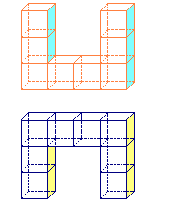
Hajm – fazoviy jismning quyidagi xossalarga ega bo‘lgan miqdoriy ko‘rsatkichidir:
$$1$$
$$1$$
$$V=1$$
$$1$$
Hajm o‘lchov birliklari
$$m^{3}, {dm}^{3}, {sm}^{3}, {mm}^{3}, l$$

Slide 10
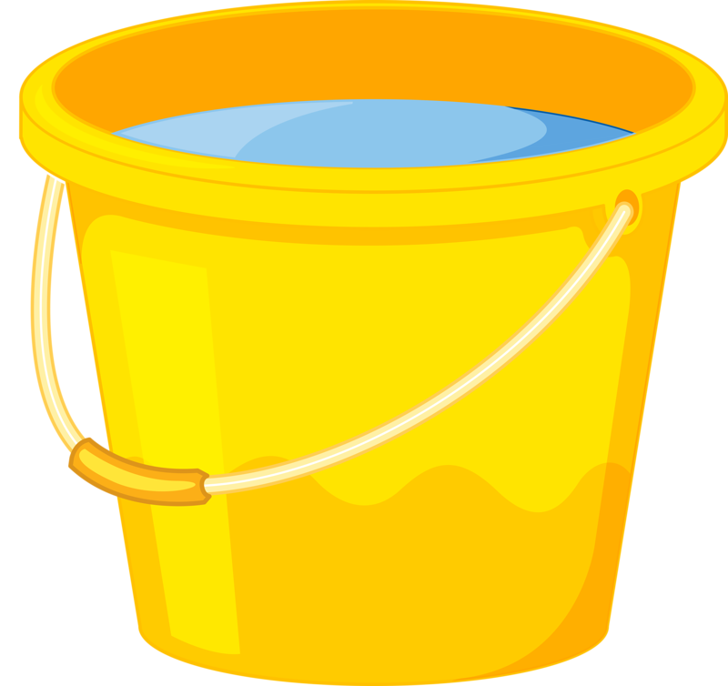

Slide 11
Parallelepipedning hajmi
To‘g‘ri burchakli parallelepipedning hajmi uning uchta o‘lchamlari ko‘payt-masiga teng:
$$c$$
$$V=a∙b∙c$$
$$a$$
$$b$$

Slide 12
Parallelepipedning hajmi
To‘g‘ri burchakli parallelepipedning hajmi asosining yuzi bilan balandligining ko‘paytmasiga teng:
$$h$$
$$V=S_{asos}∙h$$
$$S_{asos}$$

Slide 13
Parallelepipedning hajmi
Ixtiyoriy parallelepipedning hajmi asosining yuzi bilan balandligining ko‘paytmasiga teng:
$$V=S_{asos}∙h$$
$$h$$
$$S_{asos}$$

Slide 14
Kubning hajmi
$$V=a∙a∙a$$
$$V=a^{3}$$
$$a$$
$$a$$
$$a$$

Slide 15
1-masala
Rasmda berilgan yoyilmaga ko‘ra yasalgan
idishning hajmini toping.
$$48 cm$$
$$8 cm$$
$$8 cm$$
$$36 cm$$

Slide 16
Masalaning yechimi
$$a=36−2∙8=36−16=20$$
$$b=48−2∙8=48−16=32$$
$$c=8$$
$$V=a∙b∙c=20∙32∙8=5120 {cm}^{3}$$
$$48 cm$$
$$8 cm$$
$$b$$
$$a$$
$$8 cm$$
$$c$$
$$36 cm$$
Javob: $5120 {cm}^{3}$

Slide 17
2-masala
To‘g‘ri burchakli parallelepiped yog‘ining yuzi
12 cm ga va unga perpendikulyar qirra uzunligi 18 cm ga teng. Parallelepipedning hajmini toping.
Berilgan:
Yechish:
$h=18$ $cm$
$$V=S_{asos}∙h$$
$$S_{asos}=12 cm$$
$$V=18∙12=216$$
$$h=18$$
Topish kerak:
Javob: $216 {cm}^{3}$
$$V= ?$$
$$S_{asos}=12$$

Slide 18
3-masala
To‘g‘ri burchakli parallelepiped bir uchidan chiquvchi uchta qirralarining uzunliklari 4, 6 va 9 ga teng.
Unga tengdosh kub qirrasini toping.
Berilgan:
Yechish:
$$b$$
$$a=4$$
$$V=a∙b∙c$$
$$b=6$$
$$V=4∙6∙9=216$$
$$a$$
$$c=9$$
$$V={\left(a_{kub}\right)}^{3}$$
Topish kerak:
$$c$$
$$a_{kub}= ?$$

Slide 19
3-masala
To‘g‘ri burchakli parallelepiped bir uchidan chiquvchi uchta qirralarining uzunliklari 4, 6 va 9 ga teng.
Unga tengdosh kub qirrasini toping.
Berilgan:
Yechish:
$$a=4$$
$$V=a∙b∙c$$
$$a$$
$$b=6$$
$$V=4∙6∙9=216$$
$$a$$
$$c=9$$
$$V={\left(a_{kub}\right)}^{3}$$
$$a$$
Topish kerak:
$${\left(a_{kub}\right)}^{3}=216=6^{3}$$
$$a_{kub}= ?$$
$$a_{kub}=6$$
Javob: $6$

Slide 20
4-masala
Agar kubning qirralarini 1 birlik orttirilsa, uning hajmi 19 birlikka ortadi. Kubning qirrasini toping.
Berilgan:
Yechish:
$$a$$
$$V$$
$$V=a^{3}$$
$$a+1$$
$$V+19$$
$$V+19={\left(a+1\right)}^{3}$$
$$a^{3}+19=a^{3}+3a^{2}+3a+1$$
Topish kerak:
$$3a^{2}+3a−18=0$$
$$a= ?$$
$$a^{2}+a−6=0$$
$$a_{1}=2$$
$$a_{2}=−3$$
Javob: $2 cm$

Slide 21
5-masala
Birinchi kubning hajmi ikkinchisinikidan 8 marta katta. Birinchi kubning to‘la sirtining yuzi ikkinchisinikidan necha marta katta?
Berilgan:
Yechish:
$$V_{1}=V_{2}∙8$$
$$a_{1}^{3}=a_{2}^{3}∙8$$
Topish kerak:
$$a_{1}^{3}=a_{2}^{3}∙2^{3}$$
$$\frac{S_{1}}{S_{2}}= ?$$
$$a_{1}^{3}={\left(a_{2}∙2\right)}^{3}$$
$$a_{1}=a_{2}∙2$$

Slide 22
$$\frac{S_{1}}{S_{2}}=\frac{6∙a_{1}^{2}}{6∙a_{2}^{2}}=\frac{a_{1}^{2}}{a_{2}^{2}}={\left(\frac{a_{1}}{a_{2}}\right)}^{2}={\left(\frac{a_{2}∙2}{a_{2}}\right)}^{2}=4$$
$$S_{1}=S_{2}∙4$$
Javob: $4$
$$a_{2}$$
$$a_{1}$$
$$a_{2}$$
$$a_{1}$$
$$a_{2}$$
$$a_{1}$$

Slide 23
Mustaqil bajarish uchun topshiriqlar
165-166-sahifalar
209
213
220
223

