Slide 1
Geometriya
11-sinf
Mavzu:
Prizma va uning sirtiga
oid masalalar yechish

Slide 2
Reja
Prizmaning yon sirti
Prizmaning to‘la sirti
Mavzuga doir masalalar yechish

Slide 3
Prizma yon sirtining yuzi
Prizmaning yon sirti uning yon yoqlari yuzi yig‘indisiga teng:
$$S_{1}$$
$$S_{2}$$
$$S_{3}$$
$$S_{yon}=S_{1}+S_{2}+ …+S_{n}$$

Slide 4
To‘g‘ri prizma yon sirtining yuzi
To‘g‘ri prizmaning yon sirti asosining perimetri bilan balandligining
ko‘paytmasiga teng:
$$S_{yon}=P_{asos}∙h$$

Slide 5
Prizma asosining yuzi
$$a$$
$$c$$
$$a$$
$$a$$
$$a$$
$$h_{∆}$$
$$a$$
$$a$$
$$b$$
$$b$$
$S_{asos}=\frac{a^{2}\sqrt{3}}{4}$
$S_{asos}=\frac{a∙b}{2}$
$S_{asos}=\frac{b∙h_{∆}}{2}$

Slide 6
Prizma asosining yuzi
$$S_{asos}=a^{2}$$
$S_{asos}=\frac{3\sqrt{3}∙a^{2}}{2}$
$$S_{asos}=a∙b$$
$$a$$
$$a$$
$$a$$
$$b$$
$$a$$
$$a$$
$$a$$
$$a$$
$$a$$
$$a$$

Slide 7
Prizmaning to‘la sirti
Prizmaning to‘la sirti yon sirtining yuzi va ikkita asosining yuzi yig‘indisiga teng:
$$S_{to‘la}=S_{yon}+2∙S_{asos}$$

Slide 8
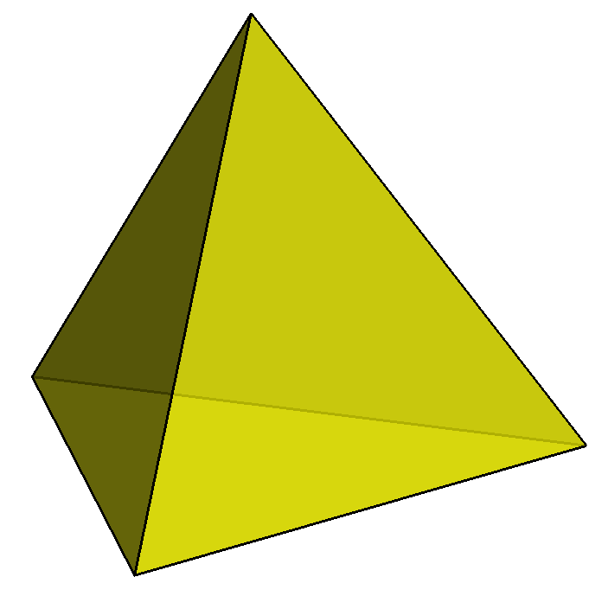
1-masala
Tetraedr bitta yog‘ining yuzi $6 {cm}^{2}$ bo‘lsa,
uning to‘la sirtini toping.
Berilgan:
Masalaning yechimi:
$$S=6 {cm}^{2}$$
$$S_{to‘la}=4∙S$$
$$Y=4$$
$$S_{to‘la}=4∙6=24$$
Topish kerak:
$$S_{to‘la}= ?$$
Javob: $24 {cm}^{2}$

Slide 9
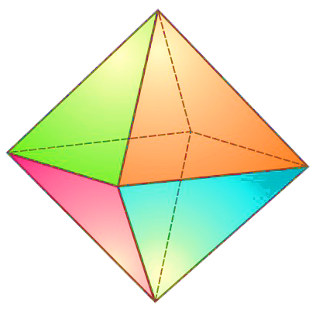
2-masala
Oktaedr to‘la sirtining yuzi $32\sqrt{3} {cm}^{2}$ bo‘lsa,
uning har bir yog‘i yuzini va qirrasining
uzunligini toping.
Berilgan:
$$S_{to‘la}=32\sqrt{3} {cm}^{2}$$
$$Y=8$$
Topish kerak:
$$S= ?$$

Slide 10
Masalaning yechimi
$$S=\frac{S_{to‘la}}{8}=\frac{32\sqrt{3}}{8}=4\sqrt{3}$$
$$S_{to‘la}=8∙S$$
$$a=\sqrt{\frac{4S}{\sqrt{3}}}=\sqrt{\frac{4∙4\sqrt{3}}{\sqrt{3}}}=\sqrt{16}=4$$
$$S=\frac{a^{2}\sqrt{3}}{4}$$
Javob: $S= 4\sqrt{3} {cm}^{2}$; $a=4 cm$

Slide 11
3-masala
Muntazam to‘rtburchakli prizmaning yon sirti 160 ga, to‘la sirti 210 ga teng. Prizma asosining diagonalini toping.
Berilgan:
$$a$$
$$a$$
$$d_{asos}$$
$$S_{yon}=160$$
$$S_{to‘la}=210$$
Topish kerak:
$$d_{asos}= ?$$

Slide 12
Masalaning yechimi
$$S_{to‘la}=S_{yon}+2∙S_{asos}$$
$$S_{asos}= ?$$
$$210=160+2∙S_{asos}$$
$S_{asos}=\frac{210−160}{2}=25$

Slide 13
Masalaning yechimi
$$S_{to‘la}=S_{yon}+2∙S_{asos}$$
$$d_{asos}$$
$$210=160+2∙S_{asos}$$
$S_{asos}=\frac{210−160}{2}=25$
$$S_{asos}=a^{2}$$
$$a=\sqrt{S_{asos}}=\sqrt{25}=5$$
$$d_{asos}=a\sqrt{2}=5\sqrt{2}$$
Javob: $5\sqrt{2}$

Slide 14
4-masala
$$1$$
$$1$$
Rasmda tasvirlangan ko‘pyoqning to‘la sirtini toping (hamma ikki yoqli burchaklar to‘g‘ri burchak).
$$2$$
$$3$$
$$2$$

Slide 15
Masalaning yechimi
$$S=3∙1+$$
$$1$$
$$1$$
$$2$$
$$3$$
$$2$$

Slide 16
$$S=3∙1+3∙1+3∙1+$$
$$1$$
$$1$$
$$1$$
$$2$$
$$3$$
$$3$$
$$2$$

Slide 17
$$S=3∙1+3∙1+3∙1+$$
$$1$$
$$1$$
$$+2∙1+1∙1+$$
$$1$$
$$2$$
$$3$$
$$1$$
$$1$$
$$2$$

Slide 18
$$S=3∙1+3∙1+3∙1+$$
$$1$$
$$1$$
$$+2∙1+1∙1+1∙1+$$
$$2$$
$$+1∙1+2∙1+$$
$$3$$
$$1$$
$$1$$
$$1$$
$$2$$

Slide 19
$$S=3∙1+3∙1+3∙1+$$
$$1$$
$$1$$
$$+2∙1+1∙1+1∙1+$$
$$2$$
$$+1∙1+2∙1+1∙1+$$
$$3$$
$$1$$
$$+1∙1=18$$
$$1$$
$$1$$
$$1$$
Javob: $18$
$$2$$

Slide 20
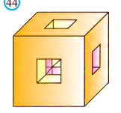
5-masala
Qirrasi 3 cm ga teng bo‘lgan kubning har bir yog‘idan ko‘ndalang kesimi - asosi 1 cm ga teng kvadrat shaklidagi teshiklar o‘yilgan. Kubning qolgan qismi to‘la sirtining yuzini toping.

Slide 21
Masalaning yechimi
$$3$$
$$a=3$$
$$3$$
$$3$$
$$S_{kub}=6∙3^{2}=54$$
$$3$$
$$3$$
$$3$$
$$3$$
$$3$$
$$3$$

Slide 22
$$S_{1}=1∙1+1∙1+$$
$$1$$
$$1$$
$$1$$
$$1$$
$$1$$

Slide 23
$$S_{1}=1∙1+1∙1+$$
$$+1∙1+1∙1=4$$
$$1$$
$$1$$
$$1$$
$$1$$

Slide 24
$$S_{kub}=6∙3^{2}=54$$
$$3$$
$$S_{1}=4$$
$$3$$
$$3$$
$${6∙S}_{1}=6∙4=24$$
$$3$$
$$3$$
$$S_{kub}+{6∙S}_{1}=$$
$$1$$
$$3$$
$$1$$
$$=54+24=78$$
$$1$$
$$1$$
$$3$$
$$1$$
Javob: $78 {cm}^{2}$
$$3$$
$$3$$

Slide 25
6-masala
Oltiburchakli muntazam prizmaning yon qirrasi 8 cm, asosining tomoni 3 cm. Prizmaning barcha qirralari uzunliklari-ning yig‘indisini toping.

Slide 26
Masalaning yechimi
Berilgan:
$$a=3 cm$$
$$l=8 cm$$
Topish kerak:
$$8$$
$$Q= ?$$
$$3$$
$$3$$
$$3$$
$$Q_{asos}=12a=12∙3=36$$
$$3$$
$$3$$
$$3$$

Slide 27
$$Q_{asos}=12a=12∙3=36$$
$$Q_{yon}=6∙l=6∙8=48$$
$$Q=Q_{asos}+Q_{yon}$$
$$8$$
$$Q=48+36=84$$
$$3$$
$$3$$
Javob:$84$
$$3$$
$$3$$
$$3$$
$$3$$

Slide 28
7-masala
Parallelepipedning bitta umumiy uchga ega yoqlarining yuzlari $6 {cm}^{2}$, $12 {cm}^{2}$ va $16 {cm}^{2}$ ga teng. Parallelepiped to‘la sirtining yuzini toping.

Slide 29
Masalaning yechimi
Berilgan:
$S_{1}=6 {cm}^{2}$;
$S_{2}=12 {cm}^{2}$;
$$S_{3}=16 {cm}^{2}$$
Topish kerak:
$$S_{to‘la}= ?$$
$$S_{1}$$
$$S_{3}$$
$$S_{2}$$
$$S_{2}$$
$$S_{3}$$
$$S_{1}$$

Slide 30
$2∙S_{1}=2∙6=12 {cm}^{2}$;
$2∙S_{2}=2∙12=24 {cm}^{2}$;
$2∙S_{3}=2∙16=32 {cm}^{2}$;
$$S_{to‘la}=2∙S_{1}+2∙S_{2}+2∙S_{3}=$$
$$=12+24+32=68 {cm}^{2}$$
Javob: $68 {cm}^{2}$

Slide 31
Mustaqil bajarish uchun topshiriqlar
$157$-sahifa
𝟏𝟓𝟕-sahifa
$158$-sahifa
𝟏𝟓𝟖-sahifa
$$186$$
𝟏𝟖𝟔
$$175$$
𝟏𝟕𝟓
$159$-sahifa
𝟏𝟓𝟗-sahifa
158-sahifa
186
$$194$$
𝟏𝟗𝟒

