Slide 1

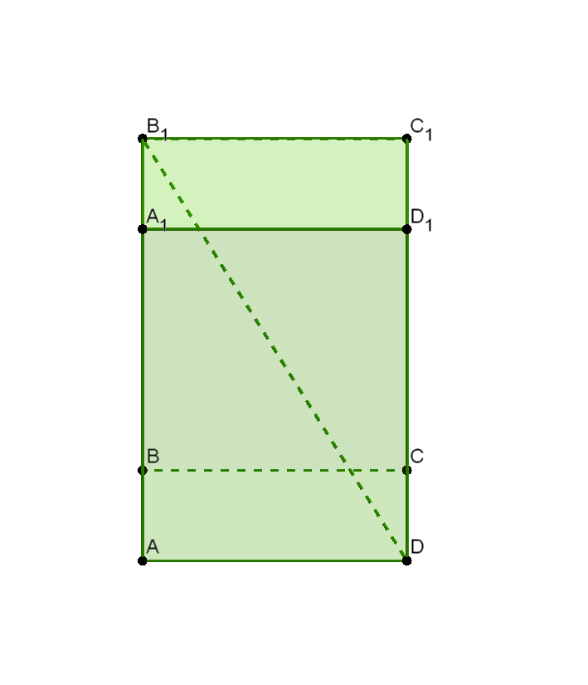
Geometriya
11-sinf
Mavzu: Parallelepiped va kub

Slide 2
Reja
Parallelepiped va uning elementlari
Kub va uning elementlari
Mavzuga doir masalalar yechish

Slide 3
Parallelepiped
Asoslari
parallelogrammdan
iborat prizma
parallelepiped
deb ataladi.

Slide 4
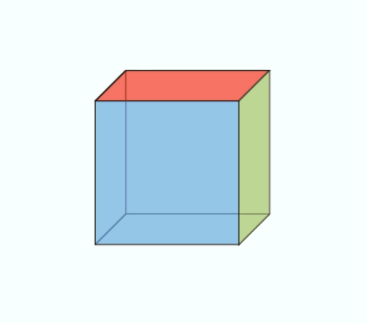

Slide 5
To‘g‘ri
parallelepiped
Og‘ma
parallelepiped

Slide 6
Parallelepipedning umumiy uchga ega bo‘lmagan yoqlari qarama-qarshi yoqlari deyiladi.

Slide 7
Parallelepipedning 12 ta qirralari bor

Slide 8
Parallelepipedning 6 ta yoqlari bor

Slide 9
Parallelepipedning 4 ta diagonali bor

Slide 10
Parallelepiped diagonallari

Slide 11
Parallelepipedning diagonal kesimlari

Slide 12
Parallelepipedning diagonal kesimlari

Slide 13
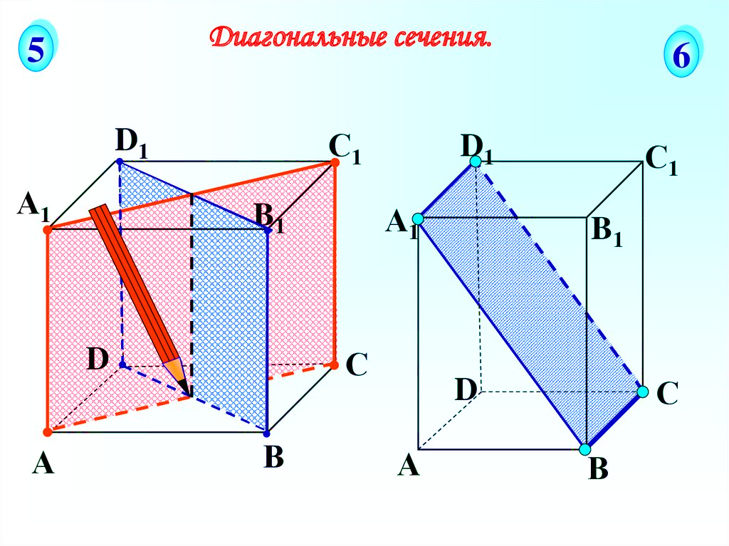
Simmetriya o‘qi
Simmetriya tekisligi

Slide 14

To‘g‘ri burchakli parallelepiped

Slide 15
To‘g‘ri burchakli parallelepipedning 3 ta
simmetriya tekisligi bor

Slide 16
To‘g‘ri burchakli parallelepipedning 3 ta
simmetriya tekisligi bor

Slide 17

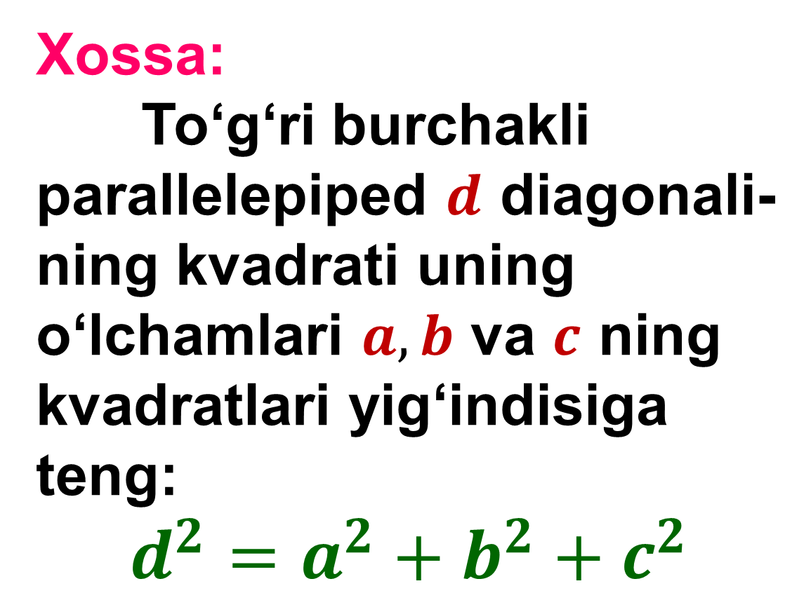



To‘g‘ri burchakli parallelepipedning o‘lchamlari
Xossa:
To‘g‘ri burchakli
parallelepiped $d$ diagonali-ning kvadrati uning o‘lchamlari $a, b$ va $c$ ning kvadratlari yig‘indisiga teng:
$d^{2}=a^{2}+b^{2}+c^{2}$
$$b$$
$$a$$
$$d$$
$$c$$

Slide 18

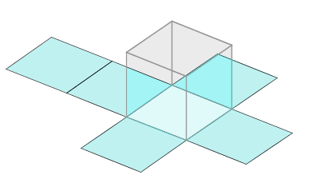
Kub

Slide 19
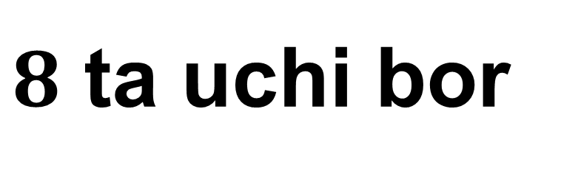
Kubning elementlari
$8$ ta uchi bor

Slide 20
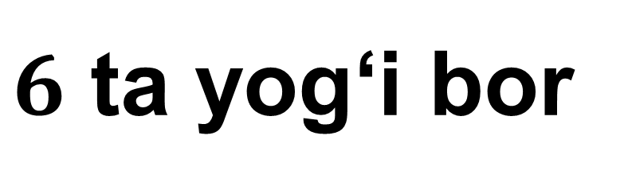
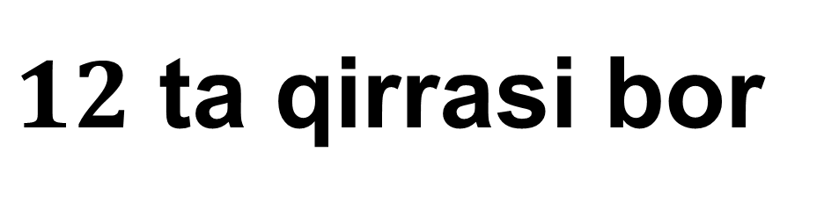
Kubning elementlari
$12$ ta qirrasi bor
$6$ ta yog‘i bor

Slide 21
Kub bitta simmetriya markaziga ega

Slide 22
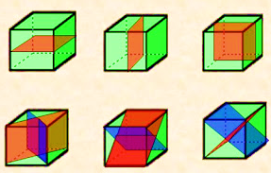
Kubning 9 ta simmetriya tekisligi bor

Slide 23

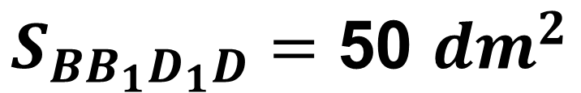


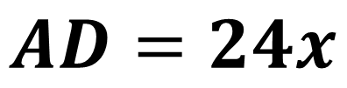
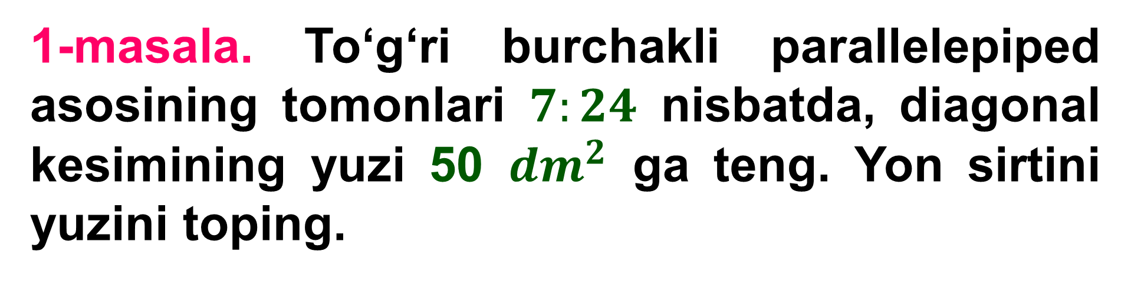

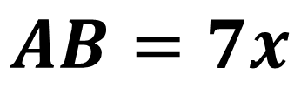





1-masala. To‘g‘ri burchakli parallelepiped asosining tomonlari $7:24$ nisbatda, diagonal kesimining yuzi 50 ${dm}^{2}$ ga teng. Yon sirtini yuzini toping.
Berilgan:
$$B_{1}$$
$$C_{1}$$
$$A_{1}$$
$$D_{1}$$
$$AB=7x$$
$$AD=24x$$
$$S_{BB_{1}D_{1}D}=\text{50 }{dm}^{2}$$
$$B$$
$$C$$
Topish kerak:
$$A$$
$$D$$
$$S_{yon}= ?$$

Slide 24




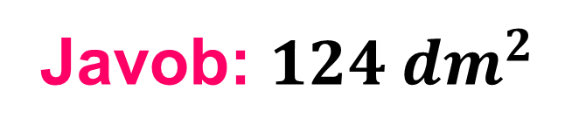














Masalaning yechimi:
$$B_{1}$$
$$C_{1}$$
$${BD}^{2}={AB}^{2}+{AD}^{2}$$
$$A_{1}$$
$$D_{1}$$
$${BD}^{2}={\left(7x\right)}^{2}+{\left(24x\right)}^{2}$$
$${BD}^{2}=625x^{2}$$
$$BD=25x$$
$$S_{BB_{1}D_{1}D}=BD∙{BB}_{1}$$
$$B$$
$$C$$
$$50=25x∙{BB}_{1}$$
$$x∙{BB}_{1}=2$$
$$A$$
$$D$$
$S_{yon}=P∙$ ${BB}_{1}$
$=2∙\left(AB+AD\right)∙$ ${BB}_{1}=$
$=2∙\left(7x+24x\right)∙$ ${BB}_{1}=$
$2∙31∙x∙$ ${BB}_{1}=62∙2=124$
Javob: $124 {dm}^{2}$

Slide 25

2-masala. To‘g‘ri parallelepiped asosining tomonlari $3 cm$ va $5 cm$, asosining diagonallaridan biri $4 cm$ ga teng. Parallelepiped diagonallaridan biri asos tekisligi bilan ${60}^{0}$ li burchak tashkil etadi. Uning diagonallari uzunligini toping.

Slide 26




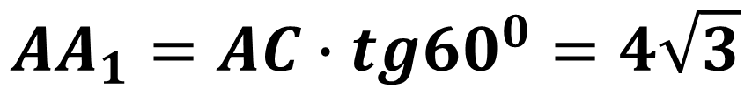
















Berilgan:
$$B_{1}$$
$$C_{1}$$
$$AB=3 cm$$
$$BC=5 cm$$
$$A_{1}$$
$$D_{1}$$
$$AC=4 cm$$
$$α={60}^{0}$$
$${30}^{0}$$
Topish kerak:
$$A_{1}C= ?$$
$$B_{1}D= ?$$
$$B$$
$${60}^{0}$$
$$C$$
Masalaning yechimi:
$$A$$
$$D$$
$$4=\frac{A_{1}C}{2}$$
$$∆ A_{1}AC$$
$$A_{1}C=2∙4=8$$
$$\frac{AA_{1}}{AC}{=tg60}^{0}$$
$$AA_{1}=AC∙tg{60}^{0}=4\sqrt{3}$$

Slide 27
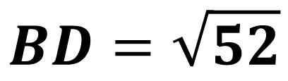
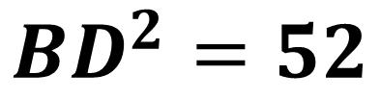
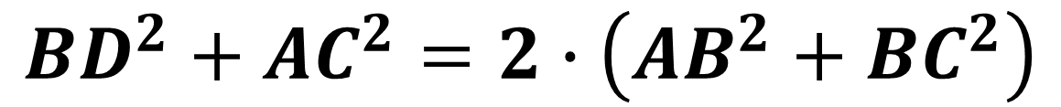
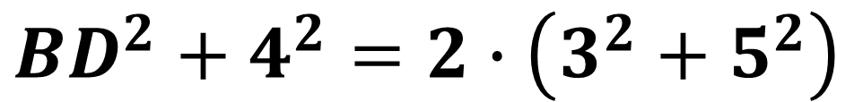

$$B_{1}$$
$$C_{1}$$
$${BD}^{2}+{AC}^{2}=2∙\left({AB}^{2}+{BC}^{2}\right)$$
$$A_{1}$$
$$D_{1}$$
$${BD}^{2}+4^{2}=2∙\left(3^{2}+5^{2}\right)$$
$${BD}^{2}=52$$
$$B$$
$$C$$
$$BD=\sqrt{52}$$
$$A$$
$$D$$

Slide 28

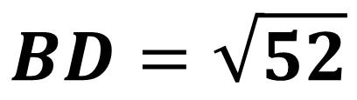
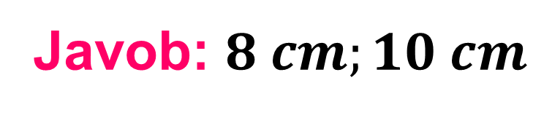

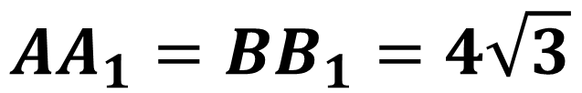

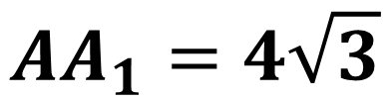
$$AA_{1}=4\sqrt{3}$$
$$B_{1}$$
$$C_{1}$$
$$AA_{1}=BB_{1}=4\sqrt{3}$$
$$A_{1}$$
$$D_{1}$$
$$BD=\sqrt{52}$$
$$∆ B_{1}BC$$
$$B$$
$$C$$
$${B_{1}D}^{2}={BB_{1}}^{2}+{BD}^{2}$$
$$A$$
$$D$$
$${B_{1}D}^{2}={\left(4\sqrt{3}\right)}^{2}+{\left(\sqrt{52}\right)}^{2}=48+52=100$$
$$B_{1}D=10$$
Javob: $8 cm;10 cm$

Slide 29

Mustaqil bajarish uchun topshiriqlar
158-sahifa
159-sahifa
194
182

