Slide 1
Geometriya
11-sinf
Mavzu: Prizma va uning kesimlari

Slide 2
Reja
O‘tilgan mavzu bo‘yicha topshiriqlar-ning yechimlarini tekshirish
Prizma elementlari, turlari
Prizmaning kesimlari
Mavzuga doir masalalar yechish

Slide 3
167 (152-sahifa)
Qavariq ko‘pyoqning har bir uchidan 4 tadan qirra chiqadi. Agar bu ko‘pyoqning qirralari soni 12 ga teng bo‘lsa, uning nechta uchi va yog‘i bor?
Yechish:
$U=\frac{2Q}{k}=\frac{2∙12}{4}=6$
$U∙k=2Q$
$$k=4$$
$$Q=12$$
$$Y=2+Q−U=2+12−6=8$$
$$U= ?$$
$$Y= ?$$
$$U=6$$
$$Y=8$$

Slide 4
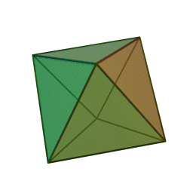
170 (152-sahifa)
Uchlari soni 6 ta, qirralari soni 12 ta bo‘lgan
muntazam ko‘pyoqning yoqlari sonini toping
va uning nomini aniqlang.
Yechish:
$$Y+U−Q=2$$
$$U=6$$
$$Y=2+Q−U$$
$$Q=12$$
$$Y=2+12−6=8$$
$$Y= ?$$
Oktaedr (sakkizyoqli)

Slide 5
172 (152-sahifa)
Uchlari soni 14 ta, qirralari soni 21 ta bo‘lgan
ko‘pyoqning yoqlari sonini toping.
Yechish:
$$Y+U−Q=2$$
$$U=14$$
$$Y=2+Q−U$$
$$Q=21$$
$$Y=2+21−14=9$$
$$Y= ?$$

Slide 6
Prizma deb ikki yog‘i
(asosi) teng $n$ burchak-
dan, qolgan $n$ ta yoqlari
parallelogrammlardan
iborat ko‘pyoqqa
aytiladi.

Slide 7
asosi
asosi

Slide 8
yon yog‘i

Slide 9
yon qirrasi

Slide 10
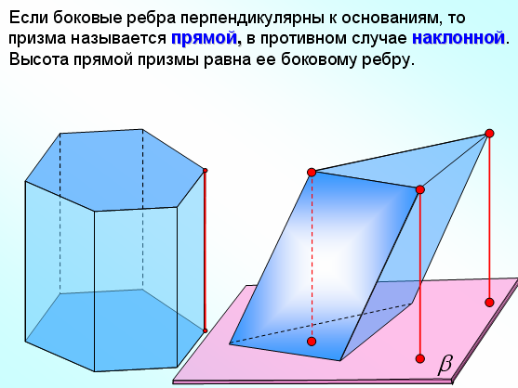
To‘g‘ri prizma
Og‘ma prizma

Slide 11
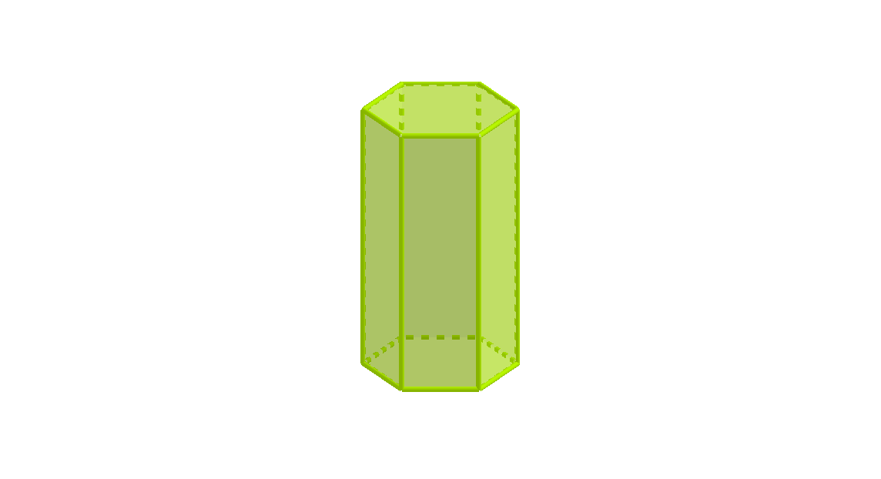
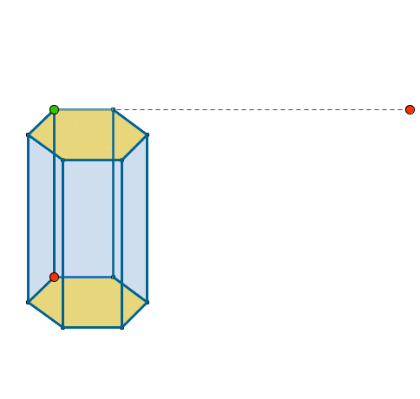
To‘g‘ri prizma

Slide 12
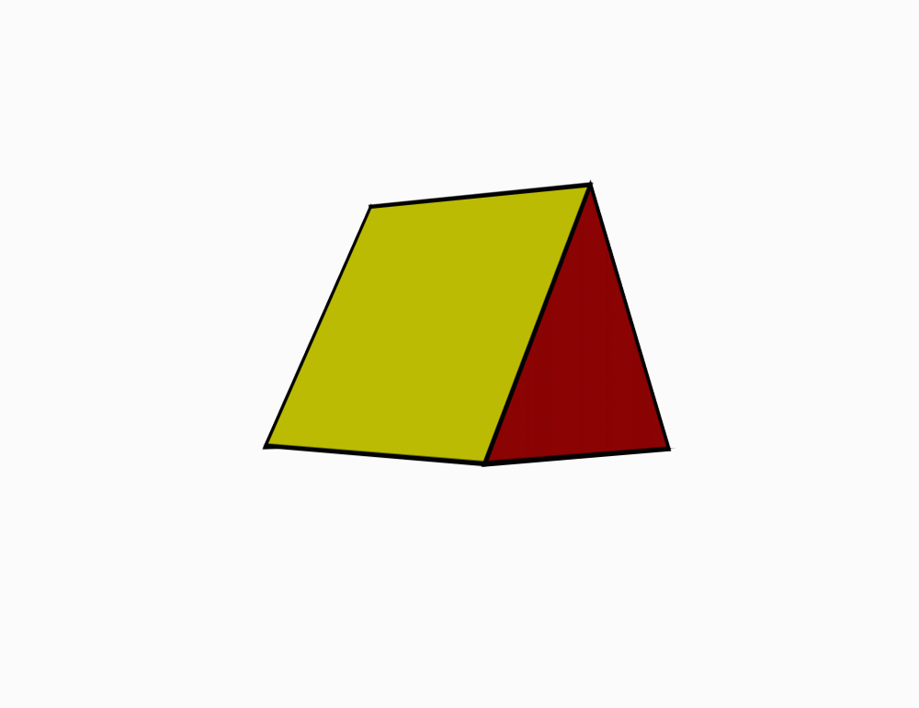
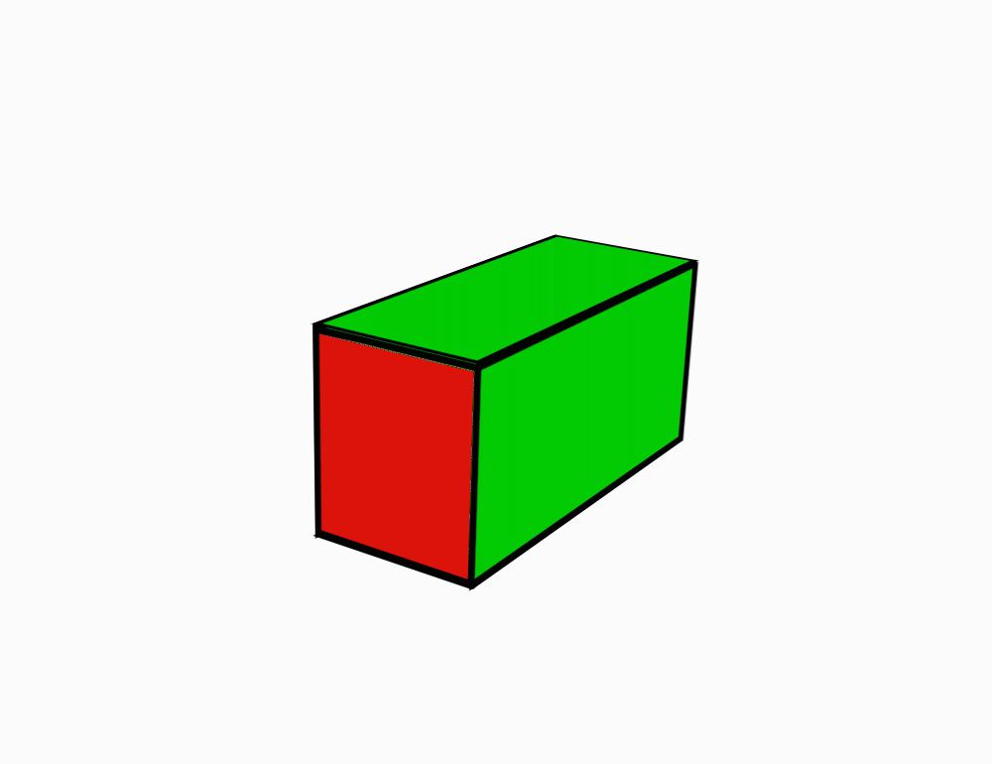
Muntazam prizma
Muntazam
uchburchakli
prizma
Muntazam
To‘rtburchakli
prizma
Muntazam
oltiburchakli
prizma

Slide 13
Prizmaning balandligi
$$h$$
$$h$$
$$h$$

Slide 14
Prizmaning diagonal kesimlari

Slide 15
$n$-burchakli prizma diagonal kesimlari soni:
$$\frac{n\left(n−3\right)}{2}$$
𝒏-burchakli prizma diagonal kesimlari soni:
𝒏(𝒏−𝟑)/𝟐
$n$-burchakli prizmaning jami diagonallari:
$$n\left(n−3\right)$$
𝒏-burchakli prizmaning jami diagonallari:
𝒏(𝒏−𝟑)

Slide 16
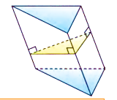
Perpendikulyar kesimi

Slide 17
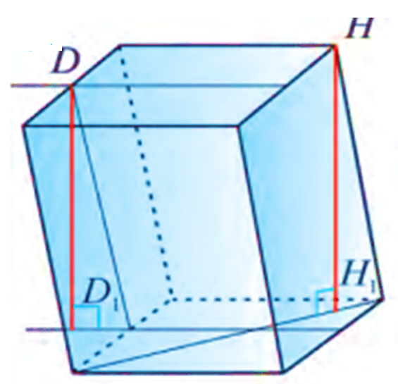
Muntazam
prizmaning
balandligi
uning yon
qirrasiga
teng bo‘ladi.

Slide 18
Prizmaning yon va to‘la sirti
Prizmaning yon sirti uning yon yoqlari yuzi yig‘indisiga teng.
Prizmaning to‘la sirti yon sirti va ikkita asosining yuzi yig‘indisiga teng:
$S_{to‘la}=S_{yon}+2S_{asos}$
Prizmaning to‘la sirti yon sirti va ikkita asosining yuzi yig‘indisiga teng:
𝑺_(𝒕𝒐‘𝒍𝒂)=𝑺_𝒚𝒐𝒏+𝟐𝑺_𝒂𝒔𝒐𝒔

Slide 19
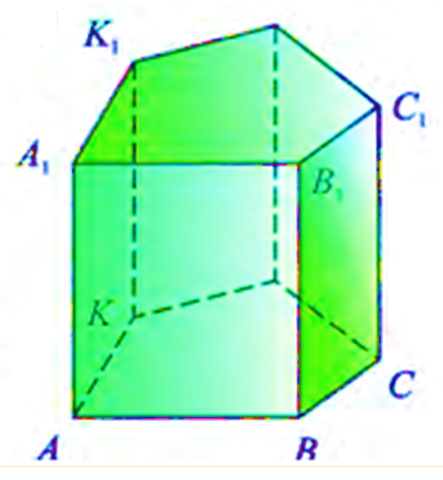
To‘g‘ri prizmaning yon sirti
Teorema. To‘g‘ri prizmaning yon sirti asosining perimetri bilan balandligi ko‘paytma-siga teng:
$$S_{yon}=P_{asos}∙h$$

Slide 20
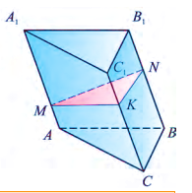
Ixtiyoriy prizmaning yon sirti
Teorema.
Ixtiyoriy prizmaning yon sirti asosining perimetri bilan yon qirrasining ko‘paytmasiga teng:
$$S_{yon}=P∙l$$

Slide 21
1-masala
Uchburchakli og‘ma prizmaning yon qirralari 15 cm, ular orasidagi masofalar 26 cm, 25 cm va 17 cm bo‘lsa, prizmaning yon sirtini toping.

Slide 22
Masalaning yechimi
Berilgan:
$$B_{1}$$
$$A_{1}A=B_{1}B=C_{1}C=15 cm$$
$$A_{1}$$
$$EF=17 cm$$
$$DE=25 cm$$
$$E$$
$$C_{1}$$
$$DF=26 cm$$
$$D$$
$$F$$
$$B$$
Topish kerak:
$$S_{yon}= ?$$
$$A$$
$$S_{yon}=P∙A_{1}A=$$
$$\left(EF+DE+DF\right)∙A_{1}A=$$
$$C$$
$$=\left(17+25+26\right)∙15=$$
$$1020$$
Javob: 1020 ${cm}^{2}$

Slide 23
2-masala
Uchburchakli og‘ma prizmaning yon qirralari $8 cm$dan, prizma perpendikulyar kesimi tomonlari $9 :10 :17$ kabi nisbatda bo‘lib, uning yuzi ${144 cm}^{2}$ ga teng. Prizmaning yon sirtini toping.

Slide 24
Masalaning yechimi
Berilgan:
$$A_{1}$$
$$C_{1}$$
$$A_{1}A=B_{1}B=C_{1}C=8 cm$$
$$B_{1}$$
$$DE :EF :DF=9 :10 :17$$
$$D$$
$$F$$
$$DE=9x$$
$$EF=10x$$
$$E$$
$$DF=17x$$
$$A$$
$$C$$
$$S_{p.k}=144 {cm}^{2}$$
$$B$$
Topish kerak:
$$S_{yon}= ?$$

Slide 25
$$S_{DEF}=S_{p.k}$$
$$A_{1}$$
$$C_{1}$$
$$p= \frac{DE+EF+DF}{2}$$
$$B_{1}$$
$$D$$
$$F$$
$$E$$
$$p= \frac{9x+10x+17x}{2}=18x$$
$$A$$
$$C$$
$$B$$
$$S_{DEF}=\sqrt{p∙\left(p−DE\right)\left(p−EF\right)∙\left(p−DF\right)}=$$
$$=\sqrt{18x∙\left(18x−9x\right)\left(18x−10x\right)∙\left(18x−17x\right)}=$$

Slide 26
$$=\sqrt{18x∙9x∙8x∙x}=$$
$$4x∙9x={36x}^{2}$$
$$A_{1}$$
$$C_{1}$$
$${36x}^{2}=144$$
$$x^{2}=4$$
$$x=2$$
$$B_{1}$$
$$DE=9x=9∙2=18 cm$$
$$D$$
$$F$$
$$EF=10x=10∙2=20 cm$$
$$E$$
$$A$$
$$C$$
$$DF=17x=17∙2=34 cm$$
$$B$$
$$S_{yon}=P∙A_{1}A=$$
$$\left(DE+EF+DF\right)∙A_{1}A=$$
$$=\left(18+20+34\right)∙8=$$
$$576$$
Javob: $576$ ${cm}^{2}$

Slide 27
Mustaqil bajarish uchun topshiriqlar
158-sahifa
184
189

