Slide 1
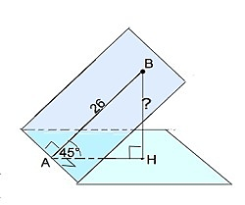
Geometriya
11-sinf
Mavzu:
Ko‘pyoqli
burchaklar

Slide 2
Reja
O‘tilgan mavzu bo‘yicha topshiriqlar-ning yechimlarini tekshirish
Ko‘pyoqli burchaklar
Mavzuga doir masalalar yechish

Slide 3
№126 (144-sahifa)
$$\overline{a}\left(1;−2;3\right)$$
$$B\left(2;0;4\right)$$
$$A\left(x;y;z\right)=?$$
$$\left(1;−2;3\right)=\left(2;0;4\right)−\left(x;y;z\right)$$
$$1=2−x$$
$$x=1$$
$$−2=0−y$$
$$y=2$$
$$3=4−z$$
$$z=1$$
$$A\left(1;2;1\right)$$

Slide 4
№129 (144-sahifa)
$$\overline{a}\left(4;−12;z\right)$$
$$\left|\overline{a}\right|=13$$
$$z= ?$$
$$\left|\overline{a}\right|=\sqrt{4^{2}+{\left(−12\right)}^{2}+z^{2}}$$
$$13=\sqrt{16+144+z^{2}}$$
$$13=\sqrt{160+z^{2}}$$
$$169=160+z^{2}$$
$$z^{2}=9$$
$$z=±3$$

Slide 5
№131 (145-sahifa)
$$\overline{p}\left(2;5;−1\right)$$
$$\overline{q}\left(0;−7;2\right)$$
$$\overline{m}=4\overline{p}+2\overline{q}$$
$$\left|\overline{m}\right|= ?$$
$\overline{m}=4∙\left(2;5;−1\right)+2∙$ $\left(0;−7;2\right)=$
$=\left(8;20;−4\right)+$ $\left(0;−14;4\right)=\left(8;6;0\right)$
$$\left|\overline{m}\right|=\sqrt{8^{2}+6^{2}+0^{2}}=\sqrt{64+36}=\sqrt{100}=10$$
$$\left|\overline{m}\right|=10$$

Slide 6
Ikkiyoqli burchak
$$β$$
$$A$$
$$\left(αβ\right)$$
$α$ va $β$ – yoqlari
$AB$ – qirrasi
$$B$$
$$α$$

Slide 7
Ikkiyoqli burchakning chiziqli burchagi
$$P$$
$$R$$
$∠QPR−$
chiziqli
burchagi
$$Q$$
$$β$$
$$α$$
$$A$$

Slide 8
Ikkiyoqli burchakning turlari
$$α$$
$$α$$
$$φ$$
$$φ$$
$$α$$
$$β$$
$$β$$
$$φ$$
$$β$$

Slide 9
Ikkiyoqli burchakning turlari
$$β$$
$$β$$
$$γ$$
$$γ$$
$$α$$
$$β_{1}$$
$$α$$

Slide 10
Ikkiyoqli burchak bissektori
$$α$$
$$γ$$
$$β$$

Slide 11
Uchyoqli burchak
$$S$$
$$\left(ab\right)$$
$$\left(bc\right)$$
$$\left(ac\right)$$
$$\left(abc\right)$$
$$a$$
$$b$$
$$c$$

Slide 12
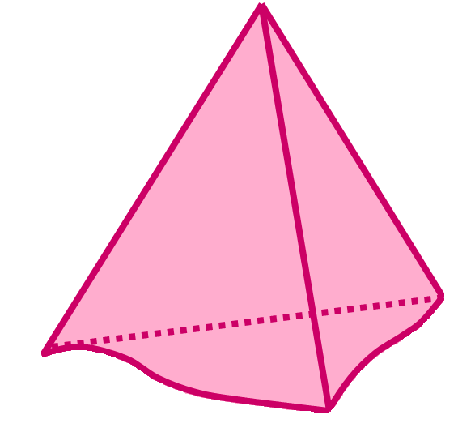
Uchyoqli burchakning tekis burchaklari
$$β$$
$$\left(ab\right)$$
$$\left(bc\right)$$
$$\left(ac\right)$$
$$α$$
$$α$$
$$β$$
$$γ$$
$$γ$$
$$α+β>γ$$
$$α+γ>β$$
$$β+γ>α$$
$$α+β+γ<{360}^{0}$$

Slide 13
Ko‘pyoqli burchak
$$O$$
$$a_{4}$$
$$a_{n}$$
$$a_{3}$$
$$a_{1}$$
$$a_{2}$$

Slide 14
1-masala
Chiziqli burchagi ${60}^{0}$ga teng bo‘lgan ikkiyoqli burchakning yoqlarida yotgan A va B nuqtalardan uning qirrasiga ${AA}_{1}$va ${BB}_{1}$perpendikulyarlar tushirilgan.
Agar ${AA}_{1}=12, {BB}_{1}=10$ va $A_{1}B_{1}=13$ bo‘lsa, $AB$ kesma uzunligini toping.

Slide 15
Masalaning yechimi
$${AA}_{1}=12$$
$${BB}_{1}=10$$
$$A$$
$A_{1}B_{1}=13$
$AB= ?$
$${60}^{0}$$
$$A_{1}$$
$$B_{1}$$
$${BB}_{1}∥{CA}_{1}$$
$${A_{1}B}_{1}∥CB$$
$$C$$
$$B$$
$$∆ABC$$
$${AC}^{2}={AA_{1}}^{2}+{A_{1}C}^{2}−2∙AA_{1}∙A_{1}C∙cosα$$
$${AC}^{2}={12}^{2}+{10}^{2}−2∙12∙10∙cos{60}^{0}=124$$

Slide 16
$${AB}^{2}={AC}^{2}+{BC}^{2}$$
$$AB=\sqrt{{AC}^{2}+{BC}^{2}}$$
$$A$$
$A_{1}B_{1}∥BC$
$${60}^{0}$$
$$A_{1}$$
$$B_{1}$$
$BC=13$
$${AC}^{2}=124$$
$$C$$
$$B$$
$$AB=\sqrt{124+{13}^{2}}$$
$$AB=\sqrt{124+169}=\sqrt{293}$$
Javob: $AB =\sqrt{293}$

Slide 17
2-masala
A nuqta to‘g‘ri ikkiyoqli burchakning yoqlaridan 6 va 8 ga teng masofada yotadi.
Bu nuqtadan ikkiyoqli burchakning qirrasigacha bo‘lgan masofani toping.

Slide 18
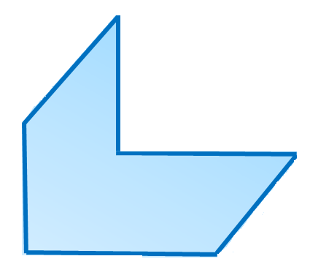
Masalaning yechimi
$$AB=8$$
$$AC=6$$
$$AC=BD=6$$
$$A$$
$$B$$
$$AB=DC=8$$
$$AD= ?$$
$$D$$
$$C$$
$${AD}^{2}={AC}^{2}+{DC}^{2}$$
$$AD=\sqrt{{AC}^{2}+{DC}^{2}}$$
$$AD=\sqrt{6^{2}+8^{2}}=\sqrt{36+64}=\sqrt{100}=10$$
Javob: $AD =10$

Slide 19
3-masala
A nuqta o‘lchovi ${60}^{0}$ bo‘lgan ikkiyoqli burchakning bitta yog‘iga tegishli bo‘lib, ikkinchi yog‘idan $5\sqrt{3}$ ga teng masofada yotadi.
Bu nuqtadan ikkiyoqli burchak qirrasigacha bo‘lgan masofani toping.

Slide 20
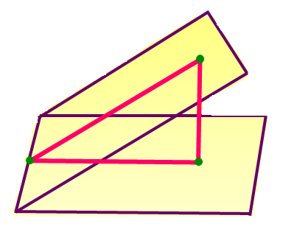
Masalaning yechimi
$$∠ACB={60}^{0}$$
$$A$$
$$α$$
$$AB=5\sqrt{3}$$
$$10$$
$${30}^{0}$$
$$5\sqrt{3}$$
$$AC= ?$$
$$β$$
$${60}^{0}$$
$$BC=5$$
$$C$$
$$B$$
$$5$$
$$AC=10$$
Javob: $AC =10$

Slide 21
Mustaqil bajarish uchun topshiriqlar
Darslikning 150-sahifasida berilgan 143 va 147 - masalalarni yeching.

