Slide 1
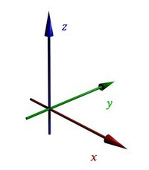
Geometriya
11
sinf
Mavzu: Fazoda dekart koordinatalar sistemasi
O‘qituvchi:
Turg‘unova Mohizabon Mahmudjon qizi

Slide 2
Reja:
Fazoda dekart koordinatalar sistemasi
Ikki nuqta orasidagi masofa
O‘rganilgan mavzuga doir
masalalar yechish

Slide 3
Tekislikda dekart koordinatalar sistemasi
$O$ – koordinatalar boshi
$$y$$
$Ox$ – abssissalar o‘qi
II
I
$Oy$– ordinatalar o‘qi
$$x$$
$$O$$
$Oxy$– koordinatalar
tekisligi
III
IV

Slide 4
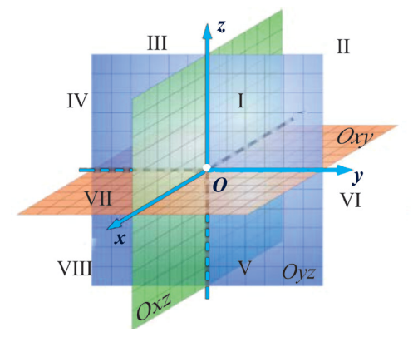
Fazoda dekart koordinatalar sistemasi
$O$ – koordinatalar boshi
$Ox$ – abssissalar o‘qi
$Oy$– ordinatalar o‘qi
$Oz$ – applikatalar o‘qi
$$Oxy$$
$$Oyz$$
$$Oxz$$
– koordinatalar
tekisliklari

Slide 5
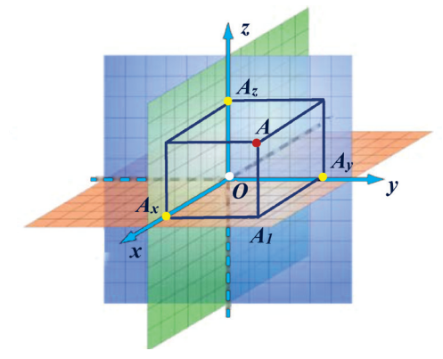
$$A\left(x;y;z\right)$$

Slide 6
Fazoda koordinata o‘qlari yo‘nalishlari
$$z$$
$$−$$
-$5$
-$4$
-$3$
-$2$
-$1$
$$y$$
$$O$$
$$1$$
$$2$$
$$3$$
$$4$$
$$5$$
$$+$$
$$x$$
$$6$$

Slide 7
Fazoda koordinata o‘qlari yo‘nalishlari
$$z$$
$$−$$
$$+$$
$$y$$
-$5$
-$4$
-$3$
-$2$
-$1$
$$O$$
$$1$$
$$2$$
$$3$$
$$4$$
$$5$$
$$x$$

Slide 8
Fazoda koordinata o‘qlari yo‘nalishlari
$$+$$
$$z$$
$$4$$
$$3$$
$$2$$
$$1$$
$$y$$
$$O$$
-$1$
-$2$
-$3$
-$4$
$$x$$
$$−$$

Slide 9
$$z$$
$$x$$
$$y$$
$$z$$
$$4$$
$$A\left(2;3;4\right)$$
$$3$$
$$A\left(2;3;4\right)$$
$$2$$
$$1$$
$$O$$
$$y$$
$$1$$
$$2$$
$$3$$
$$4$$
$$1$$
$$2$$
$$3$$
$$4$$
$$5$$
$$x$$

Slide 10
$$z$$
$$5$$
$$x$$
$$y$$
$$z$$
$$4$$
$$B\left(−2;0;0\right)$$
$$3$$
$$2$$
-$4$
$$B\left(−2;0;0\right)$$
$$1$$
-$3$
-$2$
-$1$
$$y$$
$$O$$
$$1$$
$$1$$
$$2$$
$$3$$
$$4$$
$$2$$
$$3$$
$$4$$
$$5$$
koordinatalar
o‘qida
$$x$$

Slide 11
$$z$$
koordinatalar
o‘qida
$$C\left(0;0;8\right)$$
$$8$$
$$7$$
$$6$$
$$x$$
$$y$$
$$z$$
$$5$$
$$4$$
$$3$$
$$C\left(0;0;8\right)$$
$$2$$
$$1$$
$$y$$
$$O$$
$$1$$
$$2$$
$$3$$
$$4$$
$$1$$
$$x$$
$$2$$

Slide 12
$$z$$
koordinatalar
o‘qida
$$5$$
$$4$$
$$3$$
$$2$$
$$x$$
$$y$$
$$z$$
$$D\left(0;−9;0\right)$$
$$1$$
$$y$$
-$9$
-$8$
-$7$
-$6$
-$5$
-$4$
-$3$
-$2$
-$1$
$$O$$
$$1$$
$$2$$
$$D\left(0;−9;0\right)$$
$$1$$
$$2$$
$$3$$
$$4$$
$$5$$
$$6$$
$$x$$

Slide 13
$$z$$
koordinatalar
tekisligida
$$5$$
$$4$$
$$3$$
$$x$$
$$y$$
$$z$$
$$2$$
$$E\left(0;3;1\right)$$
$$1$$
$$y$$
$$E\left(0;3;1\right)$$
$$O$$
$$1$$
$$2$$
$$3$$
$$4$$
$$1$$
$$2$$
$$3$$
$$4$$
$$5$$
$$x$$

Slide 14
$$z$$
$$x$$
$$y$$
$$z$$
$$5$$
$$4$$
$$F\left(5;−1;2\right)$$
$$3$$
$$2$$
$$1$$
$$y$$
-$4$
-$3$
-$2$
-$1$
$$O$$
$$1$$
$$2$$
$$3$$
$$4$$
$$F\left(5;−1;2\right)$$
$$1$$
$$2$$
$$3$$
$$4$$
$$5$$
$$x$$
oktantada

Slide 15
Ikki nuqta orasidagi masofa
$$A\left(x_{1};y_{1};z_{1}\right)$$
$$B\left(x_{2};y_{2};z_{2}\right)$$
$$AB=\sqrt{{\left(x_{2}−x_{1}\right)}^{2}+{\left(y_{2}−y_{1}\right)}^{2}+{\left(z_{2}−z_{1}\right)}^{2}}$$

Slide 16
1-masala
$A\left(2;0;−3\right)$ va $B\left(3;4;0\right)$
nuqtalar orasidagi masofani
toping.

Slide 17
Yechish:
$$x_{1}$$
$$y_{1}$$
$$z_{1}$$
$$x_{2}$$
$$y_{2}$$
$$z_{2}$$
$$A\left(2;0;−3\right)$$
$B\left(3;4;0\right)$
$$AB=\sqrt{{\left(x_{2}−x_{1}\right)}^{2}+{\left(y_{2}−y_{1}\right)}^{2}+{\left(z_{2}−z_{1}\right)}^{2}}$$
$$AB=\sqrt{{\left(3−2\right)}^{2}+{\left(4−0\right)}^{2}+{\left(0−\left(−3\right)\right)}^{2}}=$$
$$=\sqrt{1+16+9}=\sqrt{26}$$
Javob: $\sqrt{26}$

Slide 18
2-masala
Uchlari berilgan $A\left(2;4;−1\right),$
$B\left(−1;1;2\right),$ $C\left(5;1;2\right)$ nuqtalarda bo‘lgan $ABC$ uchburchakning perimetrini toping.

Slide 19
$$z$$
Yechish:
$$4$$
$$x$$
$$y$$
$$z$$
$$3$$
$$2$$
$$A\left(2;4;−1\right)$$
$$1$$
$$O$$
$$y$$
$$1$$
$$2$$
$$3$$
$$4$$
-$1$
$$1$$
$$2$$
-$2$
$$3$$
$$A$$
-$3$
$$4$$
$$5$$
-$4$
$$x$$

Slide 20
$$z$$
$$x$$
$$y$$
$$z$$
$$4$$
$$B$$
$$3$$
$$B\left(−1;1;2\right)$$
-$4$
$$2$$
-$3$
$$1$$
-$2$
$$O$$
-$1$
$$y$$
$$1$$
$$2$$
$$3$$
$$4$$
-$1$
$$1$$
$$2$$
-$2$
$$3$$
$$A$$
-$3$
$$4$$
$$x$$
$$5$$
-$4$

Slide 21
$$z$$
$$x$$
$$y$$
$$z$$
$$4$$
$$B$$
$$3$$
$$C\left(5;1;2\right)$$
$$2$$
-$4$
-$3$
$$1$$
-$2$
$$O$$
-$1$
$$y$$
$$1$$
$$2$$
$$3$$
$$4$$
-$1$
$$C$$
$$1$$
$$2$$
-$2$
$$3$$
$$A$$
-$3$
$$4$$
$$x$$
$$5$$
-$4$

Slide 22
$$z$$
$$∆ABC$$
$$AB= ?$$
$$4$$
$$B$$
$$3$$
$$BC= ?$$
$$2$$
-$4$
-$3$
$$1$$
-$2$
$$O$$
-$1$
$$AC= ?$$
$$y$$
$$1$$
$$2$$
$$3$$
$$4$$
-$1$
$$C$$
$$1$$
$$2$$
-$2$
$$P_{ABC}= ?$$
$$A$$
$$3$$
-$3$
$$4$$
$$x$$
$$5$$
-$4$

Slide 23
$A\left(2;4;−1\right), B\left(−1;1;2\right),$ $C\left(5;1;2\right)$
$$AB=\sqrt{{\left(−1−2\right)}^{2}+{\left(1−4\right)}^{2}+{\left(2−\left(−1\right)\right)}^{2}}=3\sqrt{3}$$
$$AC=\sqrt{{\left(5−2\right)}^{2}+{\left(1−4\right)}^{2}+{\left(2−\left(−1\right)\right)}^{2}}=3\sqrt{3}$$
$$BC=\sqrt{{\left(5−\left(−1\right)\right)}^{2}+{\left(1−1\right)}^{2}+{\left(2−2\right)}^{2}}=6$$
$$P_{ABC}=AB+BC+AC$$
$$=3\sqrt{3}+3\sqrt{3}+6$$
$$=6+6\sqrt{3}$$
Javob: $6+6\sqrt{3}$

Slide 24
3-masala
Fazoda $A\left(3;0;−1\right), B\left(−4;1;0\right), C\left(5;−2;−1\right)$ nuqtalar berilgan.$Oyz$ tekislikda $A, B, C$ nuqta-lardan teng uzoqlikda joylashgan nuqtani toping.

Slide 25
$$Oyz$$
$$K\left(0;y;z\right)$$
Yechish:
$$A\left(3;0;−1\right)$$
$$B\left(−4;1;0\right)$$
$$C\left(5;−2;−1\right)$$
$$AK=BK=CK$$
$$AK=\sqrt{9+y^{2}+{\left(z+1\right)}^{2}}$$
$$BK=\sqrt{16+{\left(y−1\right)}^{2}+z^{2}}$$
$$CK=\sqrt{25+{\left(y+2\right)}^{2}+{\left(z+1\right)}^{2}}$$

Slide 26
$$AK=BK=CK$$
$$\sqrt{9+y^{2}+{\left(z+1\right)}^{2}}=\sqrt{16+{\left(y−1\right)}^{2}+z^{2}}$$
$$9+y^{2}+z^{2}+2z+1=16+y^{2}−2y+1+z^{2}$$
$$9+ 2z =16 −2y$$
$$2z+2y=7$$
$$:2$$
$$z+y=3,5$$

Slide 27
$$AK=BK=CK$$
$$\sqrt{16+{\left(y−1\right)}^{2}+z^{2}}=\sqrt{25+{\left(y+2\right)}^{2}+{\left(z+1\right)}^{2}}$$
$$16+y^{2}−2y+1+z^{2}=25+y^{2}+4y+4+z^{2}+2z+1$$
$$16−2y=25+4y+4+2z$$
$$2z+6y=−13$$

Slide 28
$$K\left(0;y;z\right)= ?$$
$$2∙$$
$$\left\{\begin{aligned}z+y=3,5 \\ 2z+6y=−13 \end{aligned}\right.$$
$$z=3,5−y=$$
$$=3,5−\left(−5\right)=8,5$$
$$\left\{\begin{aligned}2z+2y=7 \\ 2z+6y=−13 \end{aligned}\right.$$
$$−$$
$$−4y=20$$
$$y=−5$$
Javob: $K\left(0;−5;8,5\right)$

Slide 29
Topshiriq
Darslikning
118-sahifasida berilgan
7-masalani yeching.

