Slide 1
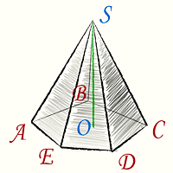
Geometriya
11-sinf
Mavzu:
Piramidaning
hajmi
$$V= ?$$

Slide 2
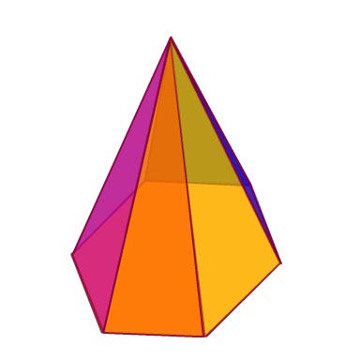
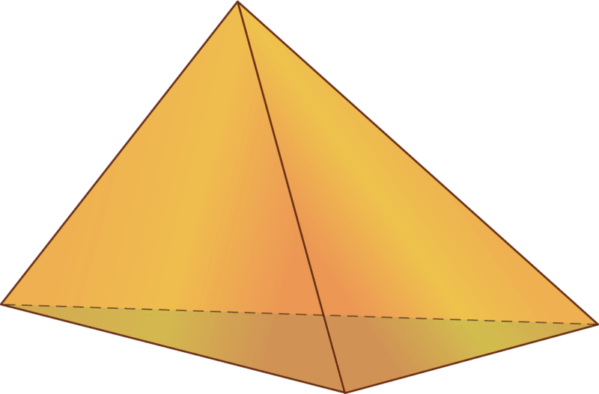
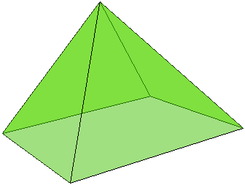
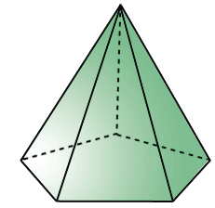
Teorema
Ixtiyoriy piramidaning hajmi asosining yuzi bilan balandligi ko‘paytmasining uchdan biriga teng: $V=\frac{1}{3}S_{asos}∙H$

Slide 3
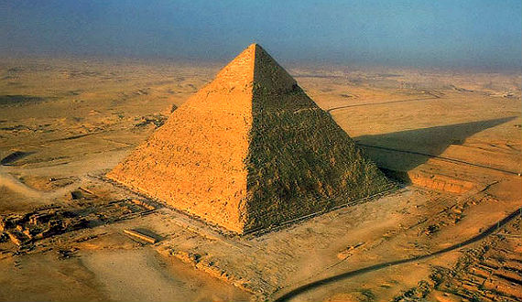
1-masala
Xeops piramidasi to‘rtburchakli muntazam piramida shaklida bo‘lib, uning asosining tomoni $230 m$, balandligi $147 m$.
Piramidaning hajmini
toping va uni kub metr-
larda ifodalang.

Slide 4
$$AB=BC=CD=AD=a=230 m$$
$$OE=H=147 m$$
$$V= ?$$
$$S_{asos}=a^{2}={\left(230 m\right)}^{2}=52900 m^{2}$$
$$O_{1}$$
$V=\frac{1}{3}S_{asos}∙H$
$V=\frac{1}{3}∙52900∙147=2592100{ m}^{3}$
$$B$$
$$a$$
$$C$$
$$a$$
$$O$$
$$a$$
$$A$$
$$D$$
$$a$$
Javob: $2592100 m^{3}$

Slide 5
2-masala
Piramidaning asosi – tomonlari $6 cm, 6 cm$ va $8 cm$ bo‘lgan teng yonli uchburchak. Hamma yon qirralari $9 cm$ ga teng.
Piramidaning hajmini toping.

Slide 6
$$AB=BC=6 cm$$
$$AC=8 cm$$
$$AO_{1}=BO_{1}=CO_{1}=9 cm$$
$$V= ?$$
$p=\frac{AB+BC+AC}{2}=\frac{6+6+8}{2}=10$
$$O_{1}$$
$$S_{asos}=\sqrt{p\left(p−AB\right)\left(p−BC\right)\left(p−AC\right)}$$
$$C$$
$$O$$
$$A$$
$$B$$
$=\sqrt{10\left(10−6\right)\left(10−6\right)\left(10−8\right)}=8\sqrt{5} {cm}^{2}$
$AO=R=\frac{AB∙BC∙AC}{4S_{asos}}=\frac{6∙6∙8}{4∙8\sqrt{5}}=\frac{9}{\sqrt{5}} cm$

Slide 7
$AO=\frac{9}{\sqrt{5}} cm$
$$AO_{1}=9 cm$$
$$H=OO_{1}= ?$$
$$∆AOO_{1}$$
$$O_{1}$$
$${AO_{1}}^{2}={OO_{1}}^{2}+{AO}^{2}$$
$${OO_{1}}^{2}={AO_{1}}^{2}−{AO}^{2}$$
$$C$$
$OO_{1}=\sqrt{{AO_{1}}^{2}−{AO}^{2}}$
$$O$$
$$A$$
$$B$$
$OO_{1}=\sqrt{9^{2}−{\left(\frac{9}{\sqrt{5}}\right)}^{2}}=\frac{18}{\sqrt{5}}$
$H=OO_{1}=\frac{18}{\sqrt{5}} cm$

Slide 8
$$AO_{1}=9 cm$$
$$S_{asos}=8\sqrt{5} {cm}^{2}$$
$H=OO_{1}=\frac{18}{\sqrt{5}} cm$
$$V=\frac{1}{3}S_{asos}∙H=\frac{1}{3}∙8\sqrt{5}∙\frac{18}{\sqrt{5}}=48 cm^{3}$$
Javob: $48 cm^{3}$

Slide 9
3-masala
Uchburchakli piramidaning bitta qirrasi $4 cm$ ga, qolganlari $3 cm$ ga teng.
Piramidaning hajmini toping.

Slide 10
$$AB=BC=3 cm$$
$$AC=4 cm$$
$$AO_{1}=BO_{1}=CO_{1}=3 cm$$
$$V= ?$$
$p=\frac{AB+BC+AC}{2}=\frac{3+3+4}{2}=5$
$$O_{1}$$
$$S_{asos}=\sqrt{p\left(p−AB\right)\left(p−BC\right)\left(p−AC\right)}$$
$$C$$
$$=\sqrt{5\left(5−3\right)\left(5−3\right)\left(5−4\right)}=2\sqrt{5} {cm}^{2}$$
$$O$$
$$A$$
$$B$$
$AO=R=\frac{AB∙BC∙AC}{4S_{asos}}=\frac{3∙3∙4}{4∙2\sqrt{5}}=\frac{9}{2\sqrt{5}}=\frac{9\sqrt{5}}{10}$

Slide 11
$AO=\frac{9\sqrt{5}}{10}cm$
$$AO_{1}=3 cm$$
$$H=OO_{1}= ?$$
$$∆AOO_{1}$$
$$O_{1}$$
$${AO_{1}}^{2}={OO_{1}}^{2}+{AO}^{2}$$
$${OO_{1}}^{2}={AO_{1}}^{2}−{AO}^{2}$$
$$C$$
$OO_{1}=\sqrt{{AO_{1}}^{2}−{AO}^{2}}$
$$O$$
$$A$$
$$B$$
$OO_{1}=\sqrt{3^{2}−{\left(\frac{9\sqrt{5}}{10}\right)}^{2}}=\frac{3\sqrt{55}}{10}$
$H=OO_{1}=\frac{3\sqrt{55}}{10}cm$

Slide 12
$H=\frac{3\sqrt{55}}{10}$
$$S_{asos}=2\sqrt{5}$$
$$V= ?$$
$$V=\frac{1}{3}S_{asos}H=\frac{1}{3}∙2\sqrt{5}∙\frac{3\sqrt{55}}{10}=\sqrt{11}$$
Javob: $\sqrt{11} {cm}^{3}$

Slide 13
4-masala
Rasmdagi piramida kubning
qanday qismini tashkil qiladi?

Slide 14
$V_{piramida}=\frac{1}{3}S_{asos}∙H$
$$V_{kub}=a^{3}$$
$$B_{1}$$
$$C_{1}$$
$$S_{asos}=a^{2}$$
$$H=a$$
$$A_{1}$$
$V_{piramida}=\frac{1}{3}a^{2}∙a=\frac{1}{3}a^{3}$
$$D_{1}$$
$$a$$
$V_{piramida}=\frac{1}{3}V_{kub}$
$$B$$
$$C$$
$$a$$
$$A$$
$$a$$
$$D$$
Javob: $\frac{1}{3}$

Slide 15
5-masala
To‘rtburchakli muntazam piramida yon sirtining yuzi $72 {cm}^{2}$ ga, asosining yuzi $64 {cm}^{2}$
ga teng. Piramidaning hajmini toping.

Slide 16
$$S_{asos}=64 {cm}^{2}$$
$$S_{yon}=72 {cm}^{2}$$
$$V= ?$$
$$AB=BC=CD=AD=a$$
$$O$$
$$S_{asos}= a^{2}$$
$$a^{2}=\sqrt{64}$$
$$a=8 cm$$
$$P=4a=4∙8=32$$
$S_{yon}=\frac{1}{2}P∙l$
$$B$$
$$C$$
$$O_{1}$$
$$E$$
$l=\frac{{2S}_{yon}}{P}=\frac{2∙72}{32}=\frac{9}{2}$
$OE=\frac{9}{2}$
$$A$$
$$D$$
$O_{1}E=r=\frac{a}{2}=\frac{8}{2}=4$

Slide 17
$OE=l=\frac{9}{2}$
$$O_{1}E=r=4$$
$${OE}^{2}={OO_{1}}^{2}+{AO_{1}}^{2}$$
$$O$$
$${OO_{1}}^{2}={OE}^{2}−{O_{1}E}^{2}$$
${OO_{1}}^{2}={\left(\frac{9}{2}\right)}^{2}−{\left(4\right)}^{2}=\frac{17}{4}$
$H=OO_{1}=\frac{\sqrt{17}}{2}$
$$B$$
$$C$$
$$O_{1}$$
$$E$$
$$A$$
$$D$$
$V=\frac{1}{3}S_{asos}∙H=\frac{1}{3}∙64∙\frac{\sqrt{17}}{2}=\frac{32\sqrt{17}}{3}$
Javob: $\frac{32\sqrt{17}}{3}$

Slide 18
6-masala
To‘rtburchakli muntazam piramida asosining perimetri $12 cm$, yon yog‘ining perimetri $18 cm$ ga teng.
Piramidaning hajmini toping.

Slide 19
$$P_{asos}=12 cm$$
$$P_{yon}=18 cm$$
$$V= ?$$
$$AB=BC=CD=AD=a$$
$$O$$
$a=\frac{P_{asos}}{4}=\frac{12}{4}=3 cm$
$$P_{asos}=4a$$
$$b$$
$$OD=OC=OB=OA=b$$
$$b$$
$$P_{yon}=a+2b$$
$$B$$
$$C$$
$$a$$
$$18=3+2b$$
$$A$$
$$a$$
$$D$$
$b=\frac{15}{2} cm$

Slide 20
$$a=3 cm$$
$OD=\frac{15}{2} cm$
$$OO_{1}=H$$
$O_{1}D=R=\frac{a\sqrt{2}}{2}=\frac{3\sqrt{2}}{2} cm$
$$O$$
$${OD}^{2}={OO_{1}}^{2}+{O_{1}D}^{2}$$
$${OO_{1}}^{2}={OD}^{2}−{O_{1}D}^{2}$$
$$B$$
$$C$$
${OO_{1}}^{2}={\left(\frac{15}{2}\right)}^{2}−{\left(\frac{3\sqrt{2}}{2}\right)}^{2}=\frac{207}{4}$
$$O_{1}$$
$$A$$
$$D$$
$OO_{1}=\frac{3\sqrt{23}}{2} cm$

Slide 21
$OO_{1}=H=\frac{3\sqrt{23}}{2} cm$
$$a=3 cm$$
$$O$$
$$S_{asos}= a^{2}=3^{2}=9 {cm}^{2}$$
$V=\frac{1}{3}S_{asos}∙H$
$V=\frac{1}{3} ∙9∙\frac{3\sqrt{23}}{2}=\frac{9\sqrt{23}}{2} {cm}^{3}$
$$B$$
$$C$$
$$O_{1}$$
$$a$$
$$A$$
$$a$$
$$D$$
Javob: $\frac{9\sqrt{23}}{2} {cm}^{3}$

Slide 22
7-masala
$ABCDA_{1}B_{1}C_{1}D_{1}$ prizmaning hajmi
$48 {cm}^{3}$ ga teng. $C_{1}ABC$ piramida hajmini toping.
$$A_{1}$$
$$C_{1}$$
$$B_{1}$$
$$A$$
$$C$$
$$B$$

Slide 23
$$V_{ABCDA_{1}B_{1}C_{1}D_{1}}=48 {cm}^{3}$$
$$V_{C_{1}ABC}= ?$$
$$V_{ABCDA_{1}B_{1}C_{1}D_{1}}=S_{asos}∙H$$
$$A_{1}$$
$$C_{1}$$
$$B_{1}$$
$V_{C_{1}ABC}=\frac{1}{3}S_{asos}∙H$
$$A$$
$V_{C_{1}ABC}=\frac{1}{3}V_{ABCDA_{1}B_{1}C_{1}D_{1}}$
$$C$$
$$B$$
$$V_{C_{1}ABC}=\frac{1}{3}∙48=16 {cm}^{3}$$
Javob: $16 {cm}^{3}$

Slide 24
Mustaqil bajarish uchun topshiriqlar
121-sahifa
388-masala

