Slide 1
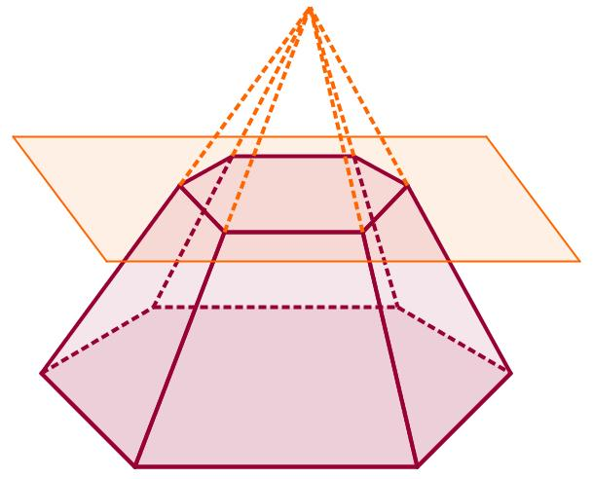
Geometriya
11-sinf
Mavzu:
Kesik piramida va
uning elementlari

Slide 2
Teorema
Piramidaning asosiga parallel va uni kesib o‘tadigan tekislik undan shu piramidaga o‘xshash piramida ajratadi.

Slide 3
Teorema

Slide 4
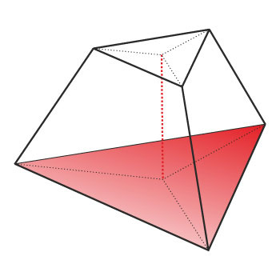
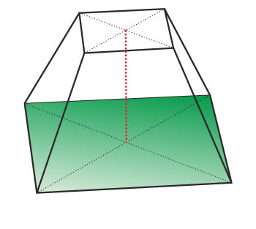
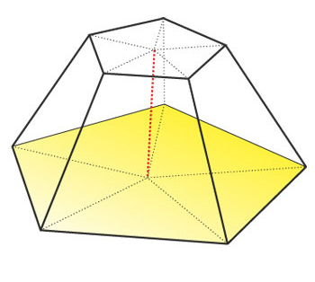
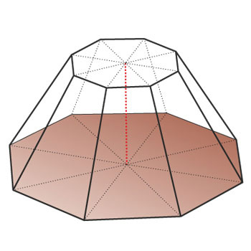
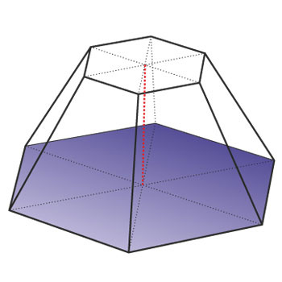
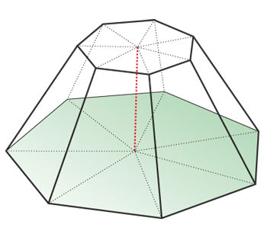
Kesik piramida asoslari

Slide 5
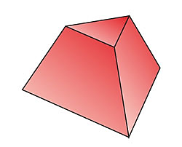
Kesik piramida yon yoqlari

Slide 6
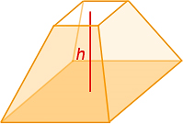
Kesik piramida balandligi

Slide 7
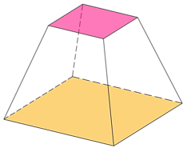
Muntazam kesik piramida
$ABCDA_{1}B_{1}C_{1}D_{1}−$ muntazam kesik piramida
$$B_{1}$$
$$C_{1}$$
$$A_{1}$$
$$E_{1}$$
apofema
asoslari
$$D_{1}$$
$$B$$
$$l$$
$$C$$
$$A$$
$$E$$
$$D$$

Slide 8
Teorema
Muntazam kesik piramida yon yog‘ining yuzi asoslari perimetrlari yig‘indisining yarmi bilan apofemasining ko‘paytmasiga teng.
$$S_{yon}=\frac{1}{2}\left(P_{1}+P_{2}\right)l$$
$$l$$

Slide 9
1-masala
To‘rtburchakli muntazam kesik piramida asoslarining tomonlari $14 cm$va $10 cm,$ diagonali $18 cm$ ga teng.
Kesik piramidaning balandligini toping.

Slide 10
Masalaning yechimi
Berilgan:
$$B_{1}$$
$$AB=BC=CD=AD=a$$
$$A_{1}$$
$$C_{1}$$
$$a=14 cm$$
$$D_{1}$$
$$B$$
$$A_{1}B_{1}=B_{1}C_{1}=C_{1}D_{1}=A_{1}D_{1}=a_{1}$$
$$E$$
$$C$$
$$a_{1}=10 cm$$
$$A$$
$$D$$
$$AC_{1}=d=18 cm$$
Topish kerak:
$$C_{1}E=H= ?$$

Slide 11
$$a=14 cm$$
$$a_{1}=10 cm$$
$$B_{1}$$
$$a_{1}$$
$$a_{1}$$
$$AC=a\sqrt{2}=14\sqrt{2}$$
$$A_{1}$$
$$C_{1}$$
$$a_{1}$$
$$a_{1}$$
$$D_{1}$$
$$B$$
$$a$$
$$A_{1}C_{1}=a_{1}\sqrt{2}=10\sqrt{2}$$
$$a$$
$$C$$
$$A$$
$$a$$
$$a$$
$$D$$

Slide 12
$$AC=14\sqrt{2}$$
$$A_{1}C_{1}=10\sqrt{2}$$
$EC=\frac{AC−A_{1}C_{1}}{2}$
$$A_{1}$$
$$C_{1}$$
$EC=\frac{14\sqrt{2}−10\sqrt{2}}{2}=2\sqrt{2} cm$
$$A$$
$$F$$
$$E$$
$$C$$
$$AF=EC=2\sqrt{2} cm$$

Slide 13
$$AC=14\sqrt{2}$$
$$A_{1}C_{1}=10\sqrt{2}$$
$EC=\frac{AC−A_{1}C_{1}}{2}$
$$A_{1}$$
$$C_{1}$$
$EC=\frac{14\sqrt{2}−10\sqrt{2}}{2}=2\sqrt{2} cm$
$$AF=EC=2\sqrt{2} cm$$
$$A$$
$$C$$
$$E$$
$$AE=AC−EC$$
$AE=14\sqrt{2}−2\sqrt{2}=12\sqrt{2} cm$

Slide 14
$$AC_{1}=18$$
$$AE=12\sqrt{2}$$
$$C_{1}E=H= ?$$
$${\left(AC_{1}\right)}^{2}={\left(AE\right)}^{2}+{\left(C_{1}E\right)}^{2}$$
$$A_{1}$$
$$C_{1}$$
$${\left(C_{1}E\right)}^{2}={\left(AC_{1}\right)}^{2}−{\left(AE\right)}^{2}$$
$${\left(C_{1}E\right)}^{2}={18}^{2}−{\left(12\sqrt{2}\right)}^{2}=36$$
$$A$$
$$E$$
$$C$$
$$C_{1}E=6 cm$$
Javob: $6 cm$

Slide 15
2-masala
To‘rtburchakli muntazam kesik piramida asoslarining tomonlari $24 cm$va $40 cm,$ balandligi $16 cm$ ga teng.
Kesik piramidaning diagonalini toping.

Slide 16
Masalaning yechimi
Berilgan:
$$B_{1}$$
$$AB=BC=CD=AD=a$$
$$A_{1}$$
$$C_{1}$$
$$a=40 cm$$
$$D_{1}$$
$$B$$
$$A_{1}B_{1}=B_{1}C_{1}=C_{1}D_{1}=A_{1}D_{1}=a_{1}$$
$$E$$
$$C$$
$$a_{1}=24 cm$$
$$A$$
$$D$$
$$C_{1}E=H=16 cm$$
Topish kerak:
$$AC_{1}=d= ?$$

Slide 17
$$a=40 cm$$
$$a_{1}=24 cm$$
$$B_{1}$$
$$a_{1}$$
$$a_{1}$$
$$AC=a\sqrt{2}=40\sqrt{2}$$
$$A_{1}$$
$$C_{1}$$
$$a_{1}$$
$$a_{1}$$
$$D_{1}$$
$$B$$
$$a$$
$$A_{1}C_{1}=a_{1}\sqrt{2}=24\sqrt{2}$$
$$a$$
$$C$$
$$A$$
$$a$$
$$a$$
$$D$$

Slide 18
$$AC=40\sqrt{2} cm$$
$$A_{1}C_{1}=24\sqrt{2} cm$$
$EC=\frac{AC−A_{1}C_{1}}{2}$
$$A_{1}$$
$$C_{1}$$
$EC=\frac{40\sqrt{2}−24\sqrt{2}}{2}=8\sqrt{2} cm$
$$A$$
$$F$$
$$E$$
$$C$$
$$AF=EC=8\sqrt{2} cm$$

Slide 19
$$AC=40\sqrt{2} cm$$
$$A_{1}C_{1}=24\sqrt{2} cm$$
$EC=\frac{AC−A_{1}C_{1}}{2}$
$$A_{1}$$
$$C_{1}$$
$EC=\frac{40\sqrt{2}−24\sqrt{2}}{2}=8\sqrt{2}$
$$AF=EC=8\sqrt{2} cm$$
$$A$$
$$E$$
$$C$$
$AE=AC−EC$
$AE=40\sqrt{2}−8\sqrt{2}=32\sqrt{2} cm$

Slide 20
$$C_{1}E=16 cm$$
$$AE=32\sqrt{2} cm$$
$${\left(AC_{1}\right)}^{2}={\left(AE\right)}^{2}+{\left(C_{1}E\right)}^{2}$$
$$A_{1}$$
$$C_{1}$$
$${\left(AC_{1}\right)}^{2}={\left(32\sqrt{2}\right)}^{2}+{\left(18\right)}^{2}$$
$${\left(AC_{1}\right)}^{2}=2304$$
$$A$$
$$E$$
$$C$$
$$AC_{1}=48 cm$$
Javob: $48 cm$

Slide 21
3-masala
To‘rtburchakli muntazam kesik piramida asoslarining tomonlari $12 cm$va $36 cm,$ apofemasi $6 cm$ ga teng.
Yon yog‘ining yuzini toping.

Slide 22
Masalaning yechimi
Berilgan:
$$B_{1}$$
$$AB=BC=CD=AD=a$$
$$A_{1}$$
$$C_{1}$$
$$F$$
$$a=36 cm$$
$$D_{1}$$
$$B$$
$$A_{1}B_{1}=B_{1}C_{1}=C_{1}D_{1}=A_{1}D_{1}=a_{1}$$
$$C$$
$$a_{1}=12 cm$$
$$A$$
$$E$$
$$D$$
$$FE=l=6 cm$$
Topish kerak:
$$S_{yon}= ?$$

Slide 23
$$a=36 cm$$
$$a_{1}=12 cm$$
$$l=6 cm$$
$$P=4a=4∙36=144 cm$$
$$S_{yon}=\frac{1}{2}\left(P_{1}+P_{2}\right)l$$
$$P_{1}=4a_{1}=4∙12=48 cm$$
$$S_{yon}=\frac{1}{2}\left(144+48\right)∙6=576 {cm}^{2}$$
Javob: $576 {cm}^{2}$

Slide 24
4-masala
To‘rtburchakli muntazam kesik piramidaning asoslarining tomonlari $8 cm$ va $2 cm,$ balandligi $4 cm$ ga teng.
Uning to‘la sirtini toping.

Slide 25
Masalaning yechimi
Berilgan:
$$B_{1}$$
$$AB=BC=CD=AD=a$$
$$A_{1}$$
$$C_{1}$$
$$a=8 cm$$
$$D_{1}$$
$$B$$
$$A_{1}B_{1}=B_{1}C_{1}=C_{1}D_{1}=A_{1}D_{1}=a_{1}$$
$$C$$
$$A$$
$$O$$
$$E$$
$$a_{1}=2 cm$$
$$D$$
$$C_{1}O=H=4 cm$$
Topish kerak:
$$S_{\text{t}\text{o}\text{‘}\text{la} }= ?$$

Slide 26
$$a=8 cm$$
$$a_{1}=2 cm$$
$$B_{1}$$
$$a_{1}$$
$$a_{1}$$
$$AC=a\sqrt{2}=8\sqrt{2}$$
$$A_{1}$$
$$C_{1}$$
$$a_{1}$$
$$a_{1}$$
$$D_{1}$$
$$B$$
$$a$$
$$A_{1}C_{1}=a_{1}\sqrt{2}=2\sqrt{2}$$
$$a$$
$$C$$
$$A$$
$$a$$
$$a$$
$$D$$

Slide 27
$$AC=8\sqrt{2} cm$$
$$A_{1}C_{1}=2\sqrt{2} cm$$
$OC=\frac{AC−A_{1}C_{1}}{2}$
$$A_{1}$$
$$C_{1}$$
$OC=\frac{8\sqrt{2}−2\sqrt{2}}{2}=3\sqrt{2} cm$
$$A$$
$$F$$
$$O$$
$$C$$
$$AF=OC=3\sqrt{2} cm$$

Slide 28
$$OC=3\sqrt{2} cm$$
$$C_{1}O=H=4 cm$$
$${C_{1}C}^{2}={C_{1}O}^{2}+{OC}^{2}$$
$$A_{1}$$
$$C_{1}$$
$${C_{1}C}^{2}={\left(3\sqrt{2}\right)}^{2}+4^{2}=34$$
$$A$$
$$O$$
$$C$$
$$C_{1}C=\sqrt{34} cm$$

Slide 29
$$CD=a=8 cm$$
$$C_{1}D_{1}=a_{1}=2 cm$$
$CC_{1}D_{1}D−$teng yonli
trapetsiya
$$B_{1}$$
$$A_{1}$$
$$C_{1}$$
$$D_{1}$$
$$B$$
$EC=\frac{CD−C_{1}D_{1}}{2}$
$$C$$
$$A$$
$$E$$
$$D$$
$EC=\frac{8−2}{2}=3 cm$

Slide 30
$$EC=3 cm$$
$$C_{1}C=\sqrt{34} cm$$
$${C_{1}C}^{2}={C_{1}E}^{2}+{EC}^{2}$$
$$D_{1}$$
$$C_{1}$$
$${C_{1}E}^{2}={C_{1}C}^{2}−{EC}^{2}$$
$${C_{1}E}^{2}={\left(\sqrt{34}\right)}^{2}−3^{2}=25$$
$$D$$
$$E$$
$$C$$
$$C_{1}E=5 cm$$

Slide 31
$$a=8 cm$$
$$a_{1}=2 cm$$
$l=5 cm$
$$P=4a=4∙8=32 cm$$
$$P_{1}=4a_{1}=4∙2=8 cm$$
$S_{\text{y}\text{on} }=\frac{1}{2}\left(P_{1}+P_{2}\right)l=\frac{1}{2}∙\left(32+8\right)∙5=100$ ${cm}^{2}$
$$S_{\text{asos} }=a^{2}=8^{2}=64 {cm}^{2}$$
$$S_{\text{asos}\text{1} }={\left(a_{1}\right)}^{2}=2^{2}=4{ cm}^{2}$$
$$S_{\text{t}\text{o}\text{‘}\text{la} }=S_{\text{y}\text{on} }+S_{\text{asos}\text{1} }+S_{\text{asos}\text{2} }$$
$$S_{\text{t}\text{o}\text{‘}\text{la} }=100+64+4=168 {cm}^{2}$$
Javob: $168 {cm}^{2}$

Slide 32
5-masala
To‘rtburchakli muntazam kesik piramida asoslarining diagonallari $6 cm$ va $10 cm$ ga, balandligi $\sqrt{14 }cm$ ga teng.
Piramidaning apofemasini toping.

Slide 33
Masalaning yechimi
Berilgan:
$$B_{1}$$
$$AB=BC=CD=AD=a$$
$$A_{1}$$
$$C_{1}$$
$$D_{1}$$
$$A_{1}B_{1}=B_{1}C_{1}=C_{1}D_{1}=A_{1}D_{1}=a_{1}$$
$$B$$
$$A_{1}C_{1}=6 cm$$
$$AC=10 cm$$
$$C$$
$$A$$
$$O$$
$$E$$
$$C_{1}O=H=\sqrt{14} cm$$
$$D$$
Topish kerak:
$$l=C_{1}E= ?$$

Slide 34
$$AC=10 cm$$
$$A_{1}C_{1}=6 cm$$
$$B_{1}$$
$$a_{1}$$
$$a_{1}$$
$$a=\frac{AC}{\sqrt{2}}=\frac{10}{\sqrt{2}}=5\sqrt{2} cm$$
$$A_{1}$$
$$C_{1}$$
$$a_{1}$$
$$a_{1}$$
$$D_{1}$$
$$B$$
$$a$$
$$a$$
$$C$$
$$A$$
$$a_{1}=\frac{A_{1}C_{1}}{\sqrt{2}}=\frac{6}{\sqrt{2}}=3\sqrt{2} cm$$
$$a$$
$$a$$
$$D$$

Slide 35
$$AC=10 cm$$
$$A_{1}C_{1}=6 cm$$
$OC=\frac{AC−A_{1}C_{1}}{2}$
$$A_{1}$$
$$C_{1}$$
$OC=\frac{10−6}{2}=2 cm$
$$A$$
$$F$$
$$O$$
$$C$$
$$AF=OC=2 cm$$

Slide 36
$$OC=2 cm$$
$$C_{1}O=H=\sqrt{14} cm$$
$${C_{1}C}^{2}={C_{1}O}^{2}+{OC}^{2}$$
$$A_{1}$$
$$C_{1}$$
$${C_{1}C}^{2}={\left(\sqrt{14}\right)}^{2}+2^{2}=18$$
$$A$$
$$O$$
$$C$$
$$C_{1}C=\sqrt{18}=3\sqrt{2} cm$$

Slide 37
$$CD=a=5\sqrt{2} cm$$
$$C_{1}D_{1}=a_{1}=3\sqrt{2} cm$$
$CC_{1}D_{1}D−$teng yonli
trapetsiya
$$B_{1}$$
$$A_{1}$$
$$C_{1}$$
$$D_{1}$$
$$B$$
$EC=\frac{CD−C_{1}D_{1}}{2}$
$$C$$
$$A$$
$$E$$
$$D$$
$EC=\frac{5\sqrt{2}−3\sqrt{2}}{2}=\sqrt{2} cm$

Slide 38
$$EC=\sqrt{2} cm$$
$$C_{1}C=3\sqrt{2} cm$$
$${C_{1}C}^{2}={C_{1}E}^{2}+{EC}^{2}$$
$$D_{1}$$
$$C_{1}$$
$${C_{1}E}^{2}={C_{1}C}^{2}−{EC}^{2}$$
$${C_{1}E}^{2}={\left(3\sqrt{2}\right)}^{2}−{\left(\sqrt{2}\right)}^{2}=16$$
$$D$$
$$E$$
$$C$$
$$C_{1}E=4 cm$$
$$l=C_{1}E=4 cm$$
Javob: $4 cm$

Slide 39
Mustaqil bajarish uchun topshiriqlar
119-sahifa
377
120-sahifa
380
381
382
386

