Slide 1
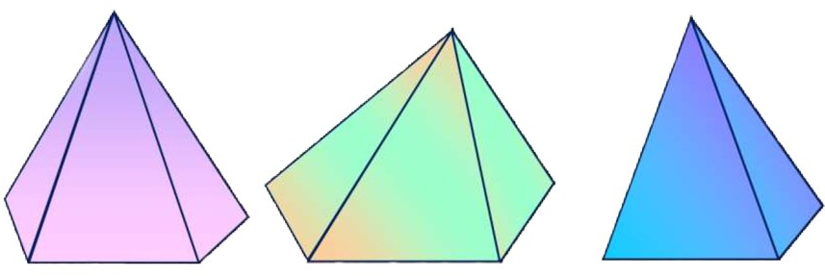
Geometriya
11-sinf
Mavzu: Piramida haqida tushuncha

Slide 2
Reja
Piramida haqida asosiy tushunchalar
Piramidaning yon sirti va to‘la sirti
Mavzuga doir masalalar yechish

Slide 3
Piramida

Slide 4
Piramidaning asosi

Slide 5

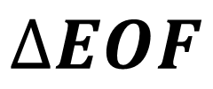


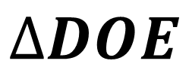


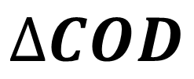

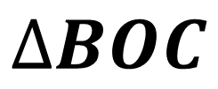

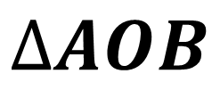
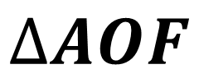
Piramidaning yon yoqlari
$$O$$
$$∆AOB$$
$$∆DOE$$
$$∆BOC$$
$$∆EOF$$
$$∆COD$$
$$∆AOF$$
$$B$$
$$C$$
$$A$$
$$D$$
$$F$$
$$E$$

Slide 6
Piramidaning qirralari

Slide 7

Piramidaning uchi
$$O$$

Slide 8
Piramidalar
Uchburchakli
piramida
To‘rtburchakli
piramida
Beshburchakli
piramida

Slide 9
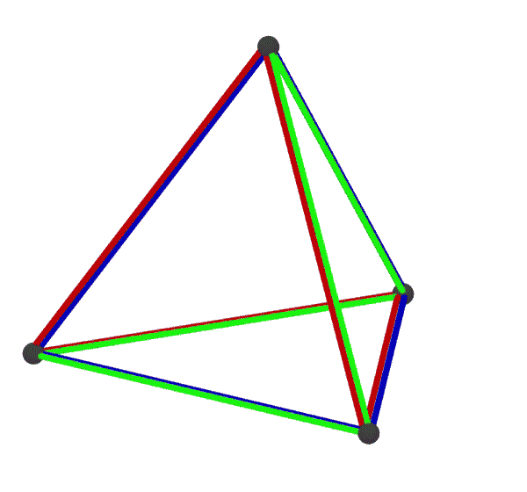
Tetraedr

Slide 10

Piramidaning balandligi
$$h$$

Slide 11

Piramidaning balandligi
$$h$$

Slide 12
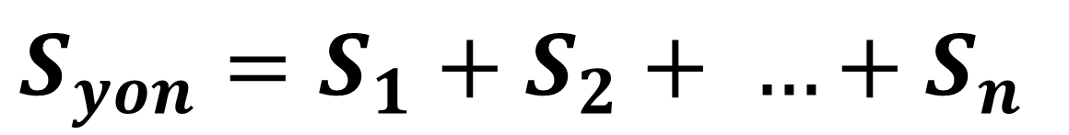

Piramidaning yon va to‘la sirti
$$S_{yon}=S_{1}+S_{2}+ …+S_{n}$$
$$S_{to‘la}=S_{yon}+S_{asos}$$

Slide 13
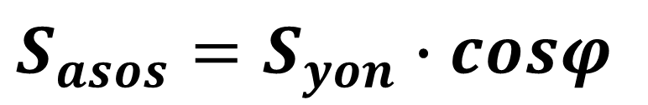

Agar piramida asosidagi barcha ikki yoqli
burchaklari $φ$ ga teng bo‘lsa, quyidagi munosabat o‘rinli bo‘ladi.
$$S_{asos}=S_{yon}∙cosφ$$

Slide 14

1-masala
$DABC$ piramida yon yoqlarining
$D$ uchidan tushirilgan balandliklari
$5$ ga teng. $AB=14, BC=13$, $AC=15$.
Piramida balandligini toping.

Slide 15








Masalaning yechimi
Berilgan:
$$D$$
$$AB=14$$
$$BC=13$$
$$AC=15$$
$$DE=5$$
$$A$$
$$C$$
Topish kerak:
$$O$$
$$E$$
$$DO= ?$$
$$B$$

Slide 16
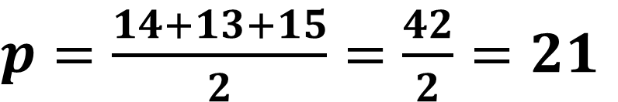


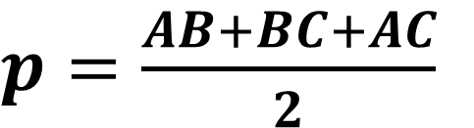





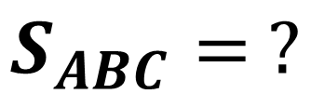


$$∆ABC$$
$$AB=14$$
$$AC=15$$
$$D$$
$$BC=13$$
$$S_{ABC}= ?$$
$p=\frac{AB+BC+AC}{2}$
$$A$$
$$C$$
$p=\frac{14+13+15}{2}=\frac{42}{2}=21$
$$B$$
$$S_{ABC}=\sqrt{p∙\left(p−AB\right)∙\left(p−BC\right)∙\left(p−AC\right)}$$
$$=\sqrt{21∙\left(21−14\right)∙\left(21−13\right)∙\left(21−15\right)}=$$
$$84$$

Slide 17


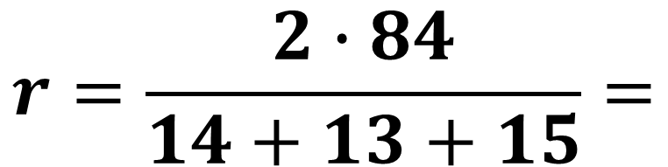
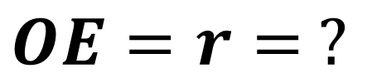

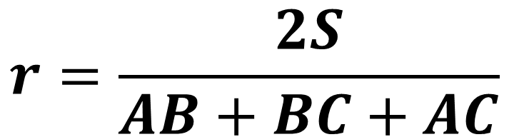



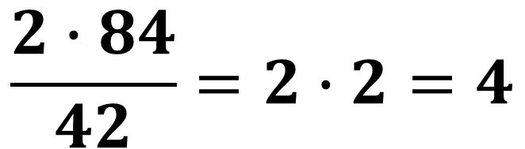


$$S=84$$
$$AB=14$$
$$D$$
$$AB=14$$
$$AC=15$$
$$BC=13$$
$$OE=r= ?$$
$$A$$
$$C$$
$$r=\frac{2S}{AB+BC+AC}$$
$$O$$
$$r$$
$$E$$
$$B$$
$$r=\frac{2∙84}{14+13+15}=$$
$$\frac{2∙84}{42}=2∙2=4$$

Slide 18
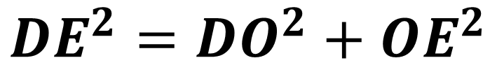




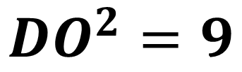

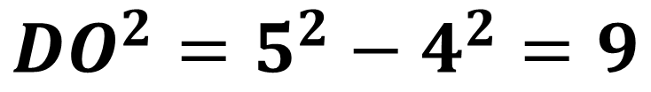
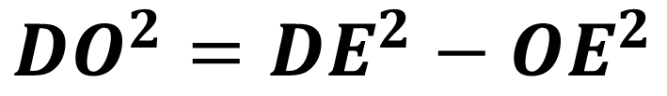

$$DE=5$$
$$OE=4$$
$$DO= ?$$
$$D$$
$${DE}^{2}={DO}^{2}+{OE}^{2}$$
$${DO}^{2}={DE}^{2}−{OE}^{2}$$
$$A$$
$$C$$
$$O$$
$${DO}^{2}=5^{2}−4^{2}=9$$
$$E$$
$$B$$
$${DO}^{2}=9$$
$$DO=3$$
Javob: $3$

Slide 19

2-masala
Piramidaning asosi $6 cm$ va $8 cm$ ga teng to‘g‘ri burchakli uchburchakdan iborat. Piramidaning har bir qirrasi $13 cm$ ga teng bo‘lsa, uning balandligini toping.

Slide 20




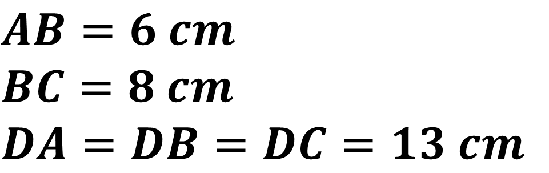


Masalaning yechimi
Berilgan:
$$D$$
$$AB=6 cm$$
$$BC=8 cm$$
$$DA=DB=DC=13 cm$$
$$A$$
Topish kerak:
$$O$$
$$C$$
$$B$$
$$DO= ?$$

Slide 21

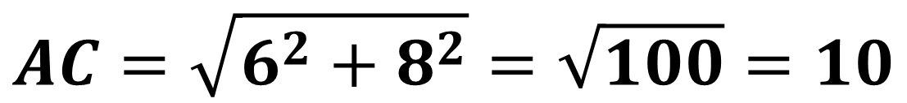
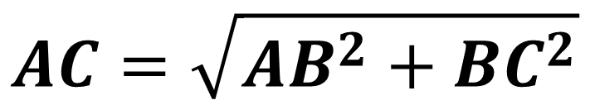

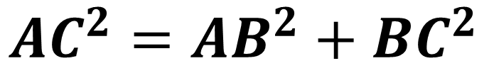
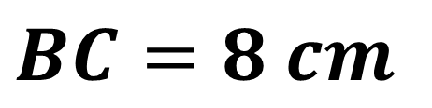
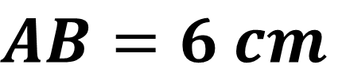
$$∆ABC$$
$$AB=6 cm$$
$$BC=8 cm$$
$$AC= ?$$
$$D$$
$${AC}^{2}={AB}^{2}+{BC}^{2}$$
$$AC=\sqrt{{AB}^{2}+{BC}^{2}}$$
$$A$$
$$O$$
$$C$$
$$AC=\sqrt{6^{2}+8^{2}}=\sqrt{100}=10$$
$$B$$

Slide 22
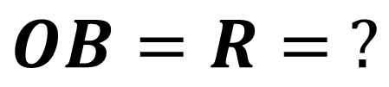
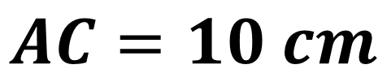

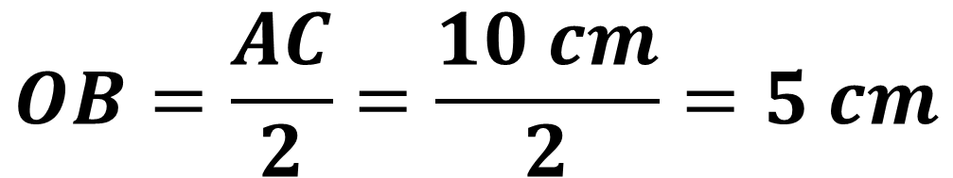

$$AC=10 cm$$
$$D$$
$$OB=R= ?$$
$$A$$
$$O$$
$$C$$
$$OB=\frac{AC}{2}=\frac{10 cm}{2}=5 cm$$
$$R$$
$$B$$

Slide 23
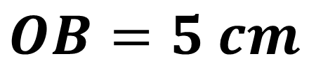
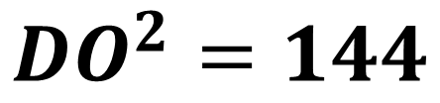
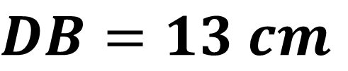
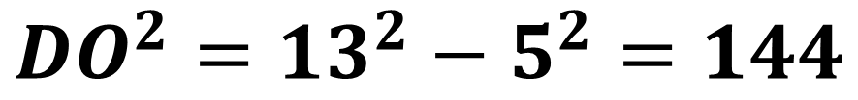
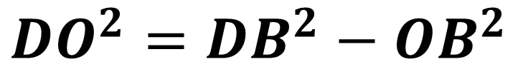

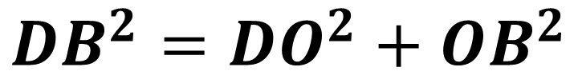




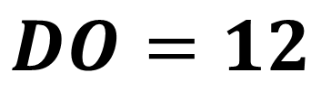
$$DB=13 cm$$
$$OB=5 cm$$
$$DO= ?$$
$${DB}^{2}={DO}^{2}+{OB}^{2}$$
$$D$$
$${DO}^{2}={DB}^{2}−{OB}^{2}$$
$${DO}^{2}={13}^{2}−5^{2}=144$$
$$A$$
$$O$$
$$C$$
$${DO}^{2}=144$$
$$DO=12$$
$$R$$
$$B$$
Javob: $12$

Slide 24

3-masala
Piramidaning asosi – tomonlari $3 cm$ va $7 cm$, diagonallaridan biri $6 cm$ ga teng bo‘lgan parallelogrammdan iborat. Piramidaning balandligi $4 cm$ ga teng bo‘lib, piramida diagonallarining kesishish nuqtasidan o‘tadi. Piramidaning yon qirralarini toping.

Slide 25









Masalaning yechimi
Berilgan:
$$S$$
$$AD=7 cm$$
$$AB=3 cm$$
$$BD=6 cm$$
$$SO=4 cm$$
$$B$$
$$C$$
Topish kerak:
$$O$$
$$CS= ?$$
$$A$$
$$D$$
$$DS= ?$$

Slide 26





$$BD=6 cm$$
$$BO=OD AO=OC$$
$$S$$
$$∆AOS=∆COS$$
$$∆BOS=∆DOS$$
$$B$$
$$C$$
$$BS=DS AS=CS$$
$$O$$
$$OD=\frac{1}{2}∙BD=\frac{1}{2}∙6=3$$
$$A$$
$$D$$

Slide 27








$$OD=3 cm$$
$$SO=4 cm$$
$$∆DOS$$
$$S$$
$${DS}^{2}={SO}^{2}+{OD}^{2}$$
$${DS}^{2}=4^{2}+3^{2}=25$$
$$B$$
$$C$$
$${DS}^{2}=25$$
$$DS=5$$
$$O$$
$$A$$
$$D$$
$$BS=DS=5$$

Slide 28




$$AD=7 cm AB=3 cm BD=6 cm AO= ?$$
$$S$$
$$2∙\left({AB}^{2}+{AD}^{2}\right)={BD}^{2}+{AC}^{2}$$
$$2∙\left(3^{2}+7^{2}\right)=6^{2}+{AC}^{2}$$
$$B$$
$$C$$
$${AC}^{2}=80$$
$$AC=\sqrt{80}=4\sqrt{5}$$
$$O$$
$$A$$
$$D$$
$$AO=\frac{1}{2}∙AC=\frac{1}{2}∙4\sqrt{5}=2\sqrt{5}$$

Slide 29









$$AO=2\sqrt{5} cm$$
$$SO=4 cm$$
$$∆AOS$$
$$S$$
$${AS}^{2}={SO}^{2}+{AO}^{2}$$
$${AS}^{2}=4^{2}+{\left(2\sqrt{5}\right)}^{2}=36$$
$${AS}^{2}=36$$
$$AS=6$$
$$B$$
$$C$$
$$AS=CS=6 cm$$
$$O$$
Javob: $5 cm;6 cm$
$$A$$
$$D$$

Slide 30

Mustaqil bajarish uchun topshiriqlar
116-sahifa
362
116-sahifa
363
117-sahifa
370

