Slide 1
Geometriya
11-sinf
Mavzu: Silindrning sirti va hajmini hisoblashga doir masalalar yechish

Slide 2
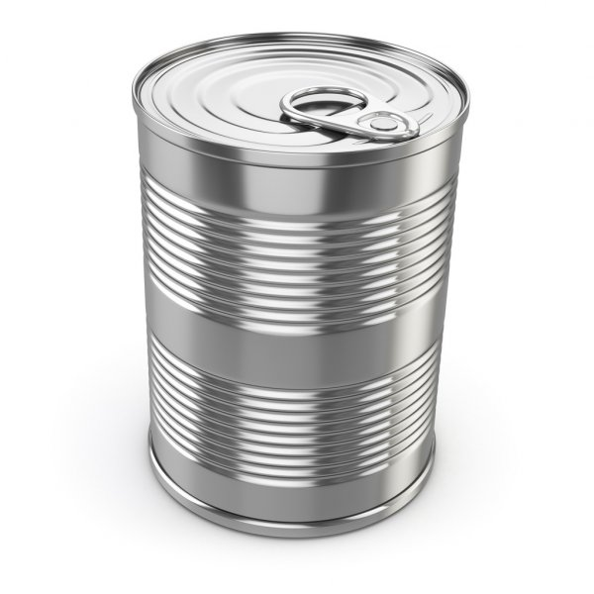
302-masala (179-sahifa)
Asosining radiusi 1,5 dyuym, balandligi
4,25 dyuym bo‘lgan silindr shaklidagi konserva bankasi berilgan.
Bankaning to‘la sirti va hajmini toping.
Berilgan:
$$r=1,5 \text{dyu}\text{y}\text{m}=1,5∙2,54 cm=3,81 cm$$
$$h=4,25 \text{dyuym}=4,25∙2,54 cm=10,795 cm$$
Topish kerak:
$$S_{to‘la}= ?$$
$$V= ?$$

Slide 3
Masalaning yechimi
$$S_{to‘la}= 2πr∙\left(h+r\right)=$$
$$=2∙3,14∙3,81∙\left(10,795+3,81\right)=$$
$$=23,9268∙14,605=349,45$$
$$V=πr^{2}h=3,14∙{3,81}^{2}∙10,795=492$$
$5∙349,45≈1747$so‘m
Javob: $349,45 {cm}^{2};$ $492 {cm}^{3};$ $1747$so‘m

Slide 4
304-masala (179-sahifa)
Fermerning yoqilg‘i baki silindr shaklida. Bakning balandligi $6 fut$, asosining radiusi $1,5 fut$. Bakning gallonlardagi sig‘imini aniqlang.
($1$kub fut $=7,5$gallon)
Berilgan:
Yechish:
$$h=6 fut$$
$$V= πr^{2}h$$
$$r=1, 5 fut$$
$$V=3,14∙{1,5}^{2}∙6=42,39 fut$$
Topish kerak:
$$42,39∙7,5=$$
$$V= ?$$
$=317,925$gallon $≈318$ gallon
Javob: $318$ gallon

Slide 5
308-masala (179-sahifa)
Birinchi silindr hajmi ${12 m}^{3}.$ Ikkinchi silindrning
balandligi birinchi silindrga qaraganda 3 marta katta,
asosining radiusi 2 marta kichik. Ikkinchi silindr
hajmini toping.
$$r_{2}=\frac{r_{1}}{2}$$
Berilgan:
$$V_{1}={12 m}^{3}$$
$$h_{2}=h_{1}∙3$$
Topish kerak:
$$V_{2}= ?$$

Slide 6
Masalaning yechimi
$$V_{2}=π∙r_{2}^{2}∙h_{2}$$
$$V_{1}=π∙r_{1}^{2}∙h_{1}$$
$$V_{2}=π∙{\left(\frac{r_{1}}{2}\right)}^{2}∙h_{1}∙3=$$
$$12=π∙r_{1}^{2}∙h_{1}$$
$$=\frac{3}{4}π∙r_{1}^{2}∙h_{1}$$
$$r_{1}^{2}∙h_{1}=\frac{12}{π}$$
$$V_{2}=\frac{3}{4}π∙\frac{12}{π}=3∙3=9$$
Javob: $9 m^{3}$

Slide 7
1-masala
Rasmda berilgan silindrning yoyilmasiga ko‘ra, uning yon va to‘la sirtining yuzini toping.
Berilgan:
$$2πr=10$$
$$10$$
$$h=5$$
$$5$$
Topish kerak:
$$S_{yon}= ?$$
$$S_{to‘la}= ?$$

Slide 8
Masalaning yechimi
$r=\frac{10}{2π}=\frac{5}{π}$
$$2πr=10$$
$$S_{yon}=2πr∙h=10∙5=50$$
$$5$$
$S_{asos}=πr^{2}=π∙{\left(\frac{5}{π}\right)}^{2}=π∙\frac{25}{π^{2}}=\frac{25}{π}$
$$\frac{5}{π}$$
$S_{to‘la}=S_{yon}+2∙S_{asos}=50+2∙\frac{25}{π}=50+\frac{50}{π}$
Javob: $50+\frac{50}{π}$

Slide 9
2-masala
Rasmda tasvirlangan silindr bo‘lagining hajmini toping.
$$O_{1}$$
$$2$$
$$4$$
$$3$$
$$2$$
$$O$$

Slide 10
Masalaning yechimi
2-masala
Berilgan:
$$h=3$$
$$O_{1}$$
$$r=2$$
$$3$$
$$3$$
Topish kerak:
$$V_{1}= ?$$
$$2$$
$$O$$
$$V_{1}= πr^{2}h=π∙2^{2}∙3=12π$$

Slide 11
Berilgan:
$$h=1$$
$$O_{1}$$
$$1$$
$$r=2$$
$$2$$
$$1$$
Topish kerak:
$$V_{2}= ?$$
$$V_{2}= \frac{1}{2}πr^{2}h=\frac{π∙2^{2}∙1}{2}=2π$$

Slide 12
2-masala
$$V_{1}+V_{2}=12π+2π=14π$$
$$O_{1}$$
$$2$$
Javob: $12π$
$$4$$
$$3$$
$$2$$
$$O$$

Slide 13
3-masala
Rasmda tasvirlangan silindr bo‘lagining hajmini toping.
$$15$$
$$O_{1}$$
$$5$$
$${60}^{0}$$
$$O$$

Slide 14
Masalaning yechimi
3-masala
$$α={60}^{0}$$
$$r=15$$
$$15$$
$$O_{1}$$
$$S_{sektor}= \frac{πr^{2}}{{360}^{0}}∙α=$$
$${60}^{0}$$
$$S_{sektor}= \frac{πr^{2}}{{360}^{0}}∙{60}^{0}= \frac{π∙{15}^{2}}{6} =\frac{225π}{6}=\frac{75π}{2}$$

Slide 15
3-masala
$$r=15$$
$$15$$
$$S_{doira}=πr^{2}=$$
$$π∙{15}^{2}=225π$$
$$O_{1}$$

Slide 16
3-masala
$$S_{asos}=S_{doira}−S_{sektor}=225π−\frac{75π}{2}=187,5π$$
$$V= S_{asos}∙h$$
$$V=187,5π∙5=937,5π$$
$$15$$
$$O_{1}$$
$$5$$
$${60}^{0}$$
Javob: $937,5π$
$$O$$

Slide 17
4-masala
To‘g‘ri prizmaning asosi katetlari $6$ va $8$ bo‘lgan to‘g‘ri burchakli uchburchakdan iborat, yon qirralari $5$ ga teng. Bu prizmaga tashqi chizilgan silindr hajmini toping.
$$8$$
$$6$$
$$5$$
$$5$$
$$5$$

Slide 18
4-masala
To‘g‘ri prizmaning asosi katetlari $6$ va $8$ bo‘lgan to‘g‘ri burchakli uchburchakdan iborat, yon qirralari $5$ ga teng. Bu prizmaga tashqi chizilgan silindr hajmini toping.
$$8$$
$$6$$
$$O_{1}$$
$$5$$
$$O$$

Slide 19
Masalaning yechimi
$$B_{1}$$
$$AB=8$$
$$BC=6$$
$$AA_{1}=5$$
$${AB}^{2}+{BC}^{2}={AC}^{2}$$
$$O_{1}$$
$$C_{1}$$
$$A_{1}$$
$${AC}^{2}=8^{2}+6^{2}=100$$
$$AC=10$$
$$5$$
$$B$$
$$R=\frac{AC}{2}=\frac{10}{2}=5$$
$$8$$
$$6$$
$$A$$
$$C$$
$$R$$
$$O$$
$$R$$

Slide 20
$$R=5$$
$$h=5$$
$$S_{asos}=πr^{2}=π∙5^{2}=25π$$
$$O_{1}$$
$$5$$
$$V=S_{asos}∙h$$
$$5$$
$$V=25π∙5=125π$$
Javob: $125π$
$$O$$

Slide 21
5-masala
Muntazam to‘rtburchakli prizma asosining radiusi va balandligi 1 ga teng bo‘lgan silindrga tashqi chizilgan. Prizma yon sirtining yuzini toping.
$$a$$
$$1$$
Berilgan:
$$h_{silindr}=1$$
$$r_{silindr}=1$$
$$h_{prizma}=1$$
$$r=1$$
$$1$$
Topish kerak:
$$S_{yon}= ?$$

Slide 22
Masalaning yechimi
$$r=\frac{a}{2}$$
$$a$$
$$a=2r=2∙1=2$$
$$1$$
$$P=4a=4∙2=8$$
$$1$$
$$1$$
$$a$$

Slide 23
Masalaning yechimi
$$a$$
$$S_{yon}=P∙h$$
$$1$$
$$S_{yon}=8∙1=8$$
$$1$$
Javob: $8$
$$1$$
$$a$$
$$a$$
$$a$$
$$a$$

Slide 24
6-masala
Uchburchakli muntazam prizma asosining radiusi $2\sqrt{3}$ ga va balandligi $2$ ga teng bo‘lgan silindrga ichki chizilgan. Prizma yon sirtining yuzini toping.
Berilgan:
$$R=2\sqrt{3}$$
$$h=1$$
Topish kerak:
$$S_{yon}= ?$$

Slide 25
Masalaning yechimi
$$R=2\sqrt{3}$$
$$R=\frac{a\sqrt{3}}{3}$$
$$a$$
$$R$$
$$a$$
$$a$$
$$a=\frac{3R}{\sqrt{3}}=\frac{3∙2\sqrt{3}}{\sqrt{3}}=6$$

Slide 26
$$h=2$$
$$P=3a=3∙6=18$$
$$a$$
$$a$$
$$S_{yon}=P∙h$$
$$a$$
$$h$$
$$h$$
$$S_{yon}=18∙2=36$$
Javob: $36$

Slide 27
Mustaqil bajarish uchun topshiriqlar
$181$-sahifa
𝟏𝟖𝟏-sahifa
$$314$$
𝟑𝟏𝟒
$$316$$
𝟑𝟏𝟔
$$319$$
𝟑𝟏𝟗

