Slide 1
Geometriya
11-sinf
Mavzu: Prizmaning hajmini hisoblashga doir masalalar yechish

Slide 2





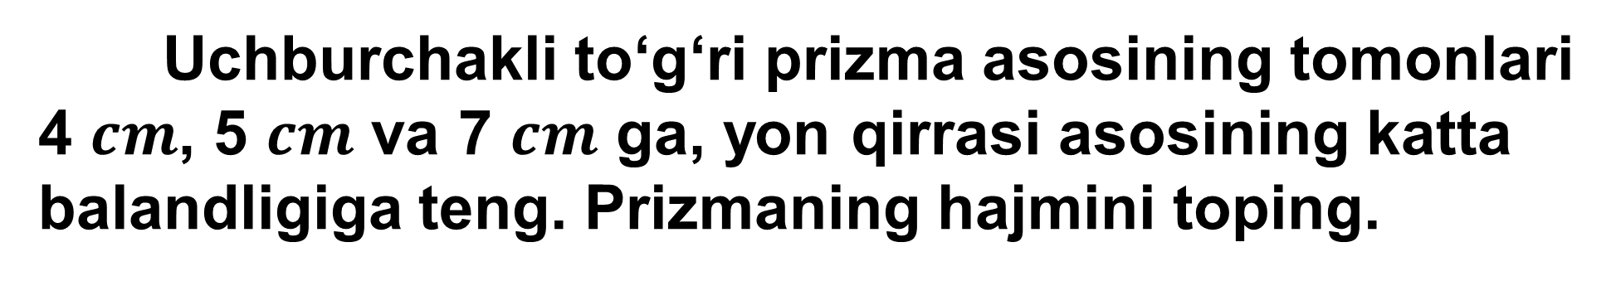






243-masala (167-sahifa)
Uchburchakli to‘g‘ri prizma asosining tomonlari
4 $cm$, 5 $cm$ va 7 $cm$ ga, yon qirrasi asosining katta balandligiga teng. Prizmaning hajmini toping.
Berilgan:
$$B_{1}$$
$$AB=4 cm$$
$$BC=5 cm$$
$$A_{1}$$
$$C_{1}$$
$$AC=7 cm$$
$$AA_{1}=h_{AB}$$
$$B$$
Topish kerak:
$$V= ?$$
$$A$$
$$C$$

Slide 3
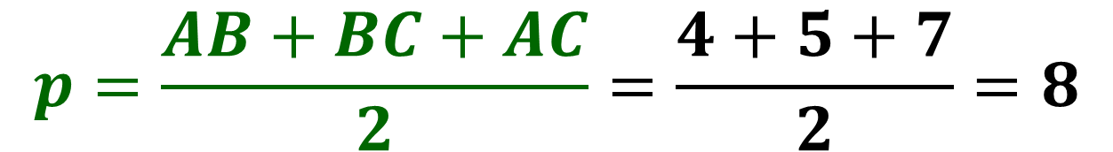


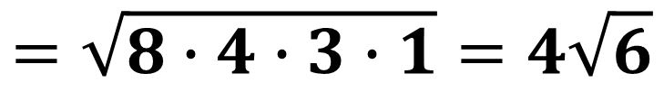




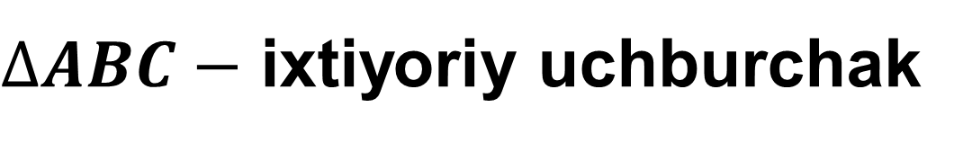
Masalaning yechimi
$$B_{1}$$
$∆ABC−$ ixtiyoriy uchburchak
$$p=\frac{AB+BC+AC}{2}=\frac{4+5+7}{2}=8$$
$$A_{1}$$
$$C_{1}$$
$$B$$
$$S_{asos}=\sqrt{p\left(p−AB\right)\left(p−BC\right)\left(p−AC\right)}$$
$$A$$
$$C$$
$$S_{asos}=\sqrt{8∙\left(8−4\right)\left(8−5\right)\left(8−7\right)}=$$
$$=\sqrt{8∙4∙3∙1}=4\sqrt{6}$$

Slide 4
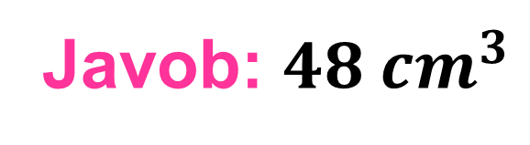
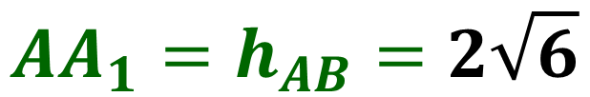
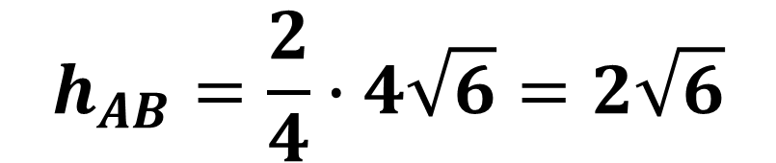
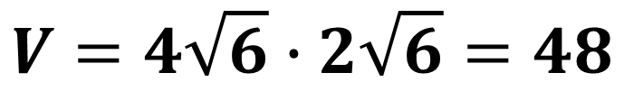


$h_{AB}=\frac{2}{AB}\sqrt{p\left(p−AB\right)\left(p−BC\right)\left(p−AC\right)}$
$$B_{1}$$
$$h_{AB}=\frac{2}{4}∙4\sqrt{6}=2\sqrt{6}$$
$$A_{1}$$
$$C_{1}$$
$$AA_{1}=h_{AB}=2\sqrt{6}$$
$$B$$
$$V=S_{asos}∙AA_{1}$$
$$h_{AB}$$
$$A$$
$$C$$
$$V=4\sqrt{6}∙2\sqrt{6}=48$$
Javob: ${48 cm}^{3}$

Slide 5
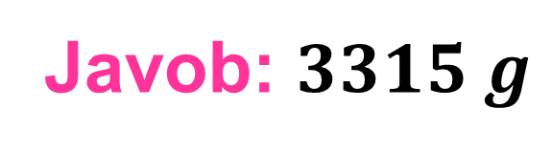
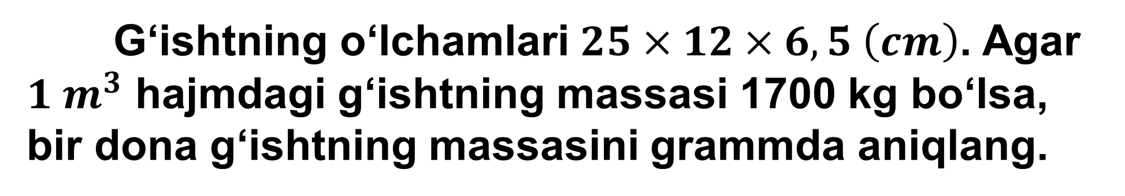

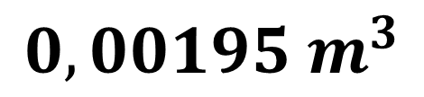
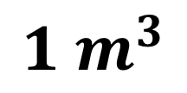
257-masala (169-sahifa)
G‘ishtning o‘lchamlari $25×12×6,5 \left(cm\right)$. Agar
$1 m^{3}$ hajmdagi g‘ishtning massasi 1700 kg bo‘lsa,
bir dona g‘ishtning massasini grammda aniqlang.
$$V=25×12×6,5=1950 {cm}^{3}=0,00195 m^{3}$$
$$1 m^{3}$$
1700 kg
$$0,00195 m^{3}$$
$$x$$
$$x=0,00195∙1700=3,315 kg=3315 g$$
Javob: $3315 g$

Slide 6











262-masala (169-sahifa)
O‘lchamlari rasmda
berilgan oltin plitkaning
massasi 12,36 kg bo‘lsa,
uning zichligini aniqlang.
$$6 cm$$
Berilgan:
$$4 cm$$
$$20 cm$$
$$a=6 cm$$
$$b=10 cm$$
$$10 cm$$
$$h_{tr}=4 cm$$
$$m=12,36 kg$$
$$h_{pr}=20 cm$$
$$h_{pr}=20 cm$$
Topish kerak:
$$ρ= ?$$

Slide 7
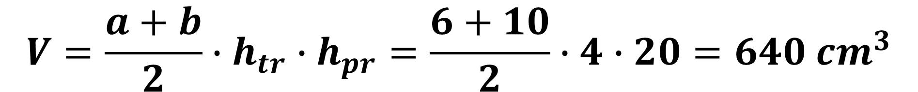
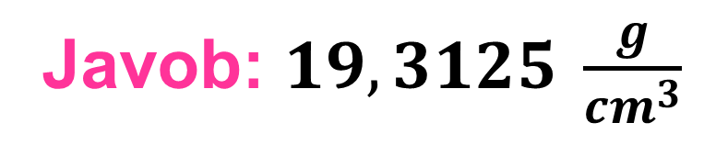
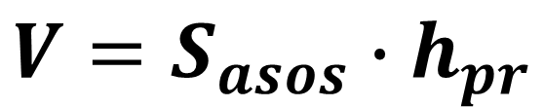
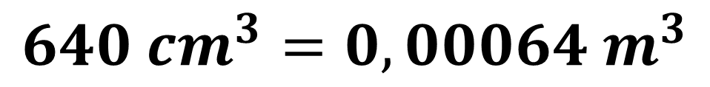

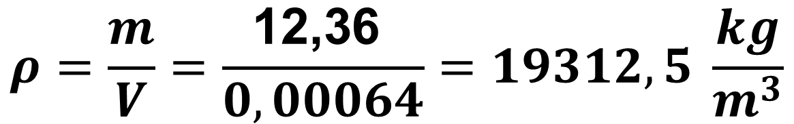
$$V=S_{asos}∙h_{pr}$$
$$V=\frac{a+b}{2}∙h_{tr}∙h_{pr}=\frac{6+10}{2}∙4∙20=640 {cm}^{3}$$
$$640 {cm}^{3}=0,00064 m^{3}$$
$$ρ=\frac{m}{V}=\frac{\text{12,36 }}{0,00064}=19312,5 \frac{kg}{m^{3}}$$
$$m=ρ∙V$$
Javob: $19,3125 \frac{g}{cm^{3}}$

Slide 8

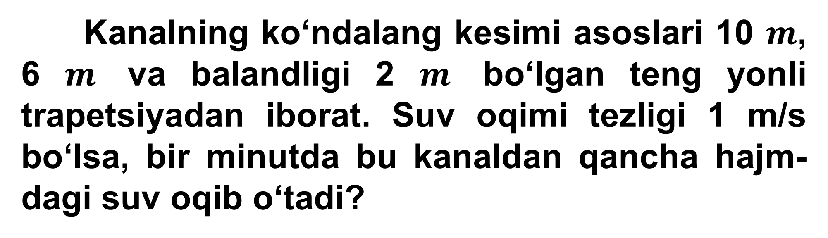


1-masala
Kanalning ko‘ndalang kesimi asoslari 10 $m$, 6 $m$ va balandligi 2 $m$ bo‘lgan teng yonli trapetsiyadan iborat. Suv oqimi tezligi 1 m/s bo‘lsa, bir minutda bu kanaldan qancha hajm-dagi suv oqib o‘tadi?
$$10 m$$
$$2 m$$
$$6 m$$

Slide 9
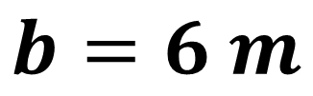

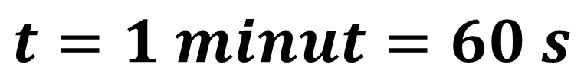

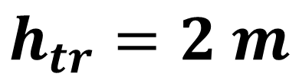
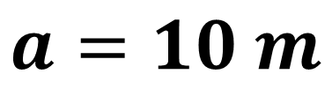
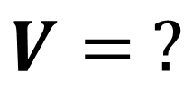

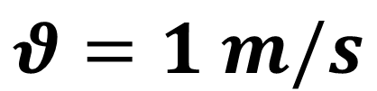
Masalaning yechimi
Berilgan:
$$10 m$$
$$a=10 m$$
$$2 m$$
$$b=6 m$$
$$h_{tr}=2 m$$
$$6 m$$
$$θ=1 m/s$$
$$t=1 minut=60 s$$
Topish kerak:
$$V= ?$$

Slide 10
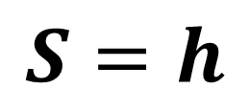
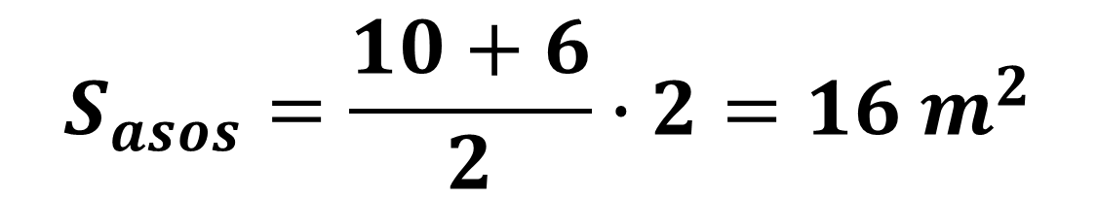
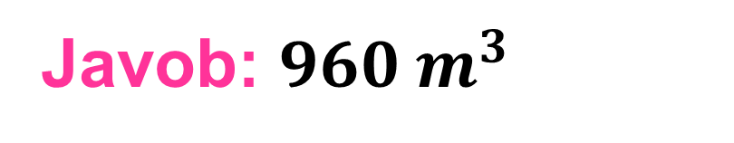
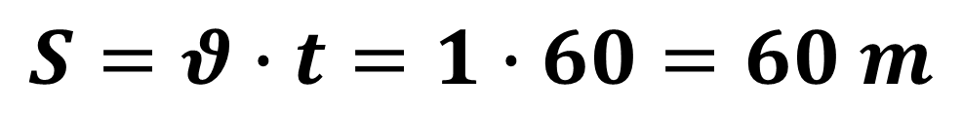
$$S_{asos}=\frac{10+6}{2}∙2=16 m^{2}$$
$$S=θ∙t=1∙60=60 m$$
$$S=h$$
$$V=S_{asos}∙h=16∙60=960 m^{3}$$
Javob: $960 m^{3}$

Slide 11







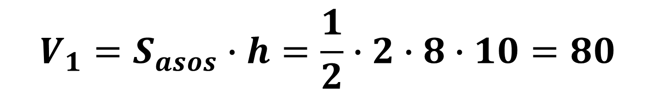
2-masala
Rasmda berilgan ma’lumotlar asosida
garajning hajmini toping.
$$2$$
$$7$$
$$2$$
$$10$$
$$8$$
$$10$$
$$8$$
$$V_{1}=S_{asos}∙h=\frac{1}{2}∙2∙8∙10=80$$

Slide 12


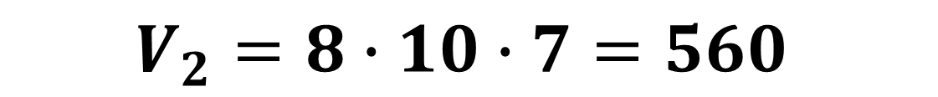
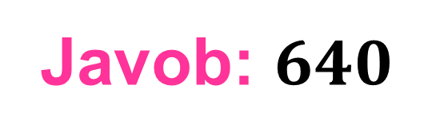
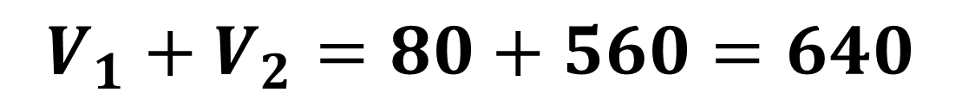

$$V_{2}=8∙10∙7=560$$
$${V_{1}+V}_{2}=80+560=640$$
$$2$$
$$7$$
$$7$$
$$10$$
$$10$$
$$8$$
$$8$$
Javob: $640$

Slide 13




3-masala
Yuk ombori rasmda tasvirlangan trapetsiyali
prizma shaklida.
Berilgan ma’lumotlar asosida omborning
sig‘imini aniqlang.
$$6 m$$
$$8 m$$
$$8 m$$
$$8 m$$

Slide 14
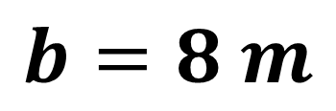
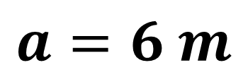
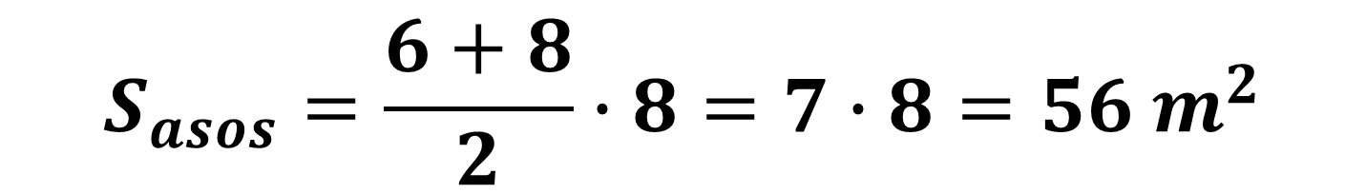

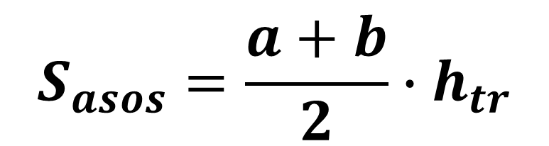
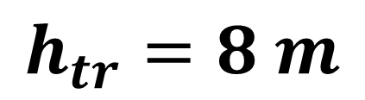
Masalaning yechimi
$$a=6 m$$
$$b=8 m$$
$$6 m$$
$$h_{tr}=8 m$$
$$8 m$$
$$S_{asos}=\frac{a+b}{2}∙h_{tr}$$
$$8 m$$
$$8 m$$
$$S_{asos}=\frac{6+8}{2}∙8=7∙8=56 m^{2}$$

Slide 15
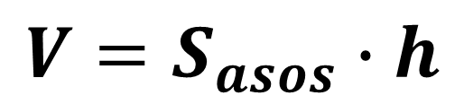
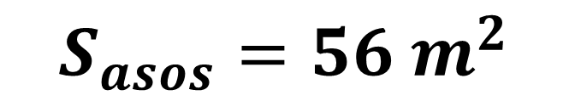
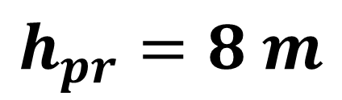
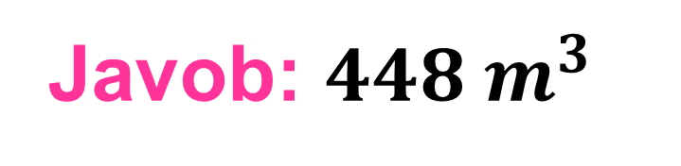
$$S_{asos}=56 m^{2}$$
$$h_{pr}=8 m$$
$$6 m$$
$$8 m$$
$$V=S_{asos}∙h$$
$$8 m$$
$$8 m$$
$$V=S_{asos}∙h=56∙8=448 m^{3}$$
Javob: $448 m^{3}$

Slide 16



4-masala
Rasmda qutining o‘lchamlari berilgan. Qutining asoslari 1 kvadrat metri 1000 so‘m, yon yoqlari 1 kvadrat metri 2000 so‘m bo‘lgan materialdan ishlangan. Qutini yasashga necha so‘mlik material ketgan?
$$6 m$$
$$5 m$$
$$14 m$$

Slide 17
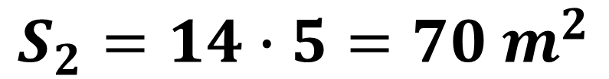




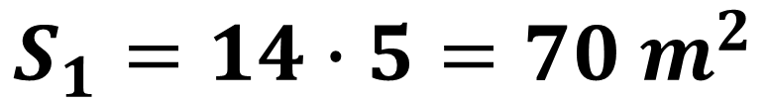

Masalaning yechimi
$$S_{1}$$
$$S_{1}=14∙5=70 m^{2}$$
$$6 m$$
$$S_{2}=14∙5=70 m^{2}$$
$$S_{2}$$
$$5 m$$
$$14 m$$
$$S_{asos}=S_{1}+S_{2}=70+70=140 m^{2}$$

Slide 18


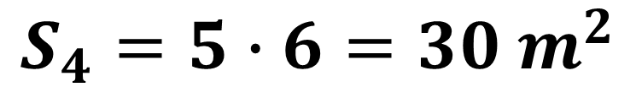
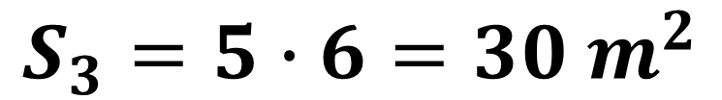
$$S_{3}=5∙6=30 m^{2}$$
$$S_{3}$$
$$S_{4}$$
$$6 m$$
$$S_{4}=5∙6=30 m^{2}$$
$$5 m$$
$$14 m$$

Slide 19


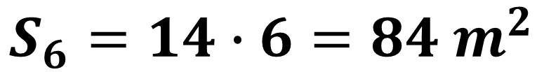
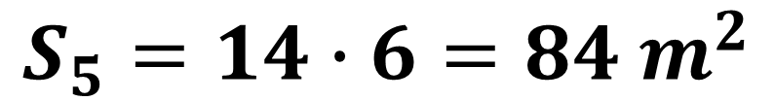
$$S_{5}=14∙6=84 m^{2}$$
$$S_{6}$$
$$6 m$$
$$S_{5}$$
$$S_{6}=14∙6=84 m^{2}$$
$$5 m$$
$$14 m$$
$$S_{yon}=2∙\left(84+30\right)=2∙114=228 m^{2}$$

Slide 20
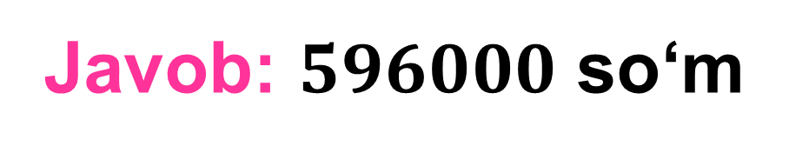
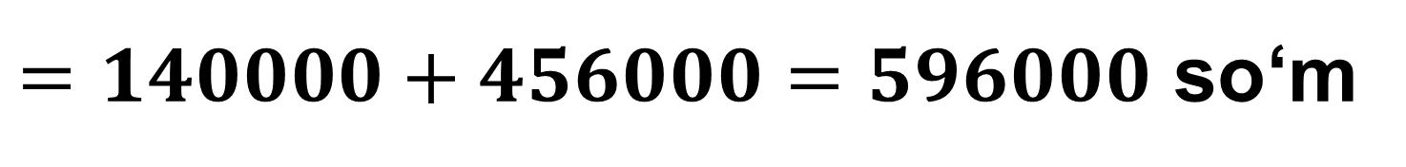
$$6 m$$
$$5 m$$
$$S=1000∙S_{asos}+2000∙S_{yon}$$
$$14 m$$
$$S=1000∙140+2000∙228=$$
$=140000+456000=596000$ so‘m
Javob: $596000$ so‘m

Slide 21
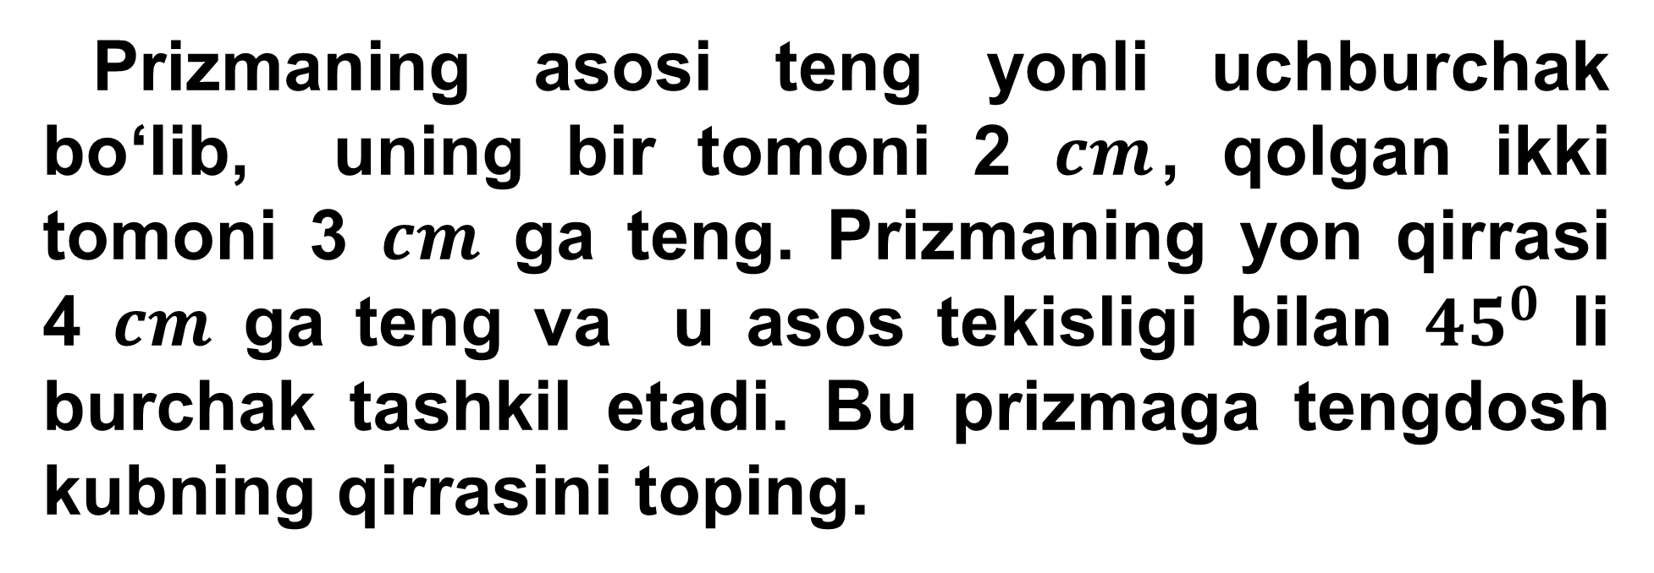
5-masala
Prizmaning asosi teng yonli uchburchak bo‘lib, uning bir tomoni 2 $cm$, qolgan ikki tomoni 3 $cm$ ga teng. Prizmaning yon qirrasi
4 $cm$ ga teng va u asos tekisligi bilan ${45}^{0}$ li burchak tashkil etadi. Bu prizmaga tengdosh kubning qirrasini toping.

Slide 22

















Masalaning yechimi
Berilgan:
$$B_{1}$$
$$a=2 cm$$
$$b=3 cm$$
$$A_{1}$$
$$C_{1}$$
$$CC_{1}=4 cm$$
$$α={45}^{0}$$
$$B$$
$${45}^{0}$$
$$h$$
Topish kerak:
$$b$$
$$b$$
$$a_{kub}= ?$$
$${45}^{0}$$
$$A$$
$$a$$
$$C$$

Slide 23








$$B_{1}$$
$$h_{∆}=\sqrt{b^{2}−\frac{a^{2}}{4}}=\sqrt{3^{2}−\frac{2^{2}}{4}}=$$
$$A_{1}$$
$$C_{1}$$
$$=\sqrt{9−1}=\sqrt{8}$$
$$B$$
$$S_{asos}=\frac{a∙h_{∆}}{2}=\frac{2∙\sqrt{8}}{2}=\sqrt{8}$$
$$b$$
$$b$$
$$h_{∆}$$
$$A$$
$$a$$
$$C$$

Slide 24








$${\left({CC}_{1}\right)}^{2}={\left(C_{1}D\right)}^{2}+{CD}^{2}$$
$$B_{1}$$
$$C_{1}D=CD=h$$
$$A_{1}$$
$$C_{1}$$
$$4^{2}=h^{2}+h^{2}$$
$$2h^{2}=16$$
$$B$$
$${45}^{0}$$
$$h$$
$$h^{2}=8$$
$$b$$
$$b$$
$$h=\sqrt{8}$$
$${45}^{0}$$
$$A$$
$$a$$
$$C$$
$$D$$
$$h$$

Slide 25






$${V=S}_{asos}∙h=\sqrt{8}∙\sqrt{8}=8$$
$$B_{1}$$
$$V={a_{kub}}^{3}$$
$$A_{1}$$
$$C_{1}$$
$${a_{kub}}^{3}=8=2^{3}$$
$$a_{kub}=2$$
$$B$$
$$h$$
$$b$$
$$b$$
Javob: $2 cm$
$$S_{asos}$$
$$A$$
$$a$$
$$C$$

Slide 26

Mustaqil bajarish uchun topshiriqlar
170-sahifa
265
267

