Slide 1
Geometriya
11-sinf
Mavzu:
Prizmaning
hajmi
$$V= ?$$

Slide 2
Reja
Topshiriqlarning yechimlarini tekshirish
Prizmaning hajmi
Mavzuga doir masalalar yechish
$$1$$
$$2$$
$$3$$

Slide 3
209-masala (165-sahifa)
To‘g‘ri burchakli parallelepiped hajmi 24 ${cm}^{3}$ ga teng va qirralaridan birining uzunligi 3 cm ga teng. Parallelepipedning bu qirraga perpendikulyar yog‘ining yuzini toping.
Berilgan:
Yechish:
$h=3$ $cm$
$$V=S∙h$$
$$V=\text{24} {cm}^{3}$$
$$V=\text{24} {cm}^{3}$$
$$24=S∙3$$
$$h=3$$
Topish kerak:
$$S=8$$
$$S_{asos}= ?$$
$$S= ?$$
Javob: $8 {cm}^{2}$

Slide 4
213-masala (165-sahifa)
Kubning hajmi $8 {cm}^{3}$ga teng bo‘lsa, uning to‘la
sirtining yuzini toping.
Berilgan:
Yechish:
$$V=8 {cm}^{3}$$
$$V=a^{3}$$
$$S_{to‘la}=6a^{2}$$
Topish kerak:
$$8=a^{3}$$
$$S_{to‘la}=6∙2^{2}$$
$$S_{to‘la}= ?$$
$$a^{3}=8=2^{3}$$
$$S_{to‘la}=24$$
$$a=2$$
Javob: $24 {cm}^{2}$

Slide 5
220-masala (166-sahifa)
To‘g‘ri burchakli parallelepipedning bitta uchidan
chiquvchi qirralari 2 cm va 6 cm ga teng. To‘g‘ri burchakli parallelepipedning hajmi 48 ${cm}^{3}$. Parallelepipedning shu uchidan chiquvchi uchinchi qirrasini toping.
Berilgan:
Yechish:
$$V=abc$$
$$V=\text{4}\text{8} {cm}^{3}$$
$$c=\frac{V}{ab}=\frac{48}{2∙6}=4$$
$$a=2 cm$$
$$b=6 cm$$
Topish kerak:
$$c= ?$$
Javob: $4 cm$

Slide 6
223-masala (166-sahifa)
To‘g‘ri burchakli parallelepipedning o‘lchamlari
15 m, 50 m va 36 m. Unga tengdosh kub qirrasini toping.
Berilgan:
Yechish:
$$a=15 m$$
$$V=a∙b∙c=15∙50∙36=27000 m^{3}$$
$$b=50 m$$
$$c=36 m$$
$$V={\left(a_{kub}\right)}^{3}$$
Topish kerak:
$${\left(a_{kub}\right)}^{3}=27000={30}^{3}$$
$$a_{kub}=30$$
Javob: $30 m$
$$a_{kub}= ?$$

Slide 7
Prizmaning hajmi
To‘g‘ri prizmaning hajmi asosining yuzi bilan balandligining ko‘paytmasiga teng.
$$V=S_{asos}∙h$$
$$S_{asos}$$
$$S_{asos}$$
$$S_{asos}$$
$$S_{asos}$$
$$h$$

Slide 8
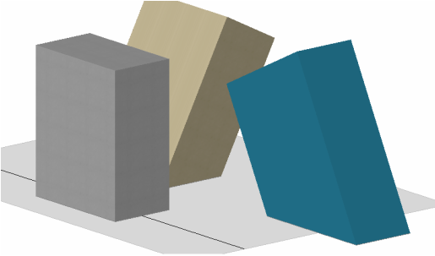
Prizmaning hajmi
Ixtiyoriy prizma-ning hajmi asosining yuzi bilan balandligi-ning ko‘paytmasiga teng:
$$V=S_{asos}∙h$$

Slide 9
1-masala
Rasmda tasvirlangan ko‘pyoqlarning hajmini toping.
$$a)$$
$$219 m$$
$$b)$$
$$c)$$
$$84 m$$
$$13,8 cm$$
$$5x mm$$
$$3x mm$$
$$31 m$$
$$8,6 cm$$
$$12,9 cm$$
$$75 m$$
$$a=75 m$$
$$a=13,8 cm$$
$$a=3x mm$$
$$b=219 m$$
$$b=8,6 cm$$
$$h_{pr}=5x mm$$
$$h_{tr}=219 m$$
$$h_{pr}=12,9 cm$$
$$V= ?$$
$$h_{pr}=31 m$$
$$V= ?$$
$$V= ?$$

Slide 10
Masalaning yechimi
$$V=S_{asos}∙h_{pr}$$
$$V=S_{asos}∙h_{pr}$$
$$V=S_{asos}∙h_{pr}$$
$V=\frac{75+219}{2}∙84∙31$
$V=\frac{13,8 ∙ 8,6}{2}∙12,9$
$$V={\left(3x\right)}^{2}∙5x$$
$$V=12348 m^{3}$$
$$V=765,486 {cm}^{3}$$
$$V=45x^{3} {mm}^{3}$$

Slide 11
2-masala
Uchburchakli to‘g‘ri prizma asosining tomonlari
29, 25 va 6 ga, qirrasi asosining katta balandligiga teng. Prizmaning hajmini toping.
Berilgan:
$$B_{1}$$
$$AB=6$$
$$BC=25$$
$$A_{1}$$
$$C_{1}$$
$$AC=29$$
$$AA_{1}=h_{AB}$$
$$B$$
Topish kerak:
$$V= ?$$
$$A$$
$$C$$

Slide 12
Masalaning yechimi
$$B_{1}$$
$∆ABC−$ ixtiyoriy uchburchak
$$p=\frac{AB+BC+AC}{2}=\frac{6+25+29}{2}=30$$
$$A_{1}$$
$$C_{1}$$
$$B$$
$$S_{asos}=\sqrt{p\left(p−AB\right)\left(p−BC\right)\left(p−AC\right)}$$
$$A$$
$$C$$
$$S_{asos}=\sqrt{30∙\left(30−6\right)\left(30−25\right)\left(30−29\right)}=$$
$$=\sqrt{30∙24∙5∙1}=60$$

Slide 13
$h_{AB}=\frac{2}{AB}\sqrt{p\left(p−AB\right)\left(p−BC\right)\left(p−AC\right)}$
$$B_{1}$$
$h_{AB}=\frac{2}{6}∙60=20$
$$A_{1}$$
$$C_{1}$$
$$AA_{1}=h_{AB}=20$$
$$B$$
$$V=S_{asos}∙AA_{1}$$
$$h_{AB}$$
$$A$$
$$C$$
$$V=60∙20=1200$$
Javob: $1200$

Slide 14
3-masala
To‘rtburchakli muntazam prizmaning diagonali
3,5 cm ga, yon yog‘ining diagonali 2,5 cm ga teng.
Prizmaning hajmini toping.
Berilgan:
$$d_{pr}=3,5 cm$$
$$d_{y}=2,5 cm$$
$$d_{pr}$$
$$d_{y}$$
Topish kerak:
$$V= ?$$
$$a$$

Slide 15
Masalaning yechimi
$$d_{pr}^{2}=d_{y}^{2}+a^{2}$$
$$a^{2}=d_{pr}^{2}−d_{y}^{2}={3,5}^{2}−{2,5}^{2}=6$$
$$d_{pr}$$
$$d_{y}$$
$$a^{2}=6$$
$$S_{asos}=a^{2}=6$$
$$a$$

Slide 16
$$d_{y}^{2}=h^{2}+a^{2}$$
$$a$$
$$h^{2}=d_{y}^{2}−a^{2}={2,5}^{2}−6=0,25$$
$$h=0,5$$
$$h$$
$$d_{y}$$
$$V=S_{asos}∙h=6∙0,5=3$$
Javob: $3 {cm}^{3}$
$$a$$

Slide 17
4-masala
Temiryo‘l ko‘tarmasining kesimi trapetsiya shaklida bo‘lib, uning pastki asosi 14 m, yuqori asosi 8 m va balandligi 3,2 m.
1 km ko‘tarmani qurish uchun qancha kub metr tuproq kerak bo‘ladi?

Slide 18
Masalaning yechimi
Berilgan:
$$a$$
$$h_{tr}$$
$$a=8 m$$
$$b=14 m$$
$$h_{pr}$$
$$b$$
$$h_{tr}=3,2 m$$
$$h_{pr}=1 km=1000 m$$
Topish kerak:
$$V= ?$$

Slide 19
Masalaning yechimi
$$8 m$$
$$S_{asos}=\frac{a+b}{2}∙h_{tr}$$
$$3,2 m$$
$$S_{asos}=\frac{8+14}{2}∙3,2=35,2$$
$$14 m$$
$$a$$
$$h_{tr}$$
$$V=S_{asos}∙h_{pr}$$
$$h_{pr}$$
$$V=35,2∙1000=35200$$
$$b$$
Javob: $35200 m^{3}$

Slide 20
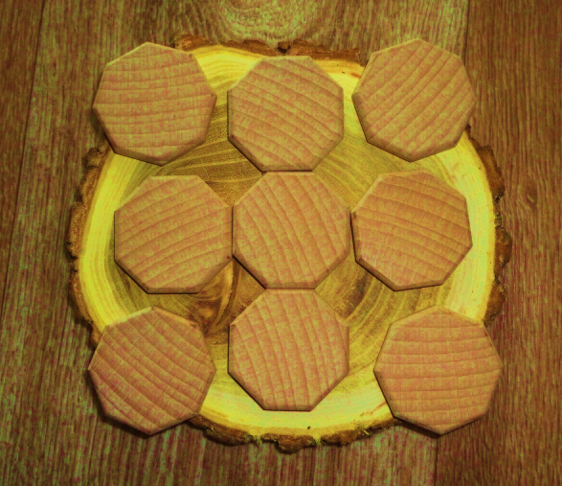
5-masala
Tomoni 3,2 cm va qalinligi 0,7 cm bo‘lgan muntazam sakkizburchak shaklidagi yog‘och plitkaning massasi 17,3 g. Yog‘ochning zichligini toping.

Slide 21
Masalaning yechimi
Berilgan:
3,2 cm
$$a=3,2 cm$$
0,7 cm
$$h_{pr}=0,7 cm$$
$$m_{\text{yog}\text{‘}\text{och} }=17,3 g$$
Topish kerak:
$$ρ_{\text{yog}\text{‘}\text{och} }= ?$$

Slide 22
Masalaning yechimi
3,2 cm
$${V=S}_{asos}∙h_{pr}=\frac{2a^{2}}{\sqrt{2}−1}∙h_{pr}$$
0,7 cm
$$V=\frac{2∙{3,2}^{2}}{\sqrt{2}−1}∙0,7=\frac{14,336}{\sqrt{2}−1}=\frac{14,336}{\sqrt{2}−1}∙\frac{\sqrt{2}+1}{\sqrt{2}+1}=$$
$$=14,336∙\left(\sqrt{2}+1\right)=34,6 {cm}^{3}$$

Slide 23
Masalaning yechimi
3,2 cm
$$ρ_{\text{yog}\text{‘}\text{och} }=\frac{m_{\text{yog}\text{‘}\text{och} }}{V}$$
0,7 cm
$$ρ_{\text{yog}\text{‘}\text{och} }=\frac{17,3}{34,6}=0,5 g/{cm}^{3}$$
Javob: $0,5 g/{cm}^{3}$

Slide 24
Mustaqil bajarish uchun topshiriqlar
243
257
262
167-sahifa
169-sahifa
169-sahifa

