Slide 1
Fizika
11-sinf
Mavzu: Masalalar yechish.
O‘qituvchi:
Toshkent shahar Uchtepa tumani 287-maktab fizika fani o‘qituvchisi
Xodjayeva Maxtuma Ziyatovna.

Slide 2
$U_{m}=\sqrt{U_{R}^{2}+{(U_{L}−U_{C})}^{2}}$
𝑈_𝑚=√(𝑈_𝑅^2+〖(𝑈_𝐿−𝑈_𝐶)〗^2 )
$X_{L}−X_{C}=ωL−\frac{1}{ωC}$
𝑋_𝐿−𝑋_𝐶=𝜔𝐿−1/𝜔𝐶
$Z=\sqrt{R^{2}+{(X_{L}−X_{C})}^{2}}$
𝑍=√(𝑅^2+〖(𝑋_𝐿−𝑋_𝐶)〗^2 )

Slide 3
${ I}_{m}=\frac{U_{m}}{Z}=\frac{U_{m}}{\sqrt{R^{2}+{(X_{L}−X_{C})}^{2}}}$
〖 𝐼〗_𝑚=𝑈_𝑚/𝑍=𝑈_𝑚/√(𝑅^2+〖(𝑋_𝐿−𝑋_𝐶)〗^2 )
$tgφ=\frac{U_{L}−U_{C}}{U_{m}}$
𝑡𝑔𝜑=(𝑈_𝐿−𝑈_𝐶)/𝑈_𝑚
$tgφ=\frac{X_{L}−X_{C}}{R}$
𝑡𝑔𝜑=(𝑋_𝐿−𝑋_𝐶)/𝑅

Slide 4

Masala
Zanjirdagi reaktiv qarshilik $3 Ω$, aktiv qarshilik 4 $Ω$, zanjirdagi o‘zgaruvchan kuchlanish amplitudasi $6\sqrt{2}$ V bo‘lsa, tok kuchining effektiv qiymatini toping.

Slide 5
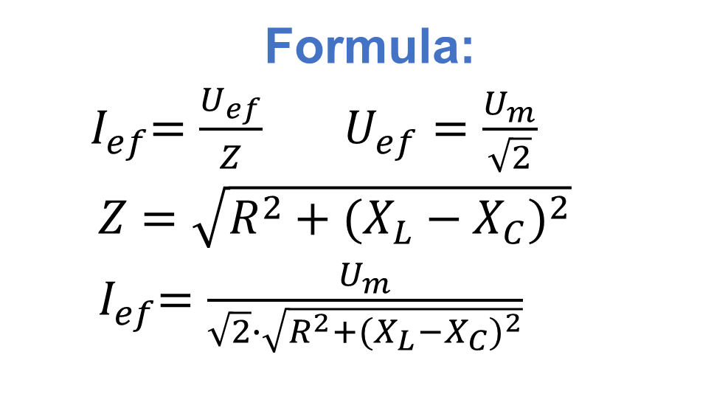
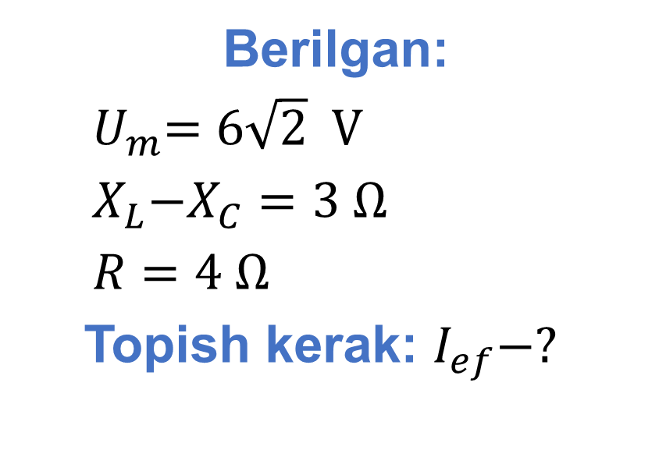
Berilgan:
${ U}_{m}=6\sqrt{2} V$
${ X}_{L}−X_{C}=3 Ω$
$R=4 Ω$
Topish kerak: $I_{ef}−?$
Formula:
${ I}_{ef}=\frac{U_{ef}}{Z}$ $U_{ef}=\frac{U_{m}}{\sqrt{2}}$
$Z=\sqrt{R^{2}+{(X_{L}−X_{C})}^{2}}$
${ I}_{ef}=\frac{U_{m}}{\sqrt{2}∙\sqrt{R^{2}+{(X_{L}−X_{C})}^{2}}}$
Yechish: $I_{ef}=\frac{6\sqrt{2} V}{\sqrt{2}∙\sqrt{{(4 Ω)}^{2}+{(3 Ω)}^{2}}}=1,2 A$
Javob: $I_{ef}=1,2 A$

Slide 6

Masala
Zanjirning aktiv qarshiligi 16 $Ω$, reaktiv qarshilgi esa 12 $Ω$ ga teng. Zanjirdagi tok kuchi va kuchlanish tebranishlari orasidagi fazalar farqini toping.

Slide 7
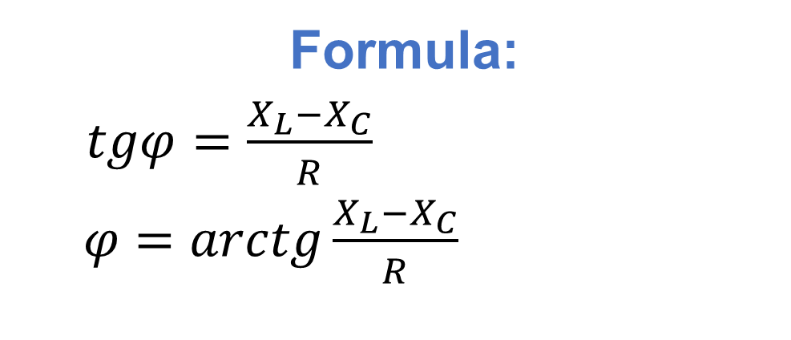
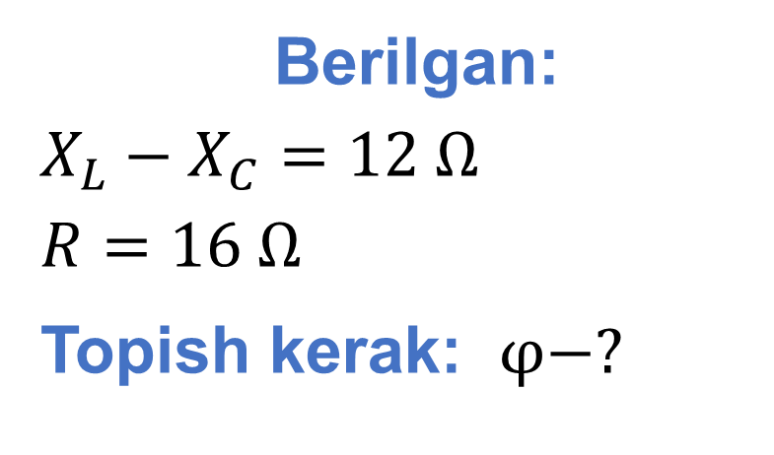
Berilgan:
$X_{L}−X_{C}=12 Ω$
$R=16 Ω$
Topish kerak: $φ−?$
Formula:
$tgφ=\frac{X_{L}−X_{C}}{R}$
$φ=arctg\frac{X_{L}−X_{C}}{R}$
Yechish: $φ=arctg\frac{12 Ω}{16 Ω}=arctg\frac{3}{4}=37°$
Javob: $φ=37°$

Slide 8
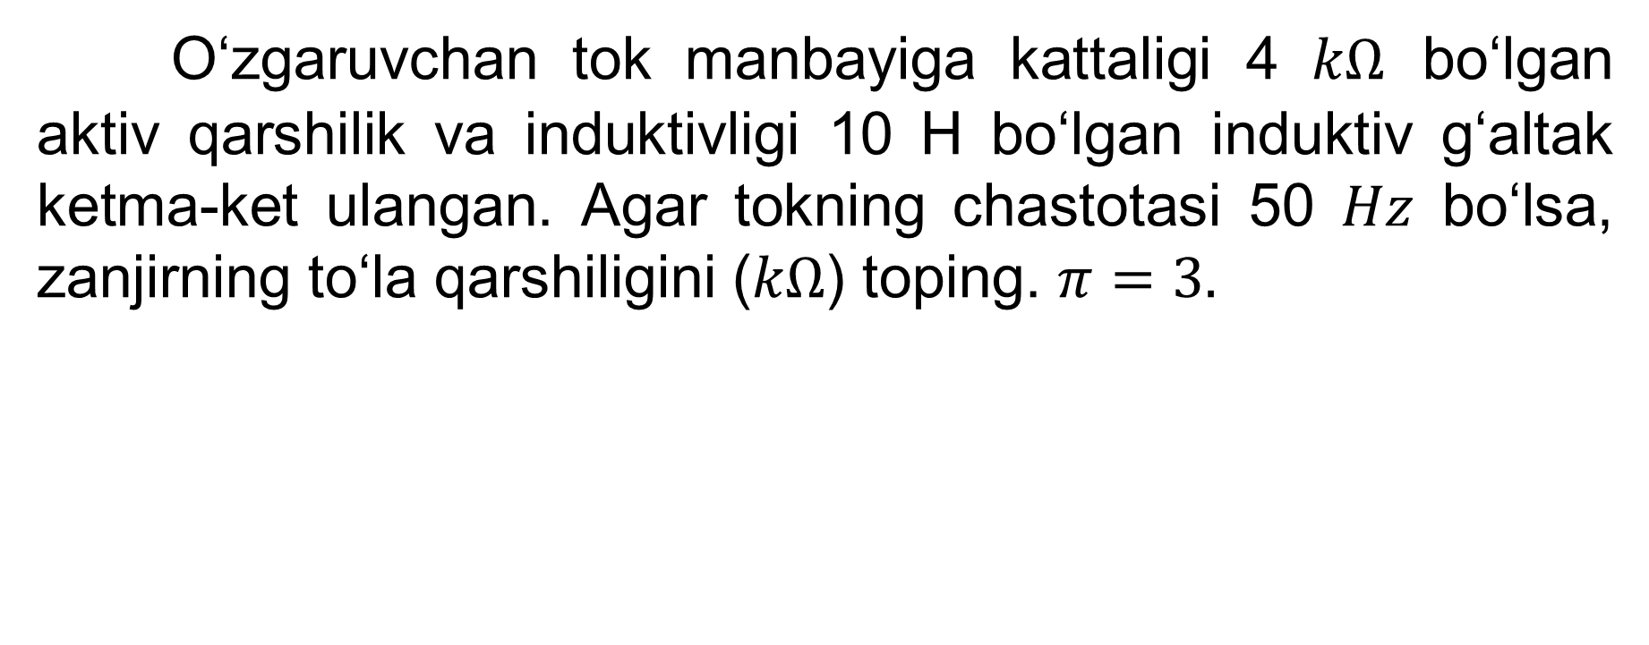
Masala
O‘zgaruvchan tok manbayiga kattaligi 4 $kΩ$ bo‘lgan aktiv qarshilik va induktivligi 10 H bo‘lgan induktiv g‘altak ketma-ket ulangan. Agar tokning chastotasi 50 $Hz$ bo‘lsa, zanjirning to‘la qarshiligini ($kΩ$) toping. $π=3.$

Slide 9
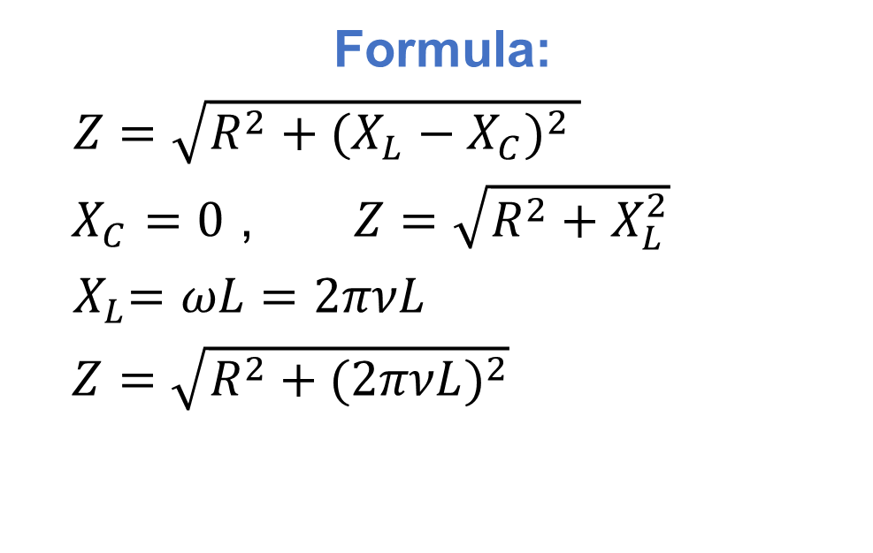
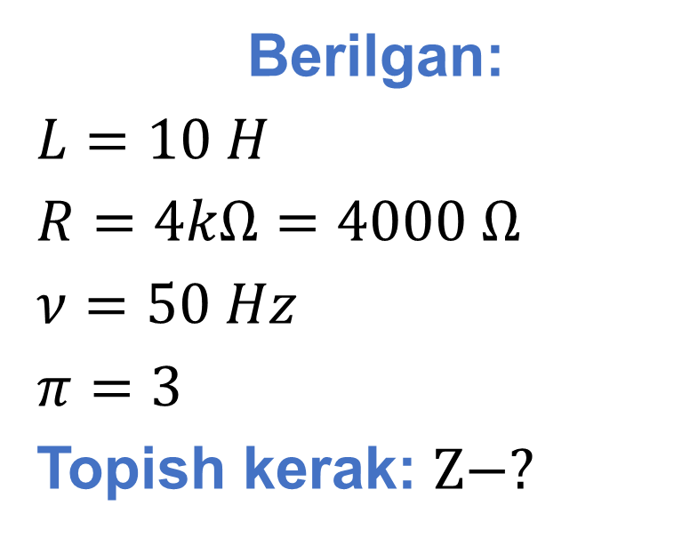
Berilgan:
$L=10 H$
$R=4kΩ=4000 Ω$
$ν=50 Hz$
$π=3$
Topish kerak: $Z−?$
Formula:
$Z=\sqrt{R^{2}+{(X_{L}−X_{C})}^{2} }$
$X_{C}=0$ , $Z=\sqrt{R^{2}+X_{L}^{2}}$
${ X}_{L}=ωL=2πνL$
$Z=\sqrt{R^{2}+{(2πνL)}^{2}}$
Yechish: $Z=\sqrt{{(4000 Ω)}^{2}+{(2∙3∙50 Hz∙10 H)}^{2}}=$
$=5000 Ω=5 kΩ$
Javob: $Z=5 kΩ$

Slide 10
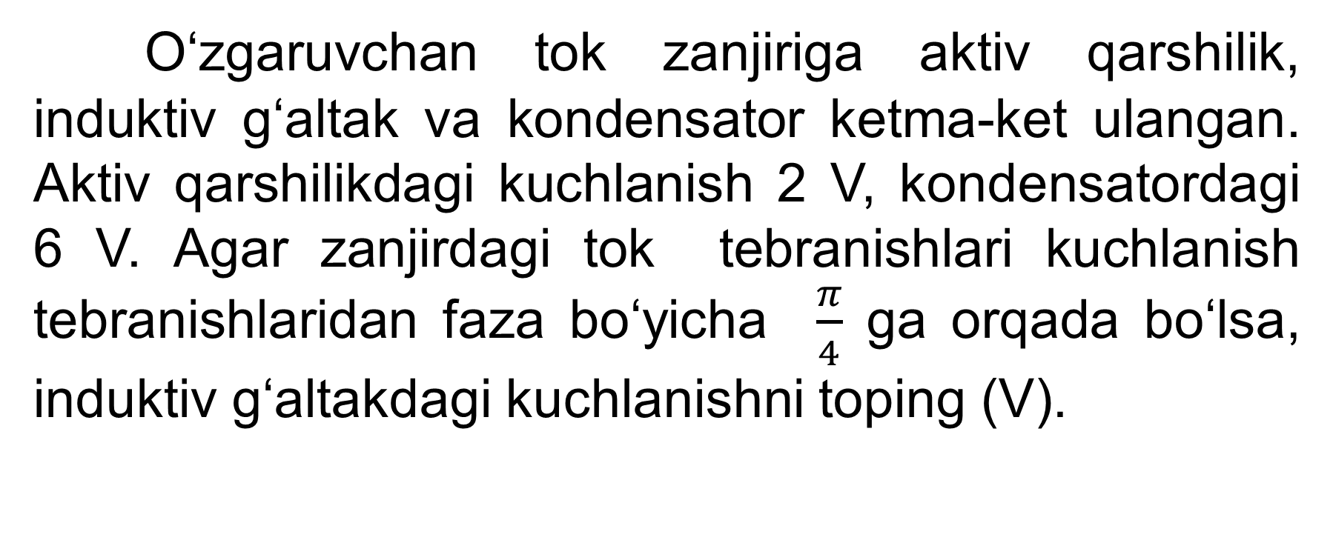
Masala
O‘zgaruvchan tok zanjiriga aktiv qarshilik, induktiv g‘altak va kondensator ketma-ket ulangan. Aktiv qarshilikdagi kuchlanish 2 V, kondensatordagi 6 V. Agar zanjirdagi tok tebranishlari kuchlanish tebranishlaridan faza bo‘yicha $\frac{π}{4}$ ga orqada bo‘lsa, induktiv g‘altakdagi kuchlanishni toping (V).

Slide 11
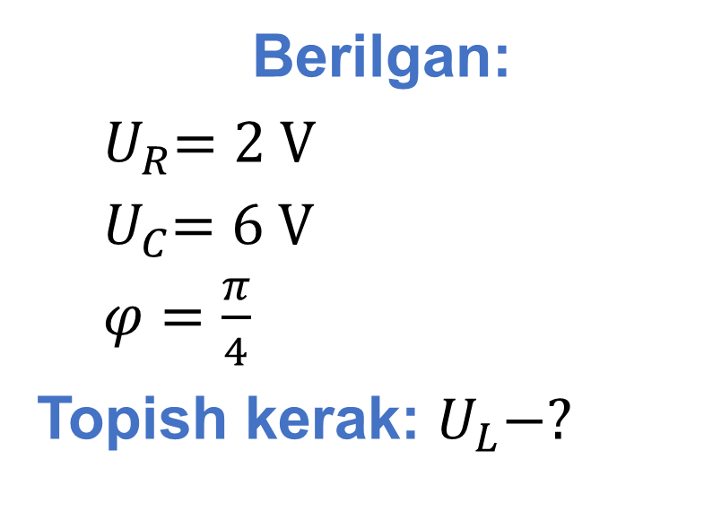
Berilgan:
${ U}_{R}=2 V$
${ U}_{C}=6 V$
$φ=\frac{π}{4}$
Topish kerak: $U_{L}−?$
Formula:
$tgφ=\frac{U_{L}−U_{C}}{U_{R}}$
$U_{R} tgφ=U_{L}−U_{C}$
$U_{L}=U_{R}tgφ+U_{C}$
Yechish: $tg\frac{π}{4}=1$ , $U_{L}=2 V∙1+6 V=8 V$
Javob: ${ U}_{L}=8 V$

Slide 12
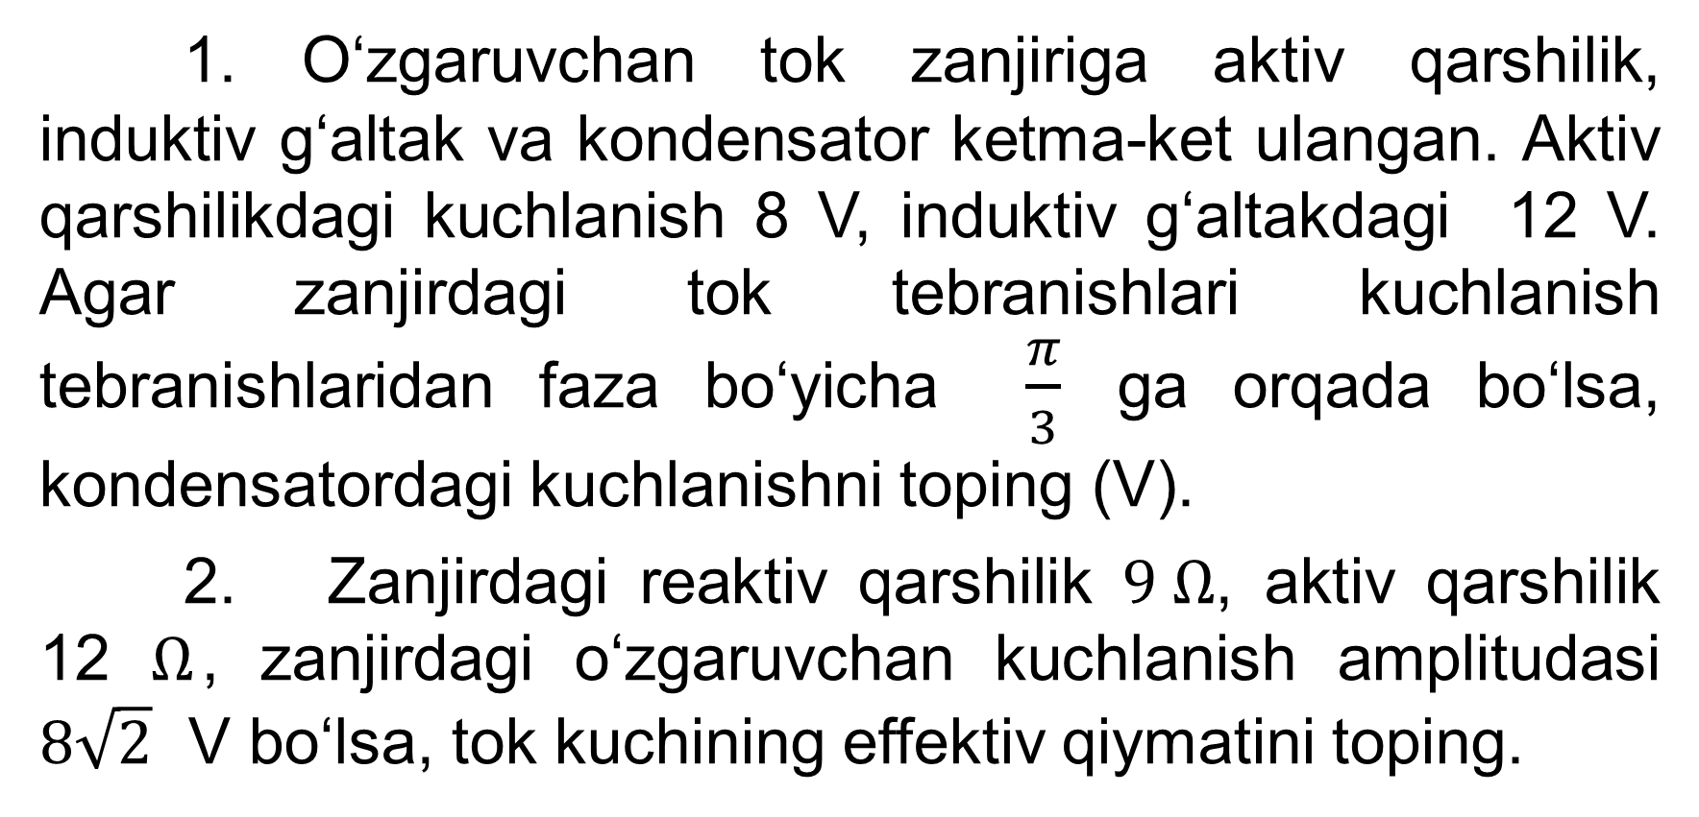
Mustaqil bajarish uchun topshiriqlar
1. O‘zgaruvchan tok zanjiriga aktiv qarshilik, induktiv g‘altak va kondensator ketma-ket ulangan. Aktiv qarshilikdagi kuchlanish 8 V, induktiv g‘altakdagi 12 V. Agar zanjirdagi tok tebranishlari kuchlanish tebranishlaridan faza bo‘yicha $\frac{π}{3}$ ga orqada bo‘lsa, kondensatordagi kuchlanishni toping (V).
2. Zanjirdagi reaktiv qarshilik $9 Ω$, aktiv qarshilik 12 $Ω$, zanjirdagi o‘zgaruvchan kuchlanish amplitudasi $8\sqrt{2}$ V bo‘lsa, tok kuchining effektiv qiymatini toping.

