Slide 1
Fizika
11-sinf
Mavzu:
Aktiv qarshilik, induktiv g‘altak va kondensator ketma-ket ulangan o‘zgaruvchan tok zanjiri uchun Om qonuni.
O‘qituvchi:
Toshkent shahar Uchtepa tumani 287-maktab fizika fani o‘qituvchisi
Xodjayeva Maxtuma Ziyatovna.

Slide 2
Aktiv qarshilik $U=U_{m}\cos{ωt}$ $R=\frac{U_{m}}{I_{m}}$
$i=I_{m}\cos{ωt}$
Sig‘im qarshilik $U=U_{m}\cos{ωt}$ ${ X}_{с}=\frac{1}{ωС}$
$i=I_{m}\cos{(ωt}+\frac{π}{2}$)
Induktiv qarshilik $U=U_{m}\cos{(ωt+\frac{π}{2}}$) ${ X}_{L}=\frac{U_{m}}{I_{m}}=ωL$
$i=I_{m}\cos{ωt}$

Slide 3
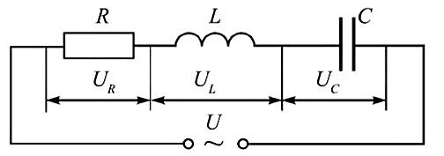
O‘zgaruvchan tok zanjirida qarshiligi $R$ bo‘lgan rezistor, induktivligi $L$ bo‘lgan induktiv g‘altak va sig‘imi $C$ bo‘lgan kondensator ketma-ket ulangan bo‘lsin.
$U=U_{m}\cos{ωt}$ $i=I_{m}\cos{ωt}$
$\vec{U}=\vec{U_{R}}+\vec{U_{C}}+\vec{U_{L}}$

Slide 4
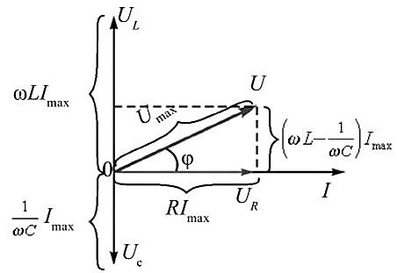
$U^{2}=U_{R}^{2}+U_{LC}^{2}$ $U_{LC}=U_{L}−U_{C}$
$U_{m}^{}=\sqrt{U_{R}^{2}+{(U_{L}−U_{C})}^{2}}$
$U_{R}=I_{max}$∙$R; U_{L}=I_{max}$∙$X_{L}$; $U_{C}=I_{max}$∙$X_{C}$
$U_{m}=\sqrt{I_{max}^{2}∙R^{2}+{(I_{max}X_{L}−I_{max}X_{C})}^{2}}=$
$=I_{max}\sqrt{R^{2}+{(X_{L}−X_{C})}^{2}}$
$I_{max}=\frac{U_{m}}{\sqrt{R^{2}+{(X_{L}−X_{C})}^{2}}}$ Om qonuni

Slide 5
$X_{L}=ωL$ va $X_{C}=\frac{1}{ωC}$
$I_{max}=\frac{U_{m}}{\sqrt{R^{2}+{(ωL−\frac{1}{ωC})}^{2}}}$
$X_{L}−X_{C}=ωL−\frac{1}{ωC}$ reaktiv qarshilik
$Z=\sqrt{R^{2}+{(X_{L}−X_{C})}^{2}}$ o‘zgaruvchan tok zanjirining to‘la qarshiligi.
tg$φ=\frac{U_{L}−U_{C}}{U_{m}}$ tg$φ=\frac{X_{L}−X_{C}}{R}$

Slide 7
Masala
O‘zgaruvchan tok zanjiriga sig‘im qarshiligi $10Ω$bo‘lgan kondensator va induktiv qarshiligi $20Ω$bo‘lgan g‘altak ketma-ket ulangan.
Agar tok kuchining samarador qiymati $2A$bo‘lsa, zanjir uchlaridagi kuchlanishning samarador qiymati qancha?

Slide 8
Berilgan: Formulasi:
$X_{C}=10 Ω$ $U_{ef}=\frac{U_{m}}{\sqrt{2}}$ va $I_{ef}=\frac{I_{m}}{\sqrt{2}}$
${ X}_{L}=20 Ω$ $I_{m}=\frac{U_{m}}{\sqrt{R^{2}+{(X_{L}−X_{C})}^{2}}}$
$I_{ef}=20 A$ $I_{m}=\frac{U_{m}}{\sqrt{{(X_{L}−X_{C})}^{2}}}=\frac{U_{m}}{X_{L}−X_{C}}$
Topish kerak: $U_{ef}−?$ ${ I}_{ef}=\frac{U_{ef}}{X_{L}−X_{C}}$
$U_{ef}=$ $I_{ef}$∙($X_{L}−X_{C}$)
Yechish: $U_{ef}=2 A∙\left(20Ω−10Ω\right)=20 V$
Javob: $U_{ef}=20 V$

Slide 9
Mustaqil bajarish uchun topshiriqlar
1. Mavzuni o‘qish va savollarga javob yozish. (62-bet)
2. 3-mashq 12, 13-masalalarni yechish. (71-bet)

