Slide 1
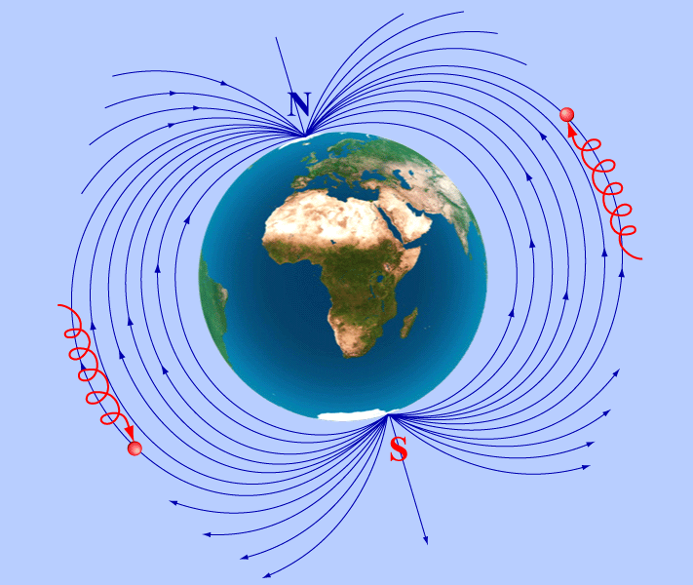
Fizika
11
sinf
Mavzu: Masalalar yechish
O‘qituvchi:
Toshkent shahar Uchtepa tumani 287-maktab fizika fani o‘qituvchisi
Xodjayeva Maxtuma Ziyatovna.

Slide 2
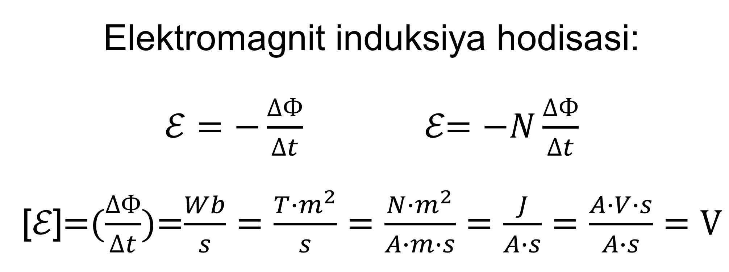
Elektromagnit induksiya hodisasi: $ℰ=−\frac{∆Ф}{∆t}$ ℰ$=−N\frac{∆Ф}{∆t}$ [ℰ]=($\frac{∆Ф}{∆t}$)=$\frac{Wb}{s}=\frac{T∙m^{2}}{s}=\frac{N∙m^{2}}{A∙m∙s}=\frac{J}{A∙s}=\frac{A∙V∙s}{A∙s}=V$

Slide 3
Test 38-bet
1-test
Elektromagnit induksiya hodisasini kim kashf qilgan?
Amper B) Ersted
C) Faradey D) Lens
To‘g‘ri javob: C) Maykl Faradey

Slide 4
Test 38-bet
2-test
Induksiya EYuKning birligini ko‘rsating.
А) T/s;
B) Wb/s;
C) H;
D) A/s;
To‘g‘ri javob: B) Wb/s

Slide 5
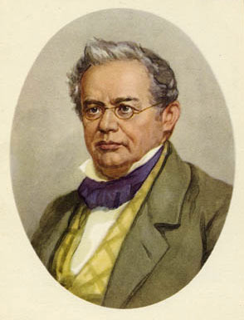
Test 38-bet
3-test
Induksion tokning yo‘nalishi kim tomonidan aniqlangan?
Amper B) Ersted
C) Faradey D) Lens
To‘g‘ri javob: D) Lens

Slide 6
1-masala 38-bet
5-test
Kоnturdаn о‘tаyotgаn mаgnit оqimi 0,3 s dаvоmidа 15 Wb dаn 12 Wb gаchа tеkis kаmаygаn bo‘lsа, kоnturdа hоsil bo‘lgаn induksiya ЕYuK ni toping (V).
A) 10; B) 9; C) 4,5; D) 5.

Slide 7
Berilgan: Formula: Yechish:
$∆t=0,3 s$ ℰ$=−\frac{∆Ф}{∆t}$ ℰ$=\frac{12 Wb−15 Wb}{0,3 s}=−10 V$
$Ф_{1}=15 Wb$ $∆Ф=Ф_{1}−Ф_{2}$
$Ф_{2}=12 Wb$ ℰ$=−\frac{Ф_{1}−Ф_{2}}{∆t}$
T.k. : ℰ-? ℰ$=\frac{Ф_{2}−Ф_{1}}{∆t}$
Javob: A) 10 V

Slide 8
2-masala 38-bet
7-test
Mаgnit оqimining o‘zgаrish tеzligi 120 mWb/s bo‘lgаndа, g‘аltаkdа 30 V ЕYuK hоsil bo‘lsа, g‘аltаkdаgi o‘rаmlаr sоni qanchaga teng?
A) 200; B) 250; C) 400; D) 500.

Slide 9


Berilgan: Formula:
$$\frac{∆Ф}{∆t}=120\frac{mWb}{s}=0,12\frac{Wb}{s}$$
ℰ$=30 V$
Topish kerak: $N−?$
$$\text{ℰ}=−N\frac{∆Ф}{∆t}$$
$$N=\frac{\text{ℰ}∙∆t}{∆Ф}=\frac{\text{ℰ}}{∆Ф/∆t}$$
Yechish: $N=\frac{30 V}{0,12 Wb/s}=250$
Javob: B) N=250 ta

Slide 10
3-masala
Solenoidda magnit oqimi 2 ms da 3mWb dan 9 mWb gacha o‘zgardi. Agar solenoidda hosil bo‘lgan EYuK 60V bo‘lsa, solenoiddagi o‘ramlar soni qancha?

Slide 11
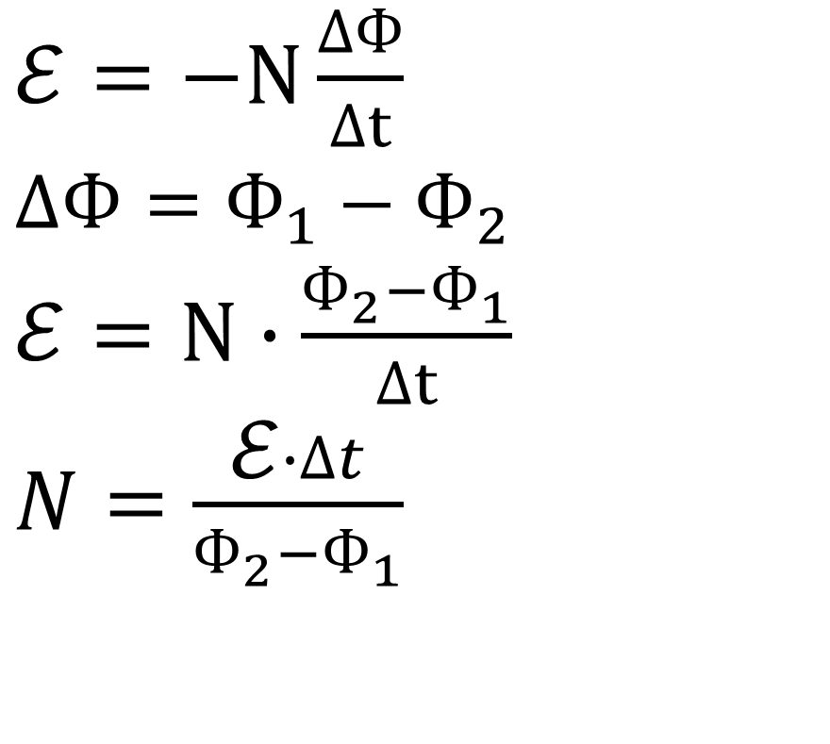
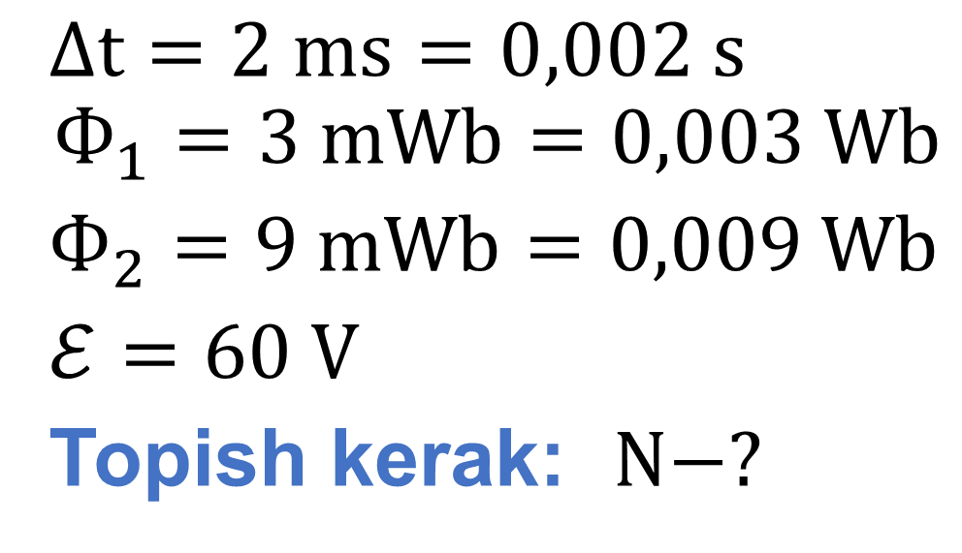
Berilgan: Formula:
$∆t=2 ms=0,002 s$
$$Ф_{1}=3 mWb=0,003 Wb$$
$Ф_{2}=9 mWb=0,009 Wb$
$\text{ℰ}=60 V$
Topish kerak: $N−?$
$\text{ℰ}=−N\frac{∆Ф}{∆t}$
$∆Ф=Ф_{1}−Ф_{2}$
$\text{ℰ}=N∙\frac{Ф_{2}−Ф_{1}}{∆t}$
$N=\frac{\text{ℰ}∙∆t}{Ф_{2}−Ф_{1}}$
Yechish: $N=\frac{60 V∙0,002 s}{0,009 Wb−0,003 Wb}=20$
Javob: N=20 ta

Slide 12
4-masala
Qarshiligi 0,01 $Ω$ bo‘lgan kontur orqali o‘tuvchi magnit oqim 2 s da 0,012 Wb ga tekis o‘zgarganda konturda hosil bo‘ladigan tok kuchini toping.

Slide 13

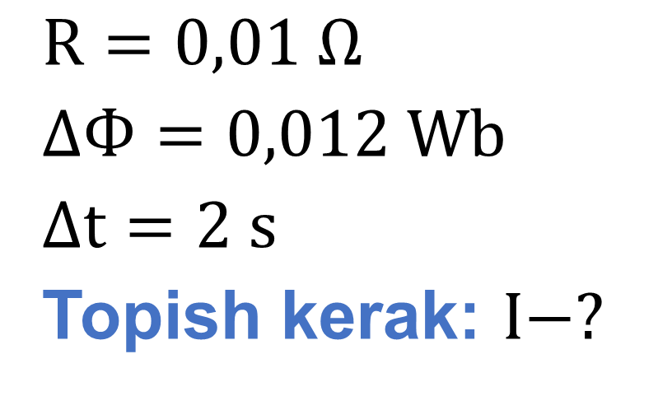
Berilgan: Formula:
$R=0,01 Ω$
$∆Ф=0,012 Wb$
$∆t=2 s$
Topish kerak: $I−?$
$\text{ℰ}=\frac{∆Ф}{∆t}$ $\text{ℰ}=I∙R$
$\frac{∆Ф}{∆t}=I∙R$ $I=\frac{∆Ф}{∆t∙R}$
Yechish: $I=\frac{0,012 Wb}{2 s∙0,01 Ω}=0,6 A [\frac{Wb}{s∙Ω}=\frac{V}{Ω}=A]$
Javob: I=0,6 A

Slide 14
5-masala
Induksiyasi 0,2 T bo‘lgan bir jinsli magnit maydonda 20 cm uzunlikdagi о‘tkazgichni induksiya chiziqlariga tik yo‘nalishda necha m/s tezlik bilan harakatlantirganda, unda 0,2 V induksiya EYuK hosil bo‘ladi?

Slide 15
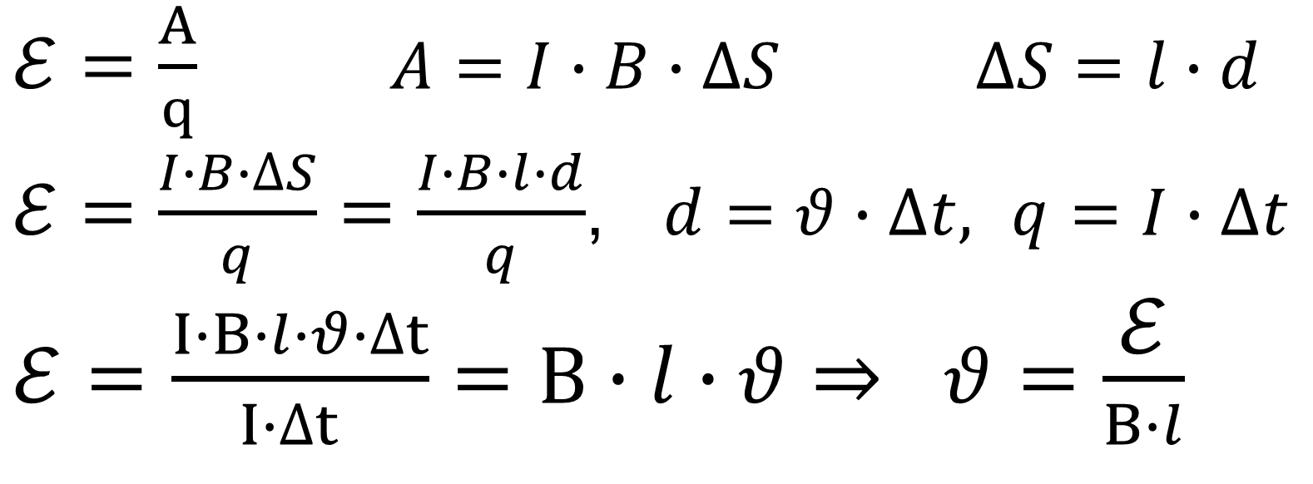
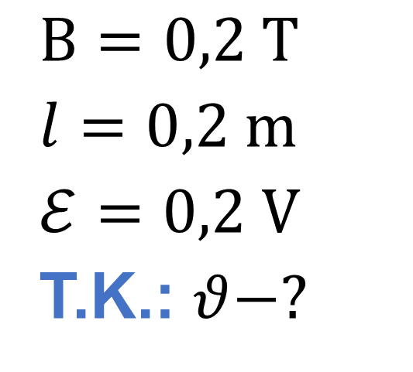
Berilgan: Formula:
$B=0,2 T$
$l=0,2 m$
$\text{ℰ}=0,2 V$
T.K.: $θ−?$
$\text{ℰ}=\frac{A}{q}$ $A=I∙B∙∆S$ $∆S=l∙d$
$\text{ℰ}=\frac{I∙B∙∆S}{q}=\frac{I∙B∙l∙d}{q}$, $d=θ∙∆t,$ $q=I∙∆t$
$\text{ℰ}=\frac{I∙B∙l∙θ∙∆t}{I∙∆t }=B∙l∙θ⇒ θ=\frac{\text{ℰ}}{B∙l}$
Yechish: $θ=\frac{0,2 V}{0,2 T∙0,2 m}=5 m/s$
Javob: $θ=5 m/s$ [ $\frac{V}{T∙m}=\frac{Wb/s}{Wb/m^{2}∙m}=m/s$ ]

Slide 16
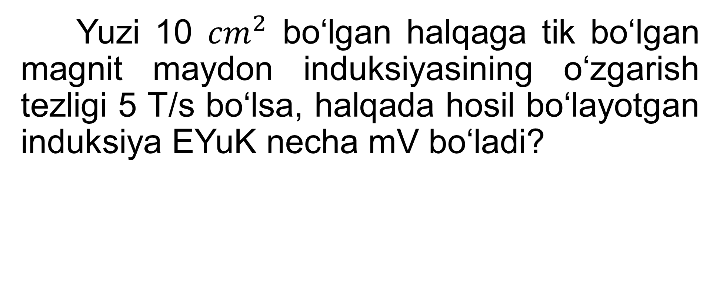
6-masala
Yuzi 10 ${cm}^{2}$ bo‘lgan halqaga tik bo‘lgan magnit maydon induksiyasining o‘zgarish tezligi 5 T/s bo‘lsa, halqada hosil bo‘layotgan induksiya EYuK necha mV bo‘ladi?

Slide 17
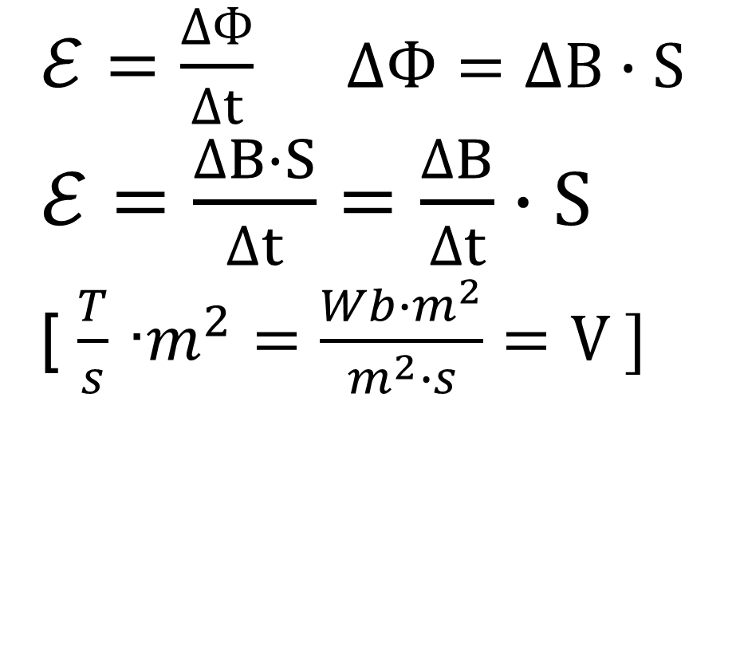
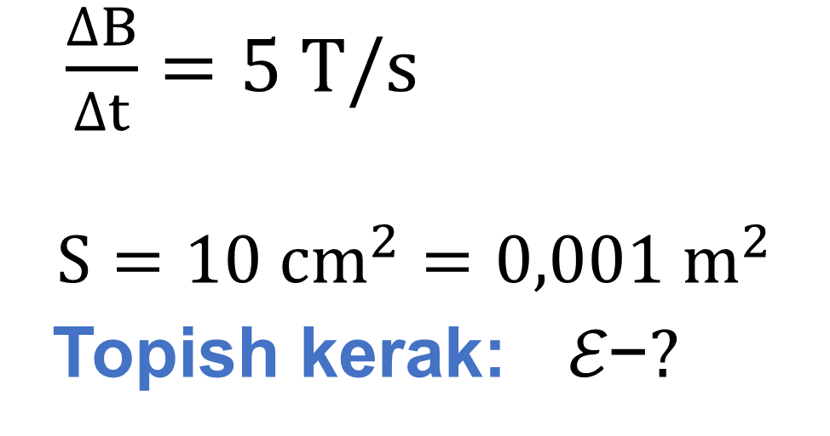
Berilgan: Formula:
$\frac{∆B}{∆t}=5 T/s$
$$S=10 {cm}^{2}=0,001 m^{2}$$
Topish kerak: $\text{ℰ}\text{−}?$
$\text{ℰ}=\frac{∆Ф}{∆t}$ $∆Ф=∆B∙S$
$\text{ℰ}=\frac{∆B∙S}{∆t}=\frac{∆B}{∆t}∙S$
[ $\frac{T}{s}$ ∙$m^{2}=\frac{Wb∙m^{2}}{m^{2}∙s}=V ]$
Yechish: $\text{ℰ} =5\frac{T}{s}∙0,001 m^{2}=0,005 V=5 mV$
Javob: $\text{ℰ}=5 mV$

Slide 18
Mustaqil ishlash uchun topshiriqlar
1. Konturni kesib o‘tuvchi magnit oqim 2 s da 10 Wb dan 2 Wb gacha tekis kamaydi. Konturda hosil bo‘lgan induksiya EYuK ni toping (V).
2. 200 o‘ramga ega bo‘lgan g‘altak ichida magnit oqim 0,2 s da 0,2 Wb dan 1,1 Wb gacha ortdi. G‘altakda induksiyalanadigan EYuK ni toping (V).
3. Induksiyasi 0,5 T bo‘lgan magnit maydonda induksiya chiziqlariga tik yo‘nalishda 6 m/s tezlik bilan harakatlanayotgan o‘tkazgichda 12 V EYuK hosil bo‘lishi uchun uning uzunligi qanday bo‘lishi kerak(m)?

