Slide 1
Algebra
11-sinf
Mavzu: Aniq integral tatbiqlari

Slide 2
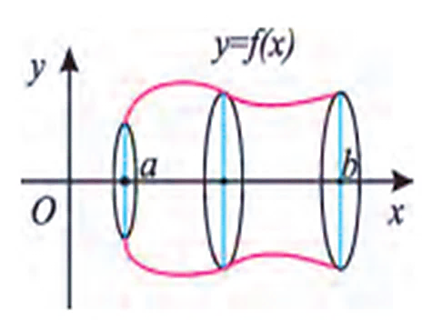
Aylanish jismlarining hajmini hisoblash
Egri chiziqli trapetsiyani $Ox$ o‘qi atrofida aylantirish natijasida hosil bo‘ladigan jismning hajmi quyidagi formula bilan hisoblanadi:
$$V=π\int_{a}^{b}{f^{2}\left(x\right)dx}$$

Slide 3
Konusning hajmini hisoblash
$AB=R$, $OB=H$ bo‘lsin. $OA$ to‘g‘ri chiziq tenglamasi $y=\frac{R}{H}x$ bo‘lsin.
$$y$$
$$A$$
$$O$$
$$B$$
$$x$$

Slide 4
Konusning hajmini hisoblash
$$y$$
$$A$$
$$O$$
$$B$$
$$x$$

Slide 5
Konusning hajmini hisoblash
$$V=π\int_{0}^{H}{{\left(\frac{R}{H}x\right)}^{2}}dx={\left.π∙\frac{R^{2}}{3H^{2}}∙x^{3} \right|}_{0}^{H}=$$
$$=π∙\frac{R^{2}}{3H^{2}}∙\left(H^{3}−0\right)=\frac{1}{3}πR^{2}H$$
$$V_{konus}=\frac{1}{3}πR^{2}H$$

Slide 6
Kesik konusning hajmini hisoblash
$$B$$
$AB$ kesmani $Ox$ o‘qi atrofida aylantirishdan kesik konus hosil bo‘ladi.
$AO=r, BD=R, OD=H$ deylik.
$AB$ to‘g‘ri chiziq tenglamasi
$y=\frac{R−r}{H}x+r$ bo‘ladi.
$$y$$
$$A$$
$$C$$
$$O$$
$$D$$
$$x$$

Slide 7
Kesik konusning hajmini hisoblash
$$y$$
$$B$$
$$A$$
$$C$$
$$x$$
$$O$$
$$D$$

Slide 8
Kesik konusning hajmini hisoblash
$$a=0, b=H, f\left(x\right)=\frac{R−r}{H}x+r$$
$$V=π\int_{0}^{H}{{\left(\frac{R−r}{H}x+r \right)}^{2}}dx=$$
$$={\left.\frac{π}{3}∙\frac{H}{R−r}∙{\left(\frac{R−r}{H}x+r\right)}^{3}\right|}_{0}^{H}=$$

Slide 9
Kesik konusning hajmini hisoblash
$$=\frac{π}{3}∙\frac{H}{R−r}∙\left(R^{3}−r^{3}\right)=$$
$$=\frac{π}{3}∙\frac{H}{R−r}∙\left(R−r\right)\left(R^{2}+Rr+r^{2}\right)=$$
$$=\frac{π}{3}∙H∙ \left(R^{2}+Rr+r^{2}\right)$$
$$V_{\begin{aligned}kesik \\ konus\end{aligned}}=\frac{π}{3}∙H∙ \left(R^{2}+Rr+r^{2}\right)$$

Slide 10
Silindrning hajmini hisoblash
$Ox$o‘qqa parallel $AB$ kesmani $Ox$o‘qi atrofida aylantirishdan hosil bo‘la-digan shakl silindr bo‘ladi.
$AB=OC=H, OA=BC=R$ bo‘lsin. $AB$ to‘g‘ri chiziq tenglamasi $y=R, x∈\left[0;H\right]$.
$$y$$
$$A$$
$$B$$
$$O$$
$$C$$
$$x$$

Slide 11
Silindrning hajmini hisoblash
$$y$$
$$A$$
$$B$$
$$x$$
$$O$$
$$C$$

Slide 12
Silindrning hajmini hisoblash
$$V=π\int_{0}^{H}{R^{2}}dx={\left.π∙R^{2}∙x \right|}_{0}^{H}=$$
$$=π∙R^{2}∙\left(H−0\right)=πR^{2}∙H$$
$$V_{silindr}=πR^{2}H$$

Slide 13
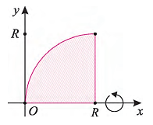
Sharning hajmini hisoblash
Radiusi $R$, markazi$\left(R;0\right)$ nuqtada bo‘lgan doiraning chorak qismini $Ox$o‘qi atrofida aylantirishdan hosil qilinadigan shakl sharning yarmidir. Aylana tenglamasi
${\left(x−R\right)}^{2}+y^{2}=R^{2}$ bo‘ladi.

Slide 14
Sharning hajmini hisoblash
$$y=\sqrt{2Rx−x^{2}}$$
$${\left(x−R\right)}^{2}+y^{2}=R^{2}$$
$$x∈\left[0;R\right]$$
$$\frac{1}{2}V=π\int_{0}^{H}{{\left(\sqrt{2Rx−x^{2}}\right)}^{2}}dx=π\int_{0}^{H}{\left(2Rx−x^{2}\right)}dx=$$
$$=π{\left.\left(Rx^{2}−\frac{x^{3}}{3}\right)\right|}_{0}^{R}=π\left(R∙R^{2}−\frac{R^{3}}{3}\right)=$$

Slide 15
Sharning hajmini hisoblash
$$=π{\left.\left(Rx^{2}−\frac{x^{3}}{3}\right)\right|}_{0}^{R}=π\left(R∙R^{2}−\frac{R^{3}}{3}\right)=\frac{2}{3}{πR}^{3}$$
$$\frac{1}{2}V=\frac{2}{3}{πR}^{3}$$
$$V=\frac{4}{3}{πR}^{3}$$

Slide 16
1-masala
$y=sinx$, $x∈\left[0;π\right]$, funksiya grafigining $Ox$o‘qi atrofida aylanishidan hosil bo‘lgan jism hajmini hisoblang.

Slide 17
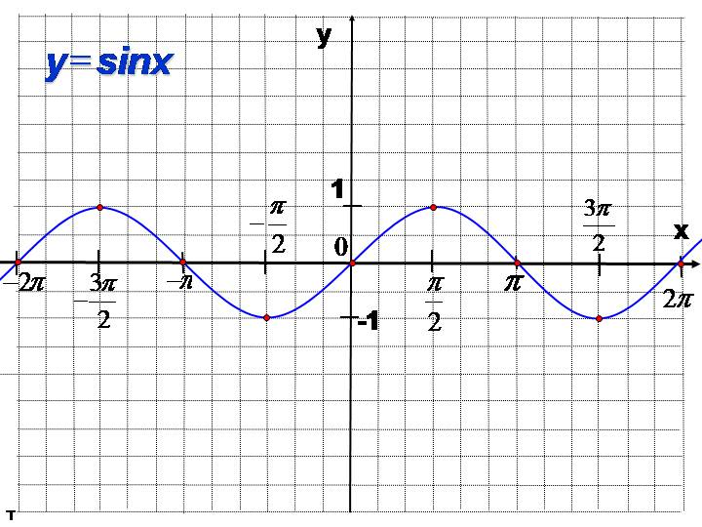
Masalaning yechimi

Slide 18
$$V=π\int_{0}^{π}{\sin^{2}xdx}=π\int_{0}^{π}{\frac{1−cos2x}{2}dx}=$$
$$= \frac{1}{2}π\int_{0}^{π}{\left(1−cos2x\right)dx}=\frac{1}{2}π{\left.\left(x−\frac{1}{2}sin2x\right)\right|}_{0}^{π}=$$

Slide 19
$$=\frac{π}{2}\left(π−\frac{1}{2}sin2π\right)−\frac{π}{2}\left(0−\frac{1}{2}sin\left(2∙0\right)\right)=$$
$$=\frac{π}{2}\left(π−\frac{1}{2}∙0\right)−\frac{π}{2}\left(−\frac{1}{2}∙0\right)=\frac{π^{2}}{2}$$
Javob: $\frac{π^{2}}{2}$ kub birlik

Slide 20
2-masala
$y=\sqrt{x}$, $y=0$, $x=1$, $x=4$ chiziqlar bilan chegaralangan shaklning $Ox$ o‘qi atrofida aylanishidan hosil bo‘ladigan jism hajmini toping.

Slide 21
Masalaning yechimi
$$y=\sqrt{x}$$
$$y=0$$
$$x=1$$
$$x=4$$

Slide 22
$$V=π\int_{1}^{4}{{\left(\sqrt{x}\right)}^{2}}dx=π\int_{1}^{4}{x}dx={\left.\left(π∙\frac{x^{2}}{2}\right)\right|}_{1}^{4}=$$
$$=π∙\left(\frac{4^{2}}{2}−\frac{1^{2}}{2}\right)=π∙\frac{16−1}{2}=π∙\frac{15}{2}=7,5π$$
Javob: $7,5π$ kub birlik

Slide 23
Mustaqil bajarish uchun topshiriq
9-sahifa
63-masala

