Slide 1
Algebra
11-sinf
Mavzu: Aniq integral tatbiqlari

Slide 2
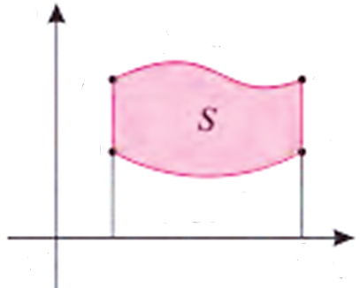
$ABCD$ shakl yuzi $S$ ni hisoblang.
Bu shaklning $S$ yuzi $aBCb$ va $aADb$ egri chiziqli trapetsiyalar yuzlarining ayirmasiga teng.
$$y$$
$$y=f_{2}\left(x\right)$$
$$B$$
$$C$$
$$A$$
$$D$$
$$y=f_{1}\left(x\right)$$
$$O$$
$$a$$
$$b$$
$$x$$

Slide 3
$ABCD$ shakl yuzi $S$ ni hisoblang.
$$S=\int_{a}^{b}{f_{2}\left(x\right)dx}−\int_{a}^{b}{f_{1}\left(x\right)dx}=\int_{a}^{b}{\left(f_{2}\left(x\right)−f_{1}\left(x\right)\right)}dx$$
Ushbu formula $f_{2}\left(x\right)≥f_{1}\left(x\right)$ shartni
qanoatlantiradigan uzluksiz funksiyalar
uchun o‘rinlidir.

Slide 4
1-masala
$y=−x^{2}+4x$ parabola $\left(4;0\right)$ va $\left(0;4\right)$ nuqtalar orqali o‘tuvchi to‘g‘ri chiziq bilan chegaralangan shakl yuzini toping.

Slide 5
Masalaning yechimi
$$x_{1}$$
$$y_{1}$$
$$x_{2}$$
$$y_{2}$$
$\frac{x−x_{1}}{x_{2}−x_{1}}=\frac{y−y_{1}}{y_{2}−y_{1}}$
$\left(4;0\right)$ $\left(0;4\right)$
$\frac{x−4}{0−4}=\frac{y−0}{4−0}$
$\frac{x−4}{−4}=\frac{y}{4}$
$y=4−x$

Slide 6
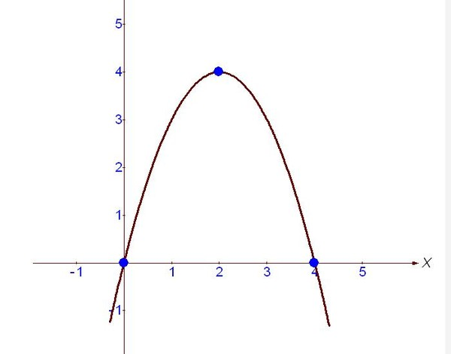
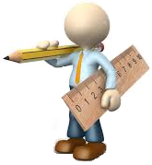
$y=−x^{2}+4x$
$$y$$
$y=−x^{2}+4x$
$y=4−x$
$y=4−x$
$−x^{2}+4x=4−x$
$x^{2}−4x+4−x=0$
$$x$$
$x^{2}−5x+4=0$
$x_{1}=1$
$x_{2}=4$

Slide 7
$$S=\int_{1}^{4}{\left[\left(−x^{2}+4x\right)−\left(4−x\right)\right]dx=}$$
$$=\int_{1}^{4}{\left[−x^{2}+4x−4+x\right]dx=}\int_{1}^{4}{\left(−x^{2}+5x−4\right)dx=}$$
$$={\left.\left(−\frac{x^{3}}{3}+\frac{5x^{2}}{2}−4x\right)\right|}_{1}^{4}=$$

Slide 8
$=\left(−\frac{4^{3}}{3}+\frac{5∙4^{2}}{2}−4∙4\right)−\left(−\frac{1^{3}}{3}+\frac{5∙1^{2}}{2}−4∙1\right)=$
$=\left(−\frac{64}{3}+\frac{80}{2}−16\right)−\left(−\frac{1}{3}+\frac{5}{2}−4\right)=$
$=−\frac{63}{3}+\frac{75}{2}−12=−21+\frac{75}{2}−12=$
$=−33+\frac{75}{2}=\frac{9}{2}=4,5$
Javob: $4,5$ (kv.birlik)

Slide 9
2-masala
$f\left(x\right)=2x−2$ funksiya grafigi va uning $F\left(0\right)=1$ shartni qanoatlantiruvchi boshlang‘ich funksiyasi bilan chegaralangan shaklning yuzini toping.

Slide 10
Masalaning yechimi
$f\left(x\right)=2x−2$
$F\left(0\right)=1$
$$F\left(x\right)=\int{\left(2x−2\right)dx}=x^{2}−2x+C$$
$$1= 0^{2}−2∙0+C$$
$$C=1$$
$$F\left(x\right)= x^{2}−2x+1$$

Slide 11
$f\left(x\right)=2x−2$
$$y$$
$${y=x}^{2}−2x+1$$
$$9$$
$$F\left(x\right)= x^{2}−2x+1$$
$$8$$
$$7$$
$y=2x−2$
$$6$$
$$2x−2=x^{2}−2x+1$$
$$5$$
$$4$$
$$3$$
$$x^{2}−4x+3=0$$
$$2$$
$$1$$
$$x$$
$$−3$$
$$−2$$
$$−1$$
$$1$$
$$2$$
$$3$$
$$4$$
$x_{1}=1$
$x_{2}=3$
$$−1$$
$$−2$$
$$−3$$

Slide 12
$$S=\int_{1}^{3}{\left[2x−2−\left(x^{2}−2x+1\right)\right]dx=}$$
$$=\int_{1}^{3}{\left(−x^{2}+4x−3\right)dx=}{\left.\left(−\frac{x^{3}}{3}+2x^{2}−3x\right)\right|}_{1}^{3}=$$

Slide 13
$$=−\frac{3^{3}}{3}+2∙3^{2}−3∙3−\left(−\frac{1^{3}}{3}+2∙1^{2}−3∙1\right)=$$
$$=−9+18−9−\left(−\frac{1}{3}+2−3\right)=\frac{1}{3}+1=\frac{4}{3}$$
Javob: $\frac{4}{3}$ (kv.birlik)

Slide 14
3-masala
Quyidagi chiziqlar bilan chegaralangan shakl yuzini toping:
$$y=x^{2}$$
$y=1−x^{2}$

Slide 15
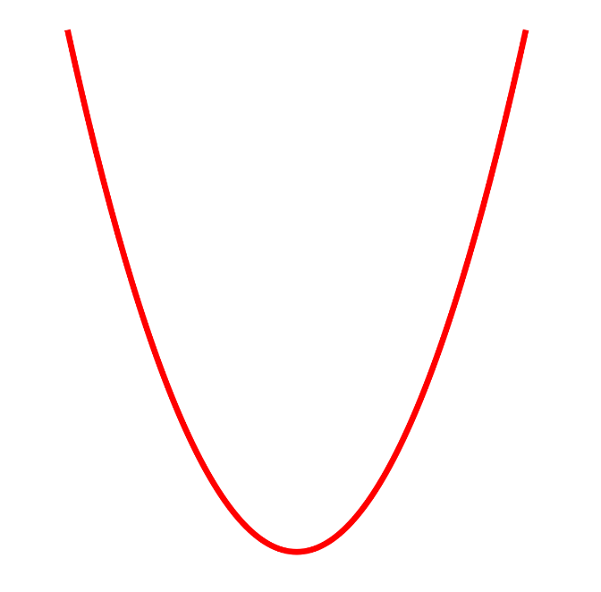
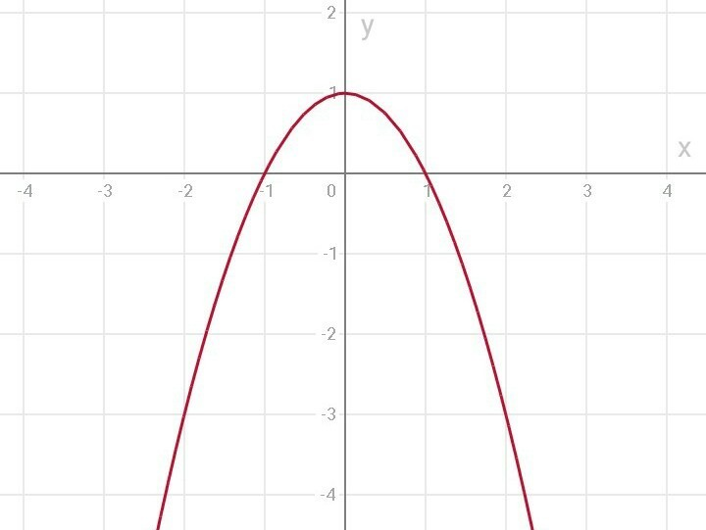
Masalaning yechimi
$$y$$
$$y=x^{2}$$
$$y=x^{2}$$
$y=1−x^{2}$
$$5$$
$$4$$
$$x^{2}=1−x^{2}$$
$$3$$
$$2$$
$x^{2}=\frac{1}{2}$
$$1$$
$${2x}^{2}=1$$
$$x$$
$$−4$$
$$−3$$
$$−2$$
$$−1$$
$$0$$
$$1$$
$$2$$
$$3$$
$$4$$
$$−1$$
$x_{1}=\frac{1}{\sqrt{2}}$
$x_{2}=−\frac{1}{\sqrt{2}}$
$$−2$$
$$−3$$
$$−4$$
$y=1−x^{2}$

Slide 16
$$S=\int_{−\frac{1}{\sqrt{2}}}^{\frac{1}{\sqrt{2}}}{\left({\left(1−x^{2}\right)−x}^{2}\right)dx=}{\left.\left(x−\frac{2x^{3}}{3}\right)\right|}_{−\frac{1}{\sqrt{2}}}^{\frac{1}{\sqrt{2}}}=$$
$$=\frac{1}{\sqrt{2}}−\frac{2∙{\left(\frac{1}{\sqrt{2}}\right)}^{3}}{3}−\left(−\frac{1}{\sqrt{2}}\right)+\frac{2∙{\left(−\frac{1}{\sqrt{2}}\right)}^{3}}{3}=$$

Slide 17
$$=\frac{2}{\sqrt{2}}−\frac{2 }{3\sqrt{8}}−\frac{2 }{3\sqrt{8}}=\frac{2}{\sqrt{2}}−\frac{4 }{3\sqrt{8}}=\frac{2}{\sqrt{2}}−\frac{4 }{3∙2\sqrt{2}}=$$
$$=\frac{2}{\sqrt{2}}−\frac{2}{3\sqrt{2}}=\frac{6−2}{3\sqrt{2}}=\frac{4}{3\sqrt{2}}=\frac{4\sqrt{2}}{3∙2}=\frac{2\sqrt{2}}{3}$$
Javob: $\frac{2\sqrt{2}}{3}$ (kv.birlik)

Slide 18
4-masala
Quyidagi chiziqlar bilan chegaralangan shakl yuzini toping:
$$y=\frac{1}{x}$$
$$y=0$$
$$x=1$$
$$x=4$$

Slide 19
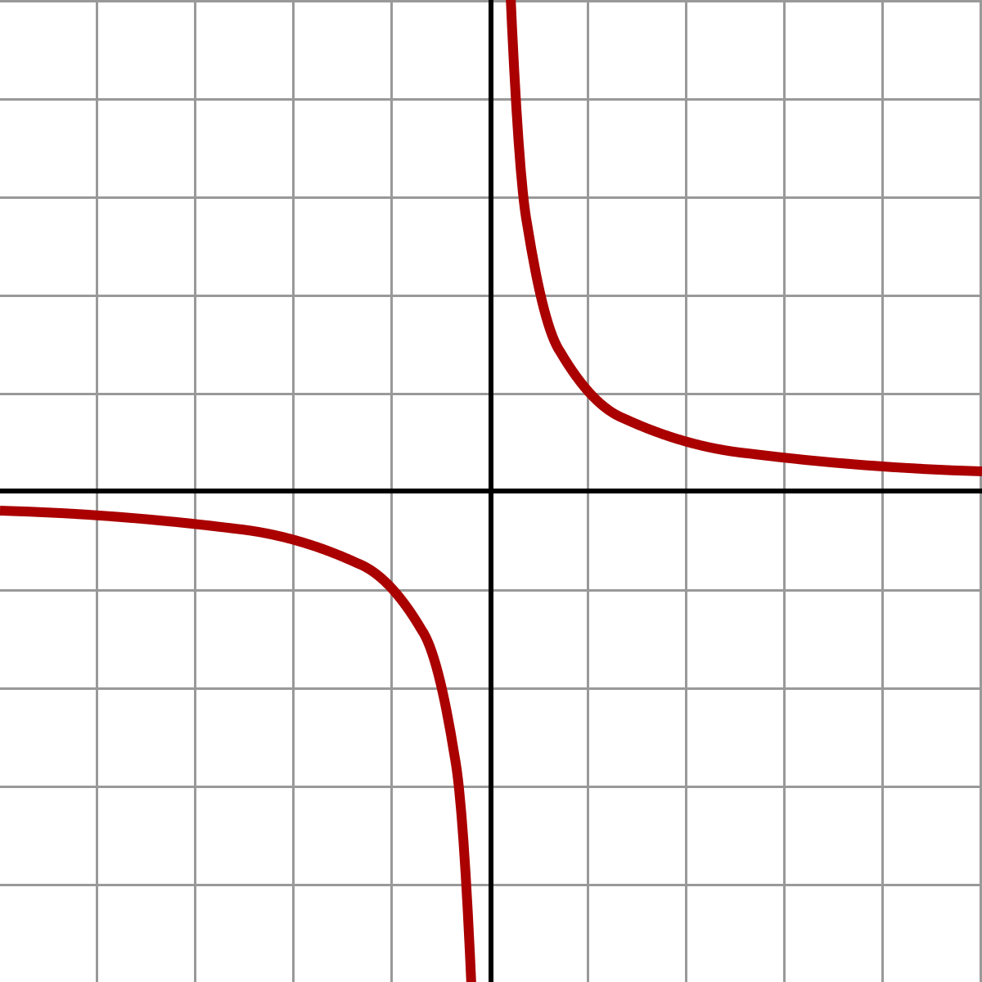
Masalaning yechimi
$$y=\frac{1}{x}$$
$$y$$
$$4$$
$$3$$
$$2$$
$$y=0$$
$$1$$
$$x$$
$$−4$$
$$−3$$
$$−2$$
$$−1$$
$$0$$
$$1$$
$$2$$
$$3$$
$$4$$
$$−1$$
$$x=1$$
$$x=4$$
$$−2$$
$$−3$$
$$−4$$

Slide 20
$$S=\int_{1}^{4}{\left(\frac{1}{x}\right)dx={\left.ln\left|x\right|\right|}_{1}^{4}=ln4−ln1=ln4 }$$
Javob: $ln4$ (kv.birlik)

Slide 21
5-masala
Quyidagi chiziqlar bilan chegaralangan shakl yuzini toping:
$$y=\frac{1}{x}$$
$$y=x^{2}$$
$$y=0$$
$$x=e$$

Slide 22
Masalaning yechimi
$$y=\frac{1}{x}$$
$$y$$
$$y=x^{2}$$
$$y=0$$
$$4$$
$$3$$
$$2$$
$$x=e$$
$$1$$
$$x$$
$$x^{2}=\frac{1}{x}$$
$$−4$$
$$−3$$
$$−2$$
$$−1$$
$$0$$
$$1$$
$$2$$
$$3$$
$$4$$
$$−1$$
$$−2$$
$$−3$$
$$−4$$
$x^{3}=1$
$x=1$

Slide 23
$$S=\int_{0}^{1}{x^{2}dx}+\int_{1}^{e}{\frac{1}{x}dx}={\left.\left( \frac{ x^{3}}{3}\right)\right|}_{0}^{1}+{\left.ln\left|x\right|\right|}_{1}^{e}=$$
$$=\frac{ 1^{3}}{3}−\frac{0^{3}}{3}+ln\left|e\right|−ln\left|1\right|=\frac{1}{3}+1=1\frac{1}{3}$$
Javob: $1\frac{1}{3}$ (kv.birlik)

Slide 24
Mustaqil bajarish uchun topshiriq
9-sahifa
62-masala

