Slide 1
Algebra
11-sinf
Mavzu: Aniq integral tatbiqlariga doir
misollar yechish

Slide 2
1-masala
$y=\frac{1}{4}x^{3}$ va $y=\sqrt{2x}$ chiziqlar
bilan chegaralangan shaklning
yuzini toping.

Slide 3
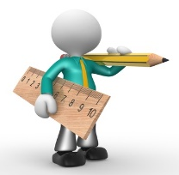
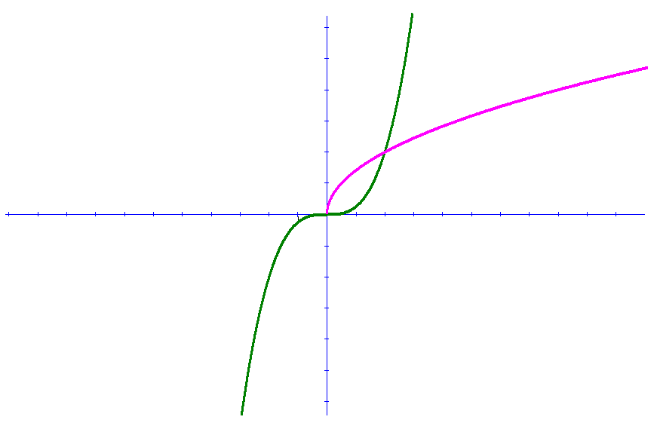
$$y$$
$y=\frac{1}{4}x^{3}$
$$6$$
$$5$$
$$4$$
$$3$$
$$y=\sqrt{2x}$$
$$2$$
$$1$$
$$x$$
-$10$
-$9$
-$8$
-$7$
-$6$
-$5$
-$4$
-$3$
-$2$
-$1$
$$1$$
$$2$$
$$3$$
$$4$$
$$5$$
$$6$$
$$7$$
$$8$$
$$9$$
$$10$$
-$1$
-$2$
-$3$
-$4$
-$5$
-$6$

Slide 4
$\frac{1}{4}x^{3}=\sqrt{2x}$
$$x_{1}=0$$
$$x_{2}=2$$
$$S=\int_{0}^{2}{\left(\sqrt{2x}−\frac{1}{4}x^{3}\right)dx}={\left.\left(\frac{2\sqrt{2}\sqrt{x^{3}}}{3}−\frac{1}{16}x^{4}\right)\right|}_{0}^{2}=$$
$$=\frac{2\sqrt{2}∙\sqrt{2^{3}}}{3}−\frac{1}{16}∙2^{4}=\frac{5}{3}=1\frac{2}{3}$$
(kv.birlik)

Slide 5
2-masala
$y=x^{2}−2$ va $y=2x+1$ chiziqlar bilan chegaralangan shaklning yuzini toping.

Slide 6
$$y=x^{2}−2$$
$$x$$
$$y=2x+1$$

Slide 7
$$x^{2}−2=2x+1$$
$$x^{2}−2x−3=0$$
$$x_{1}=−1$$
$$x_{2}=3$$
$$S=\int_{−1}^{3}{\left(2x+1− \left(x^{2}−2\right)\right)dx}=$$
$$=\int_{−1}^{3}{\left(−x^{2}+2x+3\right)dx}={\left.\left(−\frac{x^{3}}{3}+x^{2}+3x\right)\right|}_{−1}^{3}=$$

Slide 8
$$=−\frac{3^{3}}{3}+3^{2}+3∙3−\left(\frac{{\left(−1\right)}^{3}}{3}+{\left(−1\right)}^{2}+3∙\left(−1\right)\right)=$$
$$=−9+9+9−\frac{1}{3}−1+3=11−\frac{1}{3}=10\frac{2}{3}$$
(kv.birlik)

Slide 9
3-masala
$x+y=4$ va $xy=3$ chiziqlar bilan chegaralangan shaklning yuzini toping.

Slide 10
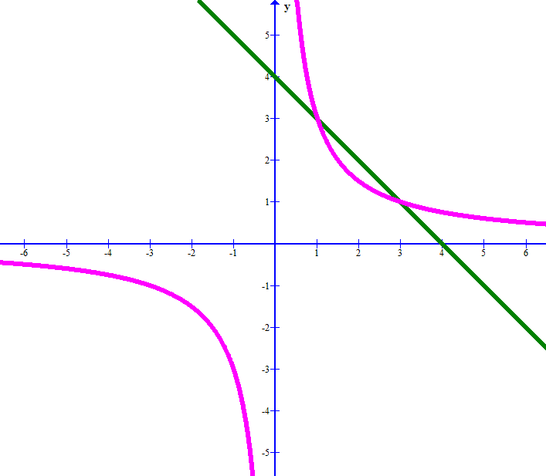
$$y= \frac{3}{x}$$
$$x$$
$$y=4−x$$

Slide 11
$4−x= \frac{3}{x}$
$$x^{2}−2x−3=0$$
$$x_{1}=1$$
$$x_{2}=3$$
$$S=\int_{ 1}^{3}{\left(4−x−\frac{3}{x}\right)dx}={\left.\left(4x−\frac{x^{2}}{2}−3lnx\right)\right|}_{1}^{3}=$$
$$=4∙3−\frac{3^{2}}{2}−3ln3−4∙1+\frac{1^{2}}{2}−3ln1=$$
$=12−4−\frac{9}{2}+\frac{1}{2}−3ln3=4−3ln3$ (kv.birlik)

Slide 12
4-masala
$y=2\sqrt{x}$, $y=1$, $x=0$ chiziqlar bilan chegaralangan shaklning $Ox$ o‘qi atrofida aylanishidan hosil bo‘lgan jismning hajmini toping.

Slide 13
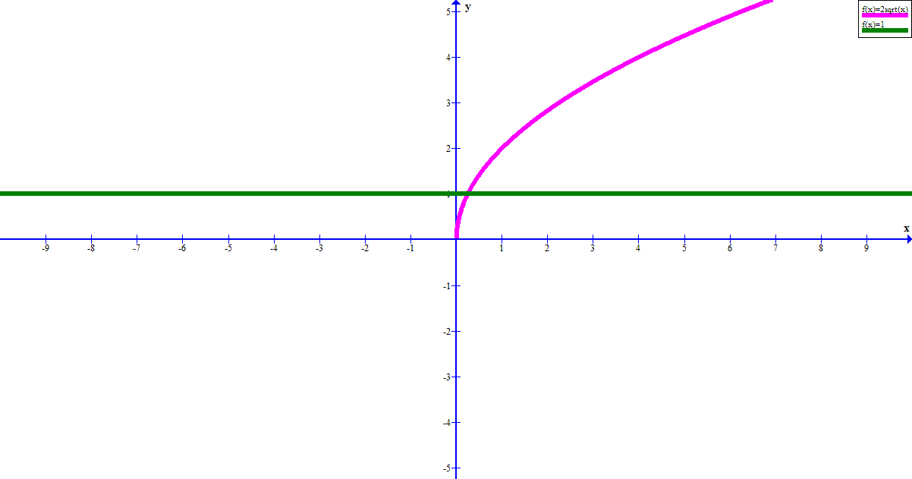
$$y=2\sqrt{x}$$
$$y=1$$
$$1$$
$$x$$
$$0$$

Slide 14
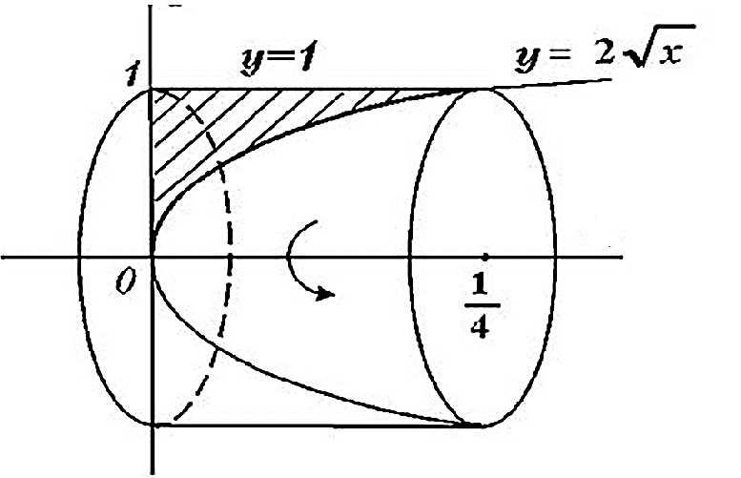
$$y$$
$$x$$

Slide 15
$$y_{1}\left(x\right)=2\sqrt{x}$$
$$y_{2}\left(x\right)=1$$
$$x=\frac{1}{4}$$
$$2\sqrt{x}=1$$
$$x=0$$
$$V=π\int_{a}^{b}{\left({y_{2}}^{2}\left(x\right)−{y_{1}}^{2}\left(x\right)\right)dx}=$$
$$=π\int_{0}^{\frac{1}{4}}{\left(1^{2}−{\left(2\sqrt{x}\right)}^{2}\right)dx=}$$

Slide 16
$$=π\int_{0}^{\frac{1}{4}}{\left(1−4x\right)dx=}π{\left.\left(x−2x^{2}\right)\right|}_{0}^{\frac{1}{4}}=$$
$$=π\left(\frac{1}{4}−2∙{\left(\frac{1}{4}\right)}^{2}\right)=π\left(\frac{1}{4}−2∙\frac{1}{16}\right)=$$
$$=π∙\left(\frac{1}{4}−\frac{1}{8}\right)=\frac{π}{8}$$
(kub.birlik)

Slide 17
5-masala
$y=x^{2}+1$, $y=0$, $x=0$, $x=1$ chiziqlar bilan chegaralangan shaklning $Ox$ o‘qi atrofida aylanishidan hosil bo‘lgan jismning hajmini toping.

Slide 18
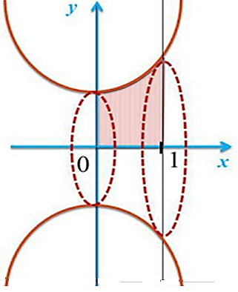
$$y=x^{2}+1$$
$$y=0$$

Slide 19
$$V=π\int_{0}^{1}{{\left(x^{2}+1\right)}^{2}dx=}$$
$$=π\int_{0}^{1}{\left(x^{4}+2x^{2}+1\right)dx=π{\left.\left(\frac{x^{5}}{5}+\frac{2x^{3}}{3}+x\right)\right|}_{0}^{1}=}$$
$$=\left(\frac{1^{5}}{5}+\frac{2∙1^{3}}{3}+1\right)π=1\frac{13}{15}π$$
(kub.birlik)

Slide 20
6-masala
$y^{2}=4x$, $x=4$ chiziqlar bilan chegaralangan shaklning $Oy$ o‘qi atrofida aylanishidan hosil bo‘lgan jismning hajmini toping.

Slide 21
$$y$$
$$y^{2}=4x$$
$$x$$

Slide 22
$$y^{2}=4x$$
$$x=4$$
$$y^{2}=4∙4$$
$$y^{2}=16$$
$$y_{1}=4$$
$$y_{2}=−4$$
$$x=\frac{y^{2}}{4}$$

Slide 23
$$V=π\int_{−4}^{4}{16dy}−π\int_{−4}^{4}{{\left(\frac{y^{2}}{4}\right)}^{2}dy}=$$
$$={\left.16πy\right|}_{−4}^{4}−π\int_{−4}^{4}{\frac{y^{2}}{16}dy}=$$

Slide 24
$$=16π∙4−16π∙\left(−4\right)−{\left.π∙\frac{y^{5}}{5∙16}\right|}_{−4}^{4}=$$
$$=128π−π∙\frac{4^{5}}{80}+π∙\frac{{\left(−4\right)}^{5}}{80}=$$
$$=128π−π∙\frac{4^{5}}{80}−π∙\frac{4^{5}}{80}=128π−2π∙\frac{4^{5}}{80}=$$

Slide 25
$$=128π−2∙\frac{4^{5}}{5∙4^{2}}π=128π−2∙\frac{4^{3}}{5}π=$$
$$=128π−\frac{128}{5}π=\frac{512π}{5}$$
(kub.birlik)

Slide 26
Mustaqil bajarish uchun topshiriq
8-sahifa
54-misol

