Slide 1
Algebra
11-sinf
Mavzu: Aniq integral tatbiqlari

Slide 2
Yuqoridan uzluksiz $y=f(x)$ funksiya grafigi, pastdan $Ox$ o‘qi, chap va o‘ngdan, mos ravishda, $x=a$ va $x=b$ vertikal chiziqlar bilan chegaralangan egri chiziqli trapetsiyaning $Oy$ o‘qi atrofida aylanishidan hosil bo‘ladigan jismning hajmi quyidagi formula bilan hisoblanadi:
$$V=2π\int_{a}^{b}{x∙f(x)dx}$$

Slide 3
Konusning hajmini hisoblash
$OA=H$, $OB=R$ deylik. $AB$ to‘g‘ri chiziq tenglamasini $y=−\frac{H}{R}x+H$ ga teng deb olsak, $AB$ kesmaning $Oy$ o‘qi atrofida aylanishidan hosil bo‘ladigan konus hajmini hisoblaymiz.
$$y$$
$$A$$
$$x$$
$$O$$
$$B$$

Slide 4
Konusning hajmini hisoblash
$$V=2π\int_{0}^{R}{x}∙\left(−\frac{H}{R}x+H\right)dx=$$
$$=2π\int_{0}^{R}{\left(−\frac{H}{R}x^{2}+Hx\right)dx}=$$

Slide 5
Konusning hajmini hisoblash
$$={\left.2π\left(−\frac{H}{R}∙\frac{x^{3}}{3}+H∙\frac{x^{2}}{2}\right)\right|}_{0}^{R}=2π\left(−\frac{H}{R}∙\frac{R^{3}}{3}+H∙\frac{R^{2}}{2}\right)=$$
$$=2πH\left(−\frac{R^{2}}{3}+\frac{R^{2}}{2}\right)=2πH∙\frac{R^{2}}{6}=\frac{1}{3}πR^{2}H$$
$$V_{konus}=\frac{1}{3}πR^{2}H$$

Slide 6
Sharning hajmini hisoblash
$OA=OB=R$ - radiusi,
$O$ - aylana markazi deylik.
Bu aylana tenglamasi
$x^{2}+y^{2}=R^{2}$ ga teng. $y=\sqrt{R^{2}−x^{2}}$, $0≤x≤R$.
Bunga mos doiraning chorak qismini $Oy$ o‘qi atrofida aylantirishdan sharning yarmi hosil bo‘ladi.
$$y$$
$$A$$
$$x$$
$$O$$
$$B$$

Slide 7
Sharning hajmini hisoblash
Avval shu yarimshar hajmini topamiz.
$$y$$
$$A$$
$$V=2π\int_{0}^{R}{x}∙\sqrt{R^{2}−x^{2}}dx$$
$$x$$
$$O$$
$$B$$
$$xdx=−\frac{du }{2}$$
$$R^{2}−x^{2}=u$$

Slide 8
Sharning hajmini hisoblash
$$\int{x\sqrt{R^{2}−x^{2}}dx=−\frac{1}{2}\int{\sqrt{u}du}=−\frac{1}{2}∙\frac{2}{3}u^{\frac{3}{2}}+C=}$$
$$=−\frac{1}{3}u^{\frac{3}{2}}+C=−\frac{1}{3}{\left(R^{2}−x^{2}\right)}^{\frac{3}{2}}+C$$
Bu yerda $C=0$ deb olish mumkin.

Slide 9
Sharning hajmini hisoblash
$$V_{yarimshar}={\left.−\frac{2π}{3}{\left(R^{2}−x^{2}\right)}^{\frac{3}{2}}\right|}_{0}^{R}=$$
$$=−\frac{2π}{3}{\left(R^{2}−R^{2}\right)}^{\frac{3}{2}}+\frac{2π}{3}{\left(R^{2}−0^{2}\right)}^{\frac{3}{2}}=\frac{2}{3}πR^{3}$$
$$V_{shar}=\frac{4}{3}πR^{3}$$
$$V_{shar}=2V_{yarimshar}$$

Slide 10
1-masala
Yuqoridan $y=e^{x}$ chiziq bilan, pastdan $Ox$ o‘qi bilan, chapdan $x=0$, o‘ngdan $x=1$ chiziq bilan chegaralangan sohaning $Oy$ o‘qi atrofida aylanishidan hosil bo‘lgan jism hajmini toping.

Slide 11
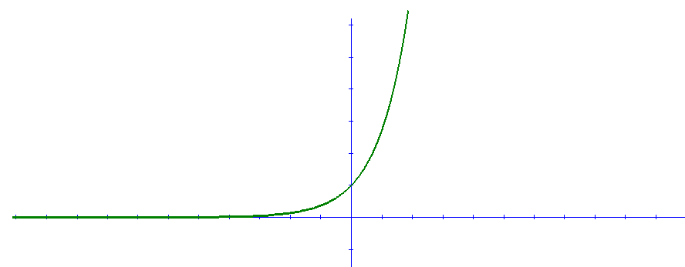
$$y$$
$$6$$
$$y=e^{x}$$
$$5$$
$$4$$
$$3$$
$$2$$
$$1$$
$$x$$
-$10$
-$9$
-$8$
-$7$
-$6$
-$5$
-$4$
-$3$
-$2$
-$1$
$$0$$
$$1$$
$$2$$
$$3$$
$$4$$
$$5$$
$$6$$
$$7$$
$$8$$
$$9$$
$$10$$
-$1$
$$x=0$$
$x=1$

Slide 12
$a=0$, $b=1$, $f\left(x\right)=e^{x}$
$$V=2π\int_{a}^{b}{x}f\left(x\right)dx=2π\int_{0}^{1}{xe^{x}dx=}$$
$$\int_{a}^{b}{f(x)}∙g^{′}\left(x\right)dx={\left.f\left(x\right)∙g\left(x\right)\right|}_{a}^{b}−\int_{a}^{b}{g\left(x\right)∙f^{′}\left(x\right)dx}$$
$$f\left(x\right)=x$$
$$f′\left(x\right)=1$$
$$g′\left(x\right)=e^{x}$$
$$g\left(x\right)=e^{x}$$

Slide 13
$$=2π\left({\left.x∙e^{x}\right|}_{0}^{1}−\int_{0}^{1}{e^{x}dx}\right)=$$
$$=2π\left(1∙e−0∙e^{0}−{\left.e^{x}\right|}_{0}^{1}\right)=$$
$$=2π\left(e−e+e^{0}\right)=2π\left(0+1\right)=2π$$
Javob: $2π$ (kub.birlik)

Slide 14
2-masala
$y={−x}^{2}+1$, $0≤x≤1$ va $Oy$ o‘qi bilan chegaralangan shaklning $Oy$ o‘qi atrofida aylanishidan hosil bo‘lgan jism hajmini toping.

Slide 15
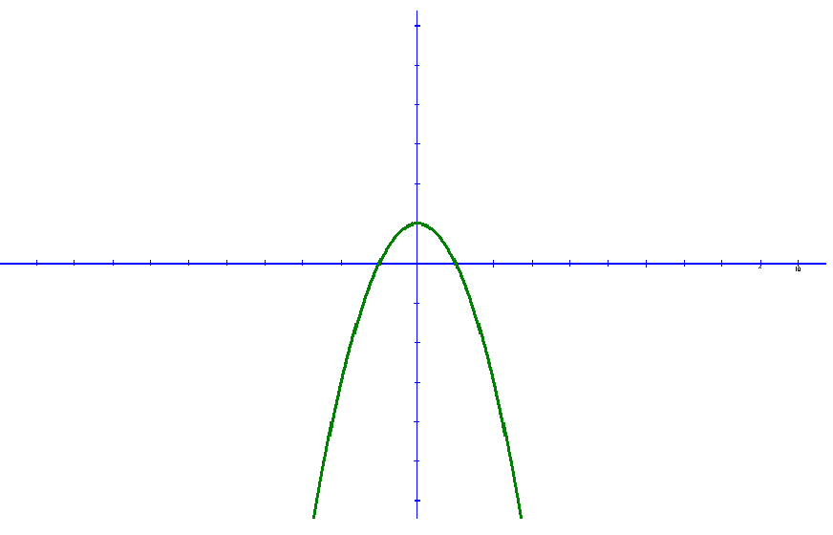
$$y$$
$$6$$
$$5$$
$$4$$
$$3$$
$$2$$
$$1$$
$$x$$
-$10$
-$9$
-$8$
-$7$
-$6$
-$5$
-$4$
-$3$
-$2$
-$1$
$$0$$
$$1$$
$$2$$
$$3$$
$$4$$
$$5$$
$$6$$
$$7$$
$$8$$
$$9$$
$$10$$
-$1$
$$y={−x}^{2}+1$$

Slide 16
$a=0$, $b=1$, $f\left(x\right)={−x}^{2}+1$
$$V=2π\int_{a}^{b}{x}∙f\left(x\right)dx=2π\int_{0}^{1}{x∙\left({−x}^{2}+1 \right)dx=}$$
$$=2π\int_{0}^{1}{\left({−x}^{3}+x \right)dx=}2π{\left.\left(−\frac{x^{4}}{4}+\frac{x^{2}}{2}\right)\right|}_{0}^{1}=$$

Slide 17
$$=2π\int_{0}^{1}{\left({−x}^{3}+x \right)dx=}2π{\left.\left(−\frac{x^{4}}{4}+\frac{x^{2}}{2}\right)\right|}_{0}^{1}=$$
$$=2π\left(−\frac{1^{4}}{4}+\frac{1^{2}}{2}\right)=2π\left(\frac{1}{2}−\frac{1}{4}\right)=2π∙\frac{1}{4}=\frac{π}{2}$$
Javob: $\frac{π}{2}$ (kub.birlik)

Slide 18
3-masala
$y=\frac{x^{2}}{2}$, $x=0$, $y=2\sqrt{2}$ chiziqlar bilan chegaralangan shaklning $Oy$ o‘qi atrofida aylanishidan hosil bo‘lgan jism hajmini toping.

Slide 19
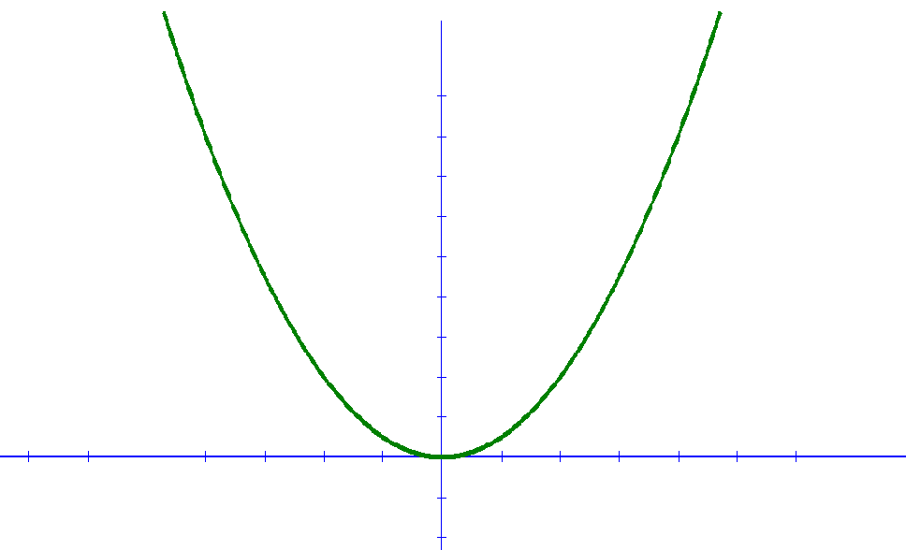
$$y$$
$$y=\frac{x^{2}}{2}$$
$$9$$
$$8$$
$$7$$
$$6$$
$$5$$
$$4$$
$$y=2\sqrt{2}$$
$$3$$
$$2$$
$$1$$
$$x$$
-$7$
-$6$
-$5$
-$4$
-$3$
-$2$
-$1$
$$0$$
$$1$$
$$2$$
$$3$$
$$4$$
$$5$$
$$6$$
$$7$$
$$8$$
$$9$$
$$x=0$$

Slide 20
$y=\frac{x^{2}}{2}$, $x=0$, $y=2\sqrt{2}$
$y=\frac{x^{2}}{2}$, $x=0$, $y=2\sqrt{2}$
$$y=\frac{x^{2}}{2}$$
$$x=\sqrt{2y}$$
$$\sqrt{2y}=0$$
$$y=0$$
$a=2\sqrt{2}$, $b=0$, $f\left(y\right)=\sqrt{2y}$

Slide 21
$$V=π\int_{a}^{b}{f^{2}\left(y\right)}dy=π\int_{0}^{2\sqrt{2}}{{\left(\sqrt{2y}\right)}^{2}}dy=$$
$$=π\int_{0}^{2\sqrt{2}}{2y}dy=π∙{\left.y^{2}\right|}_{0}^{2\sqrt{2}}=π∙{\left(2\sqrt{2}\right)}^{2}=8π$$
Javob: $8π$ (kub.birlik)

Slide 22
Mustaqil bajarish uchun topshiriqlar
9-sahifa
60-masala
69-masala

