Slide 1
Algebra
11-sinf
Mavzu: Masalalar yechish

Slide 2



1-misol
$$\int_{0}^{1}{\frac{2^{x−1}+5^{x−1}}{{10}^{x}}dx}= ?$$

Slide 3
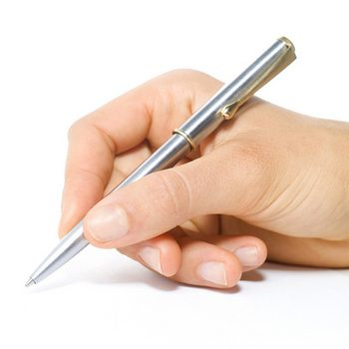


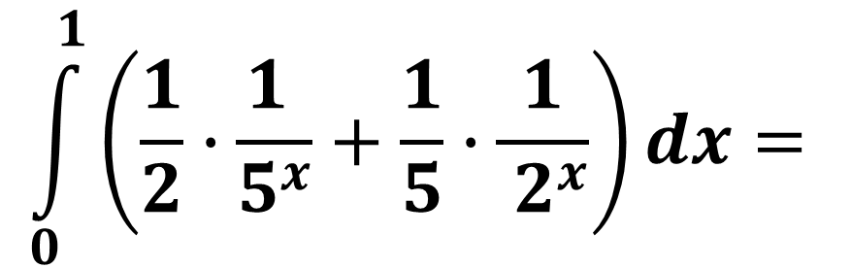
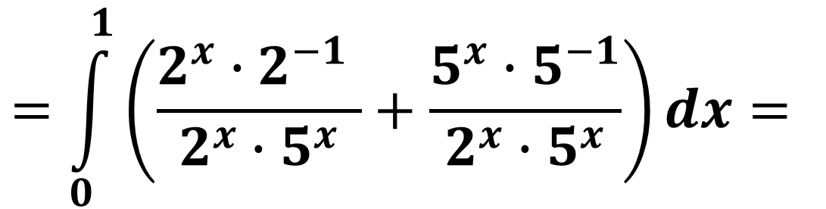
Misolning yechimi
$$\int_{0}^{1}{\frac{2^{x−1}+5^{x−1}}{{10}^{x}}dx}=$$
$$\int_{0}^{1}{\left(\frac{2^{x−1} }{{10}^{x}}+\frac{5^{x−1} }{{10}^{x}}\right)dx}=$$
$$=\int_{0}^{1}{\left(\frac{2^{x}∙2^{−1} }{2^{x}∙5^{x}}+\frac{5^{x}∙5^{−1}}{2^{x}∙5^{x}}\right)dx}=$$
$$\int_{0}^{1}{\left(\frac{1}{2}∙\frac{1 }{5^{x}}+\frac{1}{5}∙\frac{1}{ 2^{x}}\right)dx}=$$

Slide 4
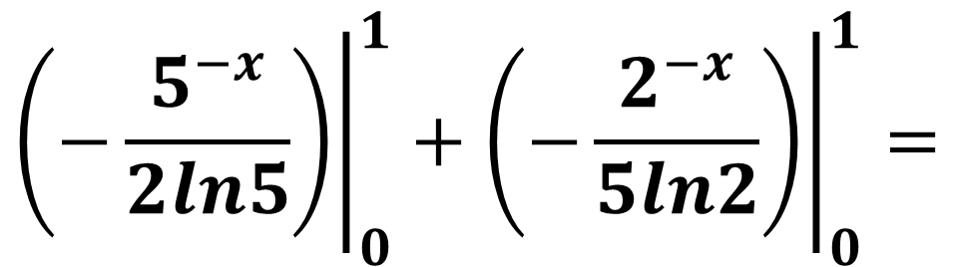
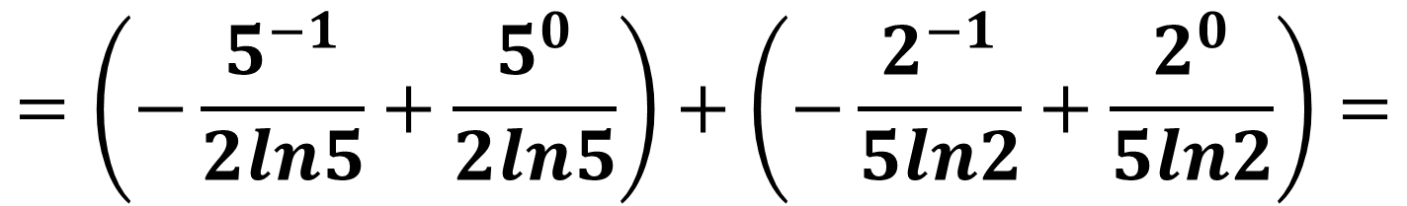
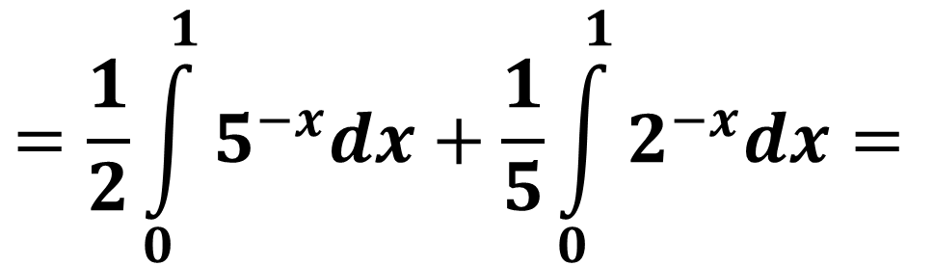
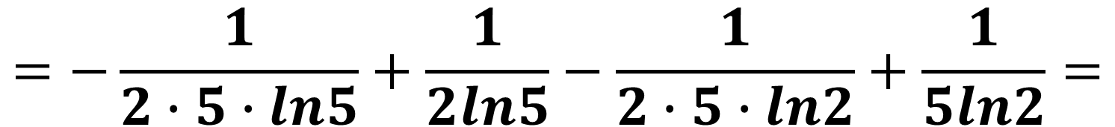
$$=\frac{1}{2}\int_{0}^{1}{5^{−x}dx}+\frac{1}{5}\int_{0}^{1}{2^{−x}dx}=$$
$${\left.\left(−\frac{5^{−x}}{2ln5}\right)\right|}_{0}^{1}+{\left.\left(−\frac{2^{−x}}{5ln2}\right)\right|}_{0}^{1}=$$
$$=\left(−\frac{5^{−1}}{2ln5}+\frac{5^{0}}{2ln5}\right)+\left(−\frac{2^{−1}}{5ln2}+\frac{2^{0}}{5ln2}\right)=$$
$$=−\frac{1}{2∙5∙ln5}+\frac{1}{2ln5}−\frac{1}{2∙5∙ln2}+\frac{1}{5ln2}=$$

Slide 5

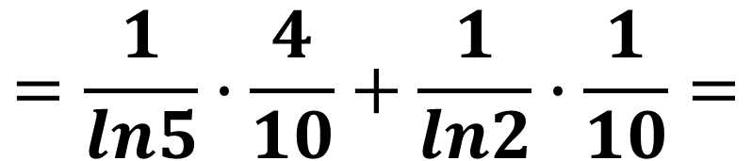
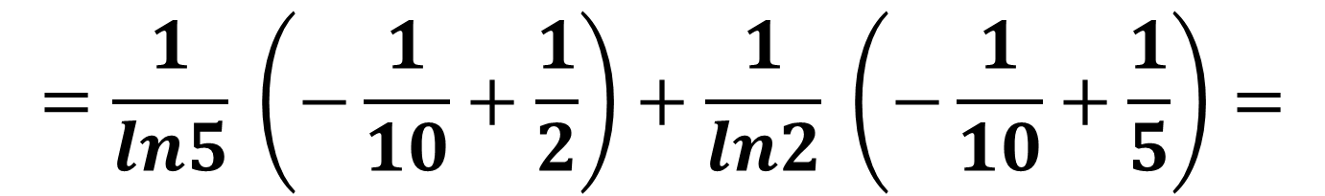
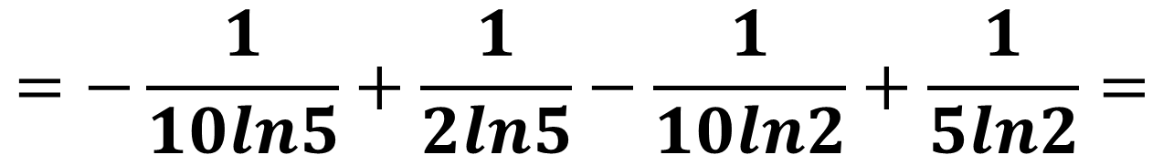

$$=−\frac{1}{10ln5}+\frac{1}{2ln5}−\frac{1}{10ln2}+\frac{1}{5ln2}=$$
$$=\frac{1}{ln5} \left(−\frac{1}{10}+\frac{1}{2}\right)+\frac{1}{ln2} \left(−\frac{1}{10}+\frac{1}{5}\right)=$$
$$=\frac{1}{ln5}∙\frac{4}{10}+\frac{1}{ln2}∙\frac{1}{10}=$$
$$\frac{1}{10}\left(\frac{4}{ln5}+\frac{1}{ln2}\right)$$

Slide 6

2-misol
$$\int_{\sqrt{3}}^{\sqrt{e+2}}{\frac{2x}{x^{2}−2}dx}= ?$$

Slide 7



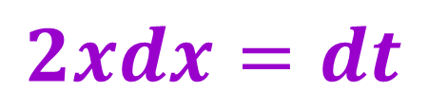
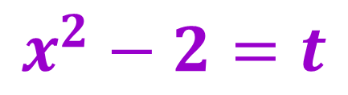

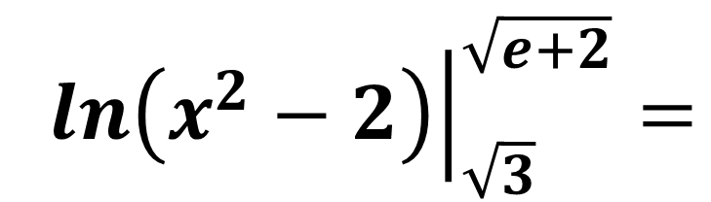
Misolning yechimi
$$\int_{\sqrt{3}}^{\sqrt{e+2}}{\frac{2x}{x^{2}−2}dx}=$$
$$\int_{\sqrt{3}}^{\sqrt{e+2}}{\frac{2xdx}{x^{2}−2} }=$$
$$x^{2}−2=t$$
$$2xdx=dt$$
$$=\int_{\sqrt{3}}^{\sqrt{e+2}}{\frac{dt}{t} }=$$
$${\left.lnt\right|}_{\sqrt{3}}^{\sqrt{e+2}}=$$
$${\left.ln\left(x^{2}−2\right)\right|}_{\sqrt{3}}^{\sqrt{e+2}}=$$

Slide 8
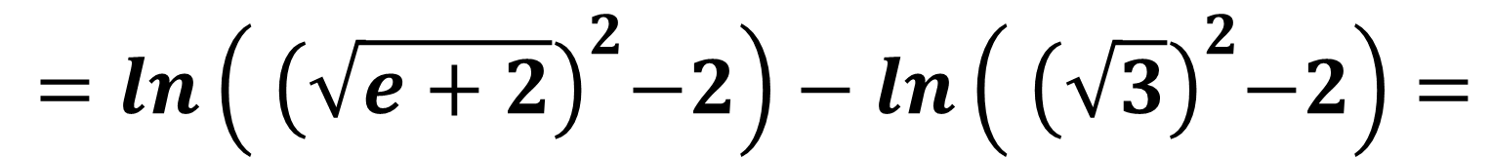

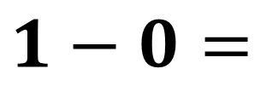
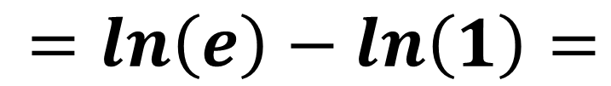
$$=ln\left({ \left(\sqrt{e+2}\right)}^{2}−2\right)−ln\left({ \left(\sqrt{3}\right)}^{2}−2\right)=$$
$$=ln\left(e+2−2\right)−ln\left(3−2\right)=$$
$$=ln\left(e\right)−ln\left(1\right)=$$
$$1−0=$$
$$1$$

Slide 9
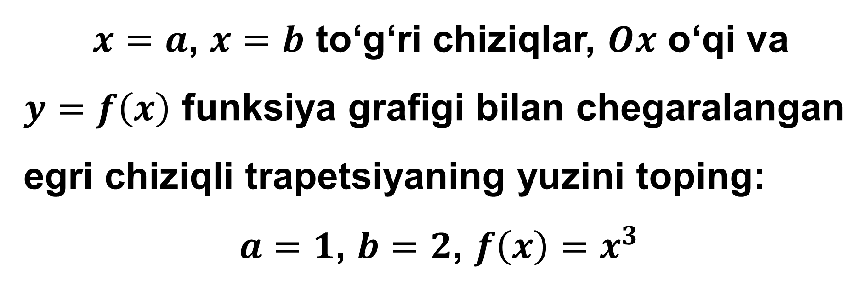
3-misol
$x=a$, $x=b$ to‘g‘ri chiziqlar, $Ox$ o‘qi va
$y=f\left(x\right)$ funksiya grafigi bilan chegaralangan egri chiziqli trapetsiyaning yuzini toping:
$a=1$, $b=2$, $f\left(x\right)=x^{3}$

Slide 10
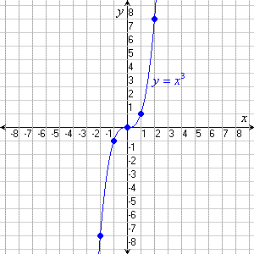

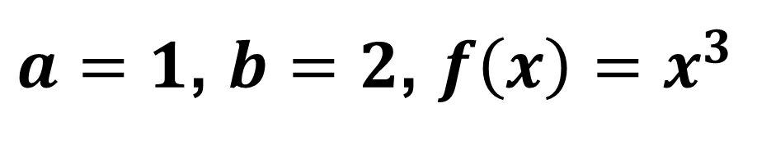
Misolning yechimi
$a=1$, $b=2$, $f\left(x\right)=x^{3}$
$$S=\int_{a}^{b}{f\left(x\right)dx}$$

Slide 11






$$S=\int_{1}^{2}{x^{3}dx}=$$
$${\left. \frac{x^{3+1}}{3+1}\right|}_{1}^{2}=$$
$${\left. \frac{x^{4}}{4}\right|}_{1}^{2}=$$
$$=\frac{2^{4}}{4}−\frac{1^{4}}{4}=$$
$$\frac{16−1}{4}=$$
$$\frac{15}{4}$$

Slide 12

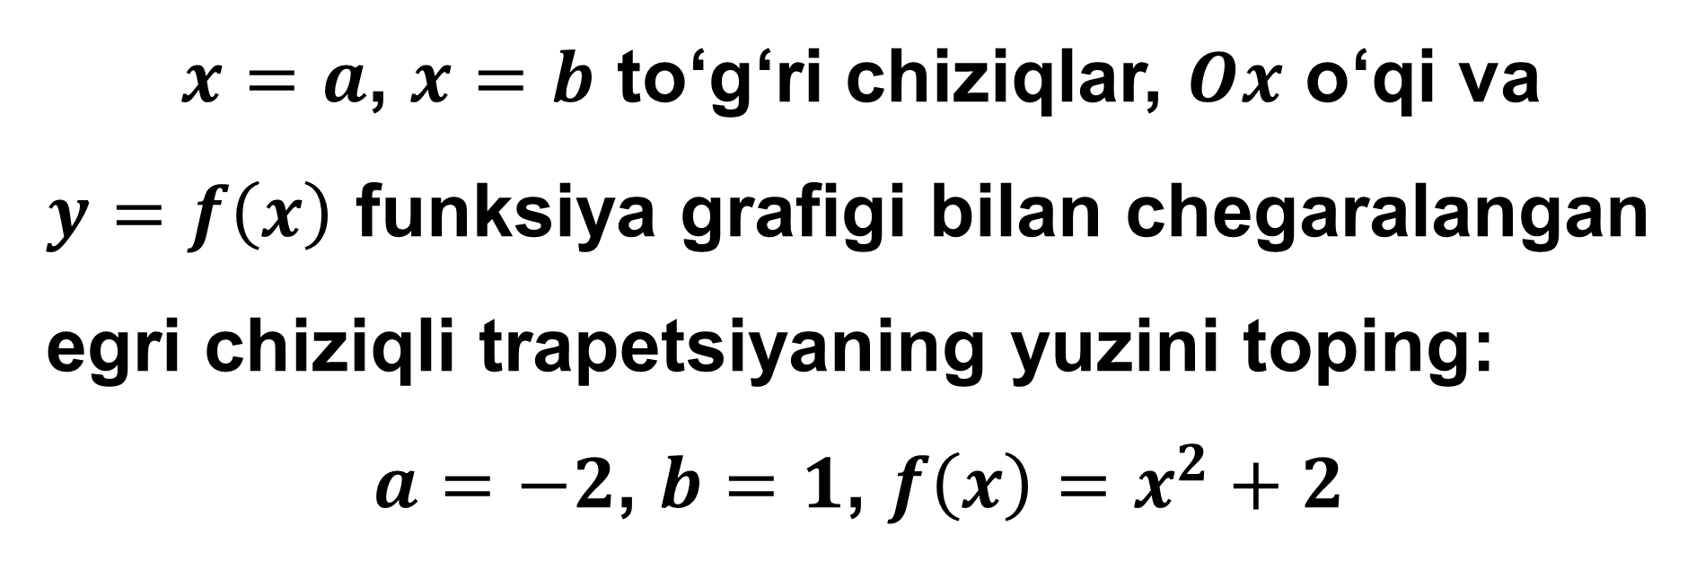
4-misol
$x=a$, $x=b$ to‘g‘ri chiziqlar, $Ox$ o‘qi va
$y=f\left(x\right)$ funksiya grafigi bilan chegaralangan egri chiziqli trapetsiyaning yuzini toping:
$a=−2$, $b=1$, $f\left(x\right)=x^{2}+2$

Slide 13
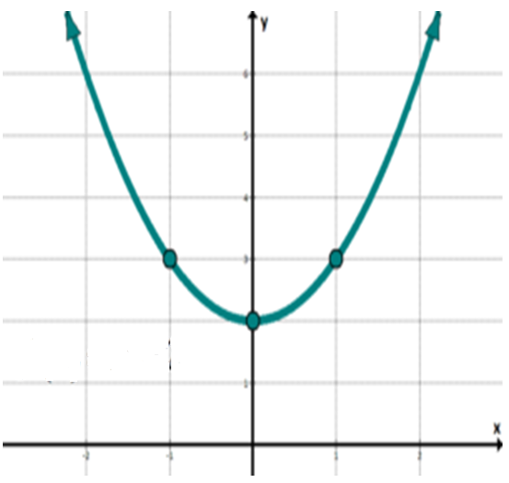










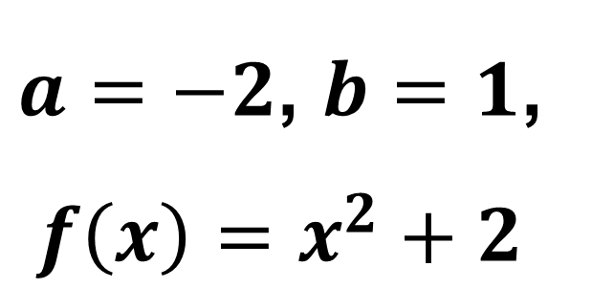


Misolning yechimi
$a=−2$, $b=1$,
$f\left(x\right)=x^{2}+2$
$$6$$
$$5$$
$$S=\int_{a}^{b}{f\left(x\right)dx}$$
$$4$$
$$3$$
$$2$$
$$1$$
-$2$
-$1$
$$0$$
$$1$$
$$2$$

Slide 14
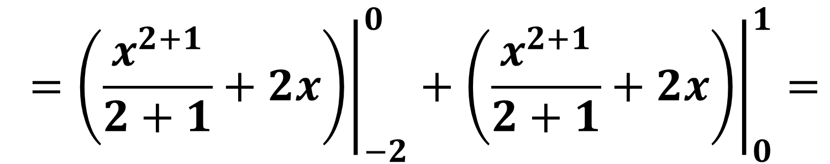
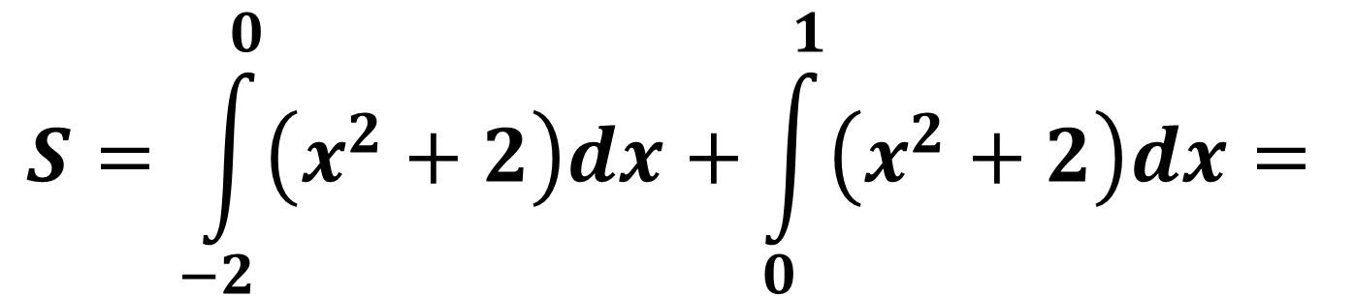
$$S=\int_{−2}^{0}{\left(x^{2}+2\right)dx}+\int_{0}^{1}{\left(x^{2}+2\right)dx}=$$
$${\left.=\left(\frac{x^{2+1}}{2+1}+2x\right)\right|}_{−2}^{0}+{\left.\left(\frac{x^{2+1}}{2+1}+2x\right)\right|}_{0}^{1}=$$

Slide 15
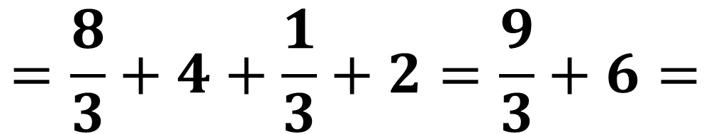
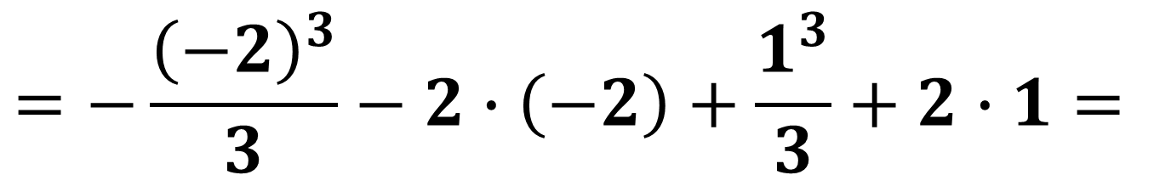
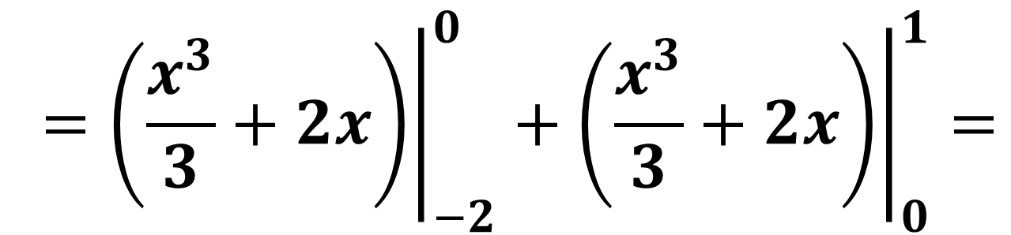

$${\left.=\left(\frac{x^{3}}{3}+2x\right)\right|}_{−2}^{0}+{\left.\left(\frac{x^{3}}{3}+2x\right)\right|}_{0}^{1}=$$
$$=−\frac{{\left(−2\right)}^{3}}{3}−2∙\left(−2\right)+\frac{1^{3}}{3}+2∙1=$$
$$=\frac{8}{3}+4+\frac{1}{3}+2=\frac{9}{3}+6=$$
$$9$$

Slide 16
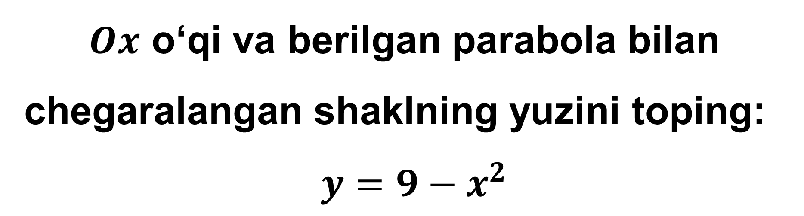
5-misol
$Ox$ o‘qi va berilgan parabola bilan chegaralangan shaklning yuzini toping:
$$y=9−x^{2}$$

Slide 17
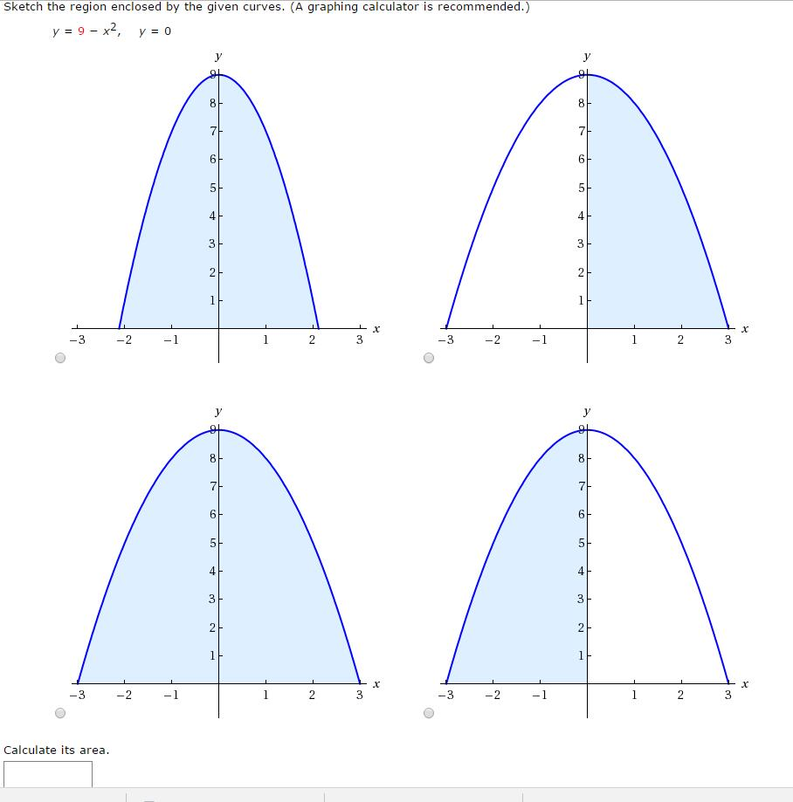

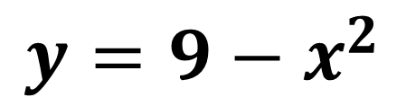







Misolning yechimi
$$y=0$$
$$y=9−x^{2}$$
$$x^{2}=9$$
$$x_{1}=−3$$
$$a$$
$$x_{2}=3$$
$$b$$
$$S=\int_{a}^{b}{f\left(x\right)dx= ?}$$
$$0$$

Slide 18





$$S=\int_{−3}^{3}{\left(9−x^{2}\right)dx}=$$
$${\left.\left(9x−\frac{x^{2+1}}{2+1}\right)\right|}_{−3}^{3}=$$
$${\left.=\left(9x−\frac{x^{3}}{3}\right)\right|}_{−3}^{3}=$$
$$\left(9∙3−\frac{3^{3}}{3}−9∙\left(−3\right)+\frac{{\left(−3\right)}^{3}}{3}\right)=$$
$$=27−9+27−9=18+18=$$
$$36$$

Slide 19

6-misol
$Ox$ o‘qi va berilgan parabola bilan chegaralangan shaklning yuzini toping:
$$y= −x^{2}+5x−6$$

Slide 20










Misolning yechimi
$$y=0$$
$$y$$
$$y=−x^{2}+5x−6$$
$$x$$
$$−x^{2}+5x−6=0$$
$$x_{1}=2$$
$$a$$
$$x_{2}=3$$
$$b$$
$$S=\int_{a}^{b}{f\left(x\right)dx= ?}$$

Slide 21



$$S=\int_{2}^{3}{\left(−x^{2}+5x−6 \right)dx}=$$
$${\left.=\left(−\frac{x^{2+1}}{2+1}+5∙\frac{x^{1+1}}{1+1}−6x\right)\right|}_{2}^{3}=$$
$${\left.=\left(−\frac{x^{3}}{3}+\frac{5x^{2}}{2}−6x\right)\right|}_{2}^{3}=$$

Slide 22




$${\left.=\left(−\frac{x^{3}}{3}+\frac{5x^{2}}{2}−6x\right)\right|}_{2}^{3}=$$
$$=−\frac{3^{3}}{3}+\frac{5∙3^{2}}{2}−6∙3−\left(−\frac{2^{3}}{3}+\frac{5∙2^{2}}{2}−6∙2\right)=$$
$$=−9+\frac{45}{2}−18+\frac{8}{3}−10+12=$$
$$\frac{1}{6}$$

Slide 23

7-misol
$y= −{2x}^{2}+7x$ va $y=3,5−x$ chiziqlar bilan chegaralangan shaklning yuzini toping.

Slide 24










Misolning yechimi
$y= −{2x}^{2}+7x$
$y=3,5−x$
$$y$$
$3,5−x= −{2x}^{2}+7x$
$${2x}^{2}−8x−3,5=0$$
$$x_{1}= 0,5$$
$$a$$
$$x_{2}=3,5$$
$$b$$
$$x$$

Slide 25



$$S=\int_{0,5}^{3,5}{\left(−{2x}^{2}+7x−\left(3,5−x\right)\right)dx}=$$
$$=\int_{0,5}^{3,5}{\left(−{2x}^{2}+7x−3,5+x\right)dx}=$$
$$=\int_{0,5}^{3,5}{\left(−{2x}^{2}+8x−3,5\right)dx}=$$

Slide 26



$${\left.=\left(−2∙\frac{x^{2+1}}{2+1}+8∙\frac{x^{1+1}}{1+1}−3,5x\right)\right|}_{0,5}^{3,5}=$$
$${\left.=\left(−2∙\frac{x^{3}}{3}+8∙\frac{x^{2}}{2}−3,5x\right)\right|}_{0,5}^{3,5}=$$
$${\left.=\left(\frac{−2x^{3}}{3}+4x^{2}−3,5x\right)\right|}_{0,5}^{3,5}=$$

Slide 27






$$=\frac{−2∙{3,5}^{3}}{3}+4∙{3,5}^{2}−3,5∙3,5−$$
$$−\left(\frac{−2∙{0,5}^{3}}{3}+4∙{0,5}^{2}−3,5∙0,5\right)=$$
$$=−\frac{85,75}{3}+49−12,25+\frac{0,25}{3}−1+1,75=$$
$$=−\frac{85,5}{3}+37,5=$$
$$−28,5+37,5=$$
$$9$$

Slide 28

8-misol
Agar $F\left(\frac{3}{2}\right)=1$ bo‘lsa, $f\left(x\right)=\frac{6}{{\left(4−3x\right)}^{2}}$ funksiyaning boshlang‘ich
funksiyasi $F\left(x\right)$ ni toping.

Slide 29






Misolning yechimi
$$F\left(x\right)=\int{\frac{6}{{\left(4−3x\right)}^{2}}dx}=$$
$$4−3x=t$$
$$−3dx=dt$$
$$=\int{−\frac{2dt}{t^{2}}}=$$
$$−2\int{t^{−2}dt}=$$
$$−2∙\frac{t^{−2+1}}{−2+1}+C=$$

Slide 30









$$=−2∙\frac{t^{−1}}{−1}+C=$$
$$\frac{2}{t}+C=$$
$$\frac{2}{4−3x}+C$$
$$F\left(\frac{3}{2}\right)=\frac{2}{4−3∙\frac{3}{2}}+C=−4+C$$
$F\left(\frac{3}{2}\right)=1$
$$−4+C=1$$
$$C=5$$
$$F\left(x\right)=\frac{2}{4−3x}+5=$$
$$\frac{22−15x}{4−3x}$$

Slide 31

Mustaqil bajarish uchun topshiriqlar
104-sahifa
47 va 48-misollar
2
4
6

