Slide 1
Algebra
11-sinf
Mavzu: Aniq integralni hisoblashga doir misollar yechish

Slide 2



1-misol
$$\int_{0}^{1}{\frac{x^{2}+2x+4}{x+1}dx= ?}$$

Slide 3



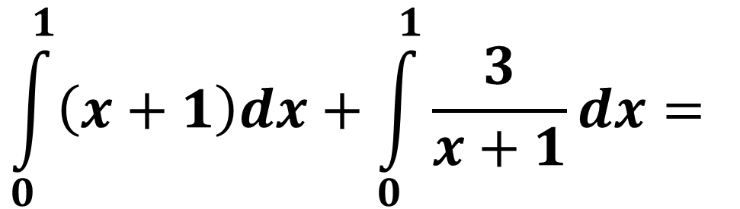
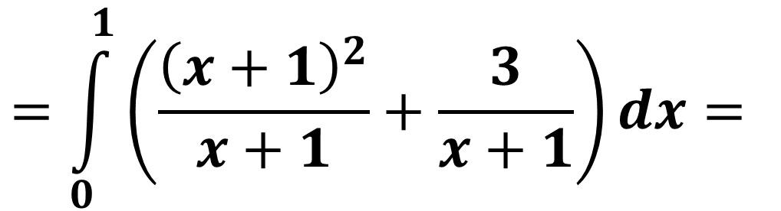
$$\int_{0}^{1}{\frac{x^{2}+2x+4}{x+1}dx= }$$
$$\int_{0}^{1}{\frac{{\left(x+1\right)}^{2}+3}{x+1}dx= }$$
$$=\int_{0}^{1}{\left(\frac{{\left(x+1\right)}^{2}}{x+1}+\frac{3}{x+1}\right)dx= }$$
$$\int_{0}^{1}{\left(x+1\right)dx}+\int_{0}^{1}{\frac{3}{x+1}dx= }$$
$$={\left.\left(\frac{x^{2}}{2}+x\right)\right|}_{0}^{1}+{\left.3ln\left(x+1\right)\right|}_{0}^{1}=$$

Slide 4

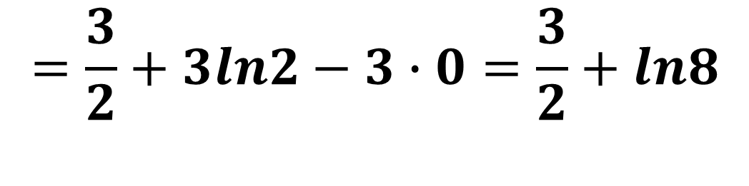
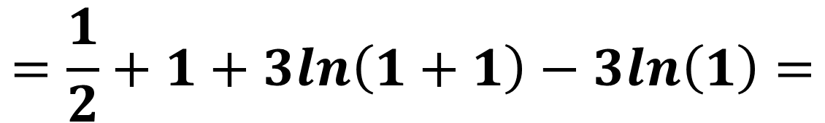
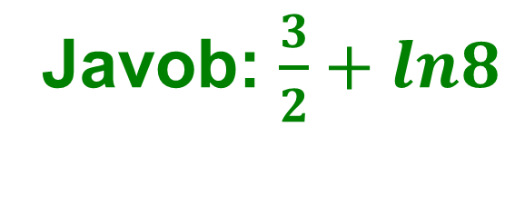

$$={\left.\left(\frac{x^{2}}{2}+x\right)\right|}_{0}^{1}+{\left.3ln\left(x+1\right)\right|}_{0}^{1}=$$
$$=\frac{1}{2}+1+3ln\left(1+1\right)−3ln\left(1\right)=$$
$$=\frac{3}{2}+3ln2−3∙0=\frac{3}{2}+ln8$$
Javob: $\frac{3}{2}+ln8$

Slide 5


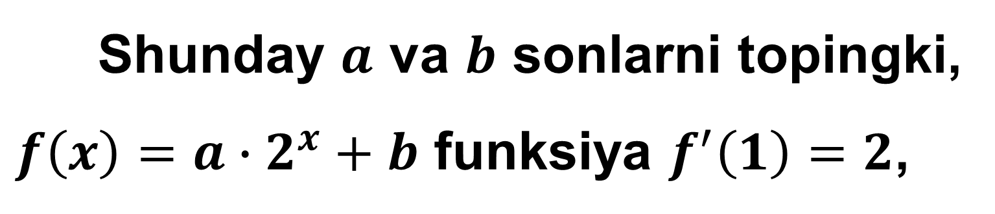
2-misol
Shunday $a$ va $b$ sonlarni topingki,
$f\left(x\right)=a∙2^{x}+b$ funksiya $f^{′}\left(1\right)=2$,
$$\int_{0}^{3}{f\left(x\right)dx=7}$$
shartni qanoatlantirsin.

Slide 6
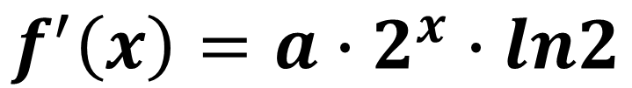
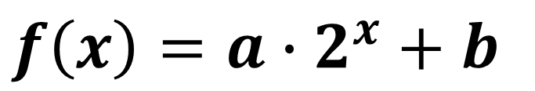

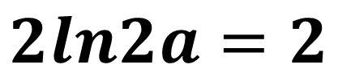
$f\left(x\right)=a∙2^{x}+b$
$$f^{′}\left(x\right)=a∙2^{x}∙ln2$$
$$f^{′}\left(1\right)=a∙2^{1}∙ln2=2ln2a$$
$$2ln2a=2$$
$$a=\frac{1}{ln2}$$

Slide 7



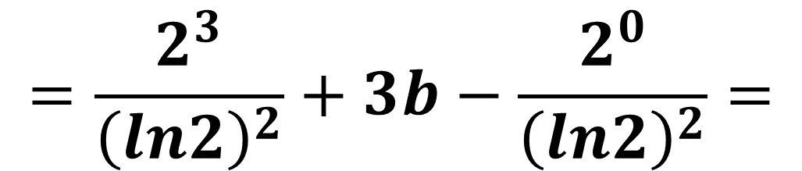


$$\int_{0}^{3}{f\left(x\right)dx=}$$
$$\int_{0}^{3}{\left(a∙2^{x}+b\right)dx=}$$
$$=\int_{0}^{3}{\left(\frac{2^{x}}{ln2}+b\right)dx=}$$
$${\left.\left(\frac{2^{x}}{{\left(ln2\right)}^{2}}+bx\right)\right|}_{0}^{3}=$$
$$=\frac{2^{3}}{{\left(ln2\right)}^{2}}+3b−\frac{2^{0}}{{\left(ln2\right)}^{2}}=$$
$$\frac{7}{{\left(ln2\right)}^{2}}+3b$$

Slide 8
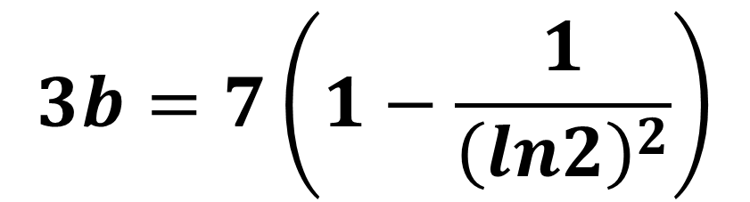
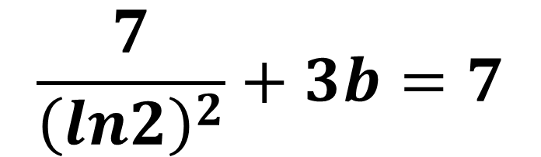
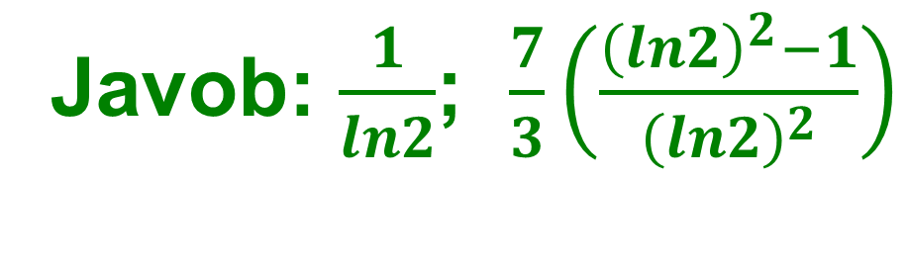
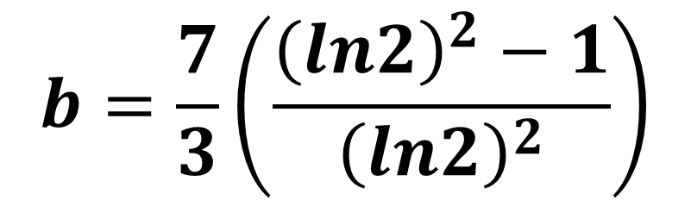
$$\frac{7}{{\left(ln2\right)}^{2}}+3b=7$$
$$3b=7\left(1−\frac{1}{{\left(ln2\right)}^{2}}\right)$$
$$b=\frac{7}{3}\left(\frac{{\left(ln2\right)}^{2}−1}{{\left(ln2\right)}^{2}}\right)$$
Javob: $\frac{1}{ln2}$; $\frac{7}{3}\left(\frac{{\left(ln2\right)}^{2}−1}{{\left(ln2\right)}^{2}}\right)$

Slide 9
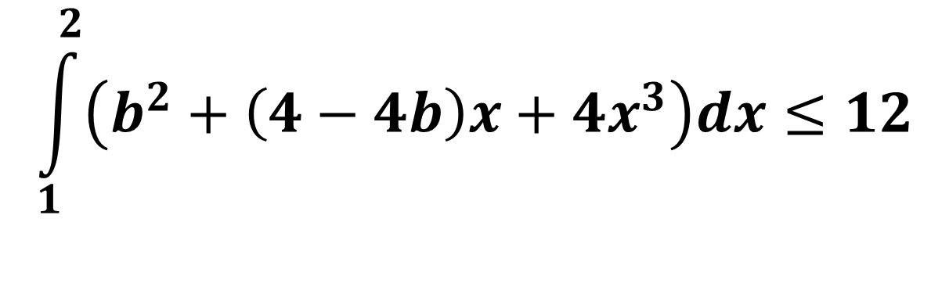
3-misol
$$\int_{1}^{2}{\left(b^{2}+\left(4−4b\right)x+4x^{3}\right)dx≤12}$$
tengsizlik bajariladigan barcha $b$ sonlarni toping.

Slide 10
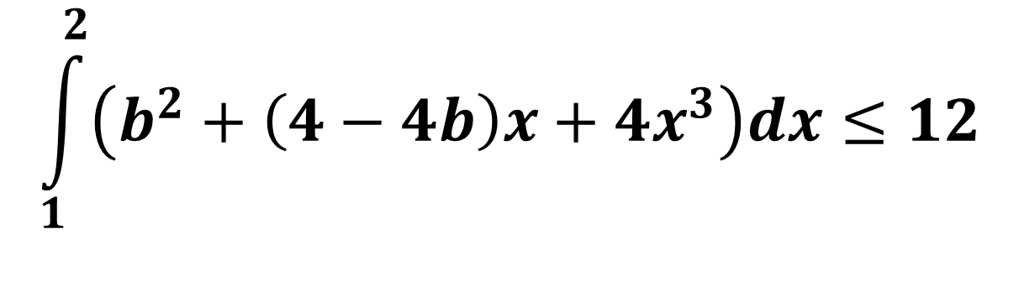
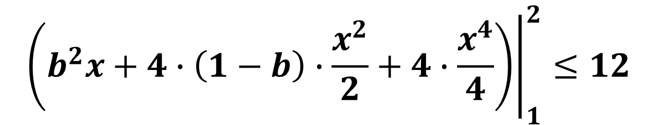


$$\int_{1}^{2}{\left(b^{2}+\left(4−4b\right)x+4x^{3}\right)dx≤12}$$
$${\left.\left(b^{2}x+4∙\left(1−b\right)∙\frac{x^{2}}{2}+4∙\frac{x^{4}}{4}\right)\right|}_{1}^{2}≤12$$
$${\left.\left(b^{2}x+2\left(1−b\right)x^{2}+x^{4}\right)\right|}_{1}^{2}≤12$$
$$2b^{2}+8\left(1−b\right)+2^{4}−\left(b^{2}+2\left(1−b\right)+1^{4}\right)≤12$$
$$b^{2}+6\left(1−b\right)+15≤12$$

Slide 11






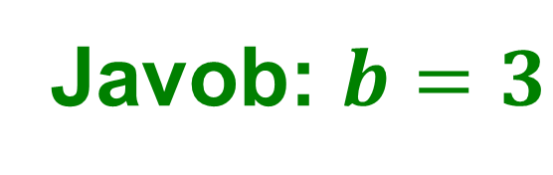
$$b^{2}+6−6b+3≤0$$
$$b^{2}−6b+9≤0$$
$${\left(b−3\right)}^{2}≤0$$
$${\left(b−3\right)}^{2}=0$$
$$b−3=0$$
$$b=3$$
Javob: $b=3$

Slide 12

4-misol
$$\int_{1}^{b}{\left(b−4x\right)dx≤6−5b}$$
tengsizlik bajariladigan barcha $b>1$ sonlarni toping.

Slide 13
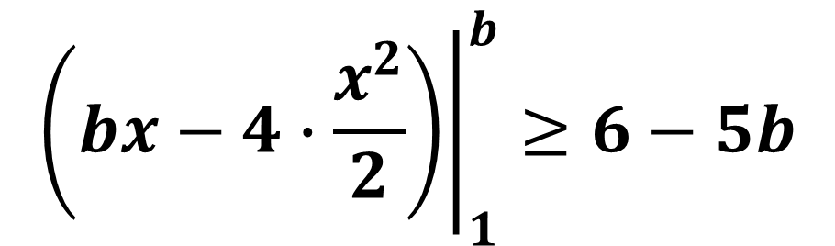

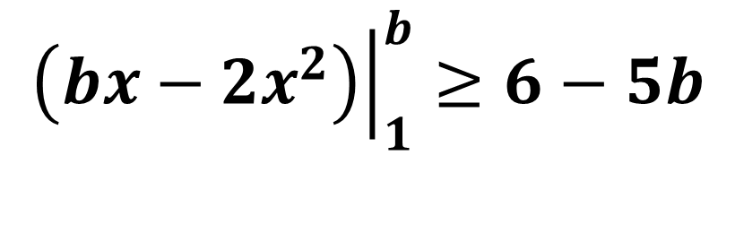
$$\int_{1}^{b}{\left(b−4x\right)dx≥6−5b}$$
$${\left.\left(bx−4∙\frac{x^{2}}{2}\right)\right|}_{1}^{b}≥6−5b$$
$${\left.\left(bx−2x^{2}\right)\right|}_{1}^{b}≥6−5b$$
$$b^{2}−2b^{2}−\left(b−2\right)≥6−5b$$

Slide 14





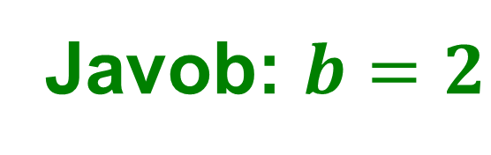
$$−b^{2}−b+2≥6−5b$$
$$b^{2}−4b+4≤0$$
$$b^{2}−4b+4≤0$$
$${\left(b−2\right)}^{2}≤0$$
$${\left(b−2\right)}^{2}=0$$
$$b=2$$
Javob: $b=2$

Slide 15


5-misol
Qanday $a>0$ sonlar uchun
$$\int_{−a}^{a}{e^{x}dx}>\frac{3}{2}$$
tengsizlik bajariladi?

Slide 16
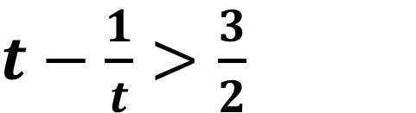


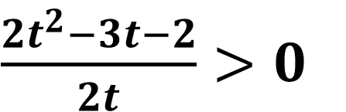





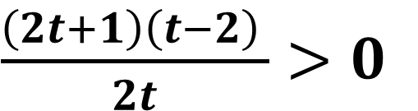




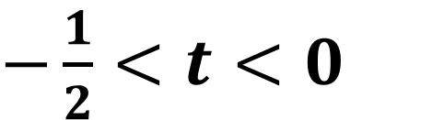

$$\int_{−a}^{a}{e^{x}dx}>\frac{3}{2}$$
$t−\frac{1}{t}>\frac{3}{2}$
$$e^{a}=t$$
$\frac{2t^{2}−3t−2}{2t}>0$
$${\left.e^{x}\right|}_{−a}^{a}>\frac{3}{2}$$
$\frac{\left(2t+1\right)\left(t−2\right) }{2t}>0$
$$e^{a}−e^{−a}>\frac{3}{2}$$
$$−$$
$$+$$
$$−$$
$$+$$
- $\frac{1}{2}$
0
$$2$$
$$e^{a}−\frac{1}{e^{a}}>\frac{3}{2}$$
$−\frac{1}{2}<t<0$
$$t>2$$

Slide 17




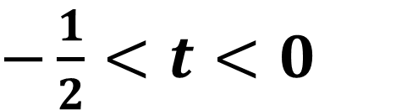






$−\frac{1}{2}<t<0$
$e^{a}>−\frac{1}{2}$
$t>−\frac{1}{2}$
$$a∉ℝ$$
$t<0$
$e^{a}<0$
$$t>2$$
$$e^{a}>2$$
$$a>ln2$$
$$a∈\left(ln2;+∞\right)$$
Javob: $a∈\left(ln2;+∞\right)$

Slide 18

6-misol
$$\int_{0}^{1}{{\left(e^{−x}+1\right)}^{2}dx}= ?$$

Slide 19
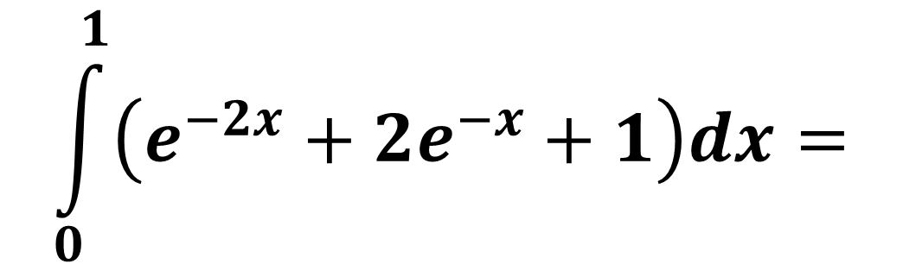


$$\int_{0}^{1}{{\left(e^{−x}+1\right)}^{2}dx}=$$
$$\int_{0}^{1}{\left(e^{−2x}+2e^{−x}+1\right)dx}=$$
$$={\left.\left(−\frac{1}{2}e^{−2x}−2e^{−x}+x\right)\right|}_{0}^{1}=$$

Slide 20




$$=−\frac{1}{2}e^{−2}−2e^{−1}+1−\left(−\frac{1}{2}e^{0}−2e^{0}+0\right)=$$
$$=−\frac{1}{2e^{2}}−\frac{2}{e}+1+\frac{1}{2}+2=$$
$$−\frac{1}{2e^{2}}−\frac{2}{e}+\frac{7}{2}$$
Javob: $−\frac{1}{2e^{2}}−\frac{2}{e}+\frac{7}{2}$

Slide 21

7-misol
$$\int_{−2}^{−1}{{10}^{x}∙2^{−x}dx}= ?$$

Slide 22






$$\int_{−2}^{−1}{{10}^{x}∙2^{−x}dx}=$$
$$\int_{−2}^{−1}{\frac{{10}^{x}}{2^{x}}dx}=$$
$$\int_{−2}^{−1}{\frac{2^{x}∙5^{x}}{2^{x}}dx}=$$
$$=\int_{−2}^{−1}{\frac{2^{x}∙5^{x}}{2^{x}}dx}=$$
$$\int_{−2}^{−1}{5^{x}dx}$$
$${\left.=\frac{5^{x}}{ln5}\right|}_{−2}^{−1}=$$

Slide 23






$$=\frac{1}{ln5}\left(5^{−1}−5^{−2}\right)=$$
$$\frac{1}{ln5}∙\left(\frac{1}{5}−\frac{1}{5^{2}}\right)=$$
$$=\frac{1}{ln5}∙\left(\frac{1}{5}−\frac{1}{25}\right)=$$
$$\frac{1}{ln5}∙\frac{4}{25}=$$
$$\frac{4}{25ln5}$$
Javob: $\frac{4}{25ln5}$

Slide 24

8-misol
$$\int_{0}^{1}{\frac{2^{x}+3^{x}}{6^{x+1}}dx}= ?$$

Slide 25






$$\int_{0}^{1}{\frac{2^{x}+3^{x}}{6^{x+1}}dx}=$$
$$\int_{0}^{1}{\left(\frac{2^{x}}{6^{x}∙6}+\frac{3^{x}}{6^{x}∙6}\right)dx}=$$
$$=\frac{1}{6}\int_{0}^{1}{\left(\frac{2^{x}}{2^{x}∙3^{x}}+\frac{3^{x}}{2^{x}∙3^{x}}\right)dx}=$$
$$\frac{1}{6}\int_{0}^{1}{\left(\frac{1}{3^{x}}+\frac{1}{2^{x}}\right)dx}=$$
$$=\frac{1}{6}\int_{0}^{1}{\left(3^{−x}+2^{−x}\right)dx}=$$
$${\left.\frac{1}{6}\left(−\frac{3^{−x}}{ln3}−\frac{2^{−x}}{ln2}\right)\right|}_{0}^{1}=$$

Slide 26




$${\left.=−\frac{1}{6}\left(\frac{1}{3^{x}ln3}+\frac{1}{2^{x}ln2}\right)\right|}_{0}^{1}=$$
$$=−\frac{1}{6}\left(\frac{1}{3ln3}+\frac{1}{2ln2}−\frac{1}{ln3}−\frac{1}{ln2}\right)=$$
$$=−\frac{1}{6}\left(−\frac{2}{3ln3}−\frac{1}{2ln2}\right)=\frac{1}{9ln3}+\frac{1}{12ln2}$$
Javob: $\frac{1}{9ln3}+\frac{1}{12ln2}$

Slide 27

Mustaqil bajarish uchun topshiriqlar
104-sahifa
45 va 46-misollar
3
4
5
6

