Slide 1
Algebra
11-sinf
Mavzu: Geometrik mazmunli ekstremal masalalarni yechishda differensial hisob usullari
Fan o‘qituvchisi:
Turg‘unova Mohizabon Mahmudjon qizi

Slide 2
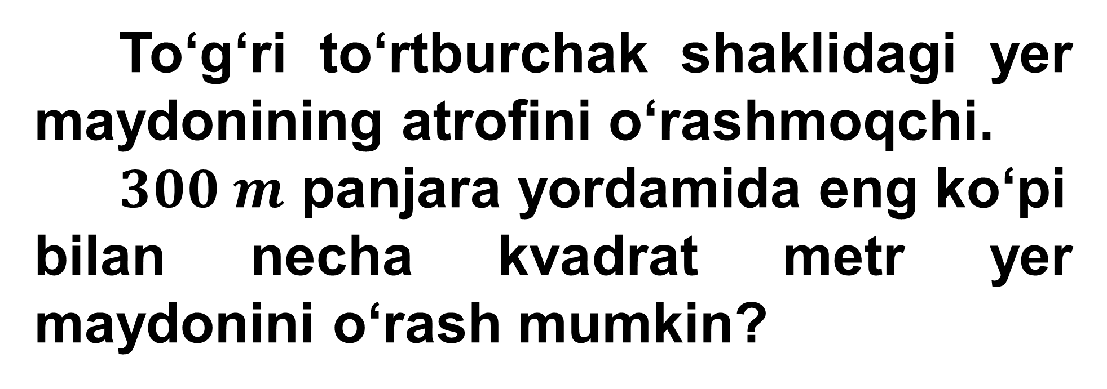
1-masala
To‘g‘ri to‘rtburchak shaklidagi yer maydonining atrofini o‘rashmoqchi.
$300 m$ panjara yordamida eng ko‘pi
bilan necha kvadrat metr yer maydonini o‘rash mumkin?

Slide 3

Masalaning yechimi
$$2x+2y=300$$
$$:2$$
$$x \left(m\right)$$
$$x+y=150$$
$$y \left(m\right)$$
$$y=150−x$$
$$S\left(x\right)=xy=x∙\left(150−x\right)=150x−x^{2}$$

Slide 4

$$S\left(x\right)=150x−x^{2}$$
$$+$$
$$−$$
$$S^{′}\left(x\right)=150−2x$$
$$150−2x=0$$
$$150=2x$$
$$x=75$$

Slide 5

$$+$$
$$−$$
$$S^{′}\left(x\right)>0$$
$$\left(−∞;75\right)$$
$$S^{′}\left(x\right)<0$$
$$\left(75;+∞\right)$$
$$x=75$$
$$S\left(75\right)=150∙75−{75}^{2}=5625$$
Javob: $5625 m^{2}$

Slide 6
2-masala
Tomoni 120 cm bo‘lgan kvadrat shaklidagi kartondan usti ochiq quti tayyorlandi. Bunda kartonning uchlaridan bir xil kvadratchalar kesib olindi.
Qutining hajmi eng katta bo‘lishi uchun kesib olingan kvadratchaning tomoni necha santimetr bo‘lishi kerak?

Slide 7
Masalaning yechimi
$$a$$
$$a=120 cm$$
$$a$$
$$a$$
$$a$$

Slide 8
$$a$$
$$a=120 cm$$
$$x$$
$$a$$
$$x$$
$$x$$
$$a$$
$$x$$
$$a$$

Slide 9



$\frac{120−x}{2}$
$\frac{120−x}{2}$
$$x$$
$$x$$
$\frac{120−x}{2}$
$$V\left(x\right)=\frac{120−x}{2}∙x∙x$$

Slide 10



$$V\left(x\right)=\frac{120−x}{2}∙x∙x=$$
$$\frac{120−x}{2}∙x^{2}=$$
$$60x^{2}−\frac{x^{3}}{2}$$
$$V\left(x\right)=−\frac{x^{3}}{2}+60x^{2}$$
$$\left[0;a\right]$$
$$V^{′}\left(x\right)=\frac{−3x^{2}}{2}+2∙60x=\frac{−3x^{2}}{2}+120x$$
$$V^{′}\left(x\right)=\frac{−3x^{2}}{2}+120x$$

Slide 11
$$\frac{−3x^{2}}{2}+120x=0$$
$$−x∙\left(\frac{3}{2}x−120\right)=0$$
$$\frac{3}{2}x−120=0$$
$$x_{1}=0$$
$$x_{2}=80$$

Slide 12



$\frac{120−x}{2}$
$$x_{1}=0$$
$$\frac{120−x}{2}=\frac{120}{2}=60$$
$\frac{120−x}{2}$
$$x_{2}=80$$
$$\frac{120−80}{2}=\frac{40}{2}=20$$
Javob: $20$

Slide 13

3-masala
Konserva banka silindr shaklida bo‘lib, uning to‘la sirti $216π {cm}^{2}$ga teng. Bankaga eng ko‘p suv sig‘ishi uchun banka asosining radiusi va balandligi qanday bo‘lishi kerak?

Slide 14
Masalaning yechimi
$$S_{to‘la}=216π {cm}^{2}$$
$$R$$
$$R= ? H= ?$$
$S_{to‘la}=S_{yon}+2S_{asos}$
$$H$$
$S_{yon}=2πRH$
$$R$$
$$S_{asos}=πR^{2}$$

Slide 15


$$216π=2πRH+2πR^{2}$$
$$:2π$$
$$108=RH+R^{2}$$
$$H=\frac{108−R^{2}}{R}$$
$$V=S_{asos}∙H=πR^{2}∙\frac{108−R^{2}}{R}=$$
$$πR∙\left(108−R^{2}\right)$$
$$V=108πR−πR^{3}$$

Slide 16

$$V′=108π−3πR^{2}$$
$$V′=0$$
$$108π−3πR^{2}=0$$
$$108π=3πR^{2}$$
$$R^{2}=\frac{108π}{3π}=36$$
$$+$$
$$−$$
$$x$$
$$−6$$
$$6$$
$$R_{1}=−6$$
$$R_{2}=6$$
$$H=\frac{108−6^{2}}{6}=\frac{108−36}{6}=12$$
Javob: $R=6$; $H=12$

Slide 17
4-masala
Radiusi $1$ga teng bo‘lgan sferaga ichki chizilgan eng katta hajmli silindr balandligini toping.

Slide 18

Masalaning yechimi
$$R_{sfera}=1$$
$$H_{silindr}= ?$$
$$R$$
$$R$$
$$1$$
$$2$$
$$H$$
$$H$$
$$H$$
$$1$$
$$R$$
$$R$$
$$2R$$

Slide 19




$$H^{2}+{\left(2R\right)}^{2}=2^{2}$$
$$2$$
$$H$$
$$H^{2}+4R^{2}=4$$
$$R^{2}=\frac{4−H^{2}}{4}$$
$$2R$$
$$π∙\left(\frac{4−H^{2}}{4}\right)∙H$$
$$V=S_{asos}∙H=πR^{2}∙H=$$
$$=\frac{4πH−πH^{3}}{4}=$$
$$πH−\frac{πH^{3}}{4}$$

Slide 20







$$V=πH−\frac{πH^{3}}{4}$$
$$V′=π−\frac{3πH^{2}}{4}$$
$$π−\frac{3πH^{2}}{4}=0$$
$$+$$
$$−$$
$$x$$
$$\frac{2\sqrt{3}}{3}$$
$$H^{2}=\frac{4π}{3π}=\frac{4}{3}$$
$$H=\sqrt{\frac{4}{3}}=\frac{2}{\sqrt{3}}=\frac{2\sqrt{3}}{3}$$
Javob: $\frac{2\sqrt{3}}{3}$

Slide 21

5-masala
Metalldan sig‘imi $13,5 l$, asosi kvadratdan iborat bo‘lgan to‘g‘ri to‘rtburchakli parallelepiped yasalmoqda. Idishning o‘lchamlari qanday bo‘lganda uni yasash uchun eng kam metall ketadi?

Slide 22
Masalaning yechimi
$$V=13,5 l=13,5∙{10}^{−3} m^{3}$$
$$a= ? b= ? c= ?$$
$$a$$
$$V=abc$$
$$b=a$$
$$V=a∙a∙c=a^{2}c$$
$$a^{2}c=13,5∙{10}^{−3}$$
$$c$$
$$ac=\frac{13,5∙{10}^{−3}}{a}$$

Slide 23
$$S=2∙\left(2a^{2}+ac\right)=$$
$$a$$
$$= 2∙\left(2a^{2}+\frac{13,5∙{10}^{−3}}{a}\right)=$$
$$b=a$$
$$=4a^{2}+\frac{27∙{10}^{−3}}{a}$$
$$c$$
$$S^{′}=8a−\frac{27∙{10}^{−3}}{a^{2}}$$

Slide 24


$$S^{′}=0$$
$$8a−\frac{27∙{10}^{−3}}{a^{2}}=0$$
$$a^{3}={\left(\frac{3}{20}\right)}^{3}$$
$$a^{3}=\frac{27}{8000}$$
$$a=\frac{3}{20}=0,15$$
$$b=a=0,15$$
$$c=\frac{13,5∙{10}^{−3}}{a^{2}}=\frac{0,0135}{{0,15}^{2}}=\frac{0,0135}{0,0225}=0,6$$
Javob: $a=0,15 m$; $b=0,15m;c=0,6 m$

Slide 25
Mustaqil bajarish uchun topshiriqlar
54-sahifa
77-masala
80-masala

