Slide 1
Algebra
11-sinf
Mavzu: Hosila yordamida funksiya grafigini tekshirish
Fan o‘qituvchisi:
Turg‘unova Mohizabon Mahmudjon qizi

Slide 2
Reja
Funksiyaning lokal maksimum va lokal minimumlari
Funksiyaning eng katta va eng kichik
qiymatlari
O‘rganilgan mavzuga doir misollar
yechish

Slide 3
Misol
Berilgan funksiyaning kamayadigan oraliqdagi barcha butun qiymatlar yig‘indisini toping:
$f\left(x\right)=\frac{2}{3}x^{3}−4x^{2}+3$
$f^{′}\left(x\right)={\left(\frac{2}{3}x^{3}−4x^{2}+3\right)}^{′}=$
Yechish:
$={\left(\frac{2}{3}x^{3}\right)}^{′}−{\left(4x^{2}\right)}^{′}+{\left(3\right)}^{′}=$
$${2x}^{2}−8x$$

Slide 4
$$f^{′}\left(x\right)={2x}^{2}−8x$$
$$f^{′}\left(x\right)=0$$
$${2x}^{2}−8x=0$$
$$2x∙\left(x−4\right)=0$$
$$x_{1}=0$$
$$x_{2}=4$$
$$+$$
$$−$$
$$+$$
$$f^{′}\left(x\right)<0$$
$$\left[0;4\right]$$
$$x$$
$$0$$
$$4$$
$$0+1+2+3+4=10$$

Slide 5
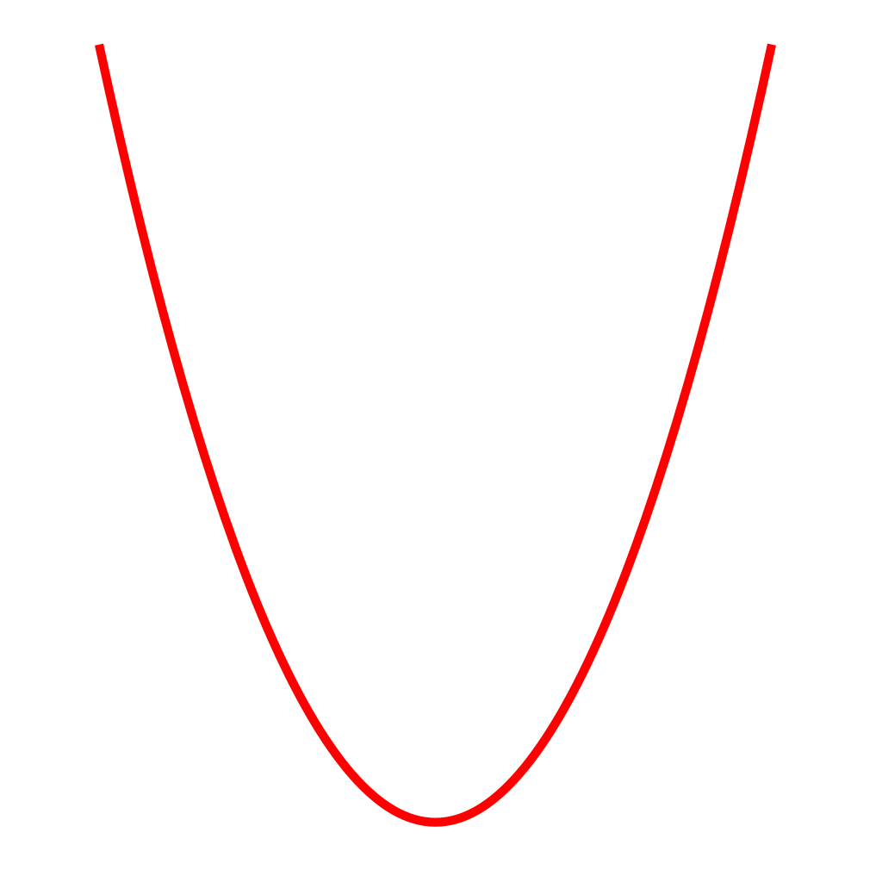
Funksiyaning lokal maksimumi
$$y$$
$$y=f(x)$$
$$f(x_{0})$$
$$x$$
$$0$$
$$a$$
$$x_{0}$$
$$b$$
$f^{′}(x)>0$
$f^{′}\left(x\right)<0$

Slide 6
Funksiyaning lokal minimumi
$$y$$
$$y=f(x)$$
$$f(x_{0})$$
$$0$$
$$a$$
$$x_{0}$$
$$x$$
$$b$$
$f^{′}(x)<0$
$f^{′}\left(x\right)>0$

Slide 7
Funksiyaning ekstremumlari
$$f′\left(x\right)$$
$$−$$
$$+$$
$$f′\left(x\right)$$
$$+$$
$$+$$
$$x_{0}$$
$$x_{0}$$
$$f\left(x\right)$$
$$f\left(x\right)$$
Ekstremum yo‘q
Lokal minimum
$$f′\left(x\right)$$
$$+$$
$$−$$
$$f′\left(x\right)$$
$$−$$
$$−$$
$$f\left(x\right)$$
$$x_{0}$$
$$f\left(x\right)$$
$$x_{0}$$
Lokal maksimum
Ekstremum yo‘q

Slide 8
1-misol
Funksiyaning ekstremumlarini toping: $f\left(x\right)=2x^{3}−3x^{2}−1$
Yechish:
$$f^{′}\left(x\right)=6x^{2}−6x$$
$$f^{′}\left(x\right)=0$$
$$6x^{2}−6x=0$$
$$6x∙\left(x−1\right)=0$$
$$x_{1}=0$$
$$x_{2}=1$$

Slide 9
$$f^{′}\left(x\right)$$
$$+$$
$$−$$
$$+$$
$$x$$
$$0$$
$$1$$
$$f\left(x\right)=2x^{3}−3x^{2}−1$$
$$x=0$$
da lokal maksimum
$$y_{max}=2∙0^{3}−3∙0^{2}−1=−1$$
$$x=1$$
da lokal minimum
$$y_{min}=2∙1^{3}−3∙1^{2}−1=−2$$

Slide 10
2-misol
Funksiyaning ekstremumlarini toping: $f\left(x\right)=2x^{3}+5$
Yechish:
$$f^{′}\left(x\right)=6x^{2}$$
$$6x^{2}=0$$
$$f^{′}\left(x\right)$$
$$+$$
$$+$$
$$f^{′}\left(x\right)=0$$
$$x$$
$$0$$
$$x^{2}=0$$
$$x=0$$
Ekstremum yo‘q

Slide 11
3-misol
Funksiyaning ekstremumlarini toping: $f\left(x\right)={2x}^{6}−4x^{3}+4$
Yechish:
$$f^{′}\left(x\right)=12x^{5}−12x^{2}$$
$$f^{′}\left(x\right)=0$$
$$12x^{5}−12x^{2}=0$$
$$12x^{2}∙\left(x^{3}−1\right)=0$$
$$x_{1}=0$$
$$x_{2}=1$$

Slide 12
$$f^{′}\left(x\right)$$
$$−$$
$$−$$
$$+$$
$$x$$
$$0$$
$$1$$
$$x=1$$
da lokal minimum
$$f\left(x\right)={2x}^{6}−4x^{3}+4$$
$$f\left(1\right)={2∙1}^{6}−4∙1^{3}+4=2$$

Slide 13
$f(x)$ $\left[a;b\right]$ kesmada aniqlangan va $\left(a;b\right)$da hosilasi mavjud bo‘lsin. Uning eng katta qiymatini topish uchun:
1
Funksiyaning bu oraliqdagi barcha statsionar nuqtalari topiladi.
2
Funksiyaning statsionar, chegaraviy $a$ va $b$ nuqtalardagi qiymatlari hisoblanadi.
3
Bu qiymatlarning eng kattasi funksiyaning shu oraliqdagi eng katta qiymati bo‘ladi.

Slide 14
5-misol
$f(x)=\frac{1}{3}x^{3}+\frac{1}{2}x^{2}−6x$ funksiyaning $\left[−1;3\right]$ kesmadagi eng katta qiymatini toping.
Yechish:
$$f^{′}\left(x\right)=\frac{1}{3}∙3x^{2}+\frac{1}{2}∙2x−6=x^{2}+x−6$$
$$x^{2}+x−6=0$$
$$x$$
-$3$
-$1$
$$2$$
$$3$$
$$x_{1}=−3$$
$$x_{2}=2$$

Slide 15
$$x=2$$
$f\left(2\right)=\frac{1}{3}∙2^{3}+\frac{1}{2}∙2^{2}−6∙2=−7\frac{1}{3}$
$$a=−1$$
$f\left(−1\right)=\frac{1}{3}∙{\left(−1\right)}^{3}+\frac{1}{2}∙{\left(−1\right)}^{2}−6∙\left(−1\right)=6\frac{1}{6}$
$$b=3$$
$f\left(3\right)=\frac{1}{3}∙3^{3}+\frac{1}{2}∙3^{2}−6∙3=−4\frac{1}{2}$
Funksiyaning eng katta qiymati: $6\frac{1}{6}$

Slide 16
$f(x)$ $\left[a;b\right]$ kesmada aniqlangan va $\left(a;b\right)$ da hosilasi mavjud bo‘lsin. Uning eng kichik qiymatini topish uchun:
1
Funksiyaning bu oraliqdagi barcha statsionar nuqtalari topiladi.
2
Funksiyaning statsionar, chegaraviy $a$ va $b$ nuqtalardagi qiymatlari hisoblanadi.
3
Bu qiymatlarning eng kichigi funksiyaning shu oraliqdagi eng kichik qiymati bo‘ladi.

Slide 17
4-misol
$f\left(x\right)=x^{3}+4,5x^{2}−9$ funksiyaning $\left[−4;2\right]$ oraliqdagi eng katta va eng kichik qiymatlarini toping.
Yechish:
$$f^{′}\left(x\right)=3x^{2}+4,5∙2x=3x^{2}−9x$$
$$3x^{2}+9x=0$$
$$3x∙\left(x+3\right)=0$$
$$x$$
-$4$
-$3$
$$0$$
$$2$$
$$x_{1}=0$$
$$x_{2}=−3$$

Slide 18
$f\left(x\right)=x^{3}+4,5x^{2}−9$
$$x_{1}=0$$
$f\left(x\right)=0^{3}+4,5∙0^{2}−9=−9$
$$x_{2}=−3$$
$f\left(x\right)={\left(−3\right)}^{3}+4,5∙{\left(−3\right)}^{2}−9=4,5$
$$a=−4$$
$f\left(x\right)={\left(−4\right)}^{3}+4,5∙{\left(−4\right)}^{2}−9=−1$
$$b=2$$
$$f\left(x\right)=2^{3}+4,5∙2^{2}−9=17$$
Funksiyaning eng katta qiymati: $17$
Funksiyaning eng kichik qiymati: $−9$

Slide 19
6-misol
$f\left(x\right)=x^{3}−3x^{2}+1$ funksiyaning $\left[−1;4\right]$
kesmadagi eng katta va eng kichik qiymatlari
ayirmasini toping.
Yechish:
$$f^{′}\left(x\right)={3x}^{2}−6x$$
$${3x}^{2}−6x=0$$
$$3x∙\left(x−2\right)=0$$
$$x$$
-$1$
$$0$$
$$2$$
$$4$$
$$x_{1}=0$$
$$x_{2}=2$$

Slide 20
$$x_{1}=0$$
→
$f\left(0\right)=0^{3}−3∙0^{2}+1=1$
$$x_{2}=2$$
→
$f\left(2\right)=2^{3}−3∙2^{2}+1=−3$
$$a=−1$$
→
$$f\left(−1\right)={\left(−1\right)}^{3}−3∙{\left(−1\right)}^{2}+1=−3$$
$$b=4$$
→
$f\left(4\right)=4^{3}−3∙4^{2}+1=17$
Funksiyaning eng katta qiymati: $17$
Funksiyaning eng kichik qiymati: $−3$
$$17−\left(−3\right)=17+3=20$$

Slide 21
Mustaqil bajarish uchun topshiriqlar
$71$-misol ($47$-sahifa)
$$1, 2, 3, 4$$
𝟕𝟏-misol (𝟒𝟕-sahifa)
𝟏, 𝟐, 𝟑, 𝟒
$73$-misol ($47$-sahifa)
$$1, 2, 3, 4$$
𝟕𝟑-misol (𝟒𝟕-sahifa)
𝟏, 𝟐, 𝟑, 𝟒

