Slide 1
Algebra
11-sinf
Mavzu: Funksiya grafigiga o‘tkazilgan
urinma tenglamasi
Fan o‘qituvchisi:
Turg‘unova Mohizabon Mahmudjon qizi

Slide 2
Reja:
Topshiriqni tekshirish
Urinma tenglamasi
O‘rganilgan mavzuga doir
misollar yechish

Slide 3
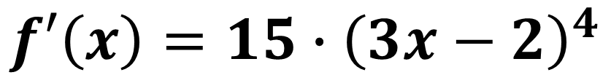
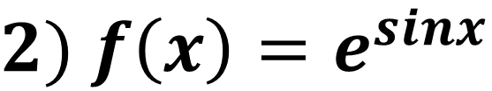
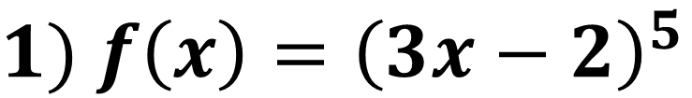
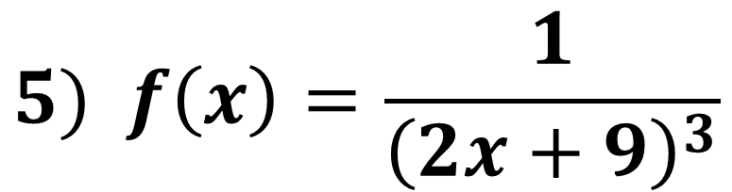

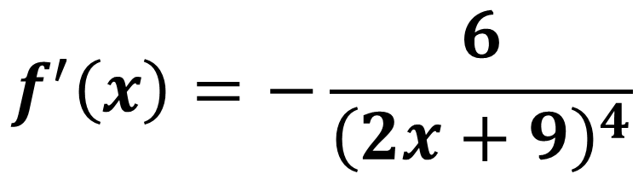
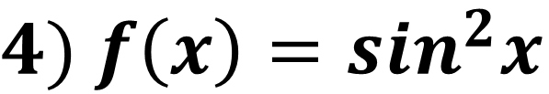
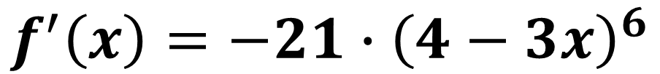
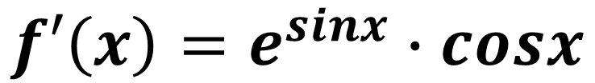
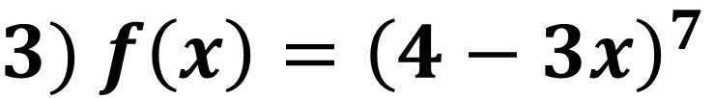
Topshiriqni tekshirish:
$№ 43$ ($33$-sahifa)
$1)$ $f\left(x\right)={\left(3x−2\right)}^{5}$
$$f′\left(x\right)=15∙{\left(3x−2\right)}^{4}$$
$2)$ $f\left(x\right)=e^{sinx}$
$$f′\left(x\right)=e^{sinx}∙cosx$$
$3)$ $f\left(x\right)={\left(4−3x\right)}^{7}$
$$f^{′}\left(x\right)=−21∙{\left(4−3x\right)}^{6}$$
$4)$ $f\left(x\right)=\sin^{2}x$
$$f^{′}(x)=2sinxcosx=sin2x$$
$$5) f\left(x\right)=\frac{1}{{\left(2x+9\right)}^{3}}$$
$$f^{′}\left(x\right)=−\frac{6}{{\left(2x+9\right)}^{4}}$$

Slide 4
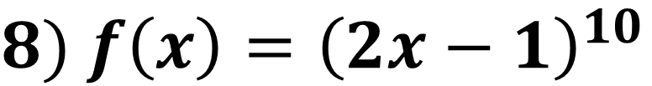
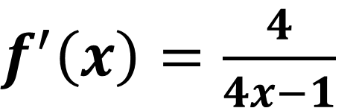
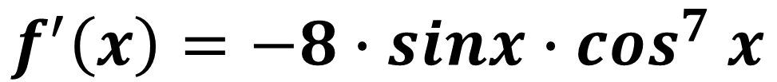
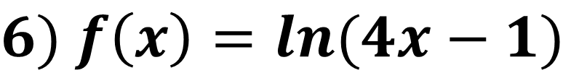
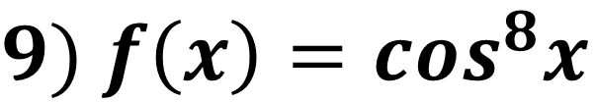
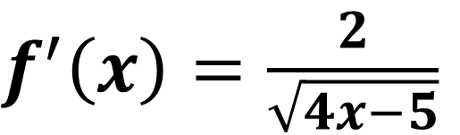
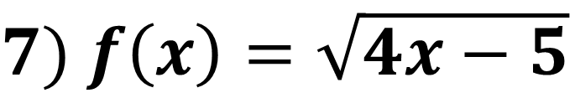
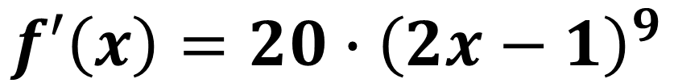
$f^{′}\left(x\right)=\frac{4}{4x−1}$
$6)$ $f\left(x\right)=ln(4x−1)$
$7)$ $f\left(x\right)=\sqrt{4x−5}$
$f^{′}\left(x\right)=\frac{2}{\sqrt{4x−5}}$
$8)$ $f\left(x\right)={\left(2x−1\right)}^{10}$
$$f′\left(x\right)=20∙{\left(2x−1\right)}^{9}$$
$9)$ $f\left(x\right)=\cos^{8}x$
$$f^{′}\left(x\right)=−8∙sinx{∙cos}^{7}x$$

Slide 5
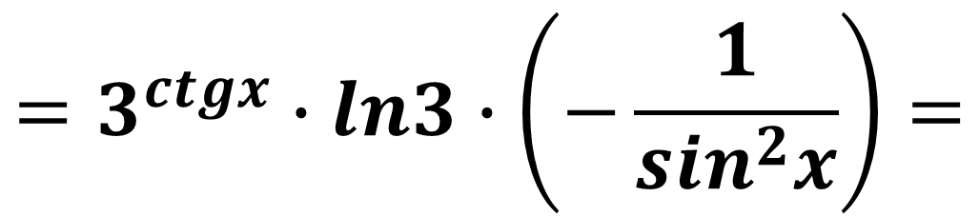


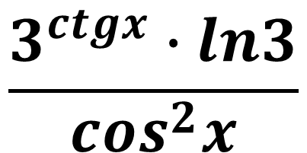

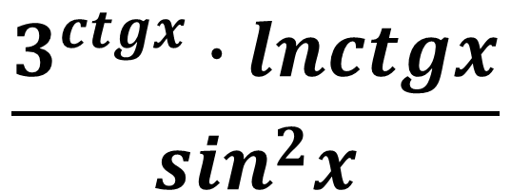

1-test.
$$y=3^{ctgx}$$
$$y^{′}= ?$$
$$\frac{3^{ctgx}∙lnctgx}{\sin^{2}x}$$
$$−\frac{3^{ctgx}∙ln3}{\sin^{2}x}$$
$$\frac{3^{ctgx}∙ln3}{\cos^{2}x}$$
$$y^{′}=3^{ctgx}∙ln3∙{\left(ctgx\right)}^{′}=$$
$$=3^{ctgx}∙ln3∙\left(−\frac{1}{\sin^{2}x}\right)=$$
$$−\frac{3^{ctgx}∙ln3}{\sin^{2}x}$$

Slide 6
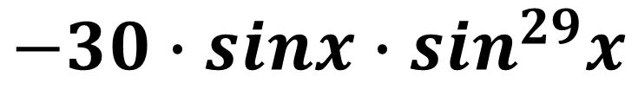

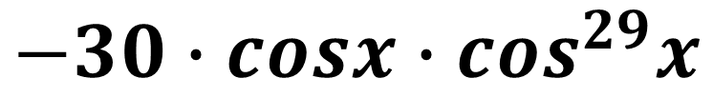

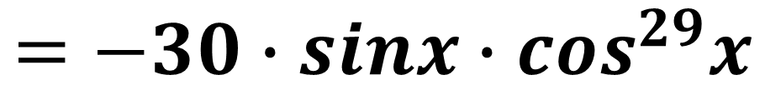

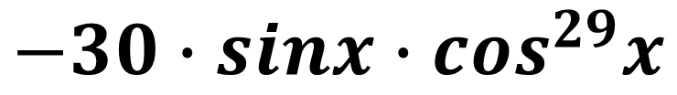
2-test.
$$y=\cos^{30}x$$
$$y^{′}= ?$$
$$−30∙cosx∙\cos^{29}x$$
$$−30∙sinx∙\cos^{29}x$$
$$−30∙sinx∙\sin^{29}x$$
$$y^{′}=30∙\cos^{30−1}x∙{\left(cosx\right)}^{′}=$$
$$=30∙\cos^{29}x∙\left(−sinx\right)=$$
$$=−30∙sinx∙\cos^{29}x$$

Slide 7
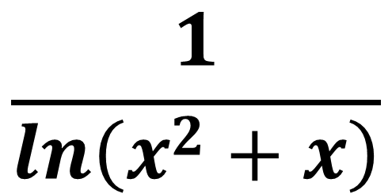




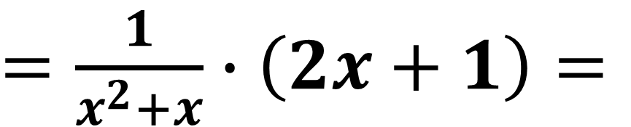
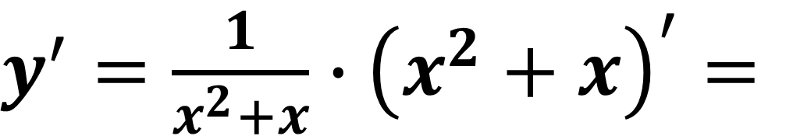
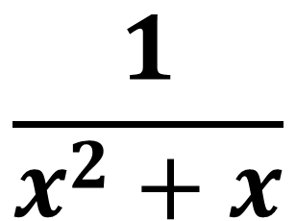
3-test.
$$y=ln\left(x^{2}+x\right)$$
$$y^{′}= ?$$
$$\frac{2x+1}{x^{2}+x}$$
$$\frac{1}{ln\left(x^{2}+x\right)}$$
$$\frac{1}{x^{2}+x}$$
$y^{′}=\frac{1}{x^{2}+x}∙{\left(x^{2}+x\right)}^{′}=$
$=\frac{1}{x^{2}+x}∙\left(2x+1\right)=$
$\frac{2x+1}{x^{2}+x}$

Slide 8
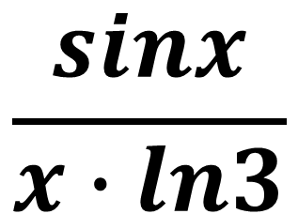
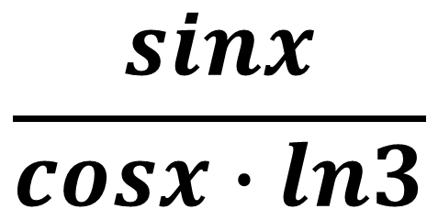


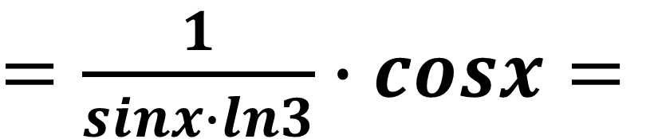
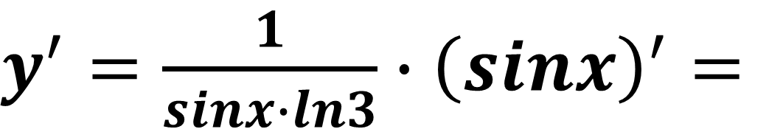

4-test.
$$y=\log_{3}{sinx}$$
$$y^{′}= ?$$
$$\frac{sinx}{cosx∙ln3}$$
$$\frac{cosx}{sinx∙ln3}$$
$$\frac{sinx}{x∙ln3}$$
$y^{′}=\frac{1}{sinx∙ln3}∙{\left(sinx\right)}^{′}=$
$=\frac{1}{sinx∙ln3}∙cosx=$
$\frac{cosx}{sinx∙ln3}$

Slide 9
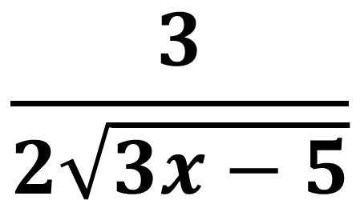




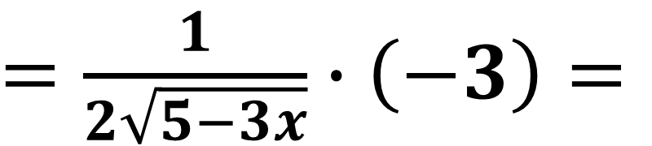
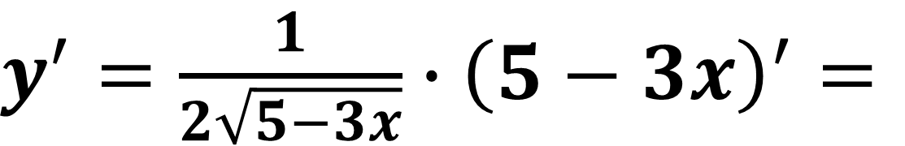
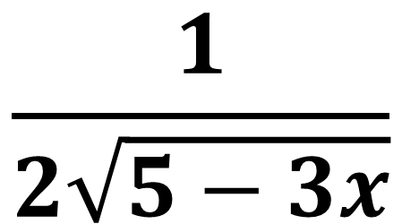
5-test.
$$y=\sqrt{5−3x}$$
$$y^{′}= ?$$
$$\frac{1}{2\sqrt{5−3x}}$$
$$\frac{3}{2\sqrt{3x−5}}$$
$$−\frac{3}{2\sqrt{5−3x}}$$
$y^{′}=\frac{1}{2\sqrt{5−3x}}∙{\left(5−3x\right)}^{′}=$
$=\frac{1}{2\sqrt{5−3x}}∙\left(−3\right)=$
$−\frac{3}{2\sqrt{5−3x}}$

Slide 10


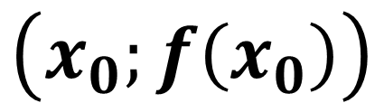


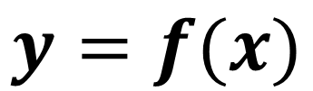
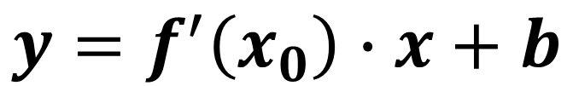

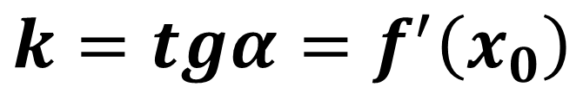

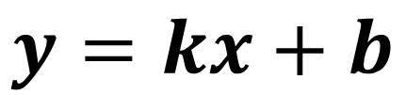

Urinma tenglamasi
$$y$$
$$y=f(x)$$
$$\left(x_{0};f\left(x_{0}\right)\right)$$
$$y=kx+b$$
$$y=f(x)$$
$$k=tgα=f^{′}\left(x_{0}\right)$$
$$f\left(x_{0}\right)$$
$$y=f^{′}\left(x_{0}\right)∙x+b$$
$$α$$
$$x$$
$$0$$
$$x_{0}$$

Slide 11
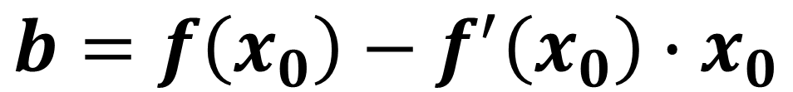


$$f\left(x_{0}\right)=f^{′}\left(x_{0}\right)∙x_{0}+b$$
$$b=f\left(x_{0}\right)−f^{′}\left(x_{0}\right)∙x_{0}$$
$$y=f^{′}\left(x_{0}\right)∙x+f\left(x_{0}\right)−f^{′}\left(x_{0}\right)∙x_{0}$$
$$y=f^{′}\left(x_{0}\right)∙\left(x−x_{0}\right)+f\left(x_{0}\right)$$
tenglama $\left(x_{0};f\left(x_{0}\right)\right)$ nuqtada
$y=f(x)$ funksiyaga o‘tkazilgan
urinma tenglamasi bo‘ladi.

Slide 12

1-misol
$f\left(x\right)=x^{2}−5x+2$ funksiya grafigiga $x_{0}=2$ abssissali nuqtada o‘tkazilgan urinma tenglamasini yozing.

Slide 13




Yechish:
$f\left(x\right)=x^{2}−5x+2$
$$x_{0}=2$$
$$f\left(x_{0}\right)=f\left(2\right)=2^{2}−5∙2+2=−4$$
$$f^{′}\left(x\right)=2x−5$$
$$f^{′}\left(x_{0}\right)=2∙2−5=−1$$

Slide 14








$$f\left(x_{0}\right)=−4$$
$$f^{′}\left(x_{0}\right)=−1$$
$$x_{0}=2$$
$$y−f\left(x_{0}\right)=f^{′}\left(x_{0}\right)∙\left(x−x_{0}\right)$$
$$y−\left(−4\right)=\left(−1\right)∙\left(x−2\right)$$
$$y+4=−x+2$$
$$y=−x−2$$
Javob: $y=−x−2$

Slide 15

2-misol
$f\left(x\right)=3x−4$ funksiya grafigiga abssissasi $x_{0}=−2$ bo‘lgan nuqtada o‘tkazilgan urinma tenglamasini yozing.

Slide 16





Yechish:
$f\left(x\right)=3x−4$
$$x_{0}=−2$$
$$f\left(x_{0}\right)=3∙\left(−2\right)−4=−6−4=−10$$
$$f^{′}\left(x\right)=3$$
$$f^{′}\left(x_{0}\right)=3$$

Slide 17









$$f\left(x_{0}\right)=−10$$
$$f^{′}\left(x_{0}\right)=3$$
$$x_{0}=−2$$
$$y−f\left(x_{0}\right)=f^{′}\left(x_{0}\right)∙\left(x−x_{0}\right)$$
$$y−\left(−10\right)=3∙\left(x−\left(−2\right)\right)$$
$$y+10=3∙\left(x+2\right)$$
$$y=3x+6−10$$
$$y=3x−4$$
Javob: $y=3x−4$

Slide 18

3-misol
$f\left(x\right)=cosx−sinx$funksiya grafigiga $x_{0}=0$ abssissali nuqtada o‘tkazilgan urinma tenglamasini yozing.

Slide 19





Yechish:
$$f\left(x\right)=cosx−sinx$$
$$x_{0}=0$$
$$f\left(x_{0}\right)=cos0−sin0=1$$
$$f^{′}\left(x\right)={\left(cosx\right)}^{′}−{\left(sinx\right)}^{′}=$$
$$=−sinx−cosx=$$
$$=−\left(sinx+cosx\right)$$

Slide 20







$$f\left(x_{0}\right)=0$$
$$f^{′}\left(x_{0}\right)=−1$$
$$x_{0}=0$$
$$f^{′}\left(x_{0}\right)=−\left(sin0+cos0\right)=−1$$
$$y−f\left(x_{0}\right)=f^{′}\left(x_{0}\right)∙\left(x−x_{0}\right)$$
$$y=−x$$
Javob: $y=−x$

Slide 21

Agar $y=f(x)$ funksiya grafigining $x_{0}$ abssissali nuqtasida o‘tkazilgan urinma $y=kx+b$
to‘g‘ri chiziqqa parallel bo‘lsa,
$f^{′}\left(x_{0}\right)=k$ bo‘ladi.

Slide 22

4-misol
$f\left(x\right)=x^{2}−3x+4$
funksiya uchun $y=2x−1$
to‘g‘ri chiziqqa parallel bo‘lgan urinma tenglamasini yozing.

Slide 23










Yechish:
$f\left(x\right)=x^{2}−3x+4$
$$f^{′}\left(x\right)=2x−3$$
$$f^{′}\left(x_{0}\right)=2x_{0}−3$$
$y=kx+b$
$y=2x−1$
$k=2$
$f^{′}\left(x_{0}\right)=k$
$2x_{0}−3=2$
$2x_{0}=5$
$x_{0}=2,5$

Slide 24




$f\left(x\right)=x^{2}−3x+4$
$x_{0}=2,5$
$f\left(x_{0}\right)={\left(2,5\right)}^{2}−3∙2,5+4=2,75$
$$f′\left(x\right)=2x−3$$
$$f^{′}\left(x_{0}\right)=2∙2,5−3=5−3=2$$

Slide 25









$$f^{′}\left(x_{0}\right)=2$$
$f\left(x_{0}\right)=2,75$
$x_{0}=2,5$
$$y−f\left(x_{0}\right)=f^{′}\left(x_{0}\right)∙\left(x−x_{0}\right)$$
$$y−2,75=2∙\left(x−2,5\right)$$
$$y−2,75=2x−5$$
$$y=2x−5+2,75$$
$$y=2x−2,25$$
Javob: $y=2x−2,25$

Slide 26

Mustaqil bajarish uchun topshiriq:
Darslikning 37-sahifasida
berilgan 45-misolning
1, 5, 7 va 9-topshiriqlarini
yeching.

