Slide 1
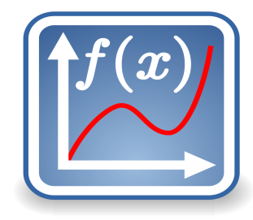
Algebra
11-sinf
Mavzu:
Limit haqida tushuncha
Fan o‘qituvchisi:
Turg‘unova Mohizabon Mahmudjon qizi

Slide 2
Reja:
Funksiyaning limiti
O‘rganilgan mavzuga doir
misollar yechish

Slide 3
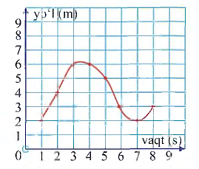


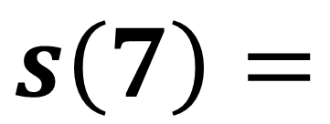

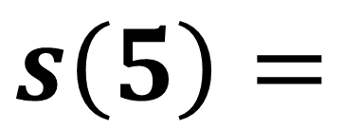

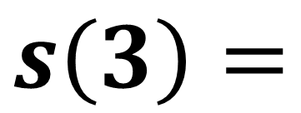


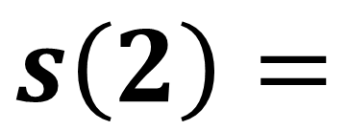


Topshiriqni tekshirish:
№ 7.2 (11-bet)
$$s\left(2\right)=$$
$$4$$
$$?$$
$$6$$
$$s\left(3\right)=$$
$$?$$
$$s\left(5\right)=$$
$$5$$
$$?$$
$$s\left(7\right)=$$
$$?$$
$$2$$

Slide 4
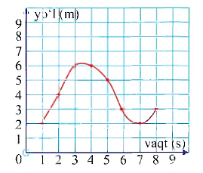
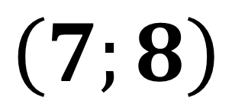
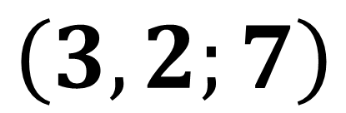
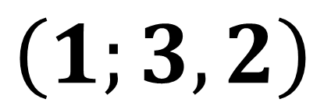
$$\left(1;3,2\right)$$
$$\left(3,2;7\right)$$
$$\left(7;8\right)$$

Slide 5
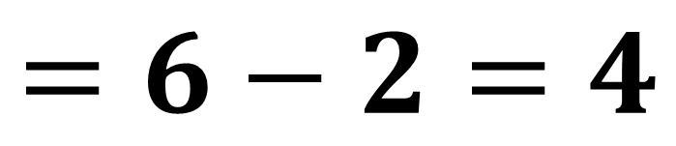
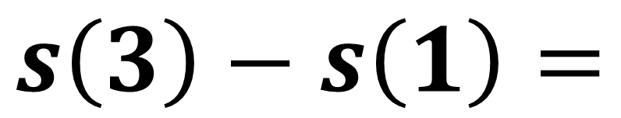
$$s\left(3\right)−s\left(1\right)=$$
$$=6−2=4$$

Slide 6
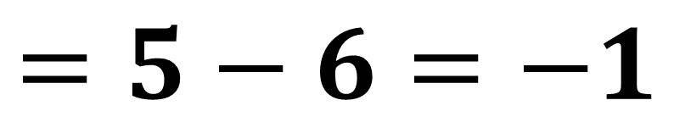
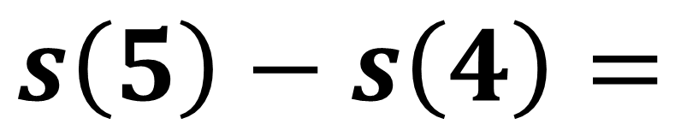
$$s\left(5\right)−s\left(4\right)=$$
$$=5−6=−1$$

Slide 7
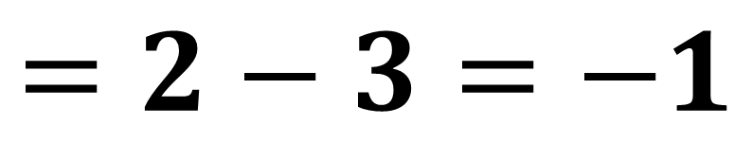
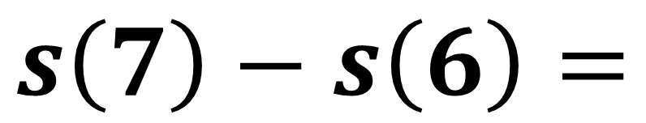
$$s\left(7\right)−s\left(6\right)=$$
$$=2−3=−1$$

Slide 8
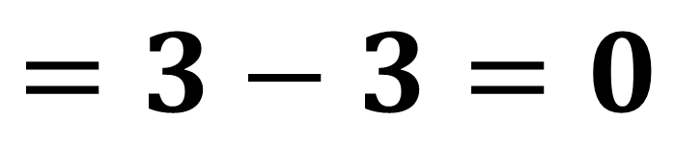
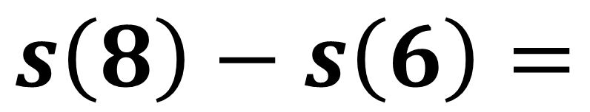
$$s\left(8\right)−s\left(6\right)=$$
$$=3−3=0$$

Slide 9
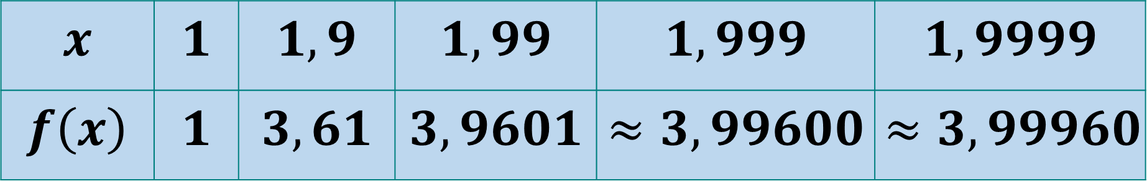
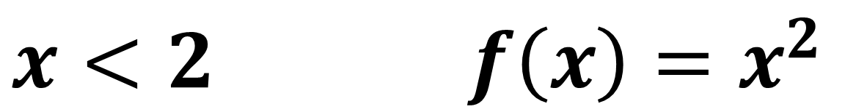
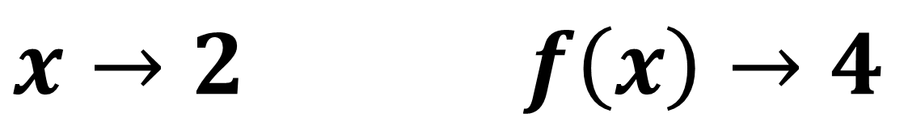
$x<2$ $f\left(x\right)=x^{2}$
$$x$$ | $$1$$ | $$1,9$$ | $$1,99$$ | $$1,999$$ | $$1,9999$$
$$f\left(x\right)$$ | $$1$$ | $$3,61$$ | $$3,9601$$ | $$≈3,99600$$ | $$≈3,99960$$
$x→2$ $f\left(x\right)→4$

Slide 10
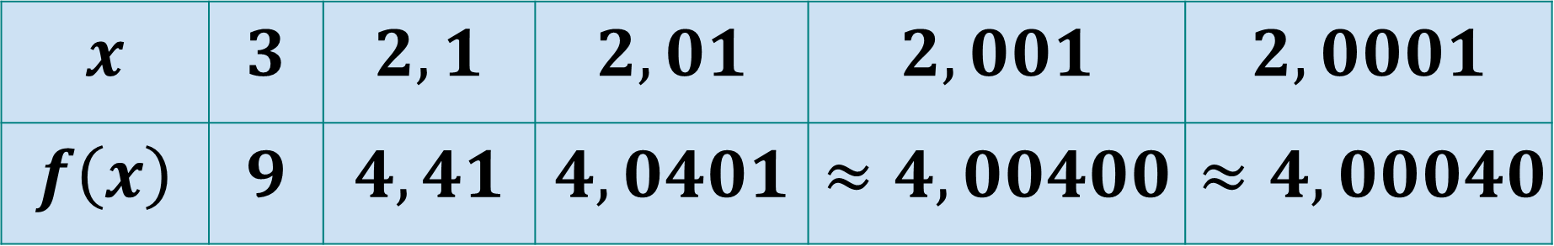
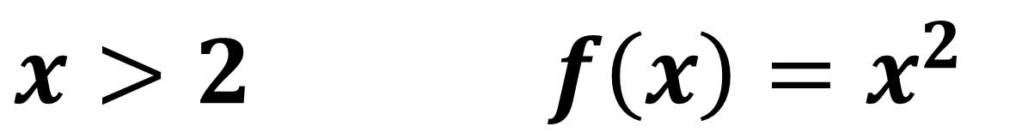
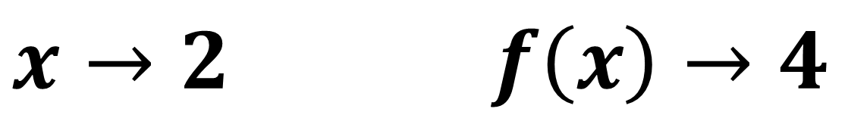
$x>2$ $f\left(x\right)=x^{2}$
$$x$$ | $$3$$ | $$2,1$$ | $$2,01$$ | $$2,001$$ | $$2,0001$$
$$f\left(x\right)$$ | $$9$$ | $$4,41$$ | $$4,0401$$ | $$≈4,00400$$ | $$≈4,00040$$
$x→2$ $f\left(x\right)→4$

Slide 11
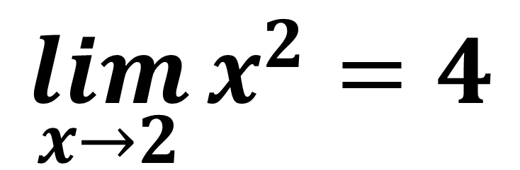
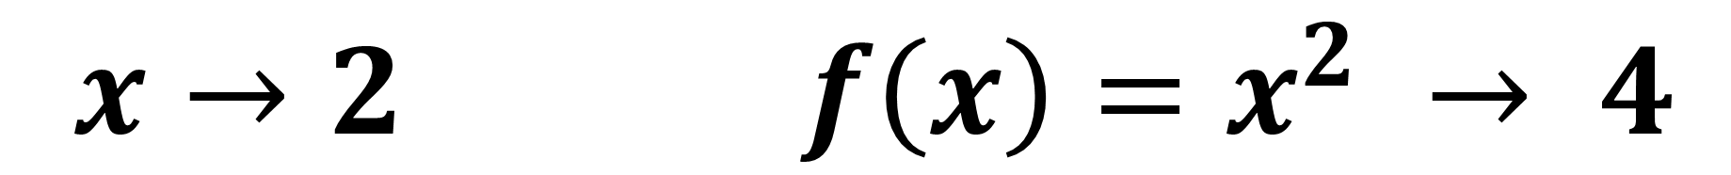
$x→2$ $f\left(x\right)=x^{2} → 4$
$$\lim_{x→2}{x^{2}}=4$$

Slide 12
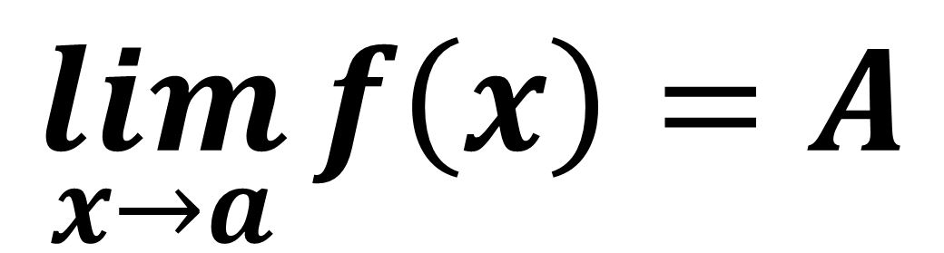
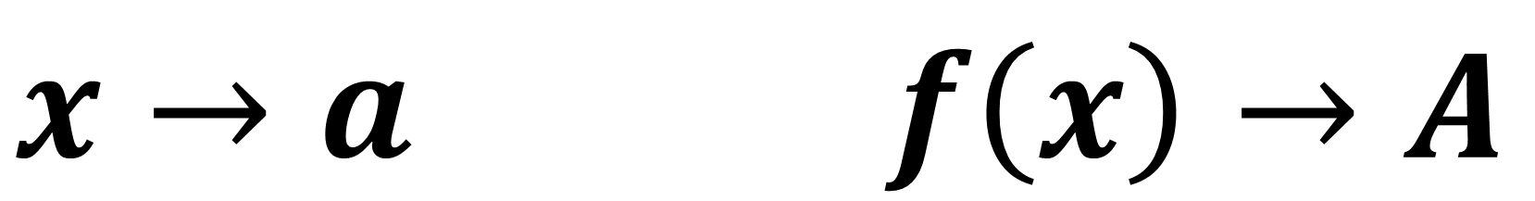
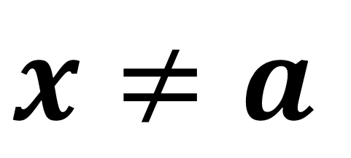
Funksiyaning limiti
$x≠a$
$$\lim_{x→a}{f\left(x\right)=A}$$
$x→a$ $f\left(x\right)→A$

Slide 13
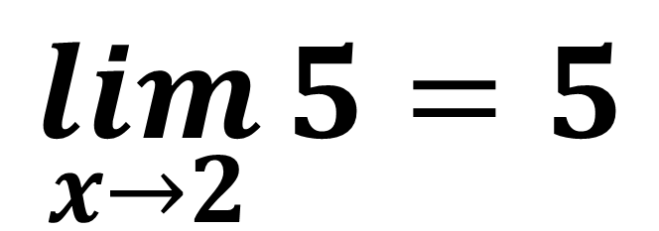
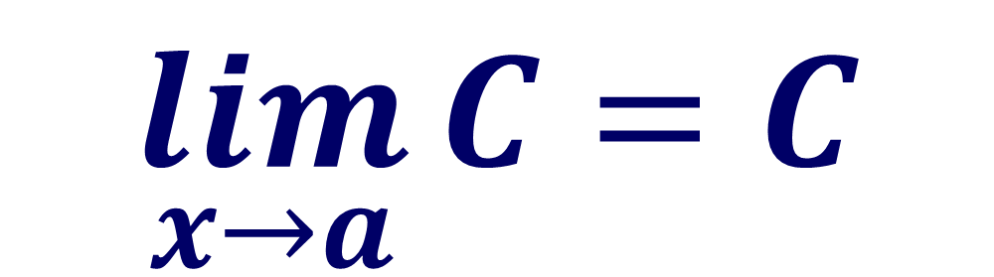
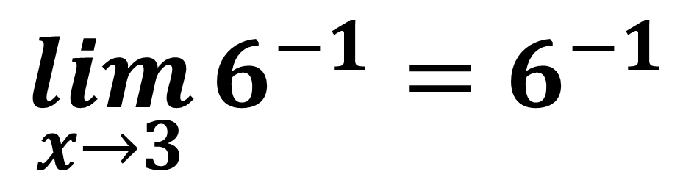
1-misol
$$\lim_{x→a}{C}=C$$
$$\lim_{x→2}{5}=5$$
$$\lim_{x→3}{6^{−1}}=6^{−1}$$

Slide 14
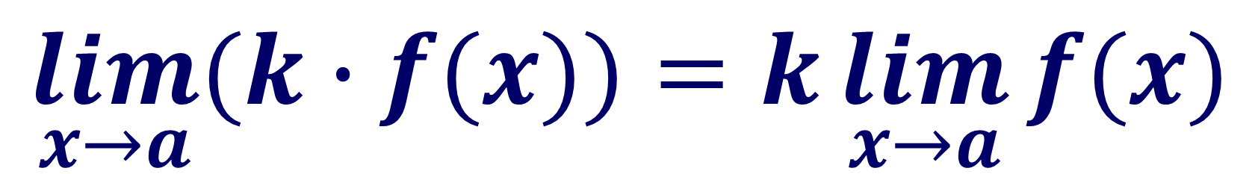
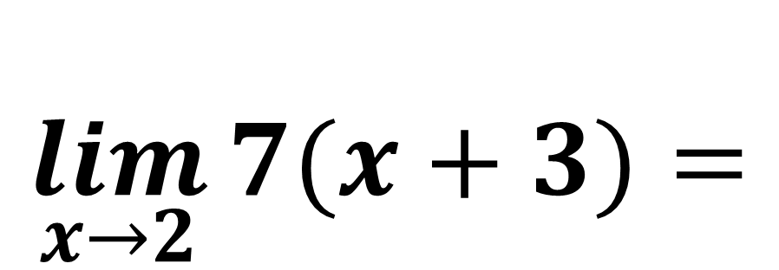
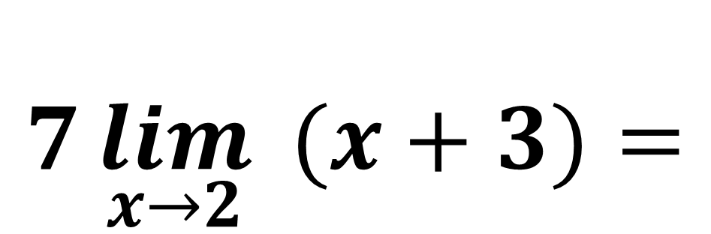
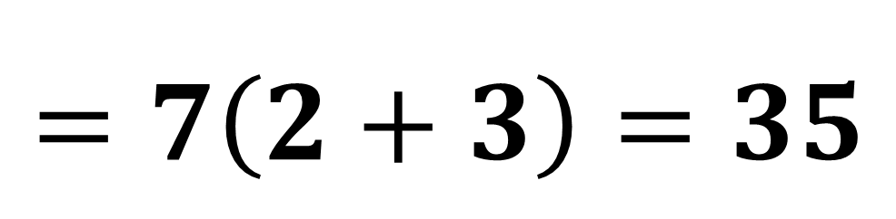
2-misol
$$\lim_{x→a}{(k∙f(x))}=k\lim_{x→a}{f(x)}$$
$$\lim_{x→2}{7(x+3)}=$$
$$7\lim_{x→2}{ (x+3)}=$$
$$=7\left(2+3\right)=35$$

Slide 15
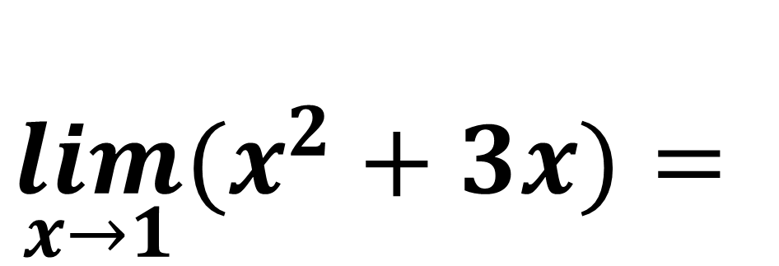
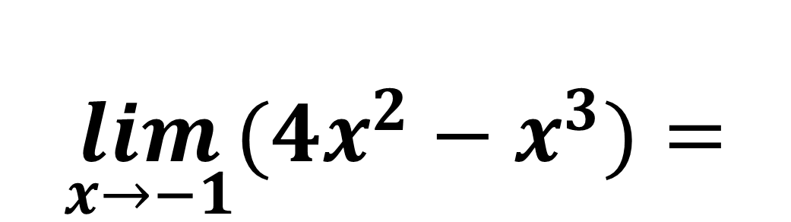
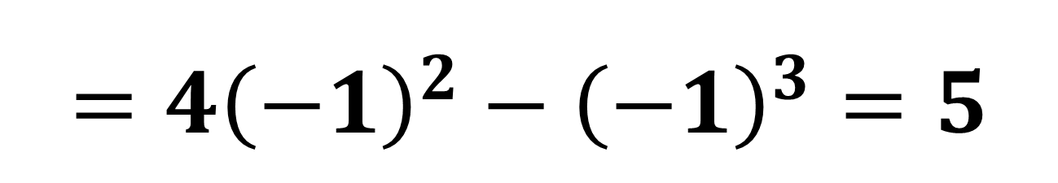
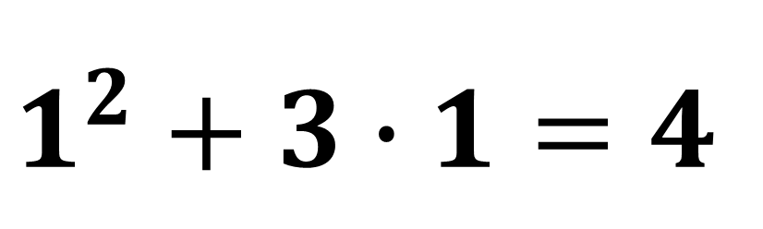
3-misol
$$\lim_{x→1}{(x^{2}+3x)}=$$
$$1^{2}+3∙1=4$$
$$\lim_{x→−1}{(4x^{2}−x^{3})}=$$
$$={4\left(−1\right)}^{2}−{\left(−1\right)}^{3}=5$$

Slide 16
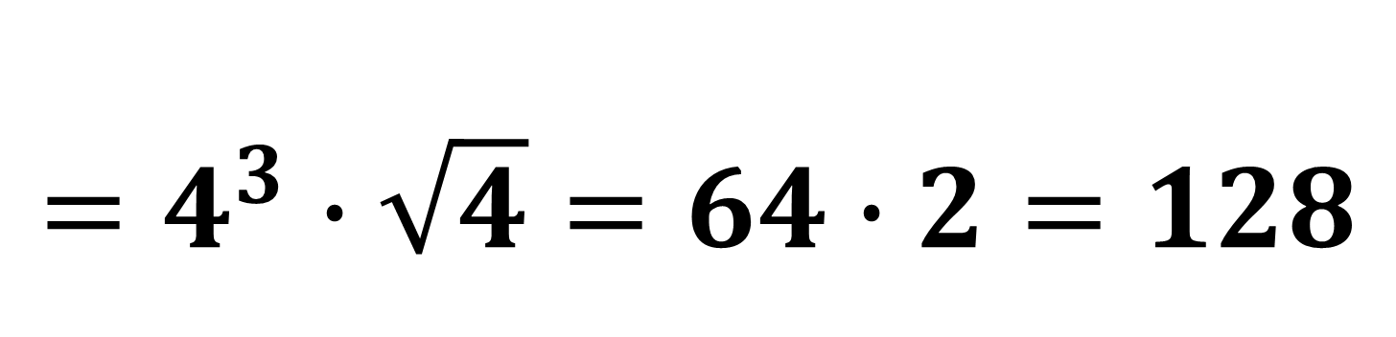
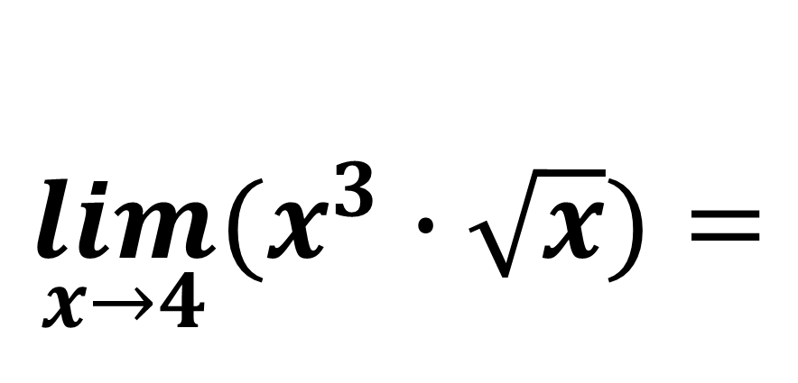
4-misol
$$\lim_{x→4}{(x^{3}∙\sqrt{x})}=$$
$$=4^{3}∙\sqrt{4}=64∙2=128$$

Slide 17
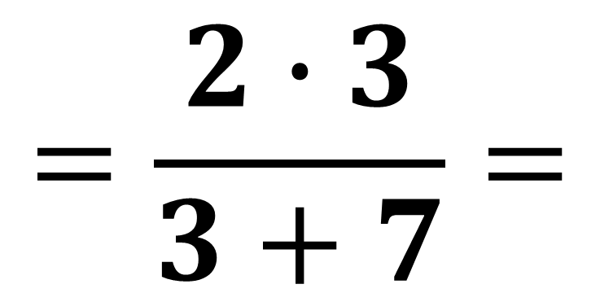
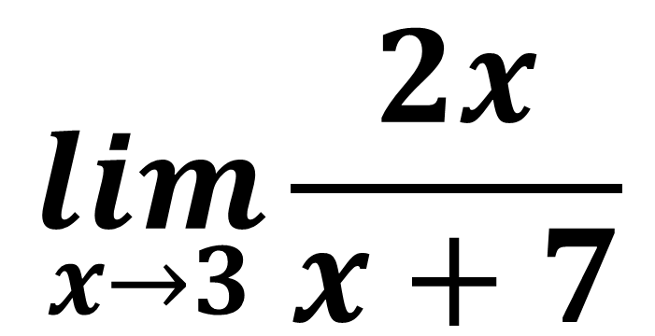
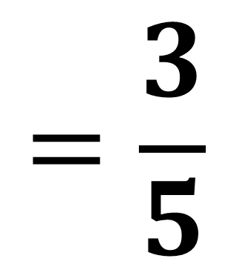
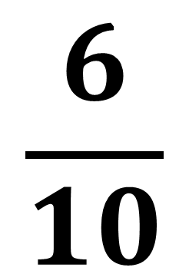
5-misol
$$\lim_{x→3}{\frac{2x}{x+7}}$$
$$=\frac{2∙3}{3+7}=$$
$$\frac{6}{10}$$
$$=\frac{3}{5}$$

Slide 18
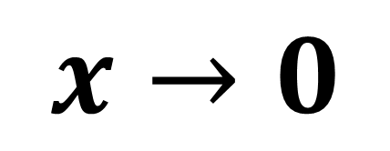
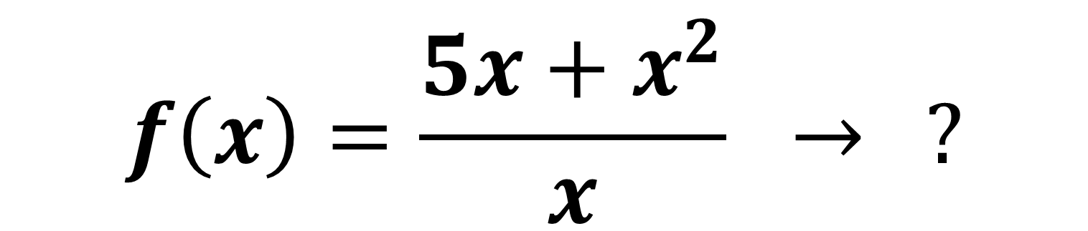


6-misol
$$f\left(x\right)=\frac{5x+x^{2}}{x} → ?$$
$$x→0$$
$$f\left(x\right)=\frac{5∙0+0^{2}}{0}=\frac{0}{0}$$
$x=0$

Slide 19



$$f\left(x\right)=\frac{5x+x^{2}}{x}=$$
$$\frac{x(5+x)}{x}$$
$$f\left(x\right)=\left\{\begin{aligned}5+x, x≠0 \\ aniqlanmagan, x=0 \end{aligned}\right.$$

Slide 20








$$y=x+5$$
$$y$$
$$f\left(x\right)=\frac{5x+x^{2}}{x}$$
$$5$$
uzilish
nuqtasi
-$5$
$$x$$
$$O$$

Slide 21



$$\lim_{x→0}{\frac{5x+x^{2}}{x}=}$$
$$\lim_{x→0}{\frac{x\left(5+x\right)}{x}=}$$
$$=\lim_{x→0}\left(5+x\right)=5$$

Slide 22




7-misol
$x−4≠0$ $x≠4$
$$\lim_{x→4}{\frac{x^{2}−16}{x−4} }=$$
$$\lim_{x→4}{\frac{\left(x−4\right)\left(x+4\right)}{x−4} }=$$
$$=\lim_{x→4}\left(x+4\right)=8$$

Slide 23

Topshiriq
Darslikning
14-sahifasida berilgan
8-misolni yeching.

