Slide 1
Algebra
11-sinf
Mavzu: O‘zgaruvchi miqdorlar orttirmalarining nisbati
Fan o‘qituvchisi:
Turg‘unova Mohizabon Mahmudjon qizi

Slide 2
Reja:
O‘zgaruvchi miqdorlar
O‘rganilgan mavzuga doir
masalalar yechish

Slide 3
$1$-masala
$1$-o‘quvchi
$2$-o‘quvchi
$3$ minut
$4$ minut
$213$ ta so‘z
$260$ ta so‘z
$6$ ta imloviy xato
$7$ ta imloviy xato

Slide 4
$1$-o‘quvchi
Matn terishning tezligi:
$$\frac{213 \text{ta} \text{so}\text{‘}\text{z} }{3 min}=71\frac{\text{so}\text{‘}\text{z} }{min}$$
Matn terishning sifati:
$$\frac{\text{6} \text{ta} \text{xato}}{\text{213} \text{ta} \text{so}\text{‘}\text{z}}≈0,0282 \frac{\text{xato}}{\text{so}\text{‘}\text{z}}$$

Slide 5
$2$-o‘quvchi
Matn terishning tezligi:
$$\frac{260 \text{ta} \text{so}\text{‘}\text{z} }{4 min}=65 \frac{\text{so}\text{‘}\text{z} }{min}$$
Matn terishning sifati:
$$\frac{\text{7 }\text{ta} \text{xato}}{\text{260 }\text{ta} \text{so}\text{‘}\text{z}}≈0,0269 \frac{\text{xato}}{\text{so}\text{‘}\text{z}}$$

Slide 6
$1$-o‘quvchi
$2$-o‘quvchi
$$71 \frac{\text{so}\text{‘}\text{z} }{min}$$
$$65 \frac{\text{so}\text{‘}\text{z} }{min}$$
$$≈0,0282 \frac{\text{xato}}{\text{so}\text{‘}\text{z}}$$
$$≈0,0269 \frac{\text{xato}}{\text{so}\text{‘}\text{z}}$$

Slide 7
$2$-masala
Bemorning pulsi o‘lchanganda u bir minutda 67 ta zarbani his qildi.
Puls chastotasi qanday kattalik?
b) Har soatda bemorning yuragi
necha marta uradi?

Slide 8
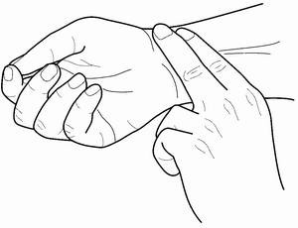
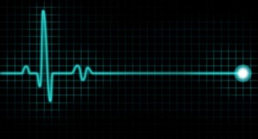
Puls chastotasi
$$1 soat=60 minut$$
$67∙60=4020$

Slide 9
$3$-masala
Ma’ruf 12 soat ishlab 148 m 20 cm, Murod 13 soat ishlab 157 m 95 cm ariq tozaladi. Ularning mehnat unumdorligini solishtiring.

Slide 10
Ma’ruf
Murod
$12$ soat
$13$ soat
$$148 m 20 cm$$
$$157 m 95 cm$$

Slide 11
Ma’ruf
$$148 m 20 cm =148,2 m$$
$$\frac{148,2 }{12 }≈12,34$$

Slide 12
Murod
$$157 m 95 cm=157,95 m$$
$$\frac{157,95}{13 }≈12,15$$

Slide 13
Ma’ruf
Murod
$$≈12,34$$
$$≈12,15$$

Slide 14
$4$-masala
Avtomashina yangi shina protektorining chuqurligi 8 mm ni tashkil qiladi. 32178 km yurilganidan so‘ng yemirilish natijasida shina protektorining chuqurligi 2,3 mm bo‘lgani ma’lum bo‘ldi.
1 km masofa yurilganda shina protektori chuqurligi qanday o‘zgaradi?
b) 10000 km masofa yurilganda-chi?

Slide 15
$$8 mm –2,3 mm =5,7 mm$$
$$32178 km$$
$$5,7 mm$$
$$1 km$$
$$?$$
$$\frac{5,7 }{32178 }=0,000177 mm$$

Slide 16
$$32178 km$$
$$5,7 mm$$
$$10000 km$$
$$?$$
$$\frac{5,7∙10000 }{32178 }≈1,771 mm$$

Slide 17
$5$-masala
Yo‘lovchi Qarshi shahridan soat 11:43 da chiqib, soat 15:49 da Guliston shahriga yetib keldi. Agar u 350 km masofa yurgan bo‘lsa, uning o‘rtacha tezligi necha $\frac{km}{soat}$ bo‘ldi?

Slide 18
11:43
15:49
Q
G
$4$soat $6$ minut $=4,1$ soat
$$\frac{350 km}{4,1 soat}=85,3 \frac{km}{soat}$$

Slide 19
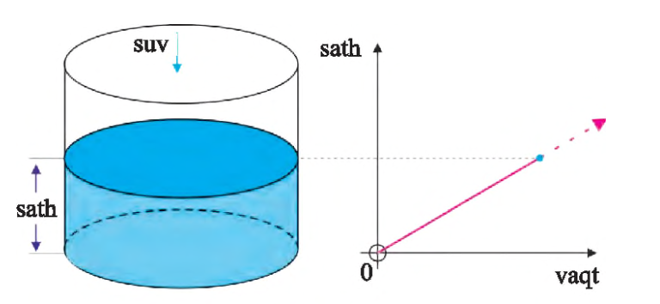

Slide 20
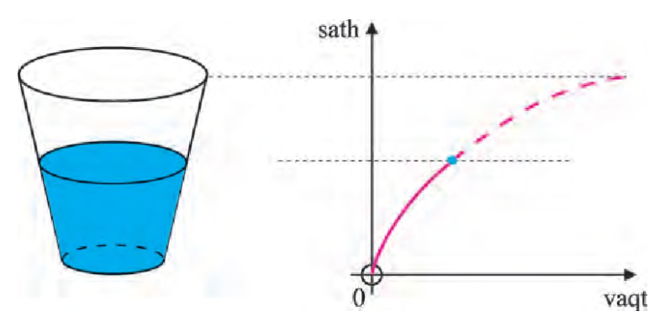

Slide 21
Topshiriq
Darslikning 4-sahifasida
berilgan
2-masalani yeching.

