Slide 1
Geometriya
11-sinf
Mavzu: Amaliy mashqlar yechish

Slide 2
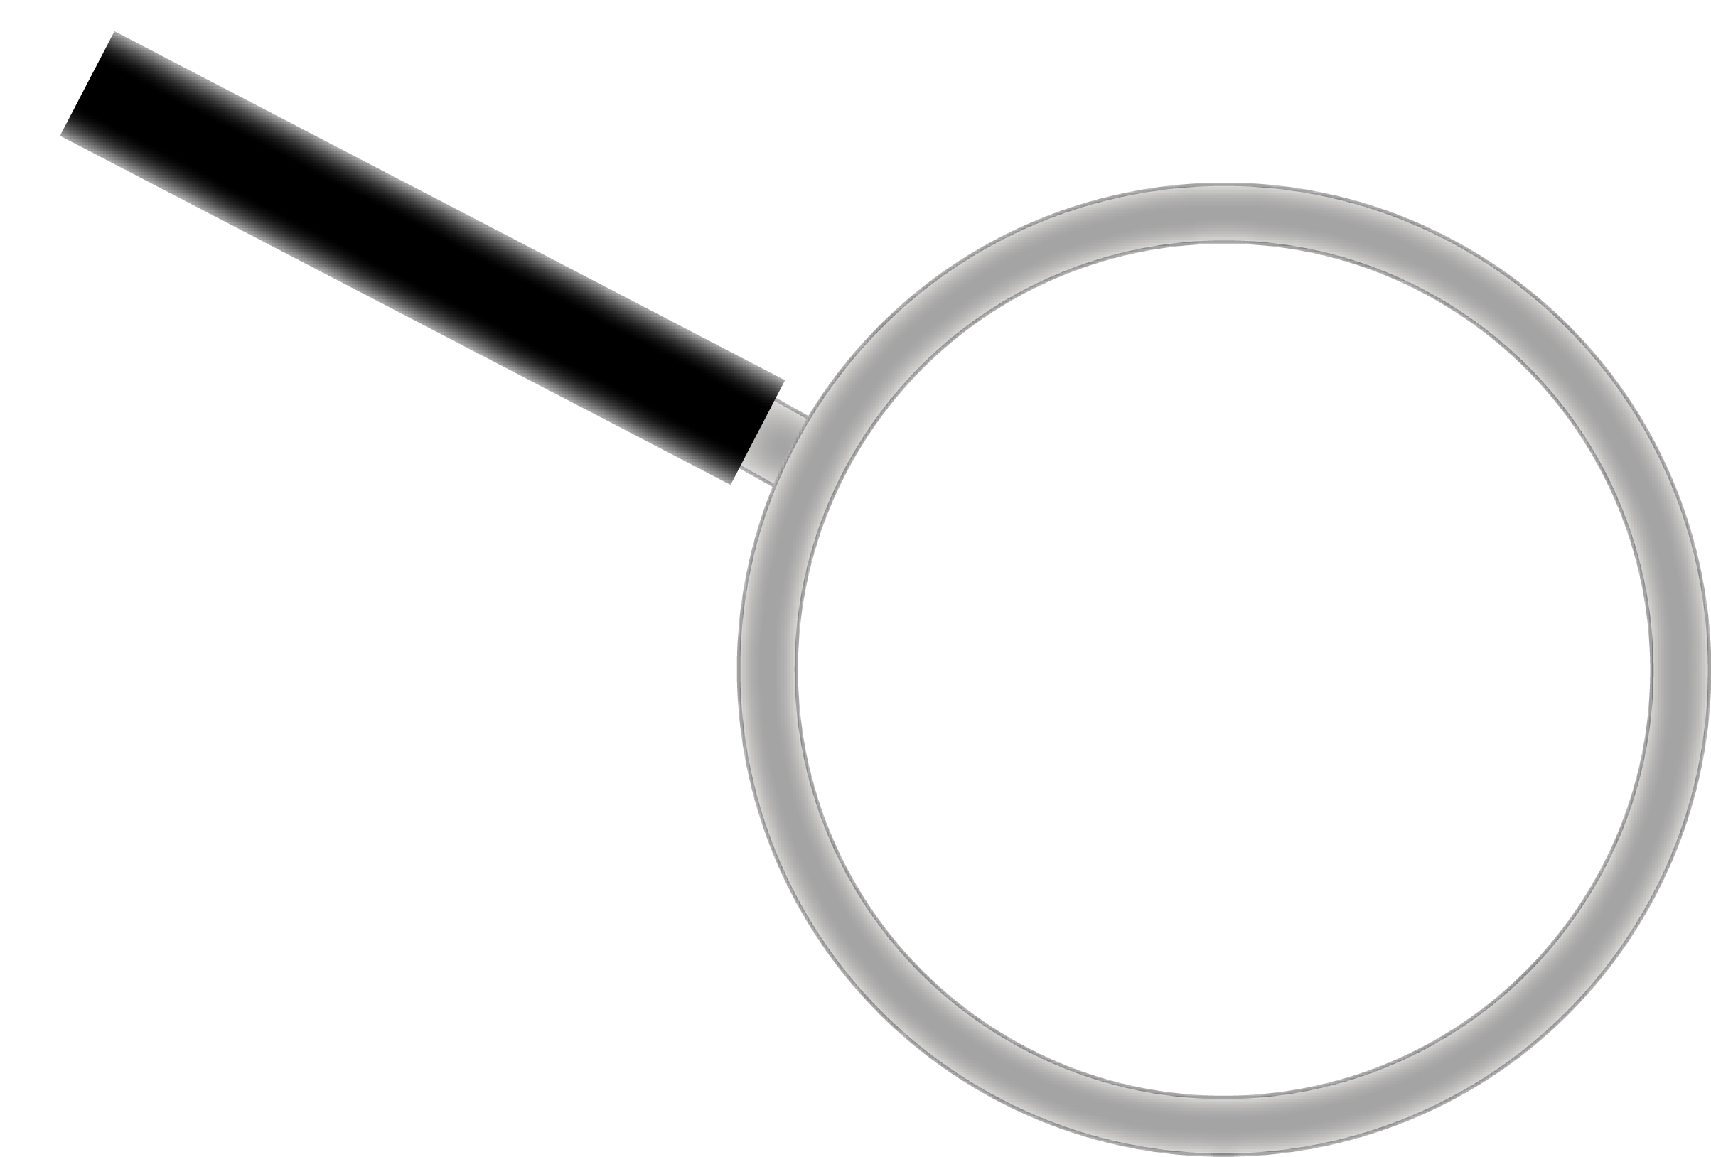
1-masala
Silindrdan konus rasmda ko‘rsatilgandek o‘yib olingan. Agar silindr asosining radiusi $6 cm$ va balandligi $8 cm$ bo‘lsa, hosil bo‘lgan jismning hajmini toping.

Slide 3
Masalaning yechimi
Berilgan:
$$r=6 cm$$
$$H=8 cm$$
$$r$$
Topish kerak:
$$H$$
$$V_{jism}= ?$$
$$r$$

Slide 4
$$r=6 cm$$
$$H=8 cm$$
$$V_{silindr}= πr^{2}H$$
$$V_{silindr}= π∙6^{2}∙8=$$
$$r$$
$$= π∙36∙8=288π {cm}^{3}$$
$$H$$
$$r$$

Slide 5
$$r=6 cm$$
$$H=8 cm$$
$$V_{konus}=\frac{1}{3}πr^{2}H$$
$$V_{konus}=\frac{1}{3}π∙6^{2}∙8=$$
$$r$$
$$H$$
$=\frac{1}{3}π∙36∙8=96π {cm}^{3}$

Slide 6
$$V_{silindr}=288π$$
$$V_{konus}=96π$$
$$V_{jism}=V_{s}−V_{k}$$
$$V_{jism}=288π−96π=$$
$$=192π {cm}^{3}$$
Javob: $192π {cm}^{3}$

Slide 7
2-masala
Katetlari $12 cm$ va $16 cm$ bo‘lgan to‘g‘ri burchakli uchburchak kichik katet atrofida aylanadi. Hosil bo‘lgan aylanma jism to‘la sirtining yuzini hisoblang.

Slide 8
Masalaning yechimi
Berilgan:
$$A$$
$$16$$
$$O$$
$$B$$
$$12$$

Slide 9
Masalaning yechimi
Berilgan:
$$r=16 cm$$
$$H=12 cm$$
$$16$$
Topish kerak:
$$12$$
$$S_{\text{to}\text{‘}\text{la} }= ?$$

Slide 10
$$r=16 cm$$
$$H=12 cm$$
$$l^{2}=H^{2}+r^{2}$$
$$l^{2}={12}^{2}+{16}^{2}=400$$
$$l=20 cm$$
$$S_{\text{to}\text{‘}\text{la} }=πr\left(r+l\right)=$$
$$l$$
$$r$$
$$=π∙16∙\left(16+20\right)=$$
$$H$$
$$=576π$$
Javob: $576π {cm}^{2}$

Slide 11
3-masala
Konus yon sirtining yuzi $32π$ ga teng, uning yasovchisi asos tekisligiga ${60}^{0}$ li burchak ostida og‘gan. Konusning hajmini toping.

Slide 12
Masalaning yechimi
Berilgan:
$$S_{yon}=32π$$
$$α={60}^{0}$$
Topish kerak:
$$l$$
$$H$$
$$V= ?$$
$$α$$
$$r$$

Slide 13
$$α={60}^{0}$$
$$cosα=\frac{r}{l}$$
$$cos{60}^{0}=\frac{r}{l}$$
$$l$$
$$\frac{1}{2}=\frac{r}{l}$$
$$H$$
$$l=2r$$
$$α$$
$$r$$

Slide 14
$$l=2r$$
$$l=2r=2∙4=8$$
$$S_{yon}=πrl$$
$$l^{2}=H^{2}+r^{2}$$
$$32π=πr∙2r$$
$$H^{2}=l^{2}−r^{2}$$
$$r^{2}=16$$
$$H^{2}=8^{2}−4^{2}=48$$
$$r=4$$
$$H=4\sqrt{3}$$
$V=\frac{1}{3}πr^{2}H=\frac{1}{3}π∙4^{2}∙4\sqrt{3}=\frac{64\sqrt{3}π}{3}$
Javob: $\frac{64\sqrt{3}π}{3}$

Slide 15
4-masala
Rasmda ko‘rsatilgan shaklni $Ox$ o‘qi atrofida aylantirishdan hosil bo‘lgan jismning hajmini toping.
$$y$$
$$3$$
-$4$
$$0$$
$$3$$
$$x$$

Slide 16
Masalaning yechimi
Berilgan:
$$r=3$$
$$H=4$$
$$3$$
Topish kerak:
$$4$$
$$V= ?$$

Slide 17
$$r=3$$
$$H=4$$
$$V=\frac{1}{3}πr^{2}H=\frac{1}{3}π∙3^{2}∙4=12π$$
Javob: $12π$

Slide 18
5-masala
Konus asosining yuzi $40$ ga teng, uning yasovchisi asos tekisligi bilan ${60}^{0}$ li burchak tashkil qiladi.
Konus yon sirtining yuzini toping.

Slide 19
Masalaning yechimi
Berilgan:
$$S_{asos}=40$$
$$α={60}^{0}$$
Topish kerak:
$$l$$
$$H$$
$$S_{yon}= ?$$
$$α$$
$$r$$

Slide 20
$$α={60}^{0}$$
$$cosα=\frac{r}{l}$$
$$cos{60}^{0}=\frac{r}{l}$$
$$l$$
$$\frac{1}{2}=\frac{r}{l}$$
$$H$$
$$l=2r$$
$$α$$
$$r$$

Slide 21
$$S_{asos}=πr^{2}$$
$$40=πr^{2}$$
$r=\sqrt{\frac{40}{π}}=\frac{2\sqrt{10}}{\sqrt{π}}$
$r^{2}=\frac{40}{π}$
$l=2r=2∙\frac{2\sqrt{10}}{\sqrt{π}}=\frac{4\sqrt{10}}{\sqrt{π}}$
$S_{yon}=πrl=π∙\frac{2\sqrt{10}}{\sqrt{π}}∙\frac{4\sqrt{10}}{\sqrt{π}}=80$
Javob: $80$

Slide 22
6-masala
Uchlari $Oxy$ tekisligining $\left(0;0\right), \left(5;0\right)$ va $\left(0;9\right)$ nuqtalarda bo‘lgan to‘g‘ri burchakli uchburchakning a) $Ox;$ b) $Oy$ o‘qi atrofida aylanishidan hosil bo‘lgan fazoviy jismning to‘la sirtini va hajmini toping.

Slide 23
Masalaning yechimi
$$Oxy$$
$$y$$
$\left(0;0\right), \left(5;0\right)$, $\left(0;9\right)$
$$9$$
$$x$$
$$0$$
$$5$$

Slide 24
a) $Ox$ o‘qi atrofida
Berilgan:
$$y$$
$$r=9$$
$$9$$
$$H=5$$
Topish kerak:
$$r$$
$$V= ?$$
$$H$$
$$x$$
$$0$$
$$5$$

Slide 25
a) $Ox$ o‘qi atrofida
$$r=9$$
$$H=5$$
$$y$$
$$l^{2}=9^{2}+5^{2}=106$$
$$9$$
$$l= \sqrt{106 }$$
$$r$$
$$l$$
$$H$$
$$x$$
$$0$$
$$5$$

Slide 26
$$l= \sqrt{106 }$$
$$r=9$$
$$H=5$$
$$S_{\text{to}\text{‘}\text{la} }=πr\left(r+l\right)=π∙9∙\left(9+\sqrt{106}\right)=$$
$$=81π+9π\sqrt{106}$$
$$V=\frac{1}{3}πr^{2}H=\frac{1}{3}π∙9^{2}∙5=135π$$
Javob: $S_{\text{to}\text{‘}\text{la} }=81π+9π\sqrt{106}$;
$V=135π$

Slide 27
b) $Oy$ o‘qi atrofida
Berilgan:
$$y$$
$$r=5$$
$$9$$
$$H=9$$
Topish kerak:
$$H$$
$$V= ?$$
$$r$$
$$x$$
$$0$$
$$5$$

Slide 28
b) $Oy$ o‘qi atrofida
$$r=5$$
$$H=9$$
$$y$$
$$l^{2}=9^{2}+5^{2}=106$$
$$9$$
$$l= \sqrt{106 }$$
$$H$$
$$l$$
$$r$$
$$x$$
$$0$$
$$5$$

Slide 29
$$l= \sqrt{106 }$$
$$r=5$$
$$H=9$$
$$S_{\text{to}\text{‘}\text{la} }=πr\left(r+l\right)=π∙5∙\left(5+\sqrt{106}\right)=$$
$$=25π+5π\sqrt{106}$$
$$V=\frac{1}{3}πr^{2}H=\frac{1}{3}π∙5^{2}∙9=75π$$
Javob: $S_{\text{to}\text{‘}\text{la} }=25π+5π\sqrt{106}$;
$V=75π$

Slide 30
7-masala
Konus o‘q kesimining konus uchidagi burchagi ${120}^{0}$ ga teng. Agar konus uchidan o‘tuvchi boshqa kesimning konus uchidagi burchagi ${90}^{0}$ bo‘lib, konus asosining radiusi $12 cm$ bo‘lsa, bu kesimning yuzini hisoblang.

Slide 31
Masalaning yechimi
$$r=12 cm$$
$$C$$
$${120}^{0}$$
$$l$$
$$B$$
$$E$$
$$D$$
$$O$$
$$r$$
$$A$$

Slide 32
$${ED}^{2}={EC}^{2}+{CD}^{2}−2EC∙CD∙cos{120}^{0}$$
$$EC=CD=l$$
$$ED=2r=2∙12=24 cm$$
$$C$$
$${ED}^{2}=3l^{2}$$
$${120}^{0}$$
$$ED=\sqrt{3}l$$
$$l$$
$$l$$
$$l=\frac{24}{\sqrt{3}}=\frac{24\sqrt{3}}{3}=8\sqrt{3} cm$$
$$E$$
$$D$$
$$r$$
$$O$$
$$r$$

Slide 33
$$l=8\sqrt{3} cm$$
$$∆ACB$$
$$AC=BC=l$$
$$S_{ACB}=\frac{1}{2}AC∙BC=\frac{1}{2}l^{2}$$
$$C$$
$$S_{ACB}=\frac{{\left(8\sqrt{3}\right)}^{2}}{2}=96 {cm}^{2}$$
$$l$$
$$B$$
$$E$$
$$D$$
Javob: $96 {cm}^{2}$
$$O$$
$$r$$
$$A$$

Slide 34
Mustaqil bajarish uchun topshiriqlar
134-sahifa
450-masala
452-masala

