Slide 1
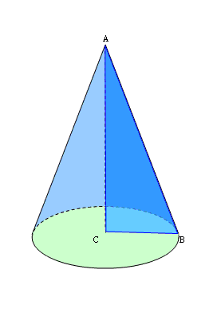
Geometriya
11-sinf
Mavzu:
Konus va
uning sirti

Slide 2
To‘g‘ri burchakli uchburchak
gipotenuza
$$a$$
$$c$$
katet
$$b$$
katet

Slide 3
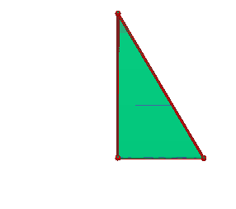
Konus

Slide 4
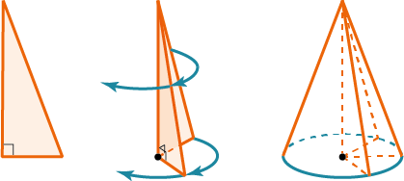
Konus

Slide 5
Konusning elementlari
yasovchisi
uchi
konusning o‘qi
asosi
balandligi

Slide 6
To‘g‘ri va og‘ma doiraviy konus

Slide 7
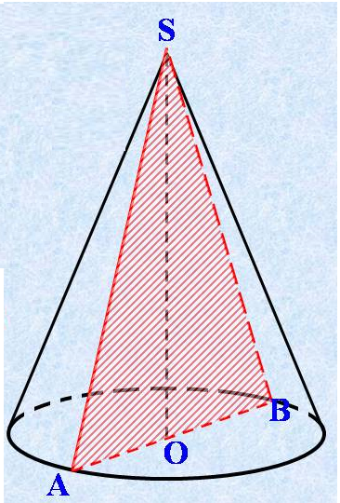
Konusning o‘q kesimi

Slide 8
Konusning yon sirti yoyilmasi
$$l$$
$$2πr$$
$$l$$
$$r$$
$$r$$

Slide 9
Konusning yon sirti
Konusning yon sirti uning asosi aylanasi uzunligining yarmi va yasovchisining ko‘paytmasiga teng
$$S_{yon}=πrl$$

Slide 10
Konusning to‘la sirti
Konusning to‘la sirti uning yon sirti va asosining yuzi yig‘indisiga teng
$$S_{\text{to}\text{‘}\text{la} }=S_{yon}+S_{asos}$$
$$S_{\text{to}\text{‘}\text{la} }=πrl+πr^{2}=πr\left(r+l\right)$$

Slide 11
1-masala
Konusning yasovchisi 13 cm, asosi aylanasining diametri 10 cm.
Konusning balandligini toping.

Slide 12
Masalaning yechimi
Berilgan:
$$l=13 cm$$
$$d=10 cm$$
$$l$$
$$H$$
Topish kerak:
$$H= ?$$
$$r$$
$$r$$

Slide 13
$$d=10 cm$$
$$d=2r$$
$$l$$
$$r=\frac{d}{2}=\frac{10}{2}=5 cm$$
$$H$$
$$r$$
$$r$$

Slide 14
$$l=13 cm$$
$$r=5 cm$$
$$l^{2}=H^{2}+r^{2}$$
$$H^{2}=l^{2}−r^{2}$$
$$H^{2}={13}^{2}−5^{2}=144$$
$$l$$
$$H$$
$$H=12 cm$$
Javob: $12 cm$
$$r$$
$$r$$

Slide 15
2-masala
Konus yasovchisi 12 cm, balandligi esa asos aylanasining radiusidan 3 marta uzun bo‘lsa, bu radiusni toping.

Slide 16
Masalaning yechimi
Berilgan:
$$l=12 cm$$
$$H=3r$$
$$H$$
$$l$$
Topish kerak:
$$r= ?$$
$$r$$

Slide 17
$$l=12 cm$$
$$H=3r$$
$$l^{2}=H^{2}+r^{2}$$
$${12}^{2}={\left(3r\right)}^{2}+r^{2}$$
$$144=9r^{2}+r^{2}$$
$$144=10r^{2}$$
$$H$$
$$l$$
$r^{2}=\frac{144}{10}$
$r=\frac{12}{\sqrt{10}}$
$$r$$
Javob: $\frac{12}{\sqrt{10}}cm$

Slide 18
3-masala
Konus asosi aylanasining radiusi 6 cm, balandligi esa yasovchisidan ikki marta qisqa bo‘lsa, konusning yasovchisini toping.

Slide 19
Masalaning yechimi
Berilgan:
$$r=6 cm$$
$H=\frac{l}{2}$ $l=2H$
$$H$$
$$l$$
Topish kerak:
$$l= ?$$
$$r$$

Slide 20
$$r=6 cm$$
$$l=2H$$
$$l^{2}=H^{2}+r^{2}$$
$${\left(2H\right)}^{2}=H^{2}+6^{2}$$
$${4H}^{2}=H^{2}+36$$
$${3H}^{2}=36$$
$$H^{2}=12$$
$$H$$
$$l$$
$$H=\sqrt{12}=2\sqrt{3}$$
$$l=2∙2\sqrt{3}=4\sqrt{3}$$
Javob: $4\sqrt{3} cm$
$$r$$

Slide 21
4-masala
Konus asosining radiusi 16 cm, konusning balandligi 12 cm.
Konus yon sirtining yuzini toping.

Slide 22
Masalaning yechimi
Berilgan:
$$r=16 cm$$
$H=12 cm$
$$H$$
$$l$$
Topish kerak:
$$S_{\text{yon} }= ?$$
$$r$$

Slide 23
$$H=12 cm$$
$$r=16 cm$$
$$l^{2}=H^{2}+r^{2}$$
$$l^{2}={12}^{2}+{16}^{2}=400$$
$$l=20 cm$$
$$l$$
$$S_{yon}=πrl$$
$$H$$
$$S_{yon}=π∙16∙20=320π$$
$$r$$
Javob: $320π {cm}^{2}$

Slide 24
5-masala
Konus asosining diametri 12 cm, yasovchisi esa 10 cm.
Konusning to‘la sirtini toping.

Slide 25
Masalaning yechimi
Berilgan:
$$d=12 cm$$
$l=10 cm$
$$H$$
$$l$$
Topish kerak:
$$S_{\text{to}\text{‘}\text{la} }= ?$$
$$r$$
$$r$$

Slide 26
$$d=12 cm$$
$$d=2r$$
$$r=\frac{d}{2}=\frac{12}{2}=6 cm$$
$$H$$
$$l$$
$$r$$
$$r$$

Slide 27
$l=10 cm$
$$r=6 cm$$
$$S_{\text{to}\text{‘}\text{la} }=S_{yon}+S_{asos}$$
$$S_{\text{to}\text{‘}\text{la} }=πr\left(r+l\right)$$
$$H$$
$$l$$
$$S_{\text{to}\text{‘}\text{la} }=π∙6∙\left(6+10\right)=96π$$
Javob: $96π {cm}^{2}$
$$r$$

Slide 28
Mustaqil bajarish uchun topshiriqlar
131 va 133-sahifalar
422
440
423

