Slide 1

KIDS’ ENGLISH 4

Slide 2


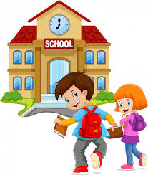
LET’S START
ENGLISH

Slide 3

LET’S CHECK YOUR HOMEWORK!

Slide 4
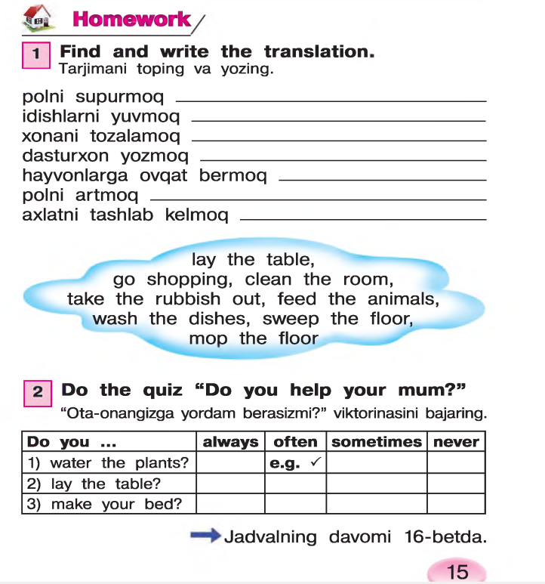
sweep the floor
wash the dishes
clean the room
lay the table
feed the animals
mop the floor
take the rubbish out

Slide 5
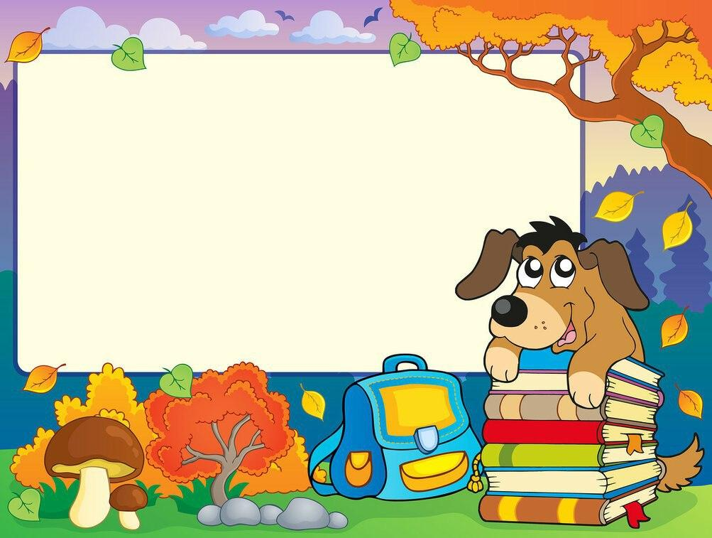
Let’s repeat
our last lesson.

Slide 6

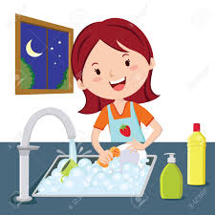
What does she do?
She washes the dishes

Slide 7
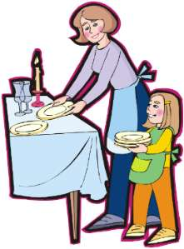
What do they do?
They lay the table

Slide 8
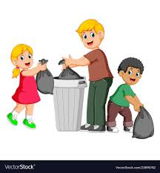
What do they do?
They take the rubbish out

Slide 9

What do they do?
They go shopping

Slide 10
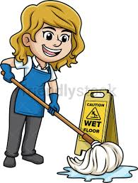
What does she do?
She mops the floor

Slide 11
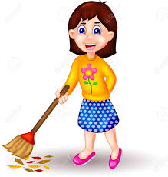
What does she do?
She sweeps the floor

Slide 12
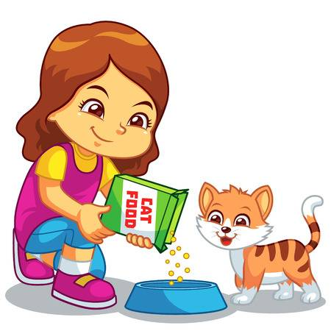
What does she do?
She feeds the animals

Slide 13

ENGLISH
4- FORM
“WE COOKED PALOV YESTERDAY“

Slide 14
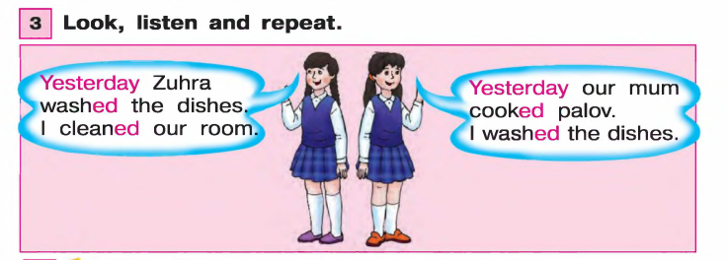

Slide 15
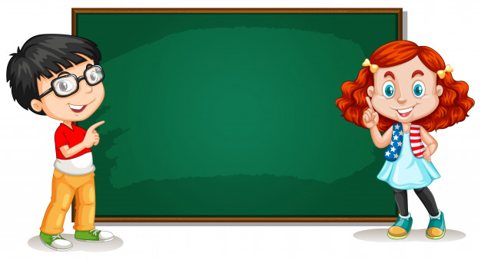
Past Simple Tense
2 types of verbs
REGULAR IRREGULAR
Cook-Cooked Go – Went
Clean –Cleaned Run – Ran

Slide 16
Past Simple Tense
(Regular verbs)
Subject + verb + ed
Ex: We cooked palov yesterday

Slide 17
Past Simple Tense
(Adverbs of time)
Yesterday(kecha)
Ago (..dan oldin)
Last(o’tgan..)last year, last month

Slide 18
1.I helped my mum yesterday
2.She watered the flowers
3.My dad washed his car yesterday

Slide 19
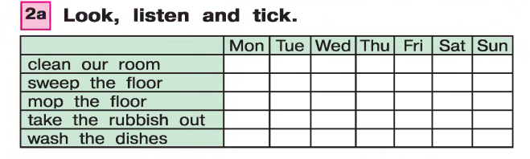


Slide 20
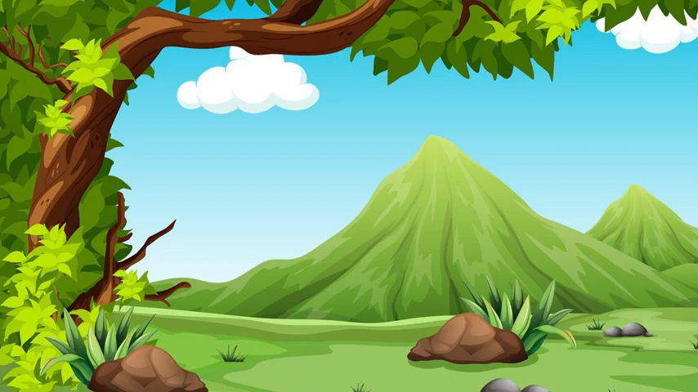
“WHAT DID YOU DO “ SONG

Slide 21
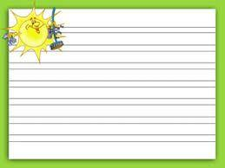
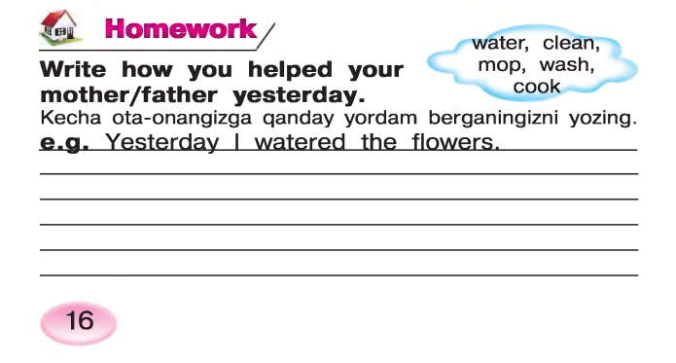

Slide 22
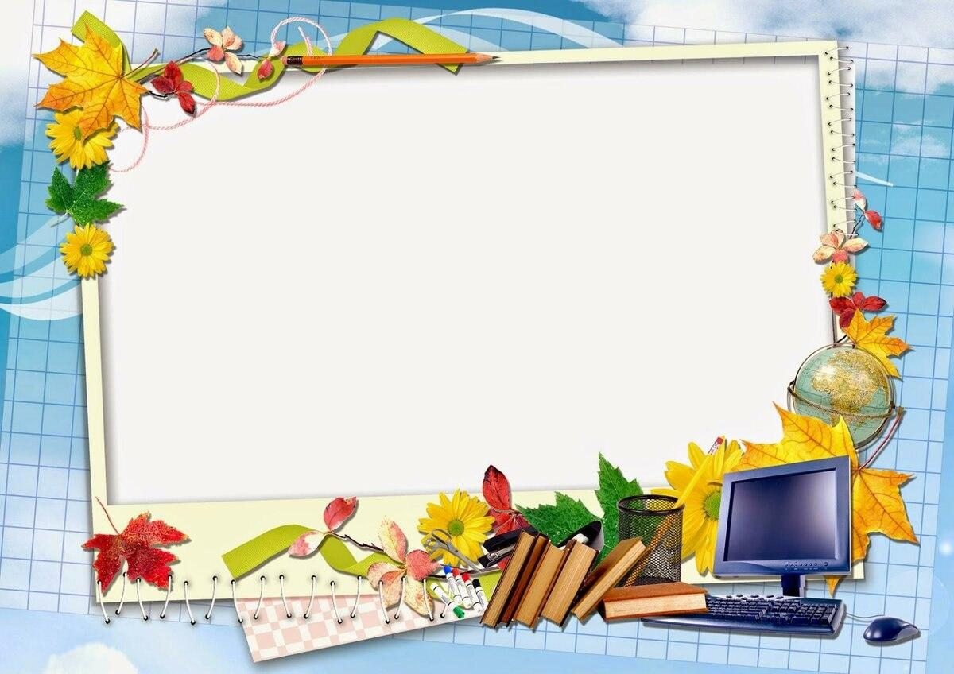
THANK YOU FOR YOUR
ATTENTION!

Slide 23
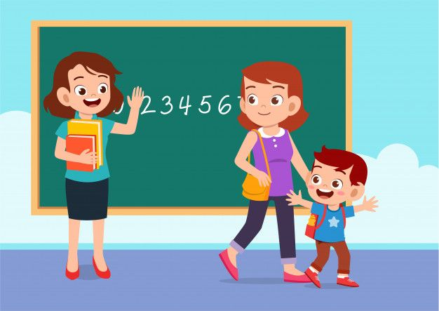
GOODBYE, KIDS!
GOOD LUCK!

