Slide 1
KIDS’ ENGLISH 4

Slide 2
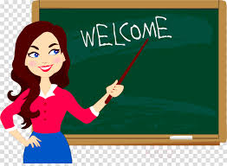
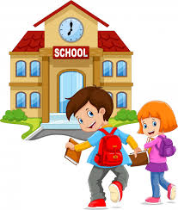
LET’S START
ENGLISH

Slide 3
LET’S CHECK YOUR HOMEWORK!

Slide 4
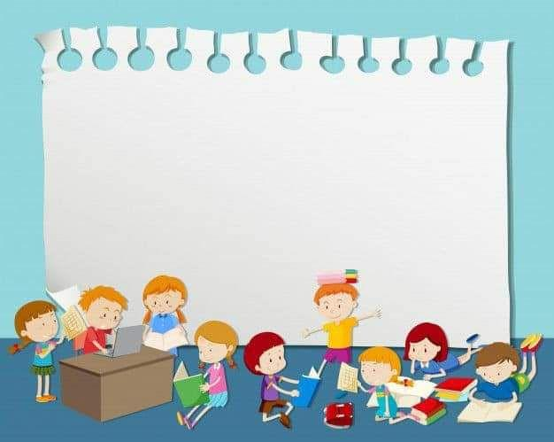
MY SUNDAY
I usually get up at 8:00 oc’lock on Sundays. I always have breakfast at 8:30 and watch TV. Then I play with my friends. We often play hopscotch or play tag. Boys like playing football but girls usually jump a rope. After a lovely day , I do my homeworks in the afternoon.So , I love Sundays!

Slide 5
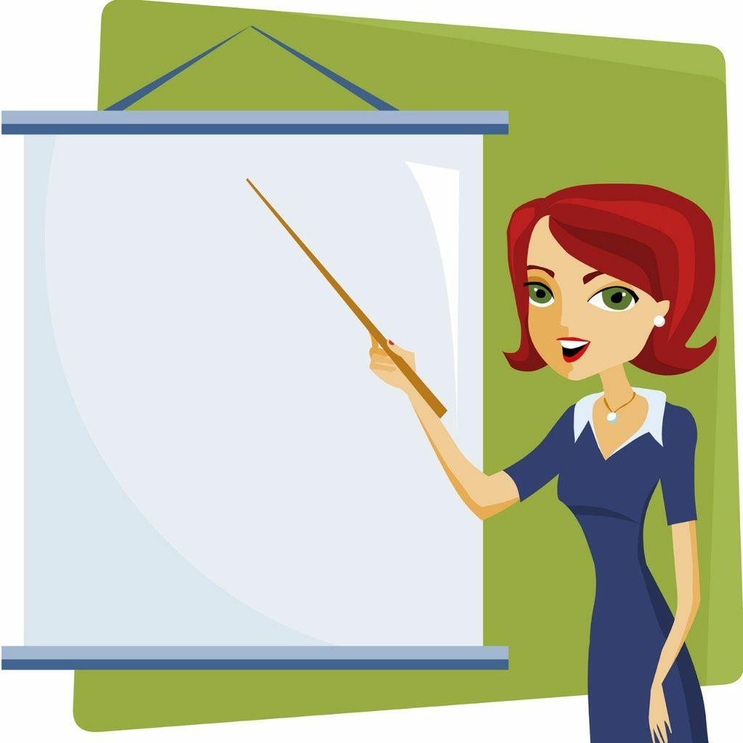
GOOD JOB! EXCELLENT!

Slide 6
ENGLISH
4- FORM
“DO YOU HELP YOUR MUM?“

Slide 7
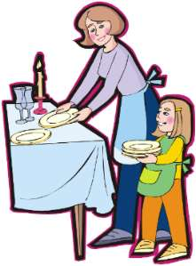
WASH
THE DISHES
LAY THE
TABLE

Slide 8
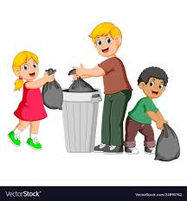
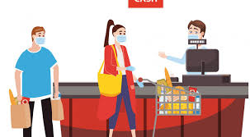
TAKE THE RUBBISH OUT
GO SHOPPING

Slide 9
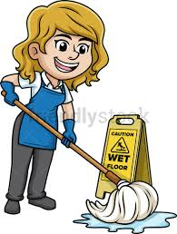
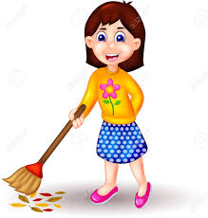
MOP THE
FLOOR
SWEEP THE
FLOOR

Slide 10
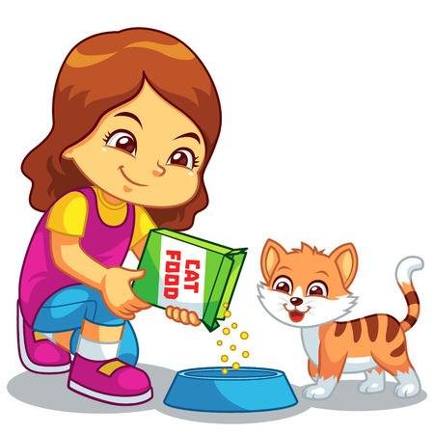
FEED THE
ANIMALS

Slide 11
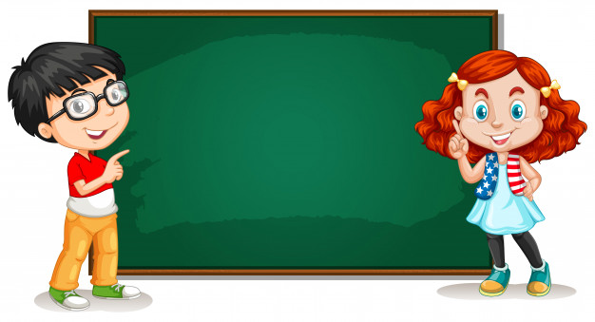
Present Simple Question
Do+Subject + +verb?
Ex:Do you get up at 6:00 o’clock?

Slide 12
Present Simple Question
*HE/SHE/IT
Does +Subject +verb?
Ex: Does he get up at 6:00 o’clock

Slide 13
COMPLETE THE SENTENCES with DO, DOES
… you feed the animals ?
-YES, I do
DO
DO
… you help your mother?-YES, I do
… he do homework in his room?
NO, He doesn’t
DOES
… you take the rubbish out ?
- YES, Ido
DO
5. ... she lay the table in the evening? – YES, She does
DOES

Slide 14
IF YOU ARE HAPPY AND CLAP YOUR HANDS

Slide 15
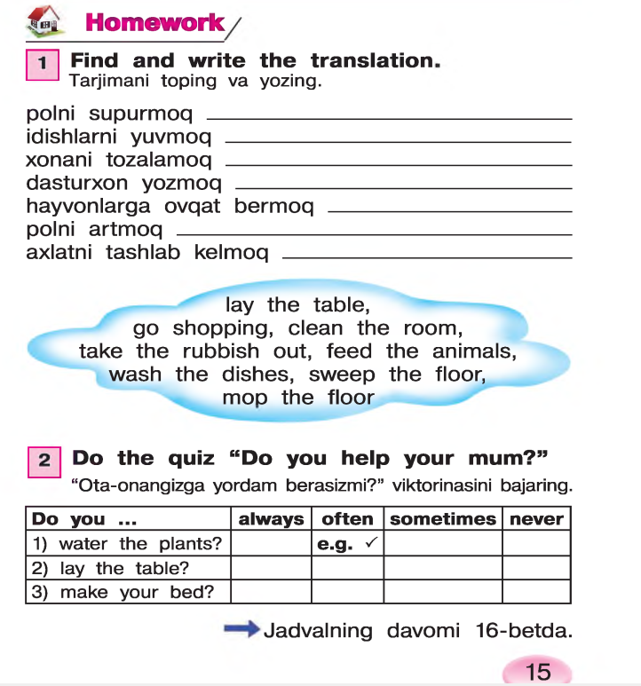

Slide 16
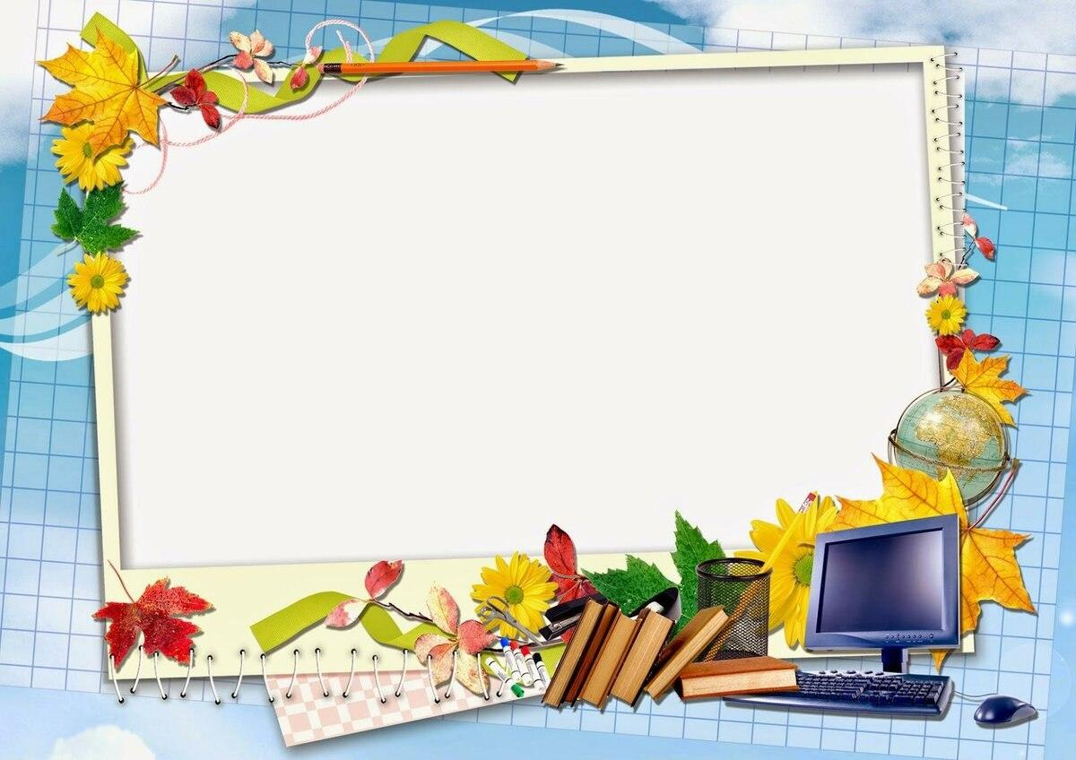
THANK YOU FOR YOUR
ATTENTION!

Slide 17
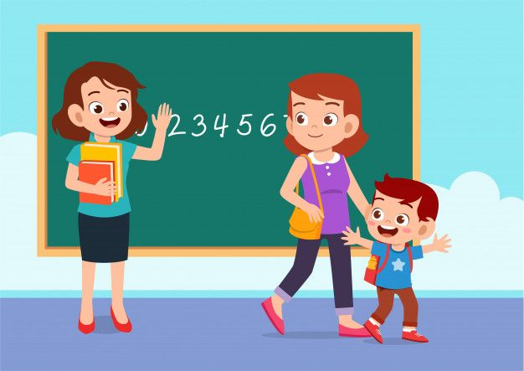
GOODBYE, KIDS!
GOOD LUCK!

