Slide 1
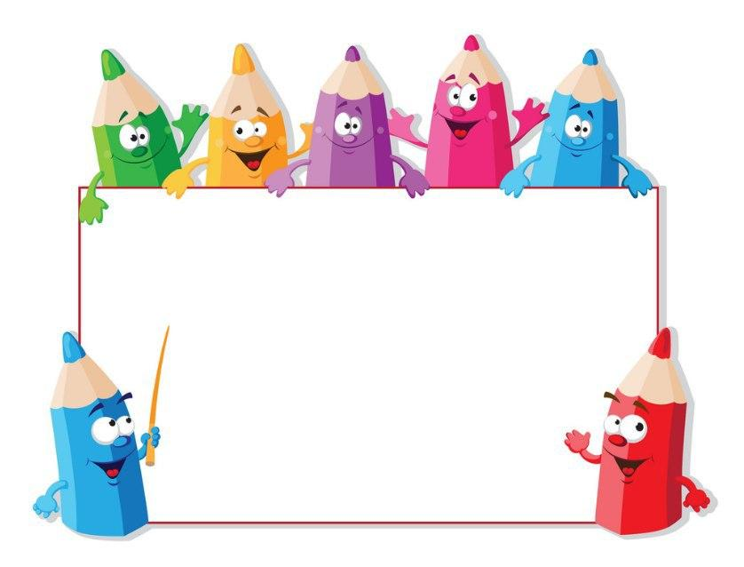
KIDS’ ENGLISH
4

Slide 2
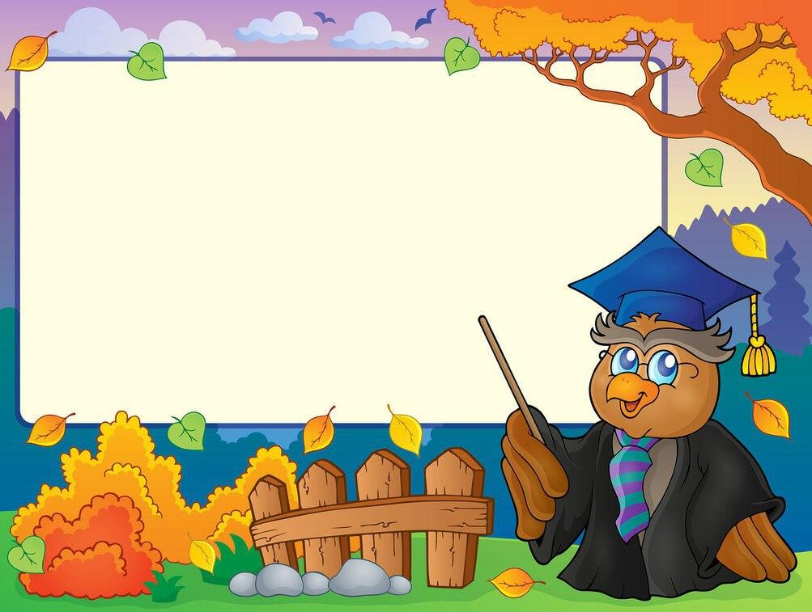
LET'S CHECK YOUR HOMEWORK!

Slide 3
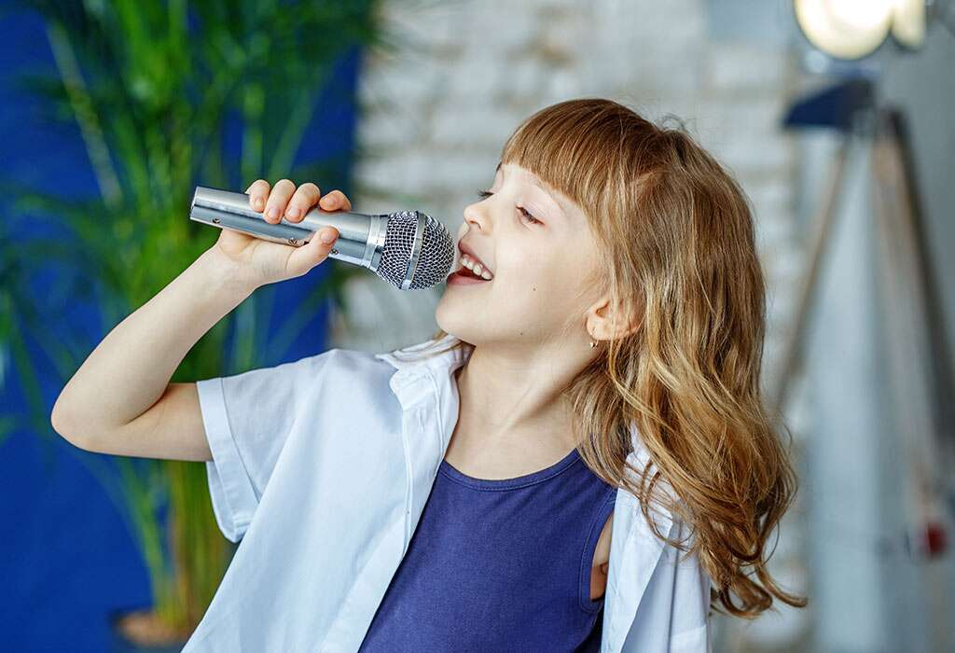
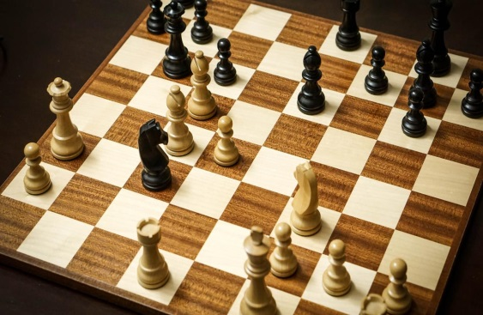
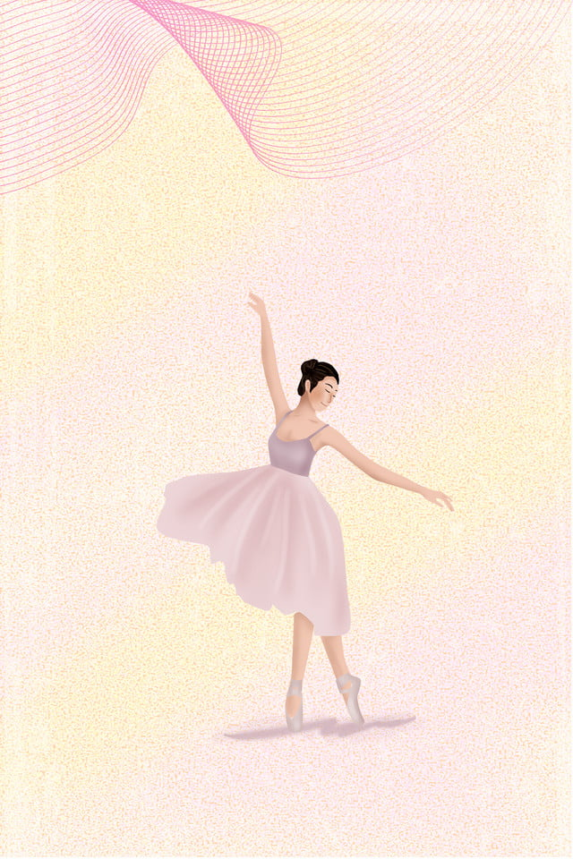
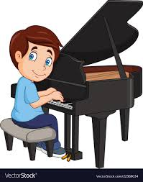
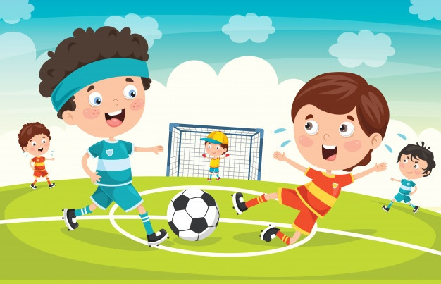
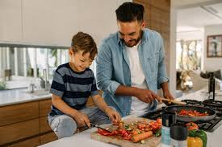
Match the words and pictures
Playing piano
Cooking
Playing football
Playing chess
Singing
dancing

Slide 4
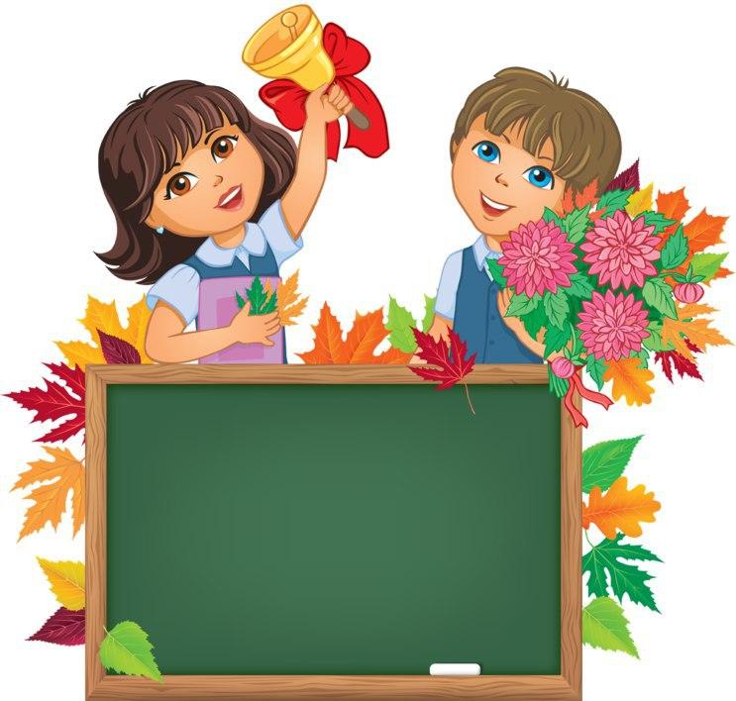
Unit 2. Lesson 1.
“I get up at 6 o’clock”

Slide 5
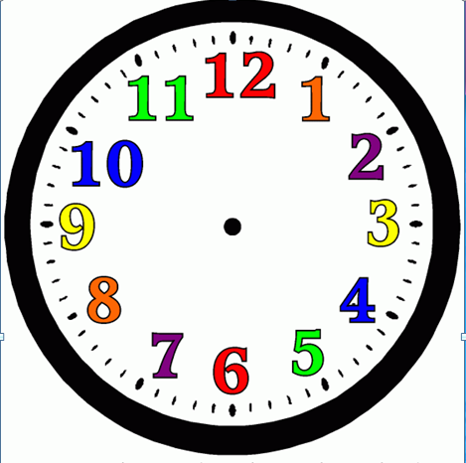
WHAT’S THE TIME? -
SOAT NECHA BO’LDI?
IT’S NINE OC’LOCK

Slide 6
WHAT’S THE TIME? -
SOAT NECHA BO’LDI?
IT’S NINE FIFTEEN

Slide 7
WHAT’S THE TIME? -
SOAT NECHA BO’LDI?
IT’S NINE THIRTY

Slide 8
WHAT’S THE TIME? -
SOAT NECHA BO’LDI?
IT’S NINE FORTY FIVE

Slide 9
WHAT’S THE TIME? -
SOAT NECHA BO’LDI?
IT’S TEN OC’LOCK

Slide 10
WHAT’S THE TIME? -
SOAT NECHA BO’LDI?
IT’S TEN OH FIVE

Slide 11
WHAT’S THE TIME? -
SOAT NECHA BO’LDI?
IT’S TEN TWENTY FIVE

Slide 13
GET UP
AT - ….DA
When do you get up?
- I get up at 6 oc’lock

Slide 14
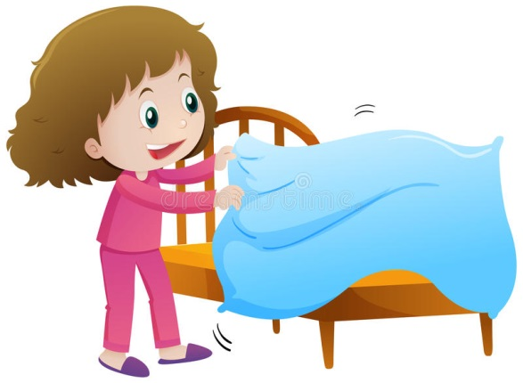
MAKE (MY) BED
When do you make your bed?
- I make my bed at 6 :05

Slide 15
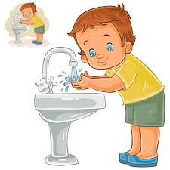
WASH MY FACE AND HANDS
When do you wash your face and hands?
- I wash my face at 6:10

Slide 16
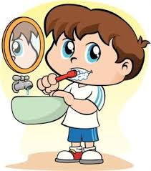
BRUSH(MY) TEETH
When do you brush your teeth?
- I brush my teeth at 6 :15

Slide 17
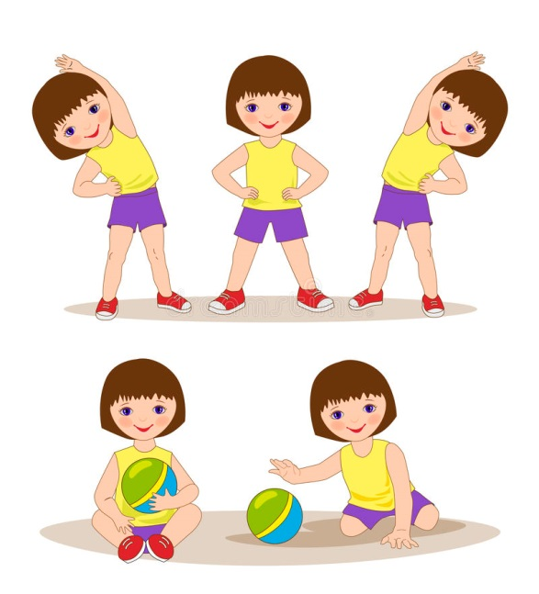
DO MORNING EXERCISES
When do you do morning exercises?
- I do morning exercises at 6:20

Slide 18
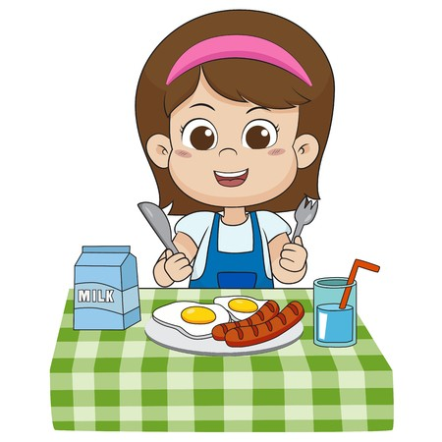
HAVE BREAKFAST
When do you have breakfast?
- I have breakfast at 6:30

Slide 19
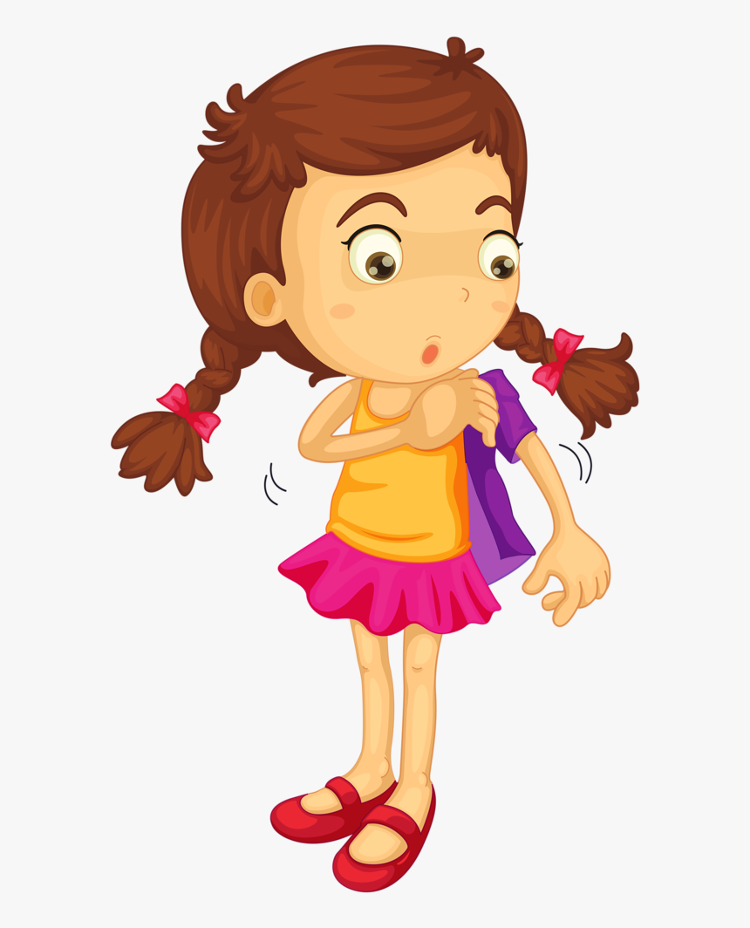
GET DRESSED
When do you get dressed?
I get dressed at 7:00

Slide 20
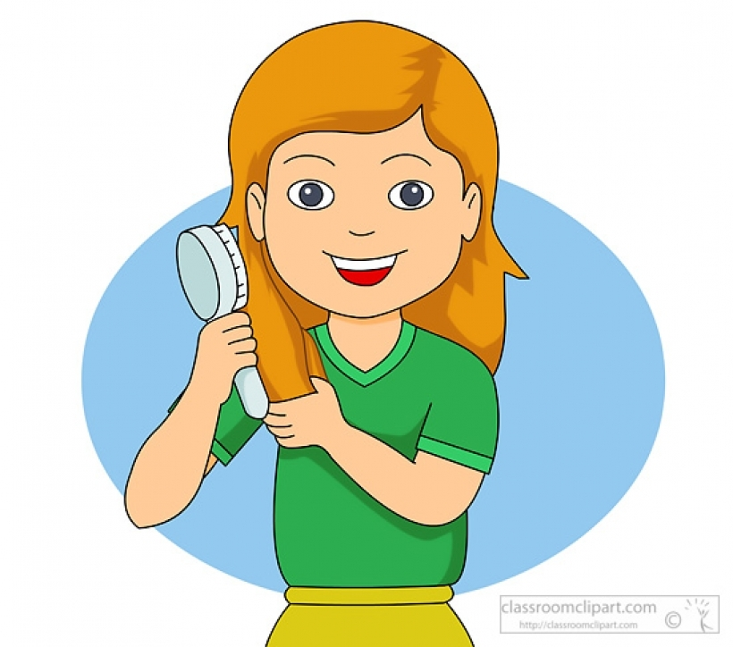
COMB (MY) HAIR
When do you comb your hair?
I comb my hair at 7:15

Slide 21
GO TO SCHOOL
When do you go to school?
I go to school at 7:30

