Slide 1
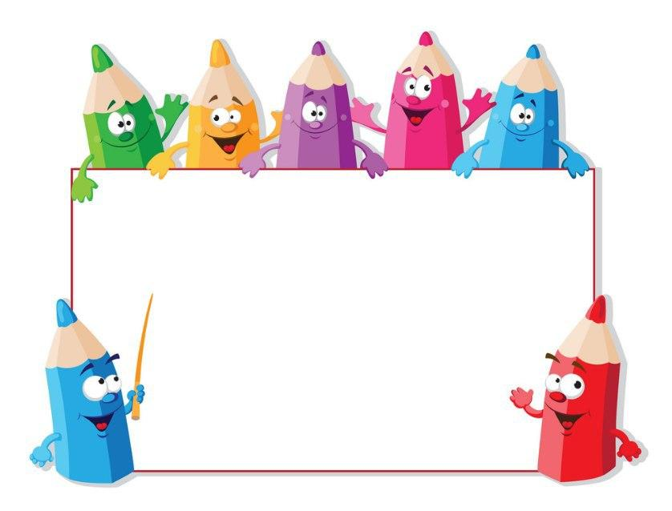
KIDS’ ENGLISH
4

Slide 2
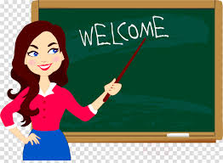
LET’S START
ENGLISH

Slide 3
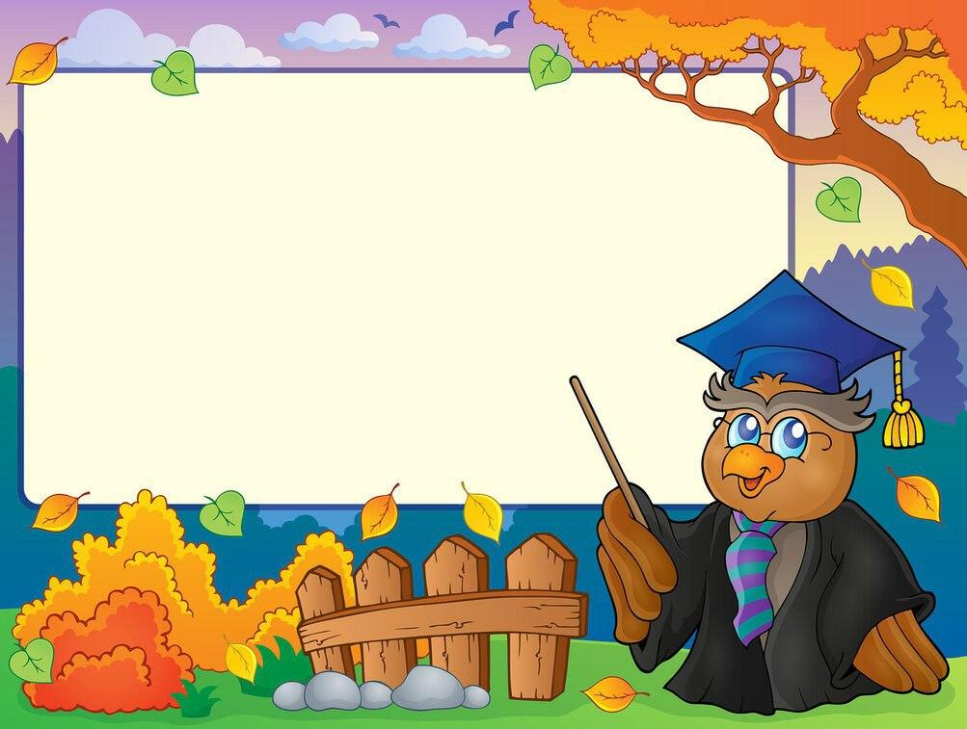
LET’S CHECK YOUR HOMEWORK!

Slide 4
Jasur
9:40
Brush teeth
10:00
Have breakfast
12:00
Watch TV
14:00
Play games

Slide 5
Let’s repeat
our last lesson.

Slide 7
COMPLETE THE SENTENCES WITH ALWAYS,USUALLY, SOMETIMES,OFTEN,NEVER
1. I ... go to school on Sundays.
never
2. I … have lunch at school.
usually
3. I …. do homework in my room.
always
4. I go swimming after school
often
5. I ... play with my friends in the street
sometimes

Slide 8
DAILY ROUTINES

Slide 9
Unit 2. Lesson 4.
“PROJECT….”

Slide 10
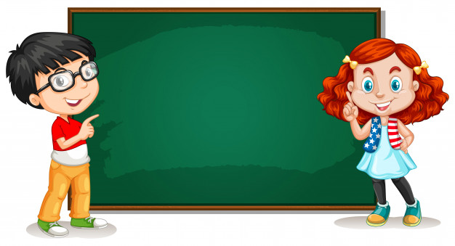
Present Simple Negative
Subject +don’t +verb
Ex: I don’t get up at 6:00 o’clock

Slide 11
Present Simple Negative
*HE/SHE/IT
Subject +doesn’t +verb
Ex: He doesn’t get up at 6:00 o’clock

Slide 12
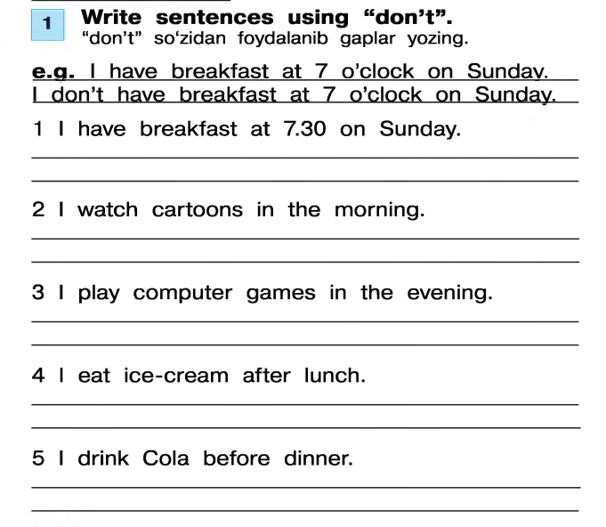
I don’t have breakfast at 7:30 on Sunday
I don’t watch cartoons in the morning
I don’t play computer games in the evening.
I don’t eat ice-cream after lunch
I don’t drink Cola before dinner

Slide 13
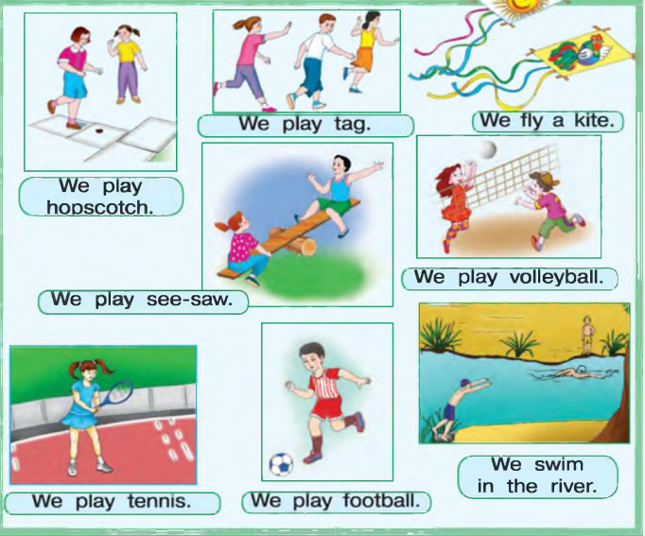

Slide 14
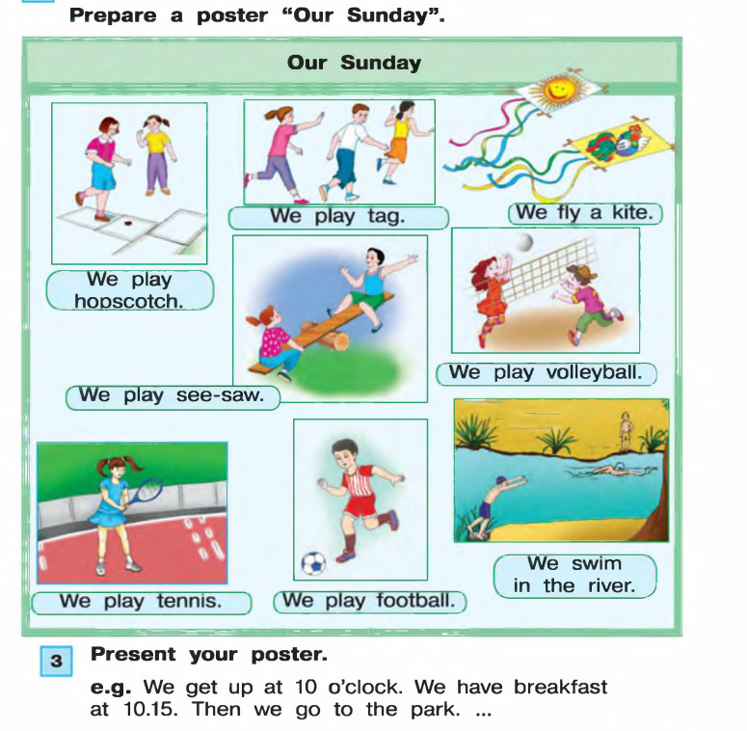
Homework:

Slide 15
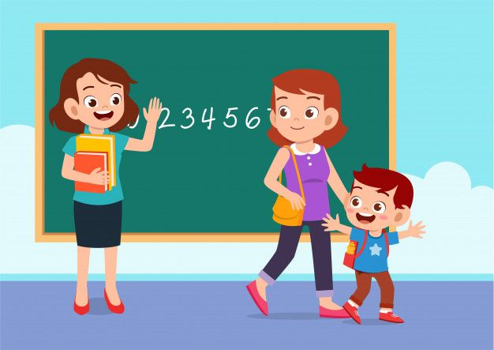
GOODBYE, KIDS!
GOOD LUCK!

