Slide 1
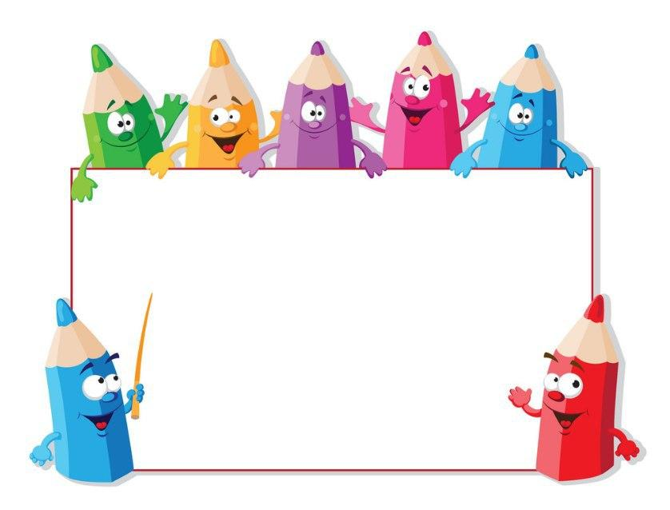
KIDS’ ENGLISH
4

Slide 2
LET'S CHECK YOUR HOMEWORK!

Slide 3
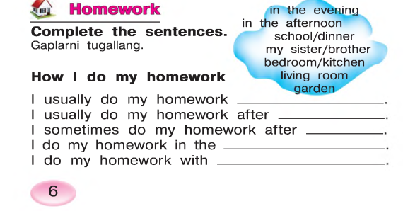
in the evening
school
dinner
bedroom
my sister

Slide 4
Let’s repeat
our last lesson.

Slide 6
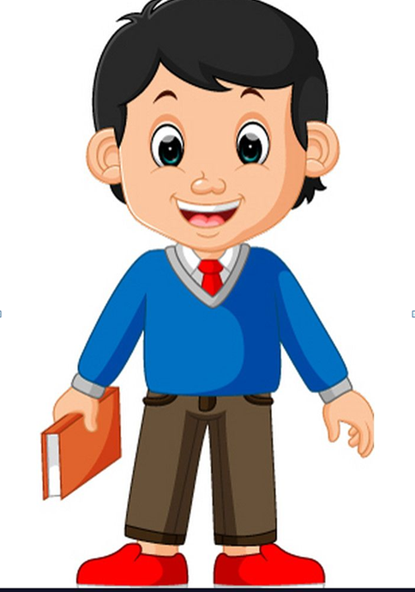
Hello! My name is Aziz.I am from Uzbekistan. I am good at drawing and playing tennis

Slide 7
This is my friend. Her name’s Sally. She’s good at dancing. She’s from….?
England

Slide 8
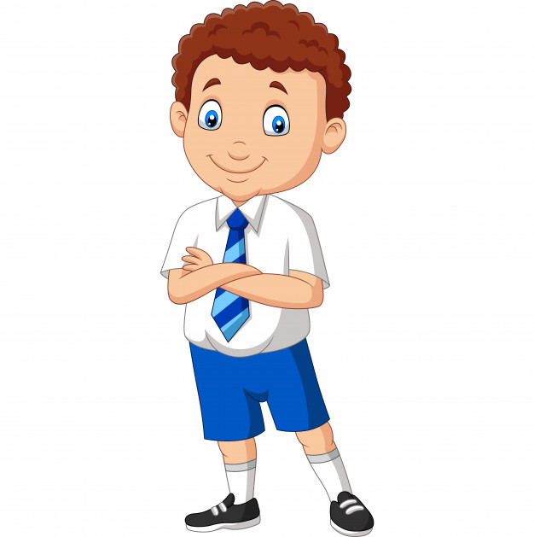
This is my friend. His name’s Sergio. He’s good at playing football. He’s from….?
France

Slide 9
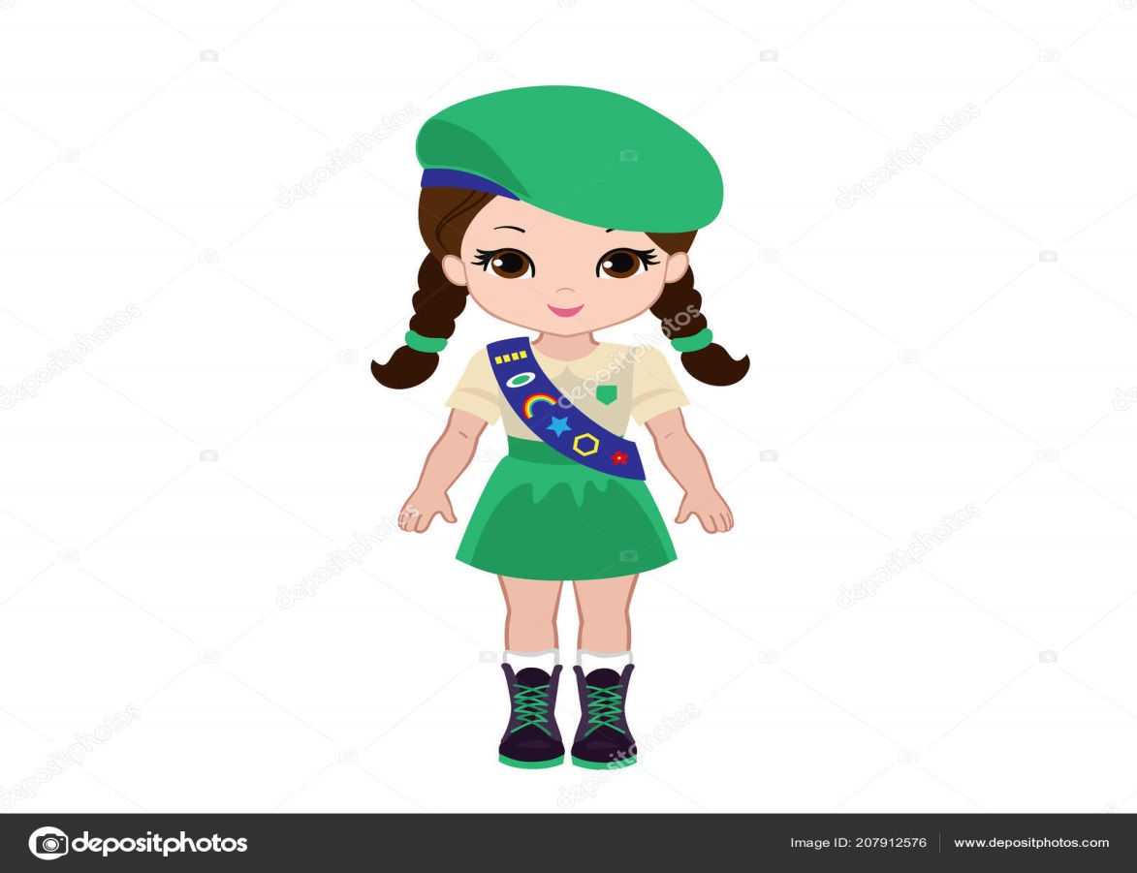
This is my friend. Her name’s Ann. She’s good at singing . She’s from….?
USA

Slide 10
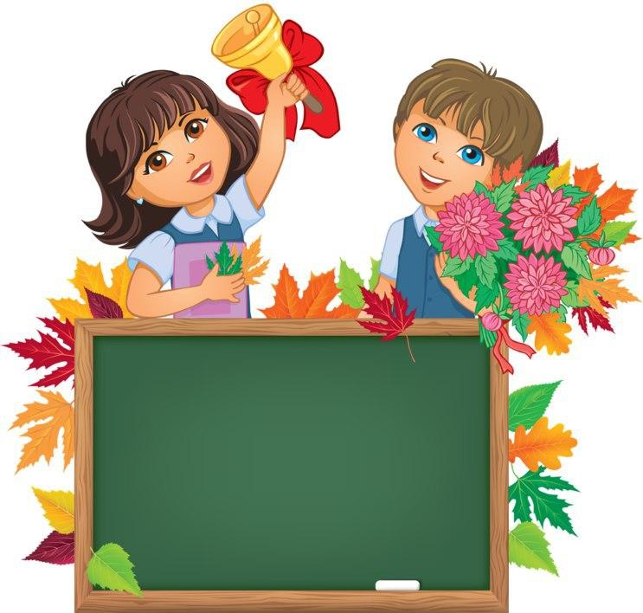
Unit 1. Lesson 4.
“Project”

Slide 11
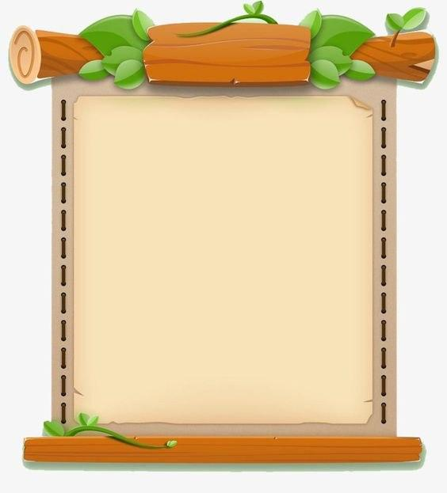
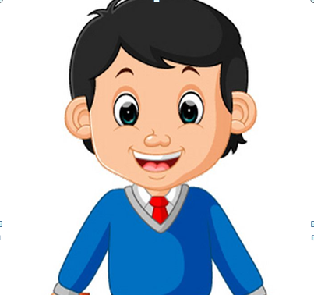
LET’S COMPLETE YOUR
STORY
Draw your portrait

Slide 12
1.My name is
2.M family name is
3.My favourite
song is
4.My favourite month is
5.My favourite day is
6.My favourite animal is
7.My favourite
colour is
8.I am good at
9.My hobby is
Aziz
Azimov
“Jingle bells”
July
Sunday
horse
green
swimming
playing tennis

Slide 13
Draw your favourite tree
This is my favourite willow tree. It’s tall and it has big, green leaves

Slide 14
Draw your favorite flower
This is my favourite flower tulip. It’s beautiful ,green and it has green leaves

Slide 15
Homework: To revise all the new words and complete the project paper.

