Slide 1
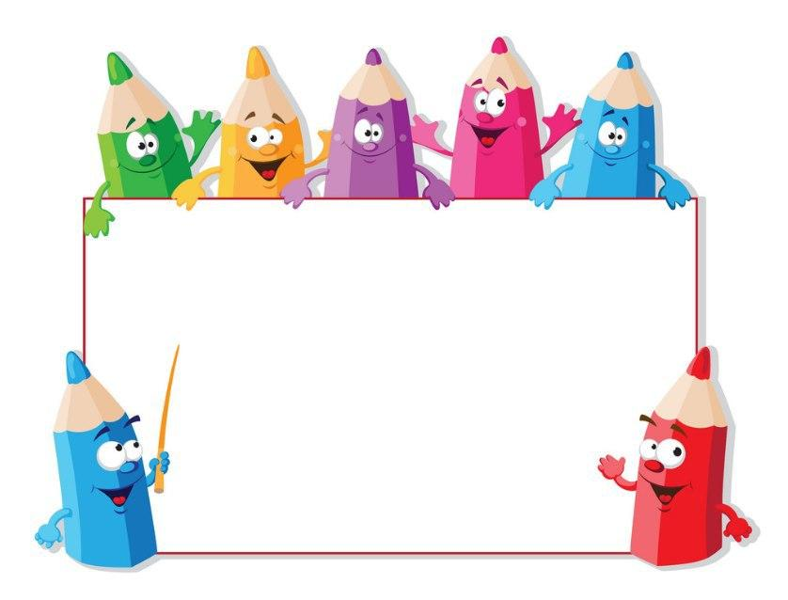
KIDS’ ENGLISH
4

Slide 2
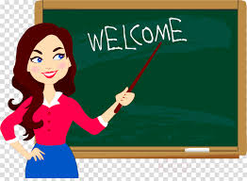
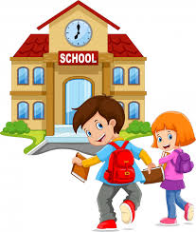
ARE YOU READY
TO START?

Slide 3
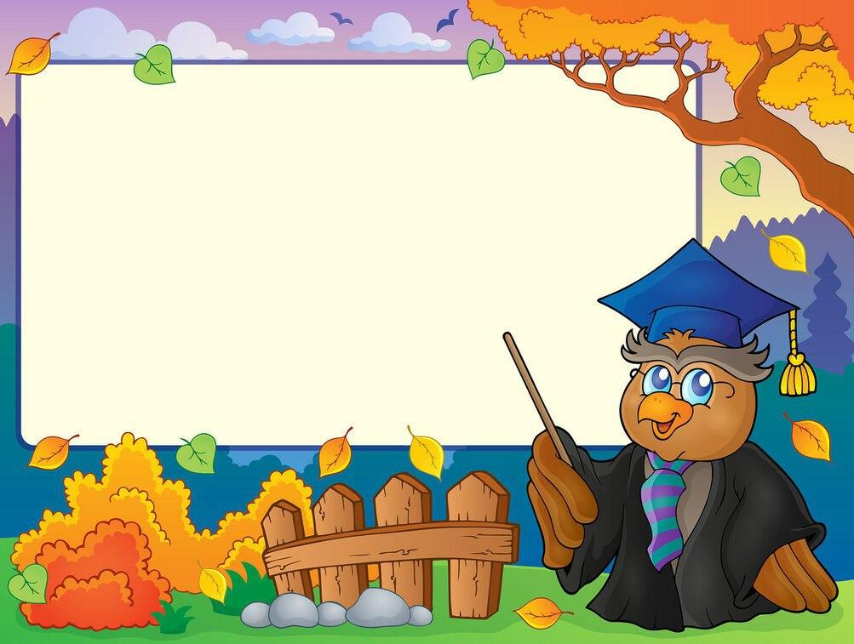
LET’S CHECK YOUR HOMEWORK!

Slide 4
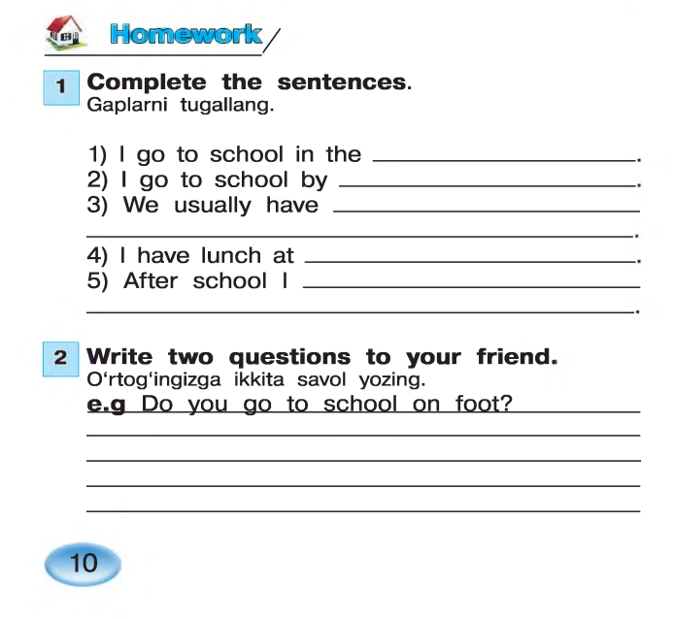
morning
bus
breakfast at 7:15
school
do my homework
Do you get dressed at 7:20?
Do you have dinner at 8:00p.m?
Do you do your homework in the evening?

Slide 5
Let’s repeat
our last lesson.

Slide 6
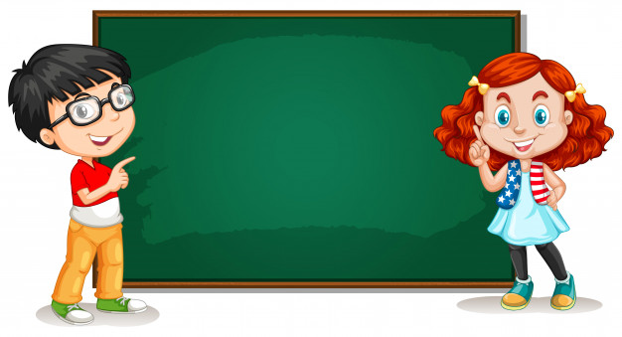
Let’s play
“SIMON SAYS….”.

Slide 7
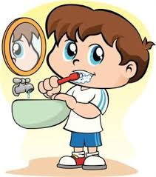
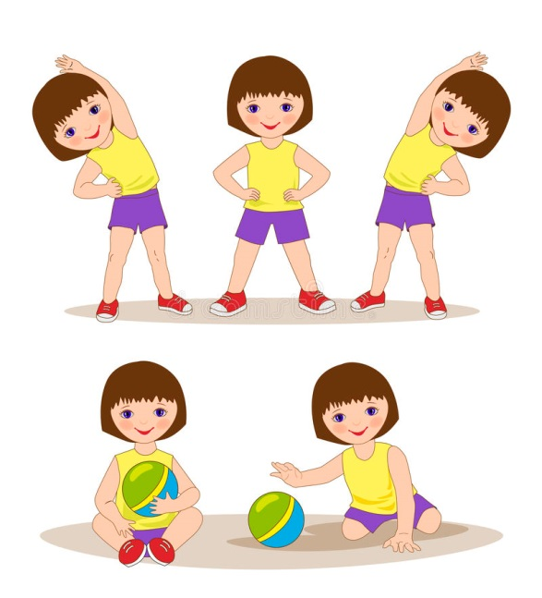
BRUSH YOUR
TEETH
DO
MORNING
EXERCISES

Slide 8
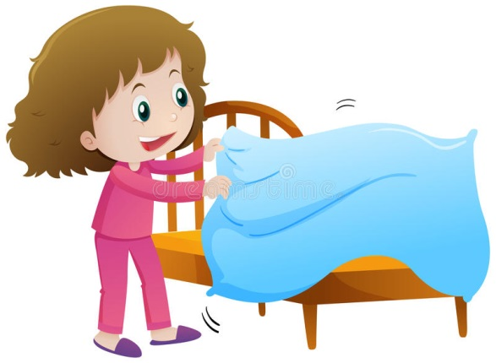
GET UP
MAKE YOUR BED

Slide 9
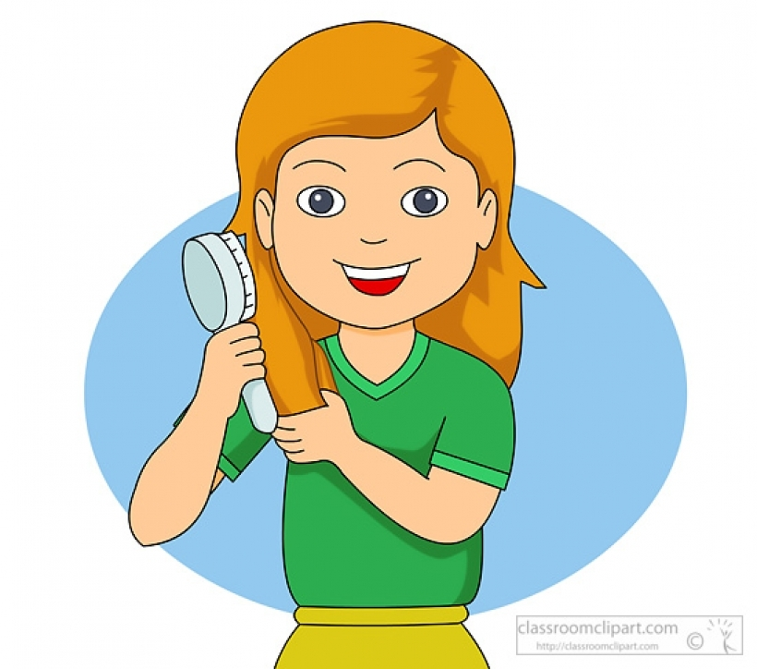
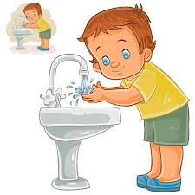
COMB YOUR
HAIR
WASH YOUR FACE AND HANDS

Slide 10
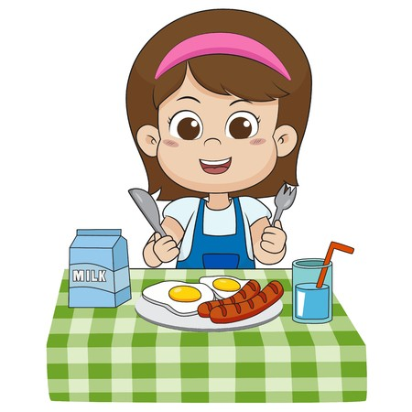
GO TO SCHOOL
HAVE BREAKFAST

Slide 11
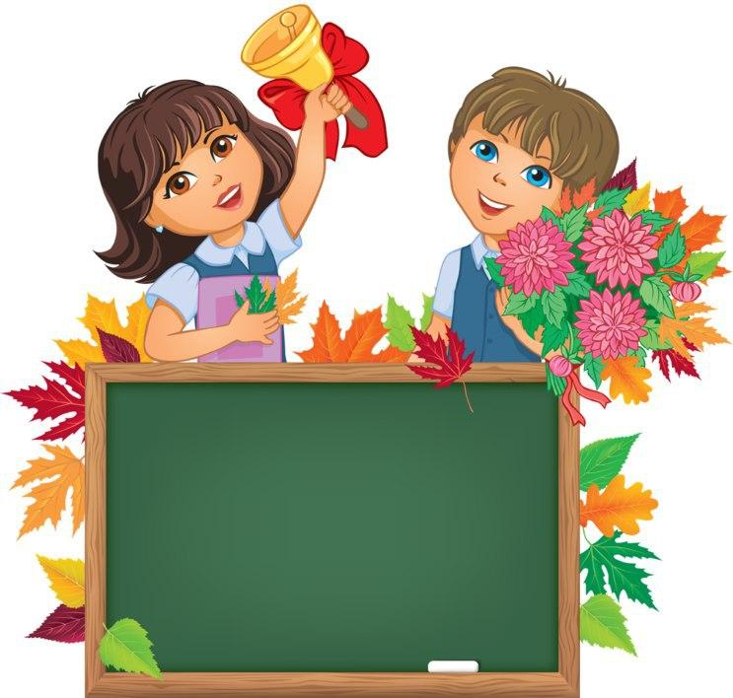
Unit 2. Lesson3.
“ON SUNDAY….”

Slide 12
HOW OFTEN DO YOU….?”.

Slide 13
ALWAYS-HAR DOIM, DOIMO
USUALLY-ODATDA
OFTEN-TEZ-TEZ
NEVER-HECH QACHON
SOMETIMES-BA’ZIDA

Slide 17
always
usually
often
always

Slide 19
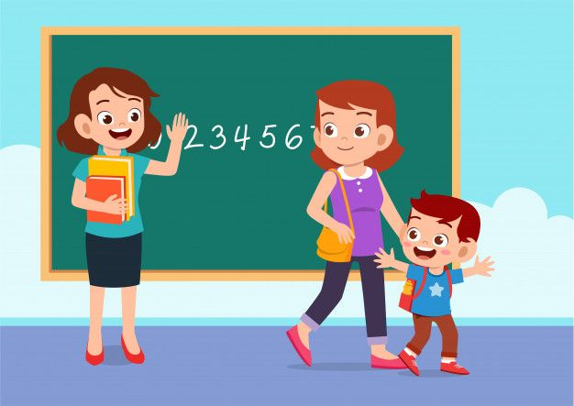
GOODBYE, KIDS!
GOOD LUCK!

