Slide 1
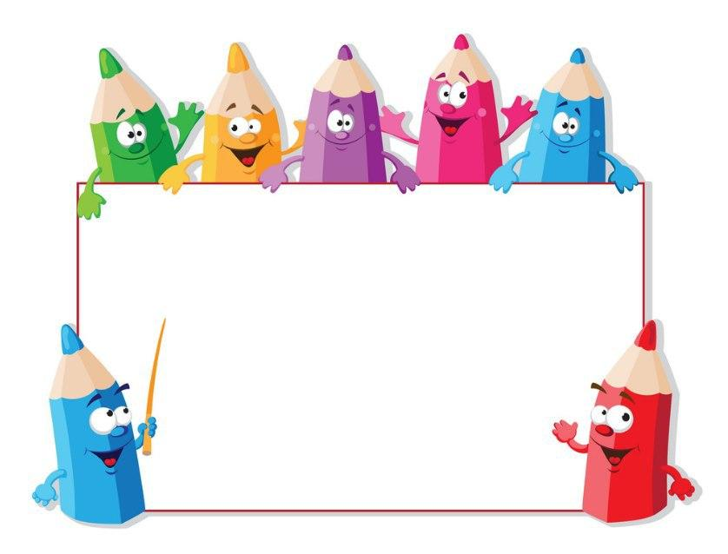
KIDS’ ENGLISH
4

Slide 2
LET'S CHECK YOUR HOMEWORK!

Slide 3
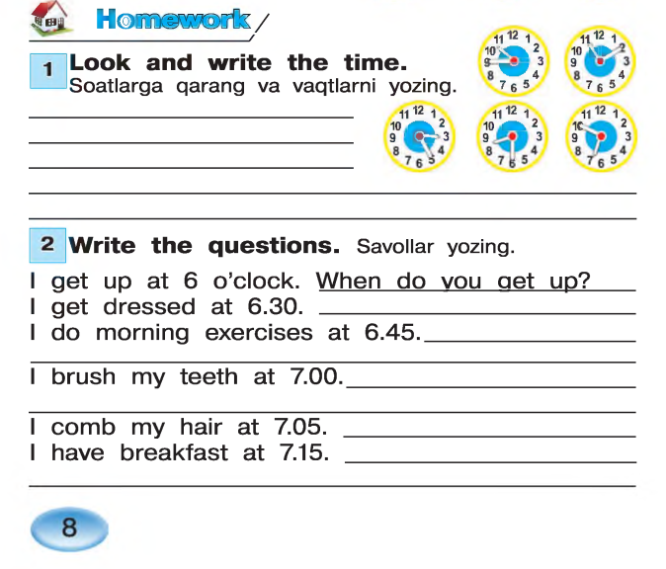
It’s ten forty five
It’s eleven ten
It’s three twenty five
It’s eight thirty
It’s six fifty
When do you get dressed?
When do you do morning exercises?
When do you brush your teeth?
When do you comb hair?
When do you have breakfast?

Slide 4
Let’s repeat
our last lesson.

Slide 5
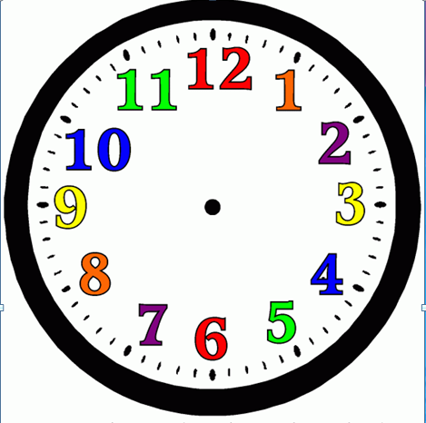
WHAT’S THE TIME? -
IT’S NINE OC’LOCK

Slide 6
WHAT’S THE TIME? -
IT’S TEN TWENTY FIVE

Slide 7
WHAT’S THE TIME? -
IT’S TEN OH FIVE

Slide 8
WHAT’S THE TIME? -
IT’S NINE THIRTY

Slide 9
WHAT’S THE TIME? -
IT’S NINE FORTY FIVE

Slide 10
WHAT’S THE TIME? -
IT’S NINE FIFTEEN

Slide 12
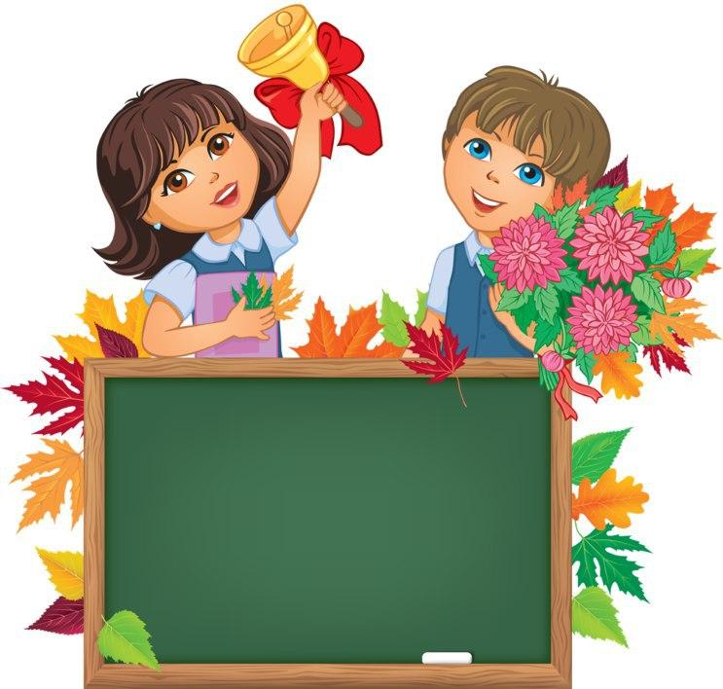
Unit 2. Lesson 2.
“MY SCHOOL
DAY”

Slide 13
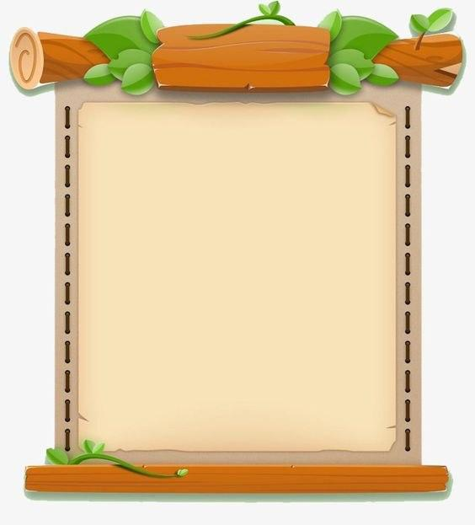
NEW WORDS
1.Stay at school-maktabda qolmoq
2.Have dinner- kechki ovqatni yemoq
3.Before- …dan oldin
4.After- …dan keyin
5.Then- keyin, so’ngra
6.Go to bed-uxlagani yotmoq

Slide 14
PAY ATTENTION!
BEFORE - ..DAN OLDIN
Before + Noun/..ing
Ex: I have breakfast before school
AFTER-….. DAN KEYIN
After + Noun/ ..ing
Ex: I do homework after school
I go to bed after drinking milk

Slide 15
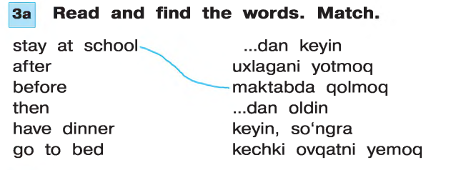

Slide 16
