Slide 1

4

Slide 2
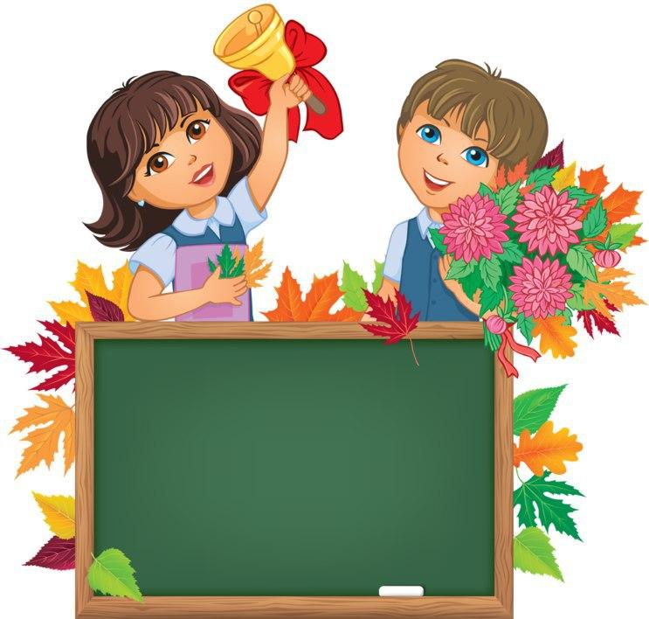
Unit 1. Lesson 1.
I CAN SPEAK ENGLISH

Slide 3
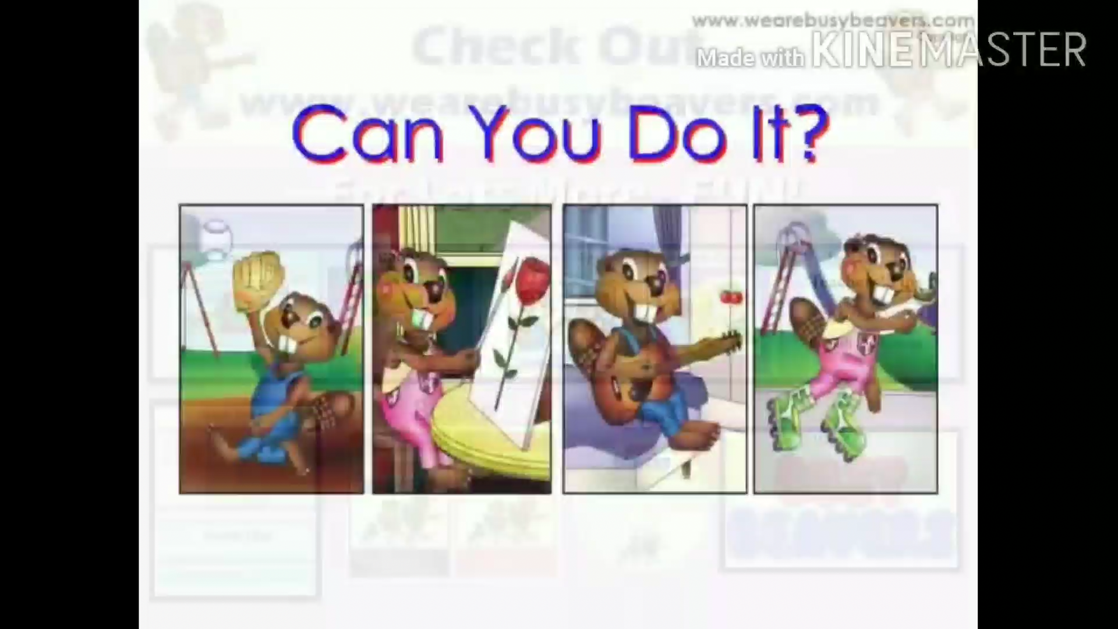

Slide 4
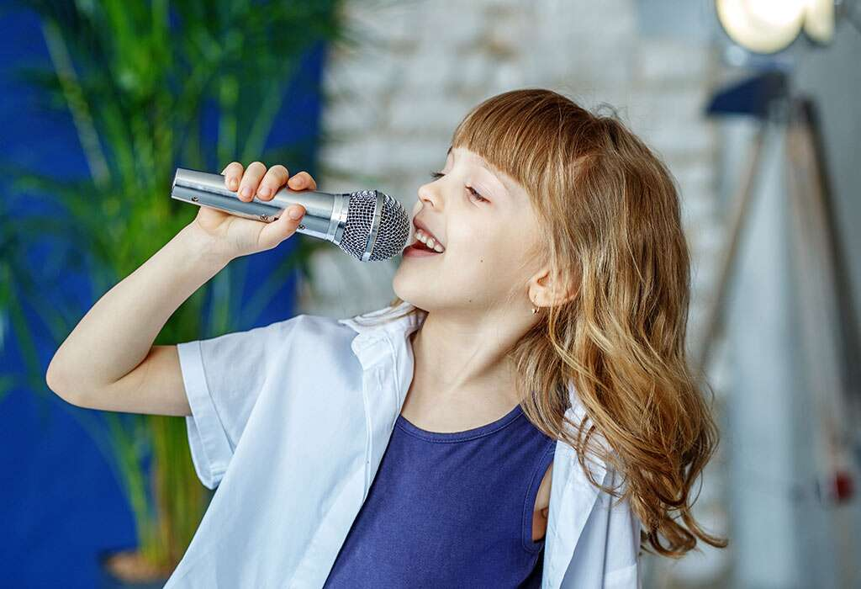
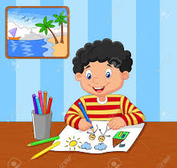
CAN – QILA OLMOQ +VERB(DO,WRITE,READ…)
I can sing a song
I am good at singing a song
He is good at drawing
He can draw

Slide 5
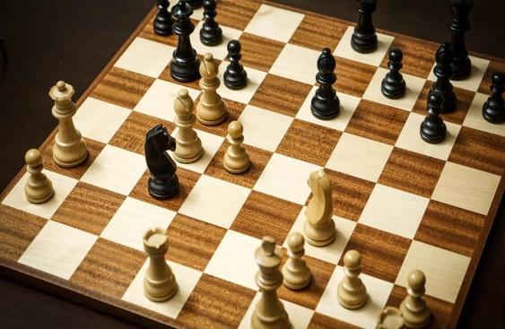
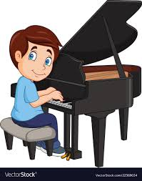
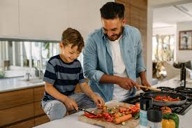
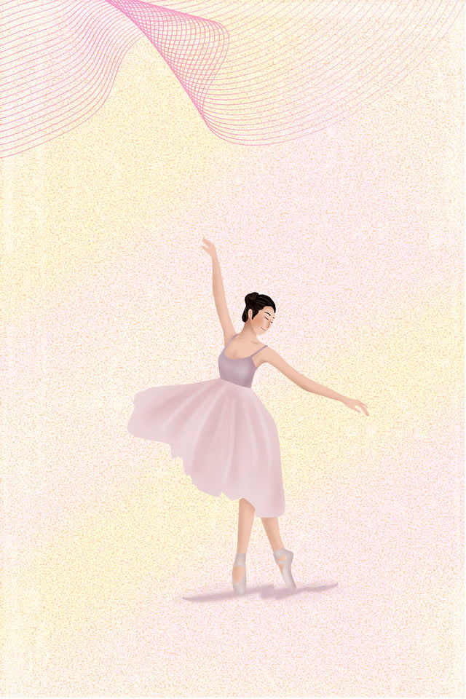
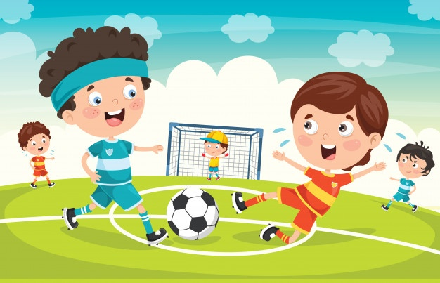
TO BE GOOD AT……- DA YAXSHI BO’LMOQ
He is good at playing the piano
I am good at playing chess
We are good at cooking
She is good at dancing
BE GOOD AT +V+ING
You are good at singing a song
They are good at playing football

Slide 6
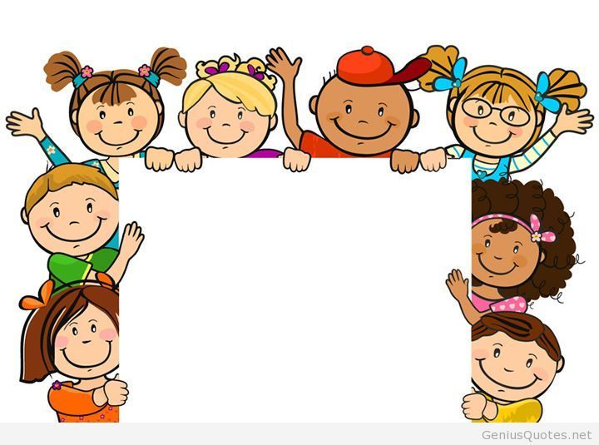
New words:
I can-Men qila olaman
To play the piano-pianino chalmoq
To play football-futbol o’ynamoq
To sing songs-kuylamoq
To draw pictures-rasm chizmoq
Sport-sport

Slide 7

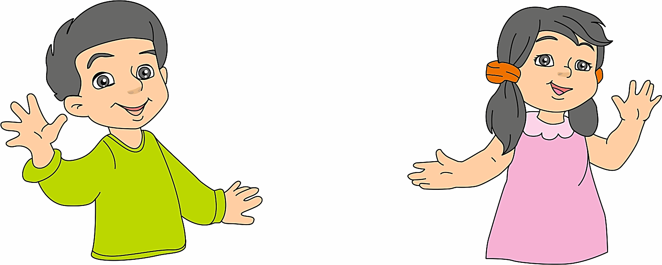
Hello!
My name is Zumrad.
I can speak English.
Hello!
My name is Jasur. I can speak Russian.

Slide 8
DO YOU
REMEMBER?

Slide 9
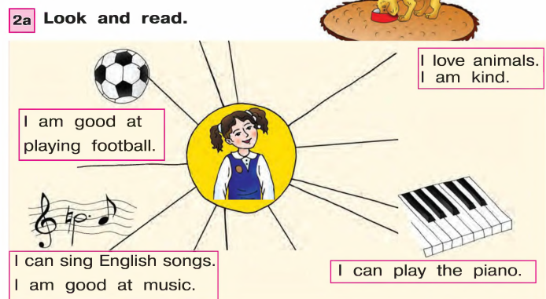

Slide 10
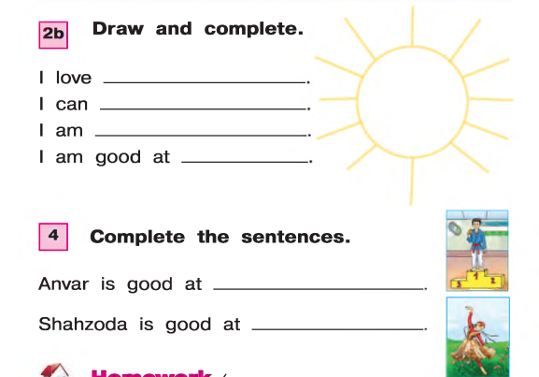
swimming
swim well
good at dancing
playing chess
doing taekwondo
dancing

Slide 11
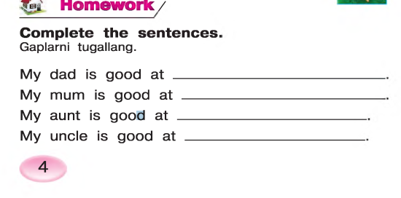
Homework : to write about family members what they are good at.

