Slide 1
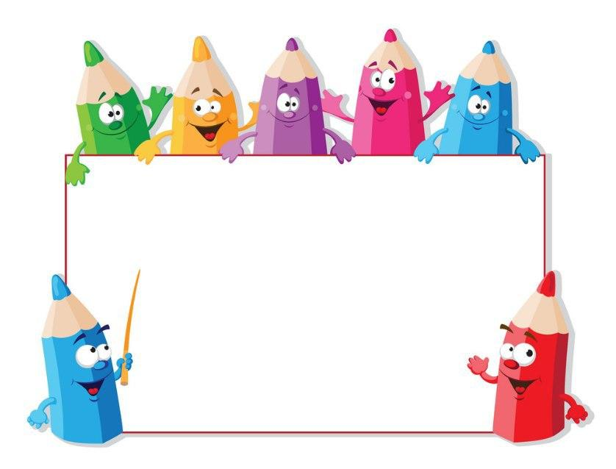
KIDS’ ENGLISH
4

Slide 2
LET'S CHECK YOUR HOMEWORK!

Slide 3
1.My mum speaks Uzbek and English
1.My brother speaks only Uzbek
kista
Eng
Germ
Turkmenis

Slide 4
Let’s repeat
our last lesson.

Slide 5
England
American
France
English
Germany
French
USA
German

Slide 6
Unit 1. Lesson 3.
“What do you after school?”

Slide 7
Review of PRESENT SIMPLE TENSE
Positive form: SUBJECT +VERB
Ex: I speak English.
They speak Russian in Russia.
*He/She/It+VERB(S)
Ex: He speaks French well.

Slide 8
QUESTION FORM:
DO+SUBJECT+VERB?
Ex:Do you speak English?
Do you like Maths?
*He/She/It –DOES+S+VERB?
Ex:Does she speak Uzbek?
Does he live in Tashkent?

Slide 9
Test on Present Simple
1.My dad …………. English very well
Speak B. speaks C. speaking
2. I ………… computer games after school
Plays B.played C.play
3.She …………… TV after school
Watches B.watch C.watched
4……… you read books after school?
A. Does B.do C.did
speaks
play
watches
do

Slide 10
Present Simple song

Slide 11
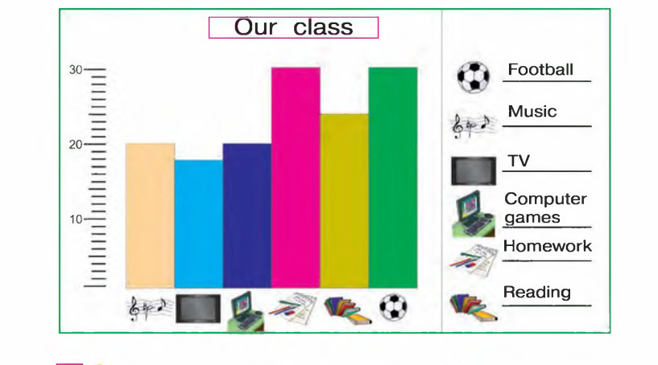
Exercise 2.

Slide 12
Exercise 2. Look, read and complete
1.__pupils do homework after school
2.___pupils read books after school
3.___pupils watch TV after school
4.___pupils play football after school
5.___pupils play computer games after school
6.___pupils have music lessons after school
30
25
18
30
20
20

Slide 13
