Slide 1
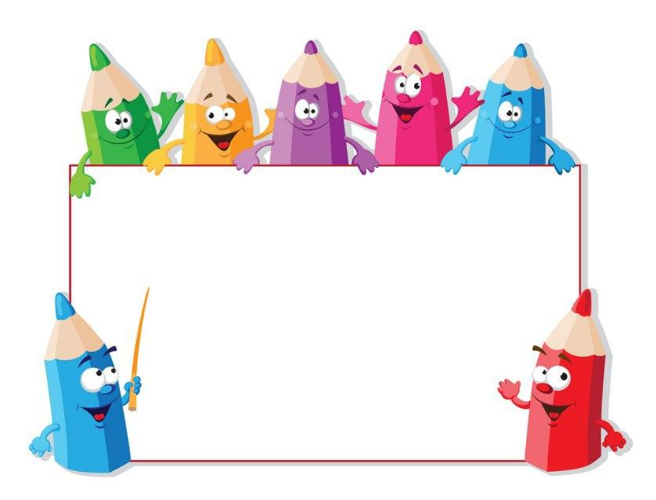
KIDS’ ENGLISH
4

Slide 2
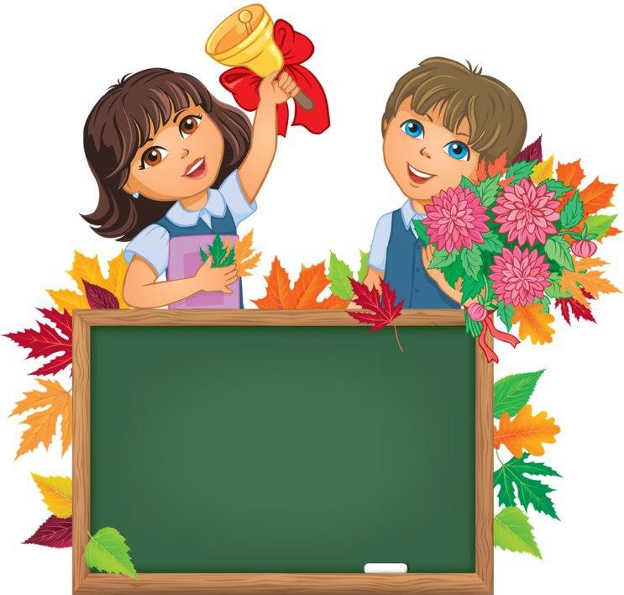
Unit 1. Lesson 2.
SHE SPEAKS ENGLISH,FRENCH AND GERMAN.

Slide 3

LET'S CHECK YOUR HOMEWORK!

Slide 4
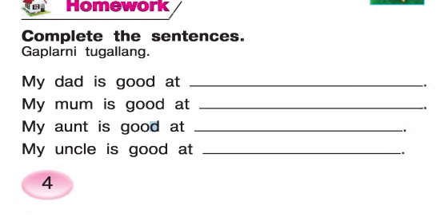
playing chess
cooking
dancing
playing football

Slide 5
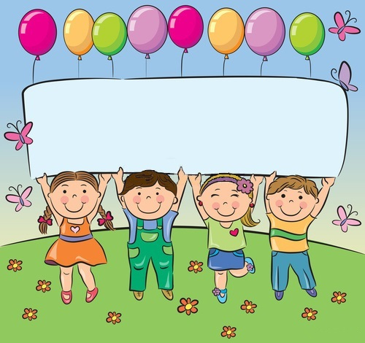
Let’s repeat our last lesson.
.

Slide 6
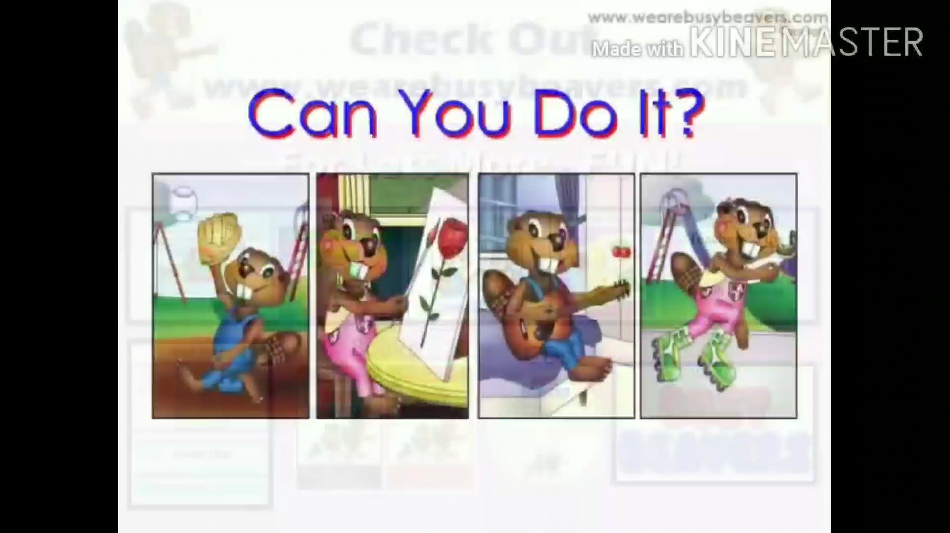

Slide 7
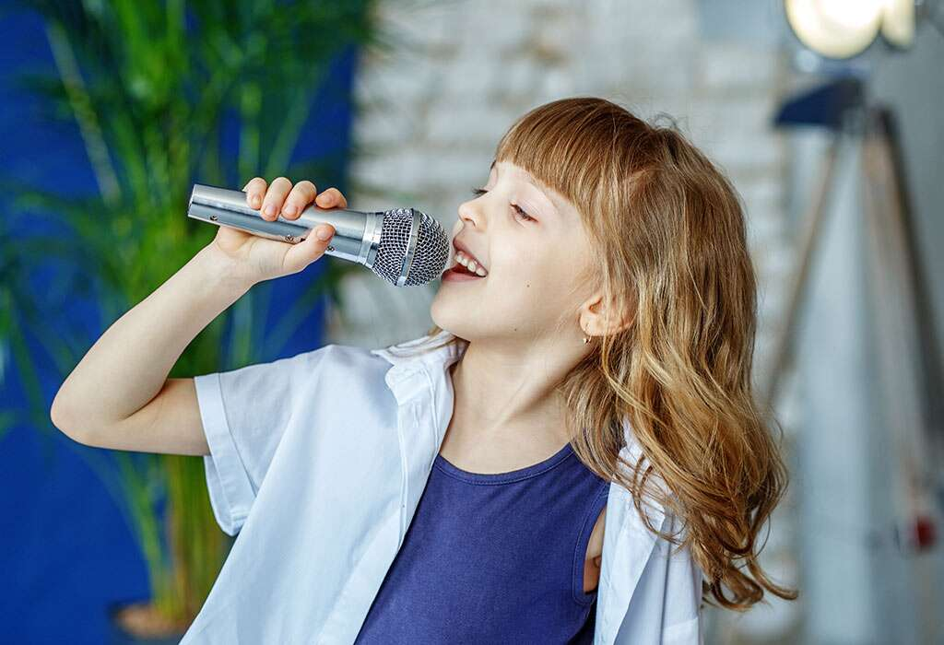
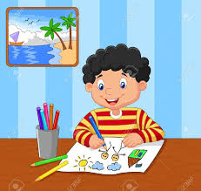
CAN – +VERB(DO,WRITE,READ…)
What is she good at?
She is good at singing a song
He is good at drawing
What is he good at?

Slide 8
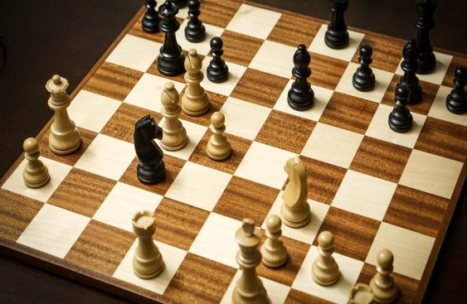
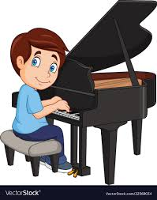
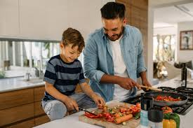
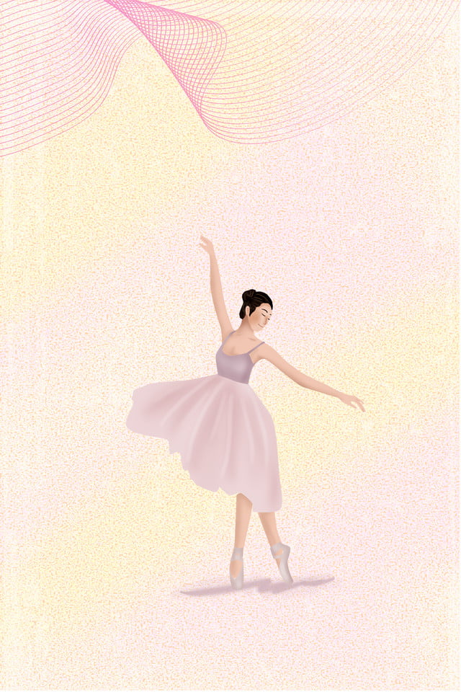
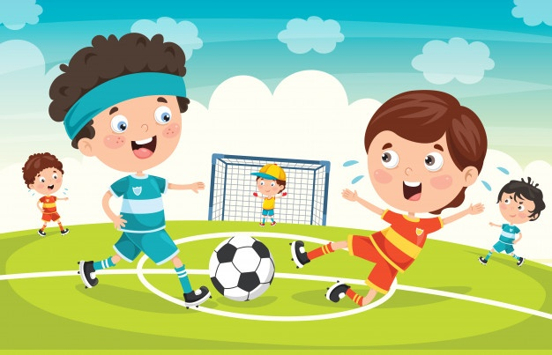
TO BE GOOD AT……- da yaxshi bo’lmoq…
Playing chess
Playing the piano
cooking
dancing
BE GOOD AT +V+ING
Playing football
singing

Slide 9
What can he do?-
U nima qila oladi?
He can play the piano

Slide 10
What can she do?
U nima qila oladi?
She can sing a song

Slide 11
She speaks English, French and German.

Slide 12
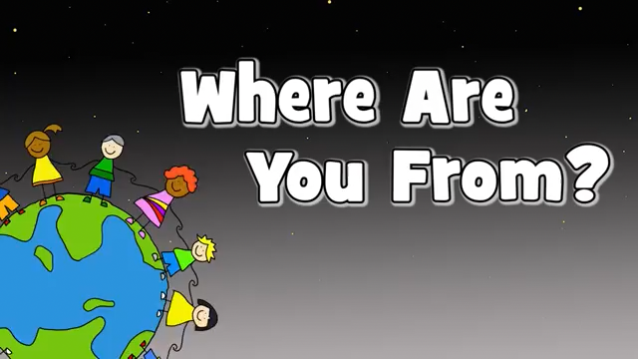

Slide 13

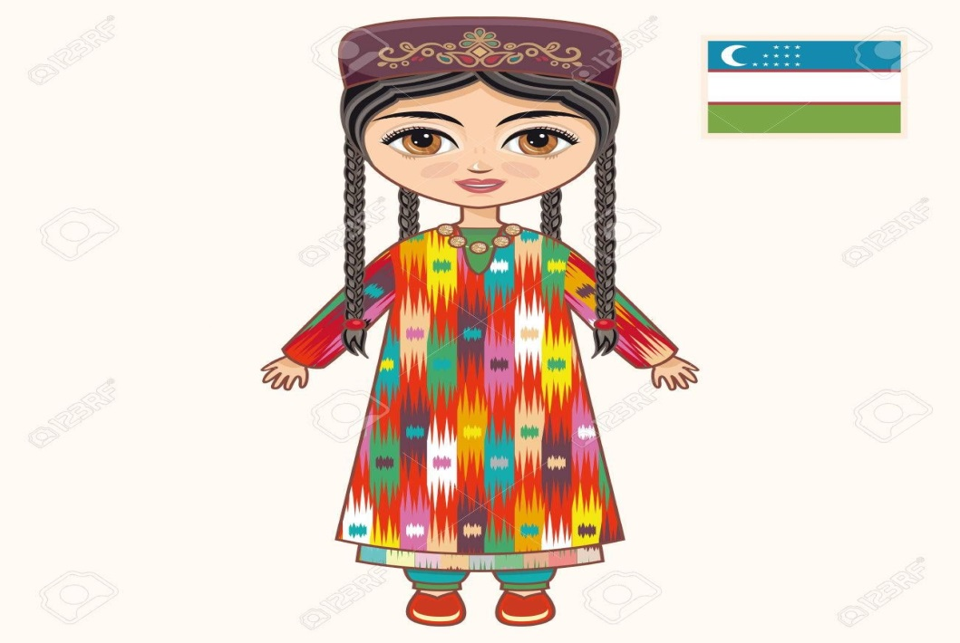
I am Jenny. I am English and I’m from England.
Where are you from?
My name is Zumrad. I am from Uzbekistan.
I am Uzbek

Slide 14

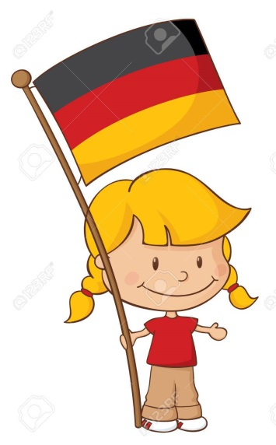
My name’s Ann.
I am American. I’m from the USA.
Where are you from?
I am Angela. I’m German and I am from Germany

Slide 15
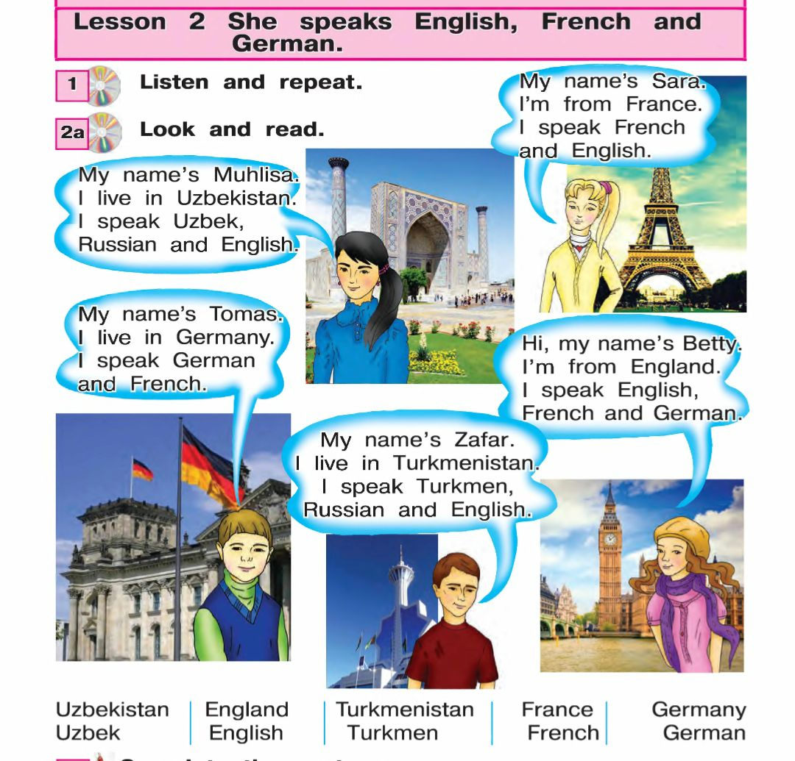

Slide 16

COUNTRIES AND NATIONALITIES
Uzbekistan- Uzbek
England -English
USA -American
Germany- German
Russia- Russian
France-French

Slide 17


The flag of England is red blue and white
The flag of France is blue , white and red

Slide 18


The flag of Turkmenistan is green
The flag of Uzbekistan is blue ,white ,green and red

Slide 19


The flag of Russia is red blue and white
The flag of Germany is black,red and yellow

Slide 20
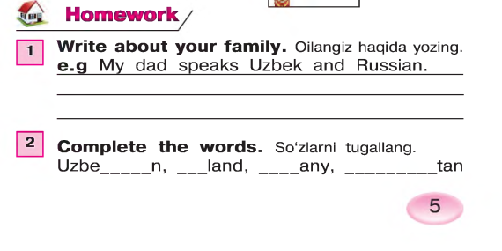

Slide 21
Good luck!

