Slide 1

ALGEBRA
7-sinf
Mavzu: Ko‘phadlarni qo‘shish va ayirish

Slide 2
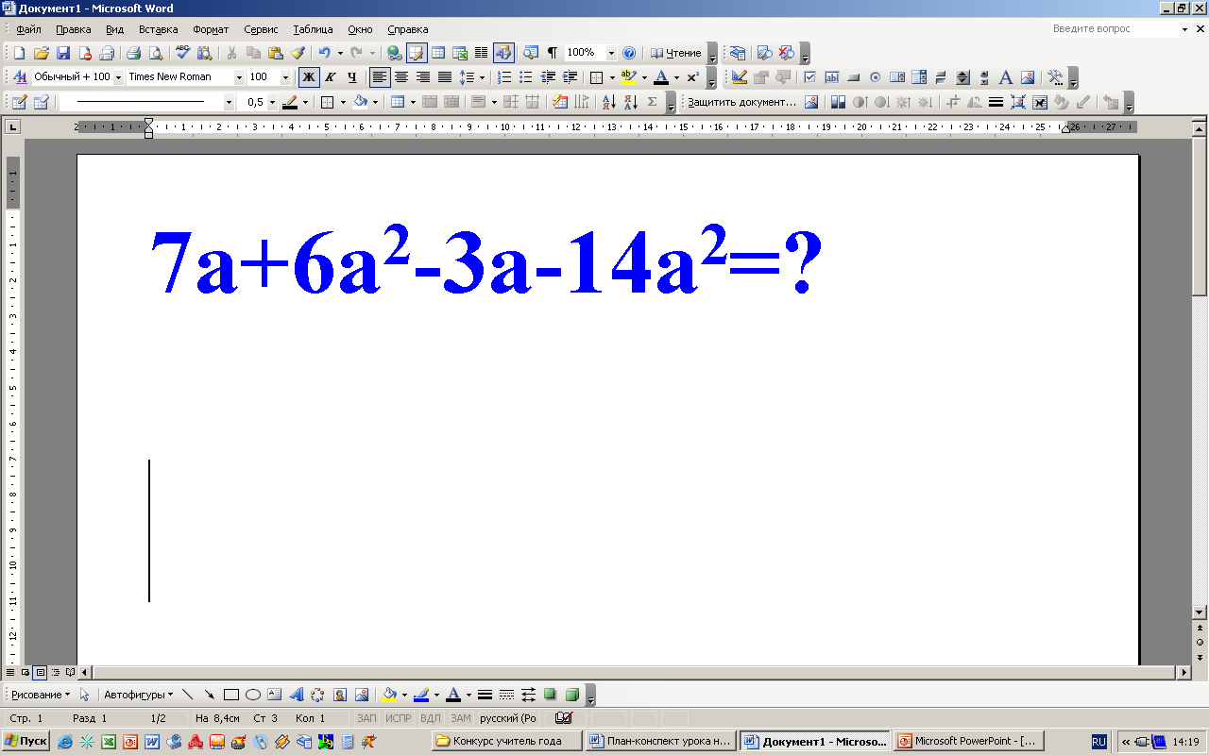
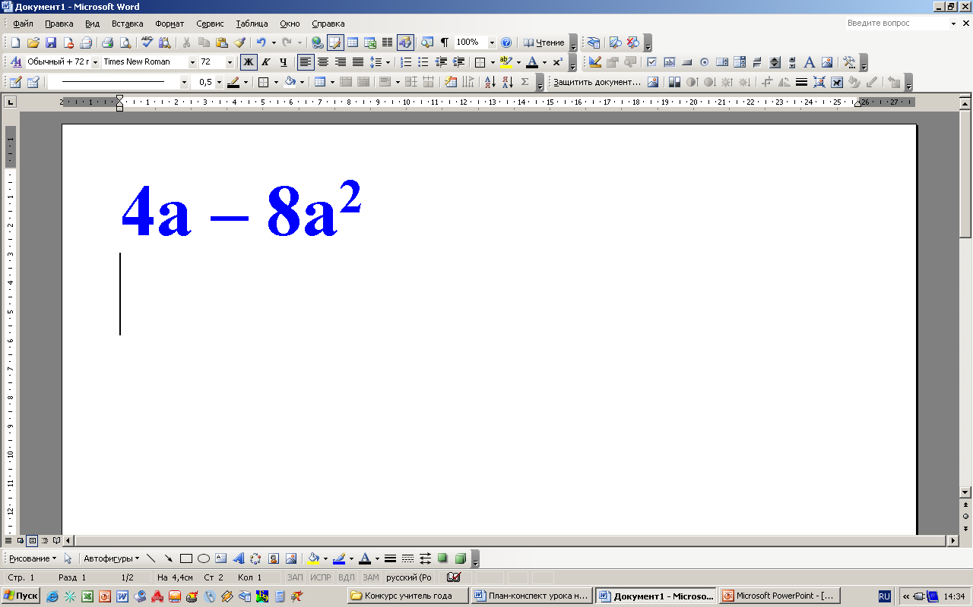
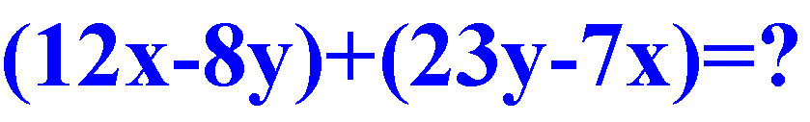
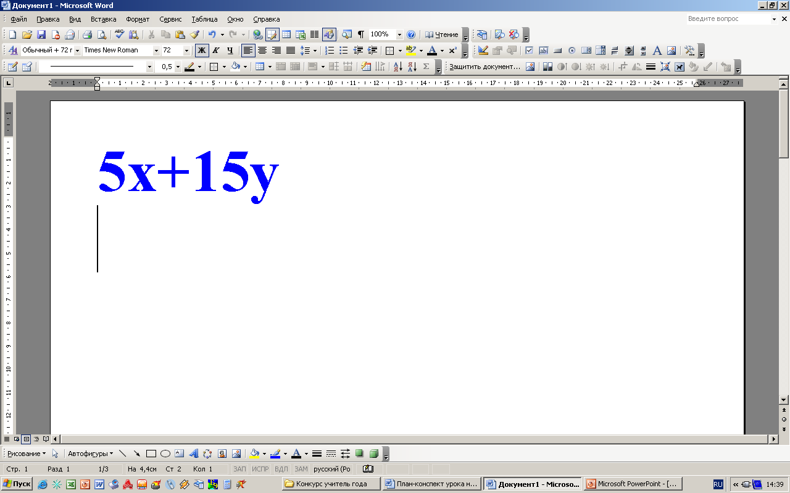
O‘xshash hadlarni ixchamlang:

Slide 3
Ko‘phadlarni qo‘shish va ayirish
Bir nechta ko‘phadning algebraik yig‘indisini standart shakldagi ko‘phad ko‘rinishida yozish uchun qavslarni ochish va o‘xshash hadlarni ixchamlash kerak.
8xy² + 4x³ va – 3x³ + 9xy² ko‘phadlarning yig‘indisini va ayirmasini toping:
1) (8xy² + 4x³) + (–3x³ + 9xy²) =
8xy² + 4x³ – 3x³ + 9xy² =
= 8xy² + 9xy² + 4x³- 3x³ =
17xy² + x³
2) (8xy² + 4x³) – (–3x³ + 9xy²) =
8xy² + 4x³ + 3x³ – 9xy² =
= 8xy² – 9xy² + 4x³+ 3x³ =
- xy² + 7x³

Slide 4
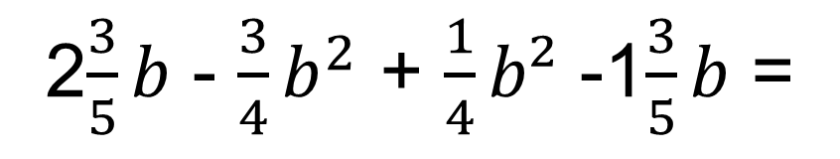
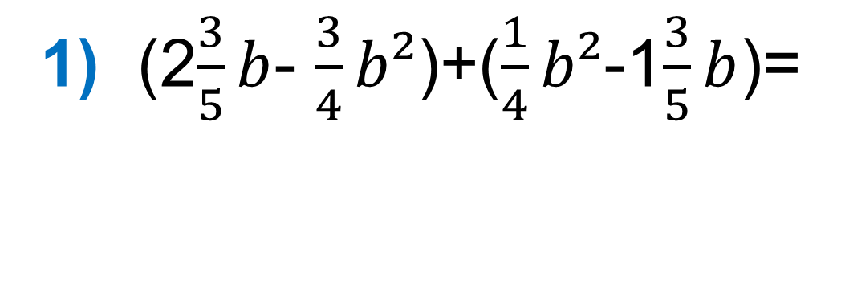
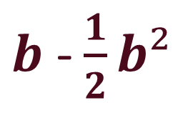
264 - misol
Ko‘phadlarni algebraik yig‘indisini toping:
1) (2$\frac{3}{5}b$- $\frac{3}{4}b²$)+($\frac{1}{4}b²$-1$\frac{3}{5}b$)=
2$\frac{3}{5}b$ - $\frac{3}{4}b^{2}$ + $\frac{1}{4}b²$ -1$\frac{3}{5}b$ =
$b$ - $\frac{1}{2}b²$
3) (13x -11y +10z) - (-15x + 10y - 15z) =
= 13x -11y +10z +15x -10y +15z =
28x - 21y + 25z

Slide 5
Ko‘phadlarni qo‘shish va ayirishning ustun usuli
24a + 17b – c va 23a – 17b – ko‘phadlarni “ustun” usulida hisoblang:
_
24a + 17b - c
23a - 17b - c
47a - 2c
24a + 17b - c
23a - 17b - c
a + 34b
+

Slide 6
Mustaqil bajarish uchun topshiriqlar:
Darslikning 80- sahifasida berilgan 262- 266- misollarni
yechish.

