Slide 1

ALGEBRA
7-sinf
Mavzu: O‘xshash hadlarni ixchamlash

Slide 2
O‘xshash hadlarni ixchamlash
Ko‘phadlarni o‘xshash birhadlar algedraik yig‘indisi bitta birhad bilan almashtiriladigan soddalashtirish o‘xshash hadlarni ixchamlash deyiladi.
3a + 2b – b – a =
3a – a + 2b – b =
2a + b
8xy² + 4x³– 5x²y – 3x³ + 4x²y – 9xy² =
= 8xy²- 9xy²+ 4x³- 3x³- 5x²y + 4x²y =
-xy²+x³–x²y

Slide 3
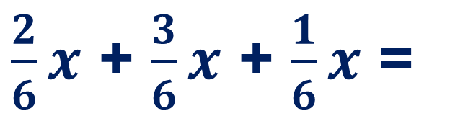
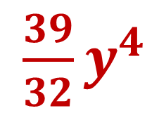
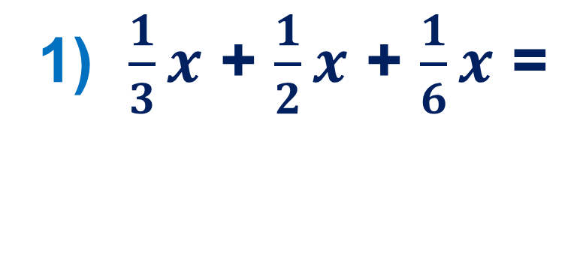
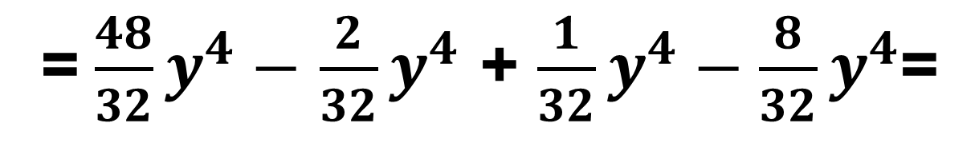
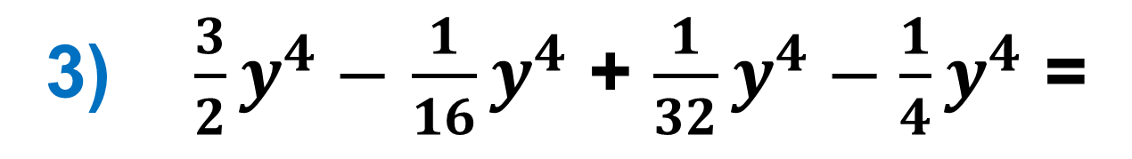
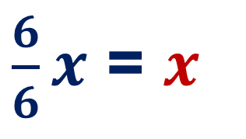
254 - misol
O‘xshash hadlarni ixchamlang:
1) $\frac{1}{3}x$ + $\frac{1}{2}x$ + $\frac{1}{6}x$ =
$\frac{2}{6}x$ + $\frac{3}{6}x$ + $\frac{1}{6}x$ =
$\frac{6}{6}x$ = $x$
3) $\frac{3}{2}y^{4}−$ $\frac{1}{16}y^{4}$ + $\frac{1}{32}y^{4}−\frac{1}{4}y^{4}$ =
= $\frac{48}{32}y^{4}−$ $\frac{2}{32}y^{4}$ + $\frac{1}{32}y^{4}−\frac{8}{32}y^{4}$=
$\frac{39}{32}y^{4}$

Slide 4
O‘xshash hadlarni ixchamlash
Har qanday ko‘phadni standart shaklda yozish mumkin. Buning uchun avval ko‘phadning har bir hadini standart shaklda yozish va so‘ngra o‘xshash hadlarni ixchamlash kerak.
№260. (1) 5b3b – 4c3b –5b2c – 4c(-2)c =
= 15b² - 12bc -10bc + 8c² =
15b² - 12bc -10bc + 8c² =
= 15b² - 22bc + 8c² ;

Slide 5
Mustahkamlash
O‘xshash hadlarni ixchamlang:
1. 13а – 5b – 3b
2. 3а³b² – 5а² – 8b²а³
3. 6аb – 2b² – 6bа +5а² + 0,6b²
4. 2а²b – 5аb² + 3а²b – 8b²а
5. -4аbа – 2а²b²
6. 5а²∙ 0,2а²b³ + 2а⁴b³ - аb
13а – 8b
-5а² – 5а³b²
5а²-1,4b²
5а²b – 13ab²
-4а²b – 2а²b²
3а⁴b³ - аb

Slide 6
Mustaqil bajarish uchun topshiriqlar:
Darslikning 80- sahifasida berilgan 256- 260- misollarni
yechish.

