Slide 1
MATEMATIKA
6- sinf
MAVZU: SONNING QISMINI TOPISH

Slide 2
MASALA
5 km li yo‘lning $\frac{2}{5}$ qismiga asfalt yotqizildi. Necha kilometr yo‘lga asfalt yotqizilgan?
Yechish:
5 ning $\frac{1}{5}$ qismi: 5 : 5 = 1
$\frac{2}{5}$ qismi esa: 1 ∙ 2 = 2
Javob: 2 km

Slide 3
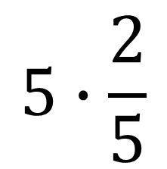
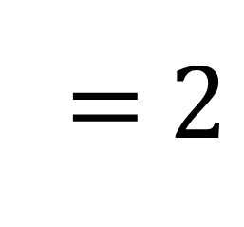
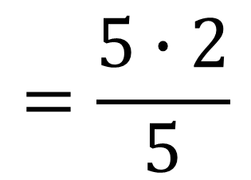
SONNING QISMINI TOPISH
5 ning $\frac{2}{5}$ qismi 2 ga teng ekan.
1
$$5∙\frac{2}{5}$$
$$=\frac{5∙2}{5}$$
=$2$
1
Bu masalada 5 – berilgan son,
$\frac{2}{5}$ - izlanayotgan qismni ifodalovchi kasr,
2 – berilgan sonning izlanayotgan qismi.

Slide 4
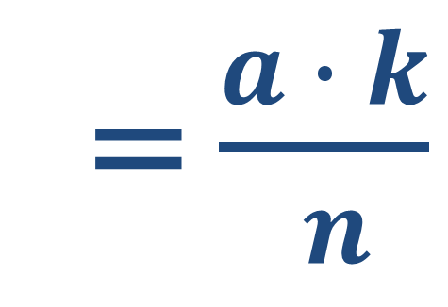
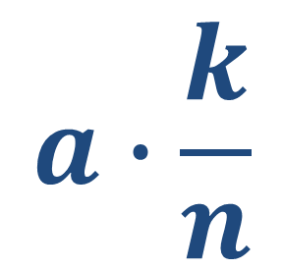
SONNING QISMINI TOPISH
Sonning berilgan qismini topish uchun sonni uning qismini ifodalovchi kasrga ko‘paytirish kerak:
$$a∙\frac{k}{n}$$
= $\frac{a ∙ k}{ n}$
bunda a, k, n – natural sonlar

Slide 5
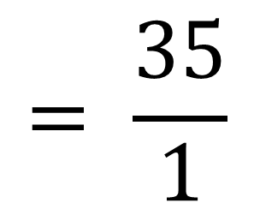
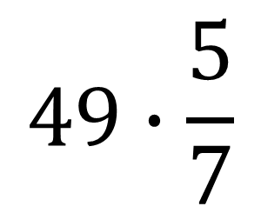
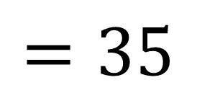
MISOL
49 ning $\frac{5}{7}$ qismini toping
Yechish:
$$49∙\frac{5}{7}$$
$$= \frac{35}{1}$$
7
$$=35$$
1
Javob: 35

Slide 6
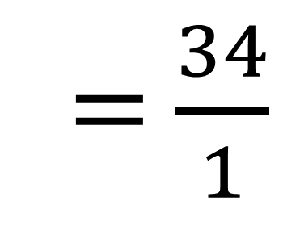

MISOL
$20\frac{2}{5}$ ning $\frac{5}{3}$ qismini toping:
34
1
$$20\frac{2}{5}∙\frac{5}{3}$$
$=\frac{102}{5}∙\frac{5}{3}$
=$\frac{34}{1}$
= 34
Yechish:
1
1
Javob: 34
Bu misolda sonning kasri topildi, chunki
34 > $20\frac{2}{5}$

Slide 7
HISOBLANG
363- masala
1) $100 ning \frac{19}{25}$ qismini
2) $110 ning \frac{13}{11}$ qismini
364- masala
1)$5\frac{1}{25} ning \frac{25}{42}$ qismini
2) $6,3 ning \frac{2}{7}$ qismini

Slide 8
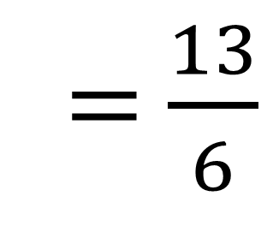

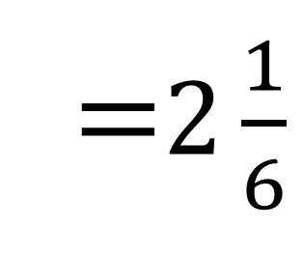
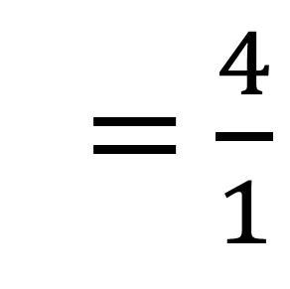

365- masala
1)$3\frac{2}{3} ning 1\frac{1}{11}$ qismini
Hisoblang:
2)$\frac{13}{20} ning 3\frac{1}{3}$ qismini
1
4
Yechish:
1) $3\frac{2}{3}∙1\frac{1}{11}$
$=\frac{11}{3}∙\frac{12}{11}$
=$\frac{4}{1}$
= 4
1
1
1
$=\frac{13}{20}∙\frac{10}{3}$
2) $\frac{13}{20}∙3\frac{1}{3}$
=$\frac{13}{6}$
=$2\frac{1}{6}$
2

Slide 9

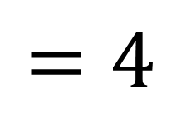
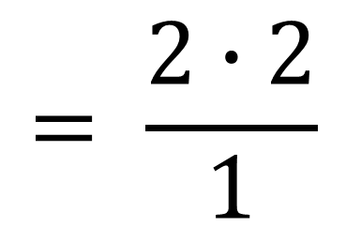
369- masala
Go‘sht qaynatilganda massasining $\frac{2}{5}$ qismini yo‘qotadi. 10 kg go‘sht qaynatilganda uning massasi necha kilogrammga kamayadi?
Yechish:
$$10∙\frac{2}{5}$$
$$= \frac{2∙2}{1}$$
2
$$=4$$
1
Javob: 4 kg

Slide 10
MUSTAQIL BAJARISH UCHUN TOPSHIRIQLAR:
Darslikning 67-betidagi 374-, 375-, 376- masalalarni yechish.

