Slide 1
MATEMATIKA
6- sinf
MAVZU: ODDIY KASRLARNI KO‘PAYTIRISH

Slide 2
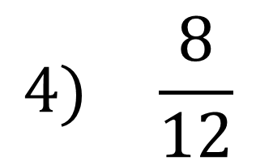
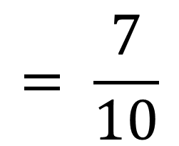
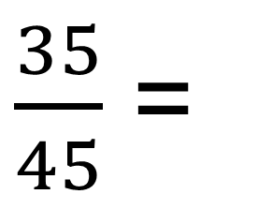
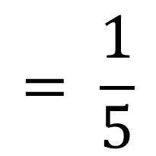
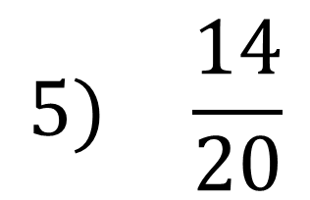
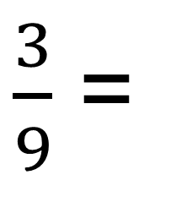
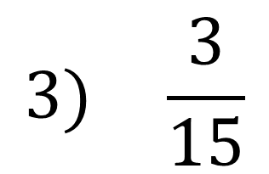
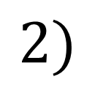
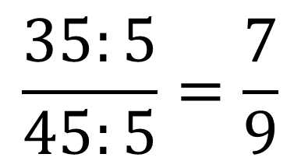
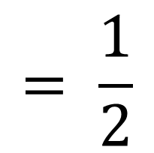
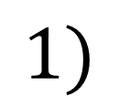
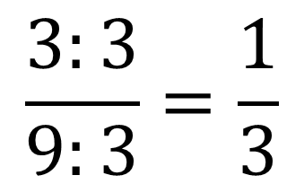
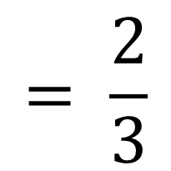
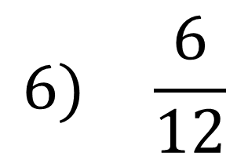
KASRNI QISQARTIRING
$\frac{3}{9}$ =
$$\frac{3:3}{9:3}=\frac{1}{3}$$
$\frac{35}{45}$ =
$$\frac{35:5}{45:5}=\frac{7}{9}$$
$$1)$$
$$2)$$
1
2
$$3) \frac{3}{15}$$
$$= \frac{1}{5}$$
$$4) \frac{8}{12}$$
$$= \frac{2}{3}$$
5
3
7
1
$$5) \frac{14}{20}$$
$$= \frac{7}{10}$$
$$6) \frac{6}{12}$$
$$= \frac{1}{2}$$
10
2

Slide 3
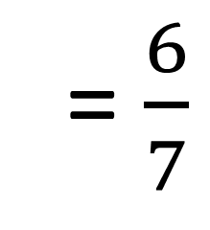
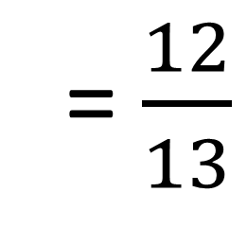
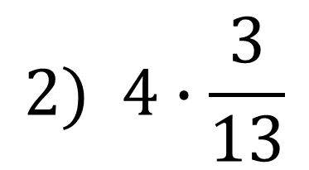
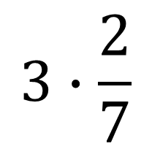
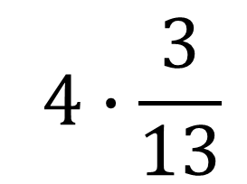
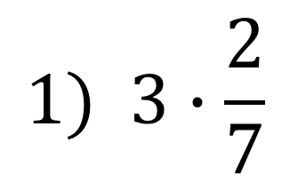
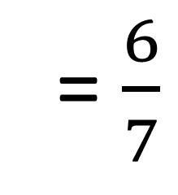
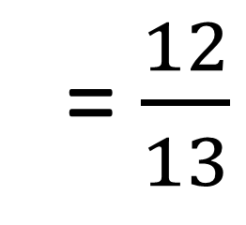
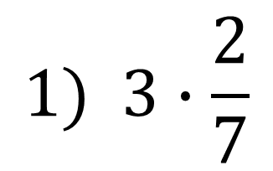
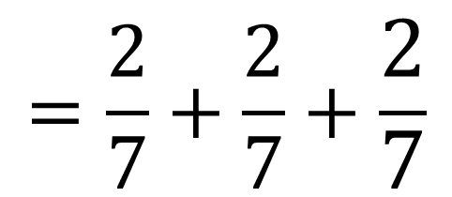
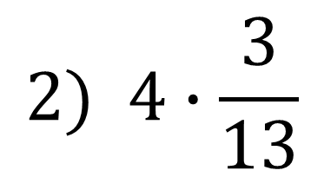
MISOL
Ko‘paytmani toping:
$$1) 3∙\frac{2}{7}$$
$$2) 4∙\frac{3}{13}$$
$$1) 3∙\frac{2}{7}$$
$$=\frac{2}{7}+\frac{2}{7}+\frac{2}{7}$$
= $\frac{6}{7}$
Yechish:
$$2) 4∙\frac{3}{13}$$
$$=\frac{3}{13}+\frac{3}{13}+\frac{3}{13}+\frac{3}{13}$$
= $\frac{12}{13}$
$$3∙\frac{2}{7}$$
= $\frac{6}{7}$
$$4∙\frac{3}{13}$$
= $\frac{12}{13}$

Slide 4
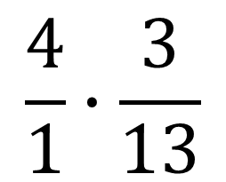
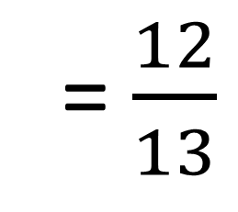
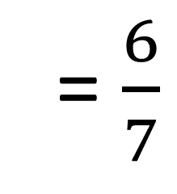
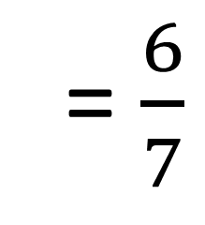
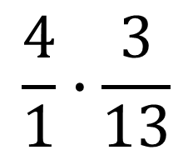
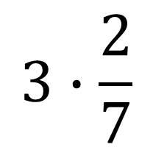
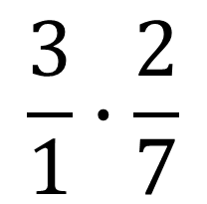
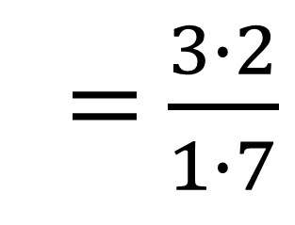
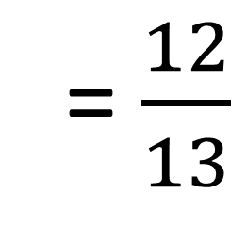
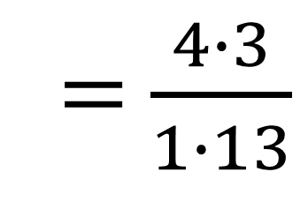
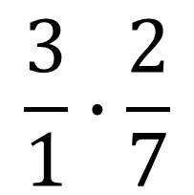
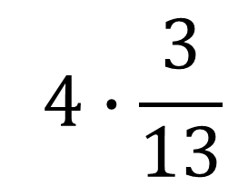
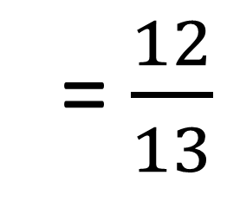
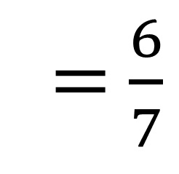
ODDIY KASRLARNI KO‘PAYTIRISH
$$3∙\frac{2}{7}$$
= $\frac{6}{7}$
$$4∙\frac{3}{13}$$
= $\frac{12}{13}$
$$\frac{3}{1}∙\frac{2}{7}$$
= $\frac{6}{7}$
$$\frac{4}{1}∙\frac{3}{13}$$
= $\frac{12}{13}$
$$\frac{3}{1}∙\frac{2}{7}$$
= $\frac{3∙2}{1∙7}$
= $\frac{6}{7}$
$$\frac{4}{1}∙\frac{3}{13}$$
= $\frac{4∙3}{1∙13}$
= $\frac{12}{13}$

Slide 5
ODDIY KASRLARNI KO‘PAYTIRISH
Kasrni kasrga ko‘paytirish uchun shu kasrlar:
suratlari ko‘paytmasini natijaning suratiga yozish kerak;
maxrajlari ko‘paytmasini natijaning maxrajiga yozish kerak.
$$\frac{k}{n}∙\frac{p}{q}$$
= $\frac{k ∙ p}{n ∙ q}$
k, n, p, q – natural sonlar

Slide 6
ODDIY KASRLARNI KO‘PAYTIRISH
Natural sonni kasrga ko‘paytirish uchun:
natural sonni suratiga ko‘paytirish kerak;
maxrajini o‘zini o‘zgarishsiz qoldirish kerak.
$$m∙\frac{k}{n}$$
= $\frac{m ∙k}{ n}$
k, n, m– natural sonlar

Slide 7
MISOLLAR
$$\frac{2}{3}∙\frac{4}{5}$$
= $\frac{2∙4}{3∙5}$
= $\frac{8}{15}$
$$\frac{4}{9}∙\frac{5}{7}$$
= $\frac{4∙5}{9∙7}$
= $\frac{20}{63}$
= $\frac{11∙3}{35}$
= $\frac{33}{35}$
$$\frac{2}{15}∙8$$
= $\frac{2∙8}{15}$
= $\frac{16}{15}$
=$1\frac{1}{15}$
11$∙\frac{3}{35}$

Slide 8
MISOLLAR
1
2
2
$$\frac{12}{19}∙\frac{19}{30}$$
= $\frac{2∙1}{1∙5}$
= $\frac{2}{5}$
$$\frac{4}{5}∙\frac{10}{11}$$
= $\frac{2∙4}{1∙11}$
= $\frac{8}{11}$
1
5
1
$$\frac{7}{18}∙6$$
1
= $\frac{7∙1}{3}$
= $\frac{7}{3}$
= 2$\frac{1}{3}$
3

Slide 9
332- masala
Ko‘paytirishni bajaring:
2) $\frac{2}{3}∙\frac{2}{5}$
$$=\frac{4}{15}$$
3) $\frac{5}{8}∙\frac{1}{9}$
$$=\frac{5}{72}$$
1) $\frac{1}{2}∙\frac{1}{3}$
$$=\frac{1}{6}$$
4) $\frac{3}{4}∙\frac{3}{5}$
$$=\frac{9}{20}$$
5) $\frac{7}{10}∙\frac{1}{4}$
$$=\frac{7}{40}$$

Slide 10
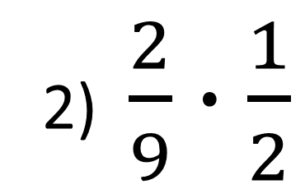
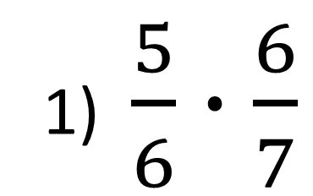
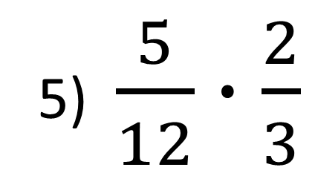
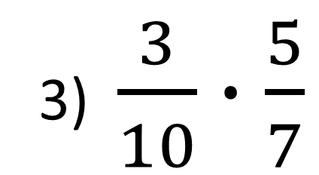
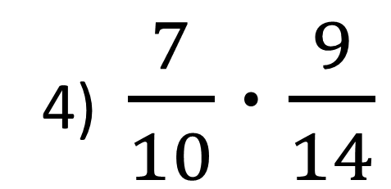
333- masala
Ko‘paytirishni bajaring:
1) $\frac{5}{6}∙\frac{6}{7}$
2) $\frac{2}{9}∙\frac{1}{2}$
3) $\frac{3}{10}∙\frac{5}{7}$
4) $\frac{7}{10}∙\frac{9}{14}$
5) $\frac{5}{12}∙\frac{2}{3}$

Slide 11
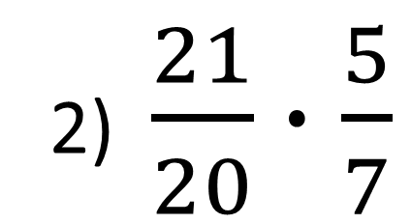
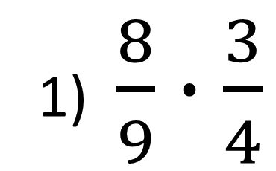
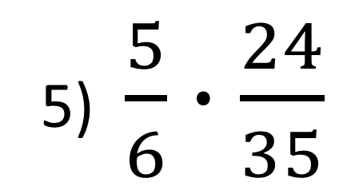
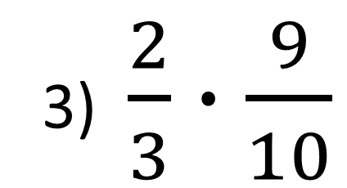
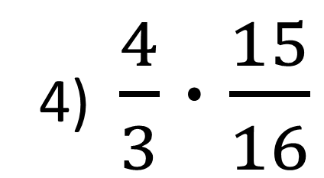
334- masala
Ko‘paytirishni bajaring:
1) $\frac{8}{9}∙\frac{3}{4}$
2) $\frac{21}{20}∙\frac{5}{7}$
3) $\frac{2}{3}∙\frac{9}{10}$
4) $\frac{4}{3}∙\frac{15}{16}$
5) $\frac{5}{6}∙\frac{24}{35}$

Slide 12
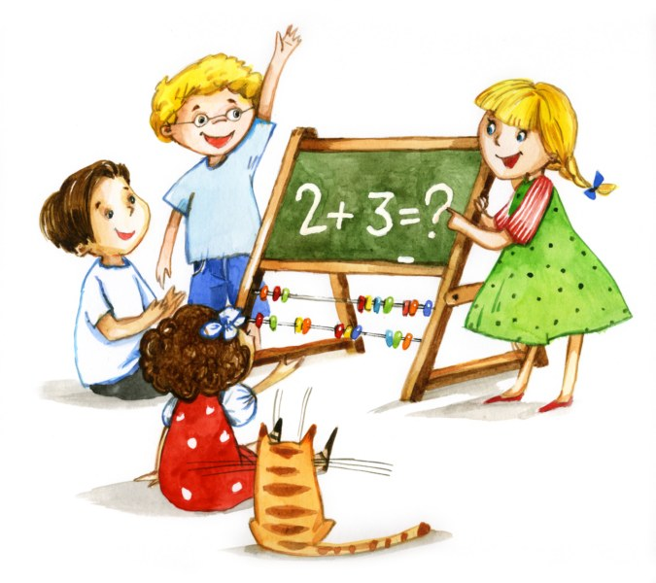
MUSTAQIL BAJARISH UCHUN TOPSHIRIQLAR:
Darslikning 64-betidagi 353-, 354-, 355-, 356- masalalarni
yechish

