Slide 1
MATEMATIKA
6- sinf
MAVZU: MASALALAR YECHISH

Slide 2
ODDIY KASRLARNI KO‘PAYTIRISH
Kasrni kasrga ko‘paytirish uchun shu kasrlar:
suratlari ko‘paytmasini natijaning suratiga yozish kerak;
maxrajlari ko‘paytmasini natijaning maxrajiga yozish kerak.
$$\frac{k}{n}∙\frac{p}{q}$$
= $\frac{k ∙ p}{n ∙ q}$
k, n, p, q – natural sonlar

Slide 3
ODDIY KASRLARNI KO‘PAYTIRISH
Natural sonni kasrga ko‘paytirish uchun:
natural sonni suratiga ko‘paytirish kerak;
maxrajini o‘zini o‘zgarishsiz qoldirish kerak.
$$m∙\frac{k}{n}$$
= $\frac{m ∙k}{ n}$
k, n, m– natural sonlar

Slide 4
ARALASH SONLARNI KO‘PAYTIRISH
Aralash sonlarni ko‘paytirish uchun ularni noto‘g‘ri kasrga aylantirish, so‘ngra ularni kasrni kasrga ko‘paytirish qoidasiga ko‘ra ko‘paytirish kerak.
Aralash sonni butun songa ko‘paytirish uchun butun va kasr qismini alohida-alohida ko‘paytirish ma’qul.

Slide 5
336- masala
$\frac{33}{66}, \frac{75}{100},\frac{125}{1000}$.
Kasrlarni qisqartiring:
Ularning: 1) yig‘indisini; 2) ko‘paytmasini toping.
Yechish:
1
3
1
$$\frac{33}{66}$$
$$= \frac{1}{2}$$
$$\frac{75}{100}$$
$$= \frac{3}{4}$$
$$\frac{125}{1000}$$
$$= \frac{1}{8}$$
2
4
8

Slide 6
YECHISH
4
2
1
$$\frac{1}{2}+\frac{3}{4}+\frac{1}{8}$$
$$= \frac{4+6+1}{8}$$
$$= \frac{11}{8}$$
$$=1\frac{3}{8}$$
$$\frac{1}{2}∙\frac{3}{4}∙\frac{1}{8}$$
$$= \frac{1∙3∙1}{2∙4∙8}$$
$$=\frac{3}{64}$$
Javob: 1) $1\frac{3}{8}$ 2) $\frac{3}{64}$

Slide 7
338- masala
Ifodaning qiymatini toping:
$1) \frac{21}{25}∙\frac{15}{28}+3\frac{4}{5}$
2) $5\frac{4}{21}−\frac{18}{49}∙\frac{7}{9}$
$$3) 7\frac{3}{10}+\frac{39}{55}∙\frac{11}{13}$$

Slide 8
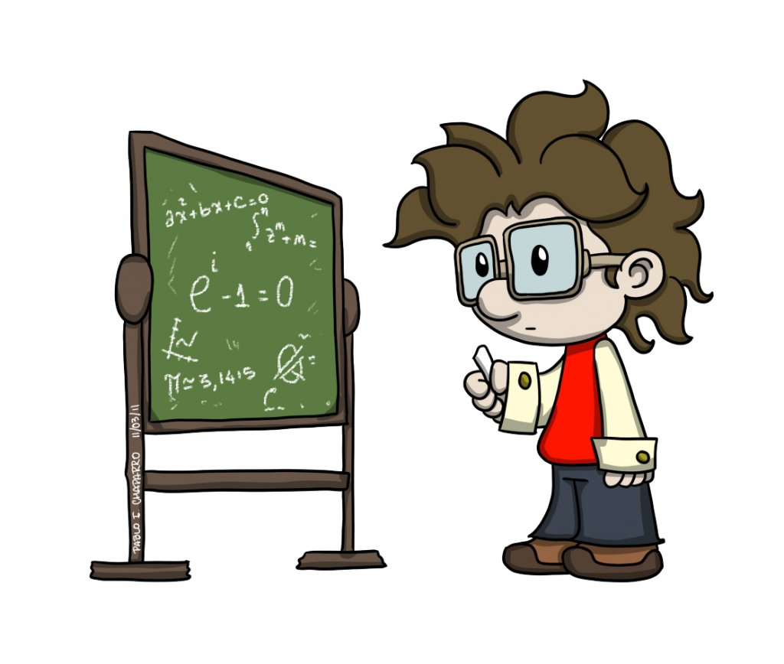
343- masala
Ko‘paytirishni bajaring:
1) $7\frac{1}{2}∙12\frac{1}{4}∙\frac{8}{49}$
2) $5∙1\frac{1}{7}∙2\frac{1}{3}∙\frac{3}{10}$

Slide 9
344- masala
Kvadratning tomoni $2\frac{3}{8}$ dm. Uning perimetri va yuzini toping.
3
P= $4∙2\frac{3}{8}$
$$=8\frac{12}{8}$$
=$9\frac{1}{2}$
=$8\frac{3}{2}$
Yechish:
(dm)
2
S=$(2\frac{3}{8})²$
$=2\frac{3}{8}∙2\frac{3}{8}$
$=\frac{19}{8}∙\frac{19}{8}$
=$\frac{361}{64}$
=$5\frac{41}{64}$
(dm²)
$9\frac{1}{2}$ dm,
$5\frac{41}{64}$ dm²
Javob:

Slide 10
348- masala
To‘g‘ri to‘rtburchakning bo‘yi 1$2\frac{4}{5}$ dm, eni esa undan 3$\frac{1}{8}$ dm ga qisqa. Shu to‘g‘ri to‘rtburchakning yuzini toping.
S = a∙b
b (eni)
a (bo‘yi)

Slide 11
YECHISH
a =$12\frac{4}{5}$ dm
b - $3\frac{1}{8}$ dm qisqa
S = ?
S = a∙b
b (eni)
a (bo‘yi)
8
5
$$=9\frac{32−5}{40}$$
b= $12\frac{4}{5}−3\frac{1}{8}$
=$9\frac{27}{40}$
(dm)
8
$=\frac{64}{5}∙\frac{387}{40}$
=$\frac{3096}{25}$
=$123\frac{21}{25}$
S$=12\frac{4}{5}∙9\frac{27}{40}$
(dm²)
5
$123\frac{21}{25}$ dm²
Javob:

Slide 12
MUSTAQIL BAJARISH UCHUN TOPSHIRIQLAR:
Darslikning 64- betidagi 351-, 352-, 360-, 361- masalalarni yechish.

