Slide 1
MATEMATIKA
6- sinf
MAVZU: ARALASH SONLARNI QO‘SHISH VA AYIRISH

Slide 2
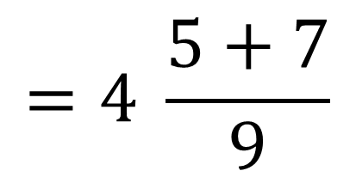
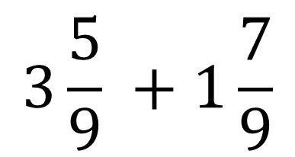
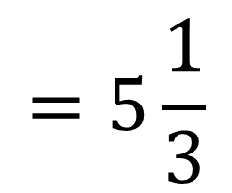
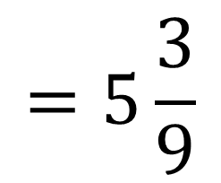
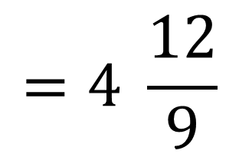
ARALASH SONLAR
Aralash sonlarni qo‘shish uchun:
ularning butun qismlari alohida qo‘shiladi va natija tenglik belgisini o‘ng tomoniga yoziladi;
so‘ngra kasr qismlar qo‘shiladi, agar noto‘g‘ri kasr hosil bo‘lsa, uning butun qismi ajratiladi va u hosil bo‘lgan butun qismga qo‘shiladi hamda ortidan qolgan kasr yozib qo‘yiladi.
Agar kasr qismida qisqaradigan kasr hosil bo‘lsa, u qisqartiriladi.
$$3\frac{5}{9} +1\frac{7}{9}$$
$$=4 \frac{5+7}{9}$$
$$=4 \frac{12}{9}$$
$$=5\frac{3}{9}$$
$$=5\frac{1}{3}$$

Slide 3
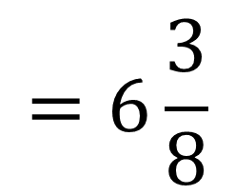
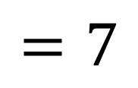
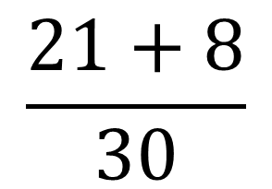
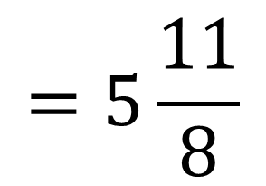
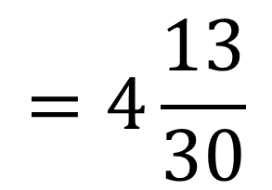
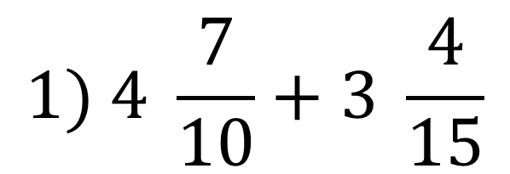
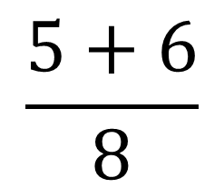
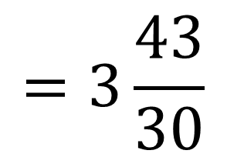
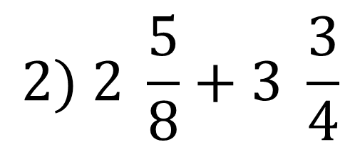
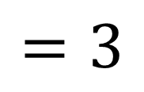
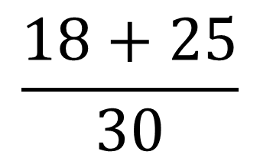
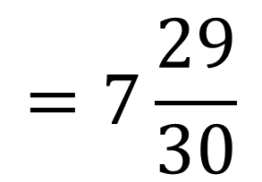
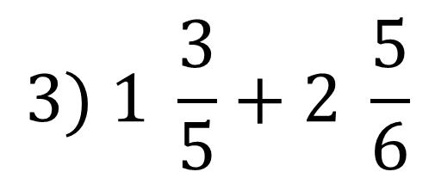
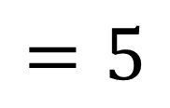
MISOL
3
2
$$1) 4 \frac{7}{10}+3 \frac{4}{15}$$
$$\frac{21+8}{30}$$
$$=7\frac{29}{30}$$
$$=7$$
1
2
$$2) 2 \frac{5}{8}+3 \frac{3}{4}$$
$$\frac{5+6}{8}$$
$$=5\frac{11}{8}$$
$$=6\frac{3}{8}$$
$$=5$$
6
5
$$3) 1 \frac{3}{5}+2 \frac{5}{6}$$
$$\frac{18+25}{30}$$
$$=3\frac{43}{30}$$
$$=4\frac{13}{30}$$
$$=3$$

Slide 4
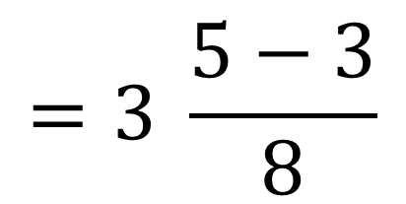
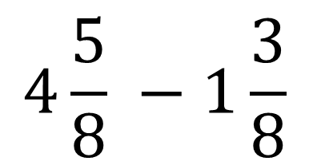
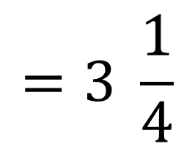
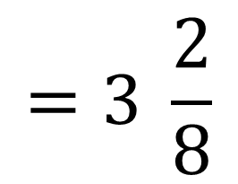
ARALASH SONLAR
Aralash sonlarni ayirish uchun:
ularning butun qismlari ayiriladi va ayirma tenglik belgisini o‘ng tomoniga yoziladi;
agar kasr qismlar ayirilganda, qisqaradigan kasr hosil bo‘lsa, u qisqartiriladi va hosil bo‘lgan butun qismga qo‘shiladi
$$4\frac{5}{8} −1\frac{3}{8}$$
$$=3 \frac{5−3}{8}$$
$$=3 \frac{2}{8}$$
$$=3 \frac{1}{4}$$

Slide 5
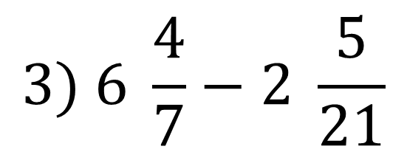
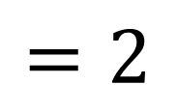
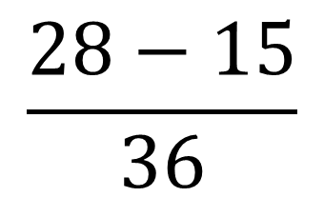
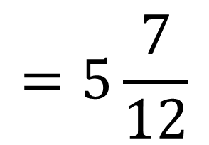
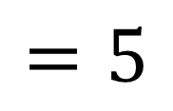
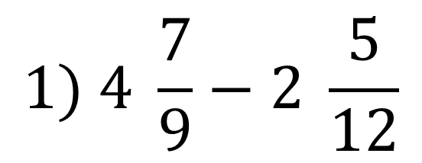
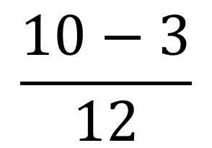
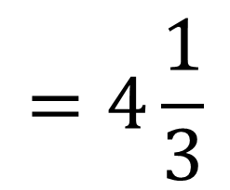
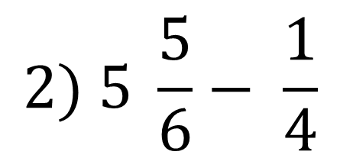
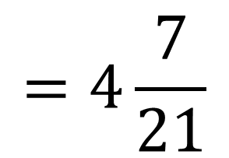
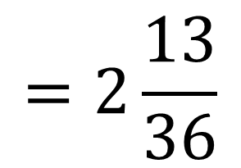
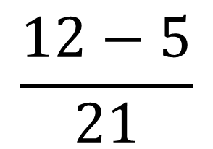
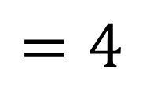
MISOL
4
3
$$1) 4 \frac{7}{9}−2 \frac{5}{12}$$
$$\frac{28−15}{36}$$
$$=2\frac{13}{36}$$
$$=2$$
2
3
$$2) 5 \frac{5}{6}− \frac{1}{4}$$
$$\frac{10−3}{12}$$
$$=5\frac{7}{12}$$
$$=5$$
3
1
$$3) 6 \frac{4}{7}−2 \frac{5}{21}$$
$$\frac{12−5}{21}$$
$$=4\frac{7}{21}$$
$$=4\frac{1}{3}$$
$$=4$$

Slide 6
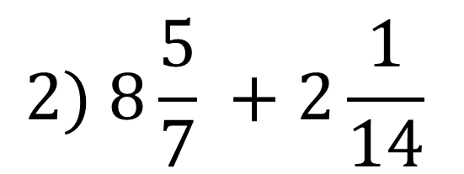
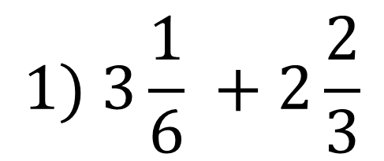
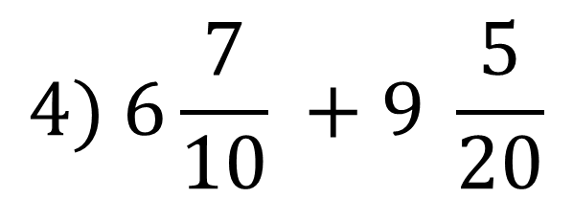
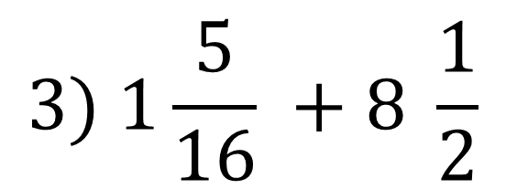
240- masala
287- masala
Yig‘indini toping:
$$1) 3\frac{1}{6} +2\frac{2}{3}$$
$$2) 8\frac{5}{7} +2\frac{1}{14}$$
$$3) 1\frac{5}{16} +8 \frac{1}{2}$$
$$4) 6\frac{7}{10} +9 \frac{5}{20}$$

Slide 7
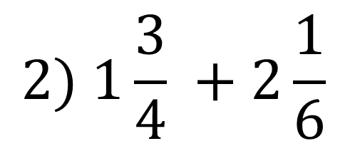
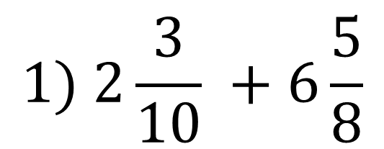
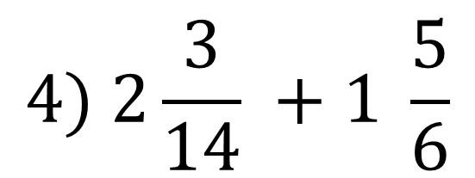
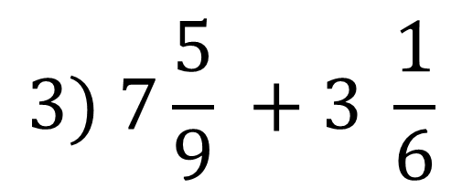
240- masala
288- masala
Hisoblang:
$$1) 2\frac{3}{10} +6\frac{5}{8}$$
$$2) 1\frac{3}{4} +2\frac{1}{6}$$
$$3) 7\frac{5}{9} +3 \frac{1}{6}$$
$$4) 2\frac{3}{14} +1 \frac{5}{6}$$

Slide 8
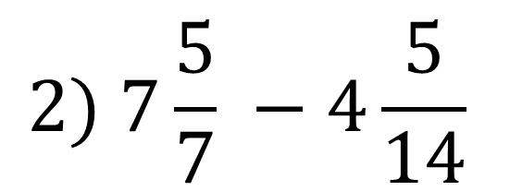
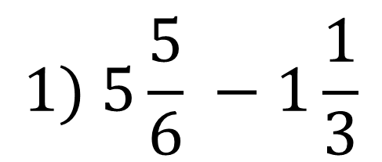
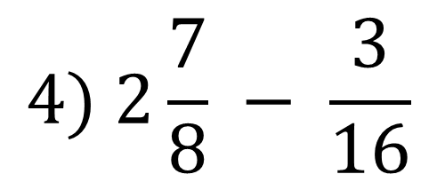
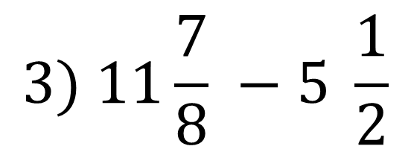
240- masala
294- masala
Hisoblang:
$$1) 5\frac{5}{6} −1\frac{1}{3}$$
$$2) 7\frac{5}{7} −4\frac{5}{14}$$
$$3) 11\frac{7}{8} −5 \frac{1}{2}$$
$$4) 2\frac{7}{8} − \frac{3}{16}$$

Slide 9
MUSTAQIL BAJARISH UCHUN TOPSHIRIQLAR:
Darslikning 57-betida berilgan
320-, 321-, 322-, 323- masalalarni yechish.

