Slide 1
MATEMATIKA
6- sinf
MAVZU: MASALALAR YECHISH

Slide 2
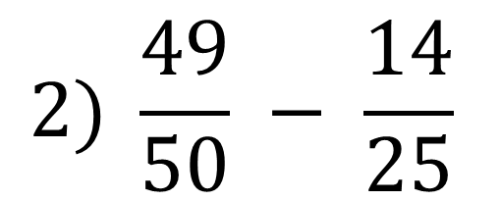
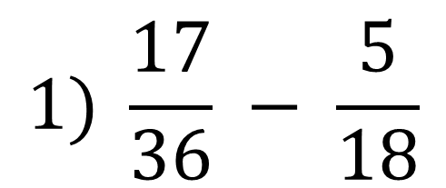
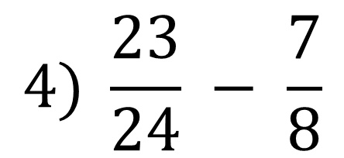
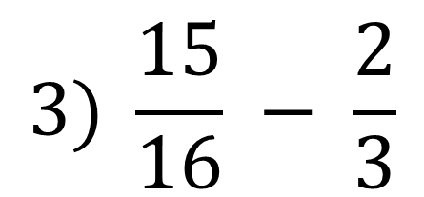
269- masala
Ayirmani toping va natijani qo‘shish bilan tekshiring:
$$1) \frac{17}{36} − \frac{5}{18}$$
$$2) \frac{49}{50} − \frac{14}{25}$$
$$4) \frac{23}{24} − \frac{7}{8}$$
$$3) \frac{15}{16} − \frac{2}{3}$$

Slide 3
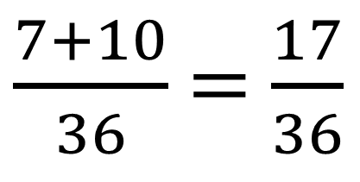
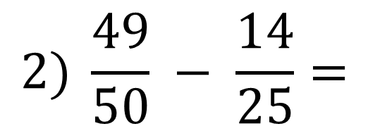
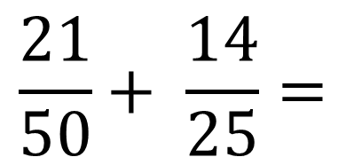
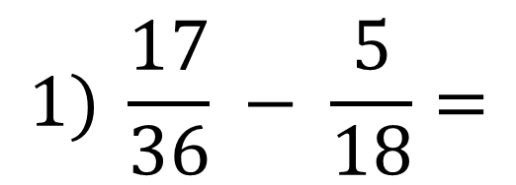
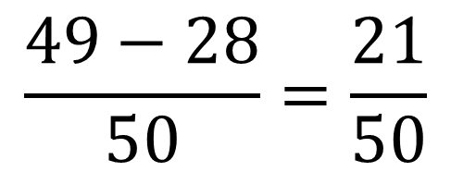
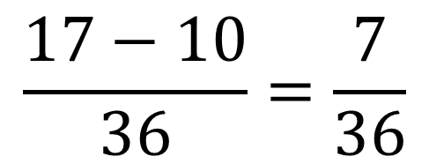
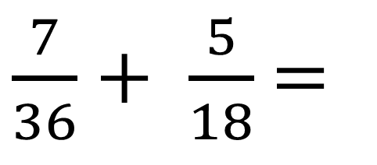
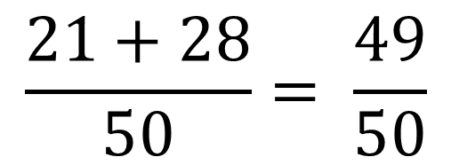
YECHISH
1
2
$$1) \frac{17}{36} − \frac{5}{18}=$$
$$\frac{17−10}{36}=\frac{7}{36}$$
1
2
$\frac{7}{36}+ \frac{5}{18}$ =
$\frac{7+10}{36}$ =$\frac{17}{36}$
Tekshirish:
1
2
$$2) \frac{49}{50} − \frac{14}{25}=$$
$$\frac{49−28}{50}=\frac{21}{50}$$
1
2
$$\frac{21}{50}+ \frac{14}{25}=$$
$$\frac{21+28}{50}= \frac{49}{50}$$
Tekshirish:

Slide 4
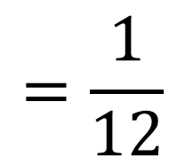
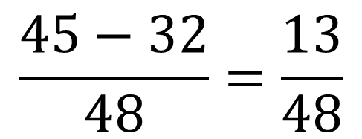
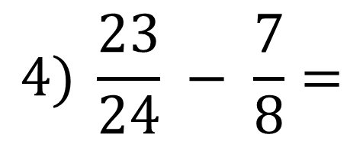
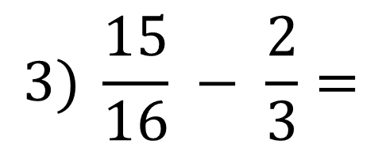
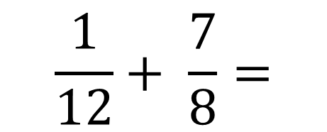
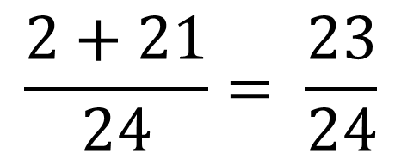
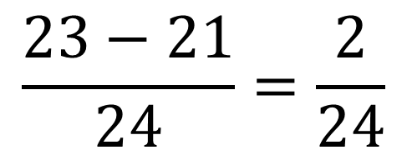
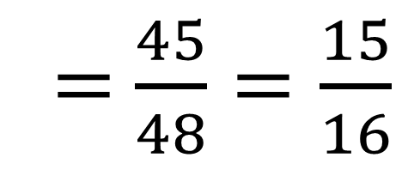
YECHISH
3
16
$$3) \frac{15}{16} − \frac{2}{3}=$$
$$\frac{45−32}{48}=\frac{13}{48}$$
1
16
$\frac{13}{48}+ \frac{2}{3}$ = $\frac{13+32}{48}$
=$\frac{45}{48}=\frac{15}{16}$
Tekshirish:
1
3
$$4) \frac{23}{24} − \frac{7}{8}=$$
$$\frac{23−21}{24}=\frac{2}{24}$$
$$=\frac{1}{12}$$
2
3
$$\frac{1}{12}+ \frac{7}{8}=$$
$$\frac{2+21}{24}= \frac{23}{24}$$
Tekshirish:

Slide 5
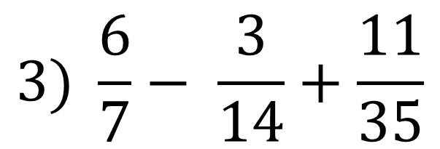
270- masala
Amallarni bajaring:
$$1) \frac{11}{12}+ \frac{3}{4}−\frac{7}{18}$$
$$2) \frac{29}{30}− \frac{2}{15}+\frac{1}{3}$$
$$3) \frac{6}{7}− \frac{3}{14}+\frac{11}{35}$$

Slide 6
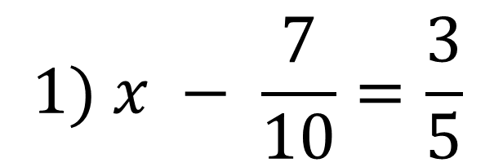
240- masala
271- masala
Tenglamani yeching:
$$1) x − \frac{7}{10}=\frac{3}{5}$$
$$2) \frac{13}{18}+x=\frac{35}{36}$$
$$3) \frac{19}{24} −x=\frac{13}{48}$$

Slide 7
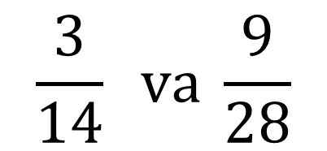
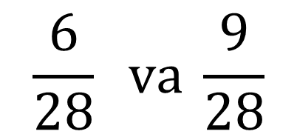
273- masala
Bir to‘g‘ri to‘rtburchakning yuzi $\frac{3}{14}$ m², ikkinchisiniki esa $\frac{9}{28}$ m². To‘g‘ri to‘rtburchakdan qaysi birining yuzi katta?
2
1
$$\frac{3}{14} va \frac{9}{28}$$
Yechish:
<
$$\frac{6}{28} va \frac{9}{28}$$
<
Javob: Ikkinchi to‘g‘ri to‘rtburchak katta.

Slide 8
MUSTAQIL BAJARISH UCHUN TOPSHIRIQLAR:
Darslikning 50-betidagi
282- 283- masalalarni
yechish.

