Slide 1

MATEMATIKA
6- sinf
MAVZU: MASALA VA TESTLAR YECHISH

Slide 2
KASRLARNI TAQQOSLASH
Yozuvda raqamlar o‘rniga harflar qo‘yilgan. Bir xil harflar bir xil raqamlarni ifodalaydi. Bu kasrlarni taqqoslay olasizmi?
…
OT
QO‘Y
<
FIL
FIL
IT
…
IT
>
MUSHUK
SICHQON
AYIQ
…
TULKI
<
QUYON
BO‘RI

Slide 3
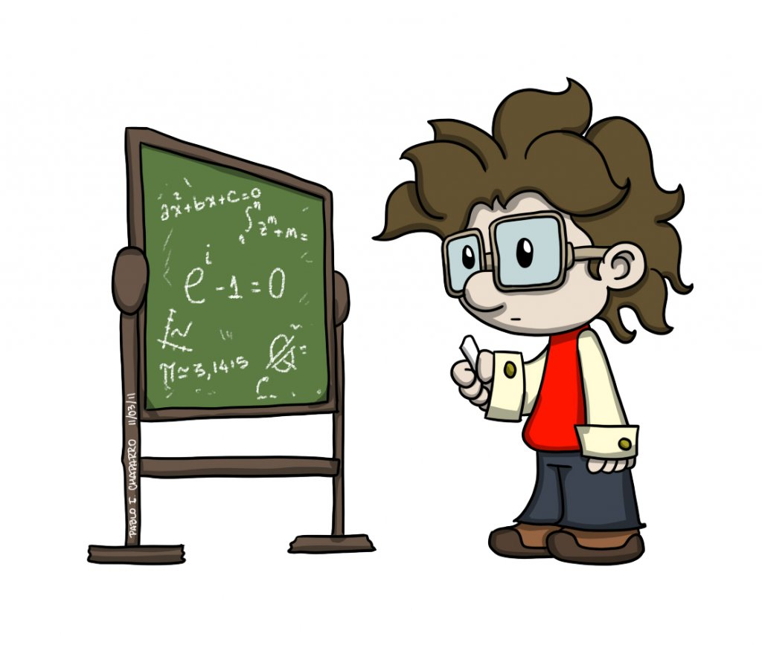
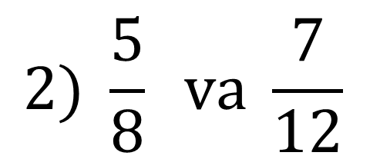
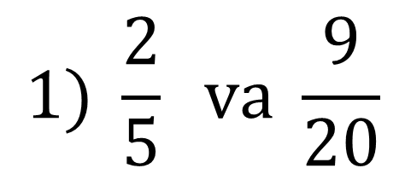
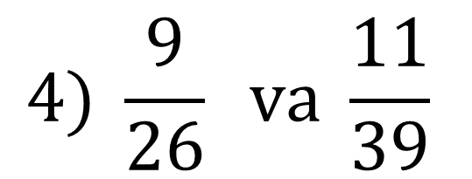
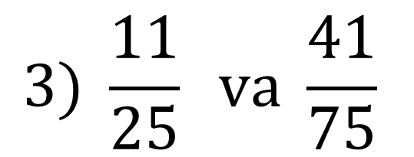
241- masala
Kasrlarni taqqoslang:
$$1) \frac{2}{5} va \frac{9}{20}$$
$$2) \frac{5}{8} va \frac{7}{12}$$
$$3) \frac{11}{25} va \frac{41}{75}$$
$$4) \frac{9}{26} va \frac{11}{39}$$

Slide 4


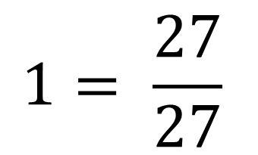
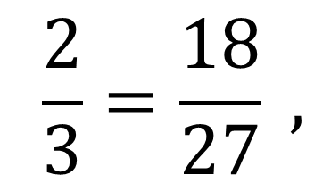
MASALA
Maxraji 27 ga teng, $\frac{2}{3}$ dan katta va 1 dan kichik, qisqarmas kasrlar nechta?
$$\frac{2}{3}=\frac{18}{27} ,$$
$$1= \frac{27}{27}$$
Yechish:
$$\frac{19}{27} , \frac{20}{27}, \frac{21}{27}, \frac{22}{27}, \frac{23}{27}, \frac{24}{27}, \frac{25}{27}, \frac{26}{27}$$
Javob: 6 ta

Slide 5
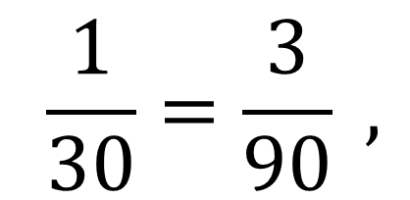
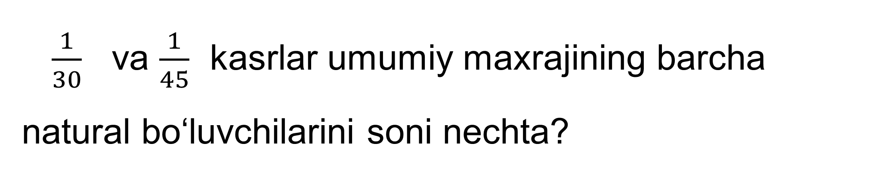
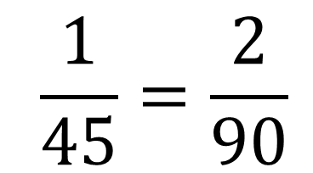
MASALA
$\frac{1}{30}$ va $\frac{1}{45}$ kasrlar umumiy maxrajining barcha natural bo‘luvchilarini soni nechta?
Yechish:
$$\frac{1}{30}=\frac{3}{90} ,$$
$$\frac{1}{45}=\frac{2}{90}$$
45 ∙ 2 = 90,
90
2
45
3
90 = 2 ∙ 3² ∙ 5
15
3
BS =(1+1)(2+1)(1+1) = 2 ∙ 3 ∙ 2 =12
5
5
Javob: 12 ta
1

Slide 6
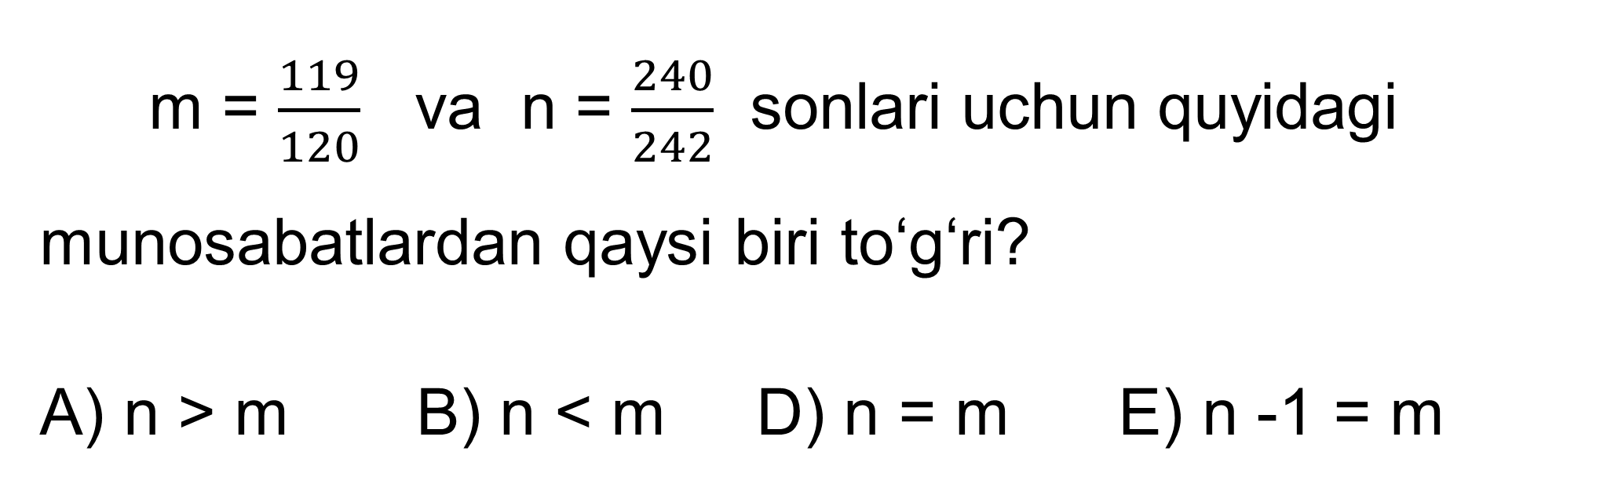
TEST
m = $\frac{119}{120}$ va n = $\frac{240}{242}$ sonlari uchun quyidagi munosabatlardan qaysi biri to‘g‘ri?
A) n > m B) n < m D) n = m E) n -1 = m

Slide 7
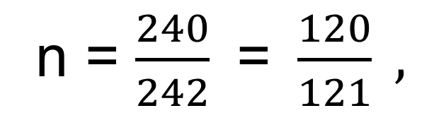
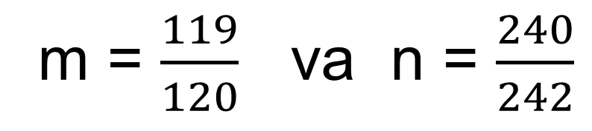
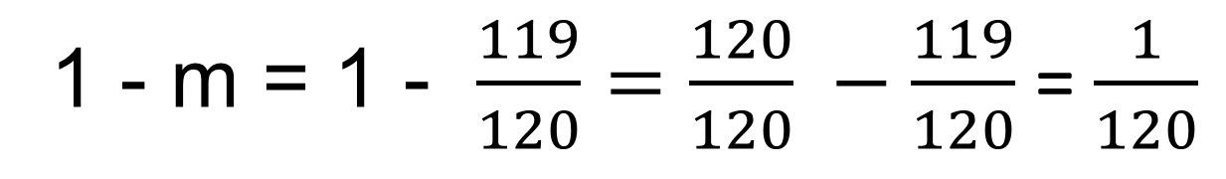
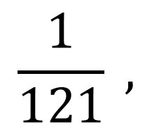
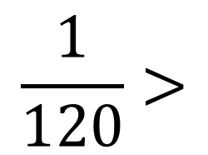
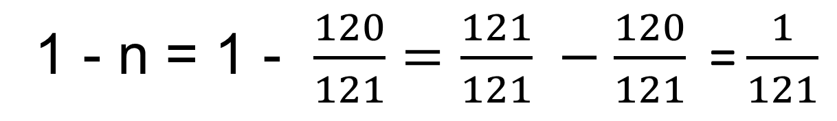
YECHISH
m = $\frac{119}{120}$ va n = $\frac{240}{242}$
1 - m = 1 - $\frac{119}{120}=\frac{120}{120} −\frac{119}{120}$ = $\frac{1}{120}$
n = $\frac{240}{242}\text{ = }\frac{120}{121} ,$
1 - n = 1 - $\frac{120}{121}=\frac{121}{121} −\frac{120}{121}\text{ =}\frac{1}{121}$
$$\frac{1}{120}>$$
$$\frac{1}{121} ,$$
m < n

Slide 8
TEST
m = $\frac{119}{120}$ va n = $\frac{240}{242}$ sonlari uchun quyidagi munosabatlardan qaysi biri to‘g‘ri?
A) n > m B) n < m D) n = m E) n -1 = m
A) n > m
Javob:

Slide 9
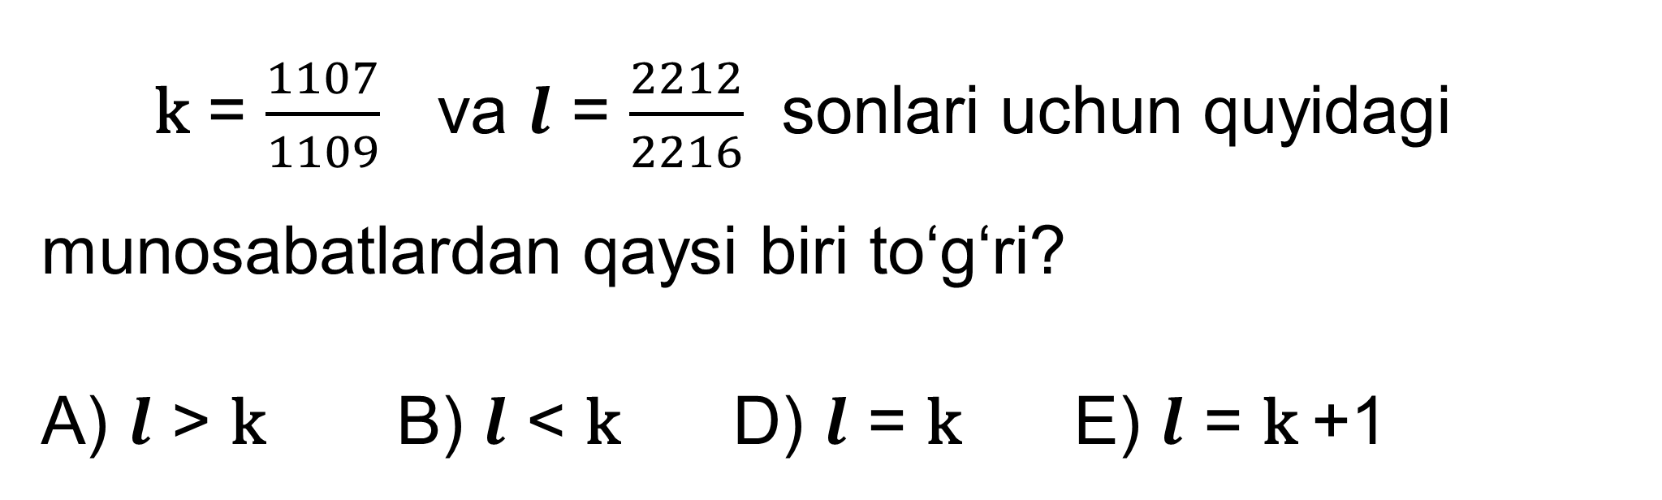
TEST
k = $\frac{1107}{1109}$ va $l$ = $\frac{2212}{2216}$ sonlari uchun quyidagi munosabatlardan qaysi biri to‘g‘ri?
A) $l$ > k B) $l$ < k D) $l$ = k E) $l$ = k +1

Slide 10
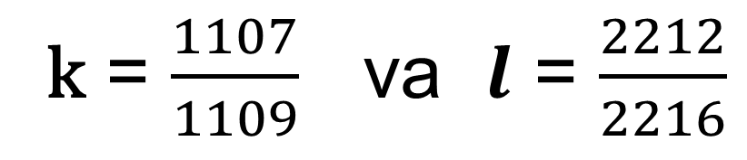
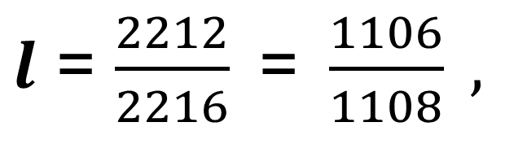
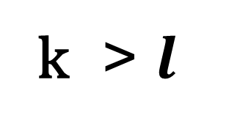
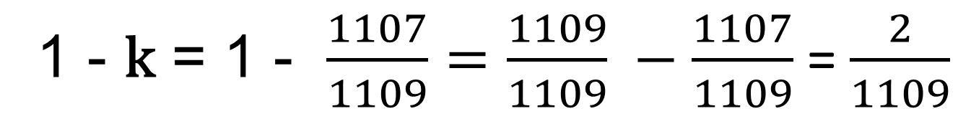
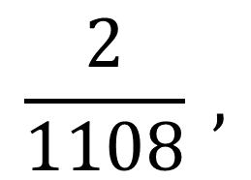
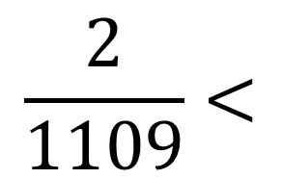
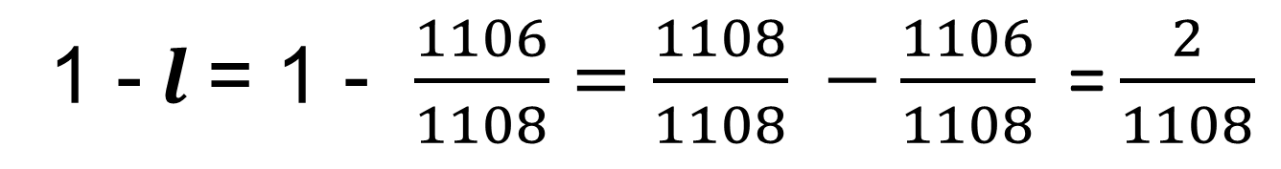
YECHISH
k = $\frac{1107}{1109}$ va $l$ = $\frac{2212}{2216}$
1 - k = 1 - $\frac{1107}{1109}=\frac{1109}{1109} −\frac{1107}{1109}$ = $\frac{2}{1109}$
$l$ = $\frac{2212}{2216}\text{ = }\frac{1106}{1108} ,$
1 - $l$= 1 - $\frac{1106}{1108}=\frac{1108}{1108} −\frac{1106}{1108}\text{ =}\frac{2}{1108}$
$$\frac{2}{1109}<$$
$$\frac{2}{1108} ,$$
k > $l$

Slide 11
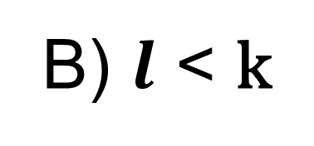
TEST
k = $\frac{1107}{1109}$ va $l$ = $\frac{2212}{2216}$ sonlari uchun quyidagi munosabatlardan qaysi biri to‘g‘ri?
A) $l$ > k B) $l$ < k D) $l$ = k E) $l$ = k +1
B) $l$ < k
Javob:

Slide 12
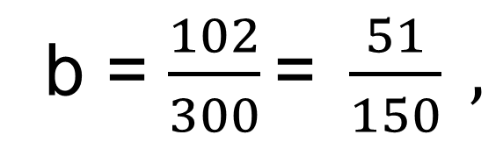
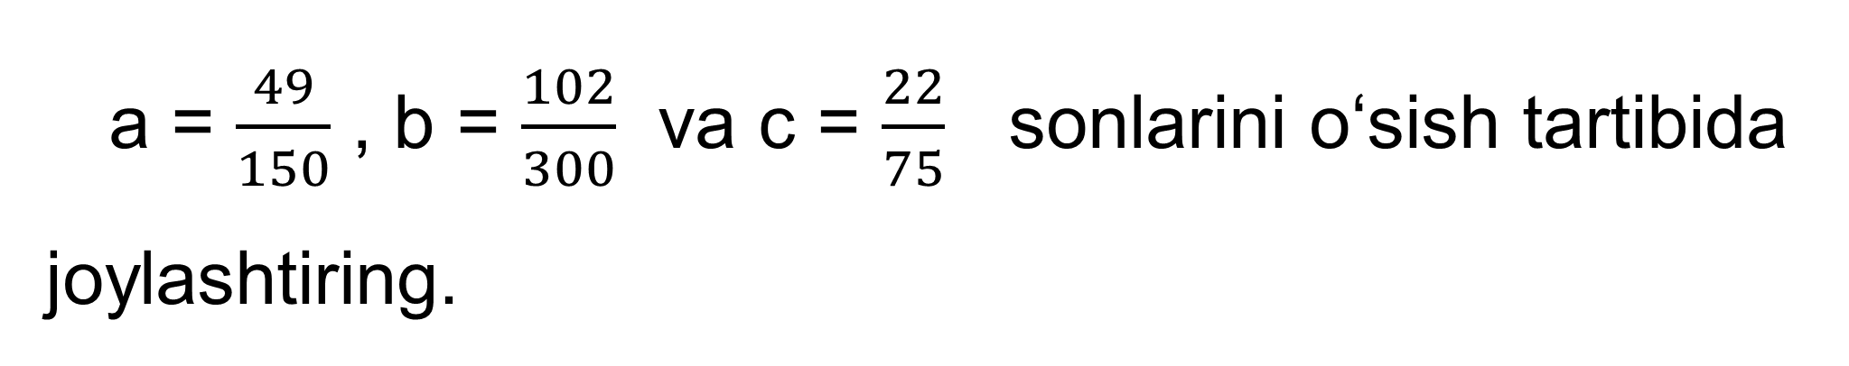
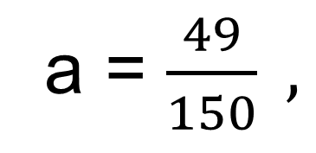
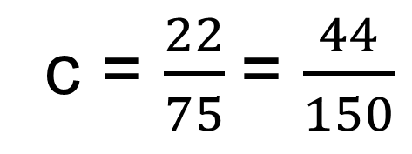
MASALA
a = $\frac{49}{150}$ , b = $\frac{102}{300}$ va c = $\frac{22}{75}$ sonlarini o‘sish tartibida joylashtiring.
Yechish:
a = $\frac{49}{150} ,$
b = $\frac{102}{300}\text{= }\frac{51}{150} ,$
c = $\frac{22}{75}$ = $\frac{44}{150}$
Javob:
c < a < b

Slide 13
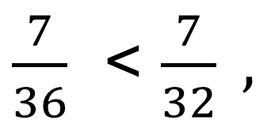
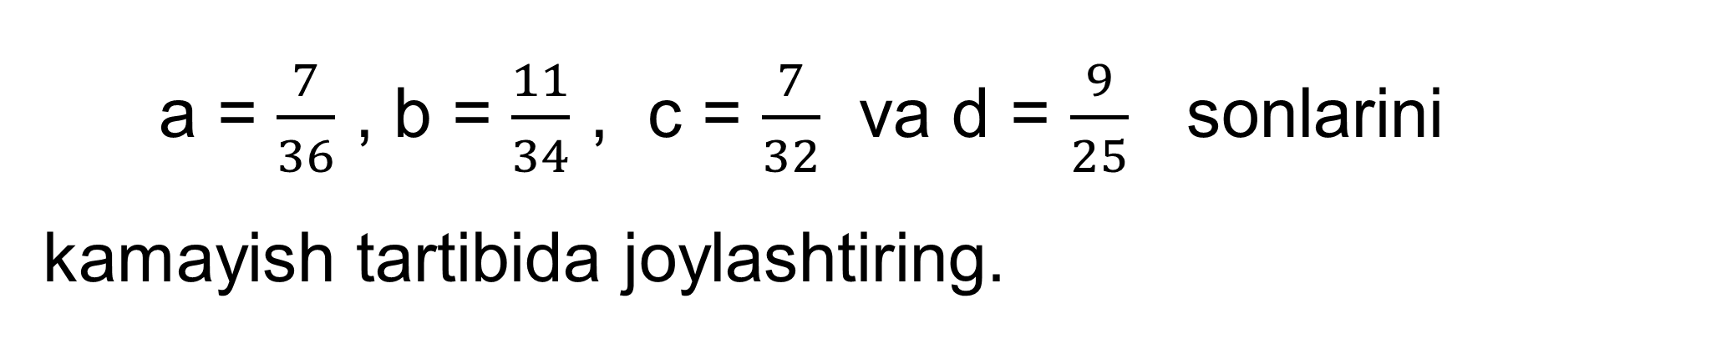
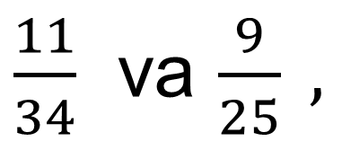
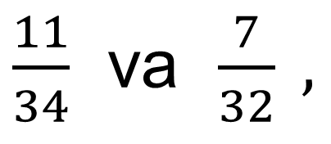
MASALA
a = $\frac{7}{36}$ , b = $\frac{11}{34}$ , c = $\frac{7}{32}$ va d = $\frac{9}{25}$ sonlarini kamayish tartibida joylashtiring.
Yechish:
$\frac{7}{36}$ < $\frac{7}{32} ,$
a < c
$\frac{11}{34}$ va $\frac{7}{32} ,$
11 ∙ 32 > 7 ∙ 34, 352 > 298,
b > c
>
$\frac{11}{34}$ va $\frac{9}{25} ,$
11 ∙ 25 < 9 ∙ 34, 275 < 306,
b < d
<
Javob:
d > b > c > a

Slide 14
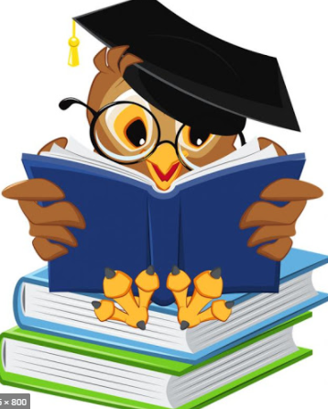
MUSTAQIL BAJARISH UCHUN TOPSHIRIQLAR:
Darslikdagi 247-, 248-, 249-, masalalarni yechish (45-bet).

