Slide 1
MATEMATIKA
6- sinf
MAVZU: MASALALAR YECHISH

Slide 2
KASRLARNI TAQQOSLASH
Har xil maxrajli kasrlarni taqqoslash uchun ularni umumiy maxrajga keltirish kerak.
Kasrlarni quyidagicha taqqoslash ham mumkin:
bunda k, $l$, m, n – natural sonlar.
$$\frac{k}{l} va \frac{m}{n},$$
$$\frac{k}{l} >\frac{m}{n}$$
1) agar k n > m $l$bo‘lsa, bo‘ladi.
$$\frac{k}{l}<\frac{m}{n}$$
2) agar k n < m $l$bo‘lsa, bo‘ladi.

Slide 3
KASRLARNI TAQQOSLASH
Berilgan to‘g‘ri kasrlarni taqqoslash o‘rniga ularning “birga to‘ldiruvchi” kasrlarini taqqoslash qulay.
Ikki to‘g‘ri kasrdan qaysi birining birga to‘ldiruvchisi kichik bo‘lsa, o‘sha kasr katta bo‘ladi, qaysi birining birga to‘ldiruvchisi katta bo‘lsa, o‘sha kasr kichik bo‘ladi.

Slide 4
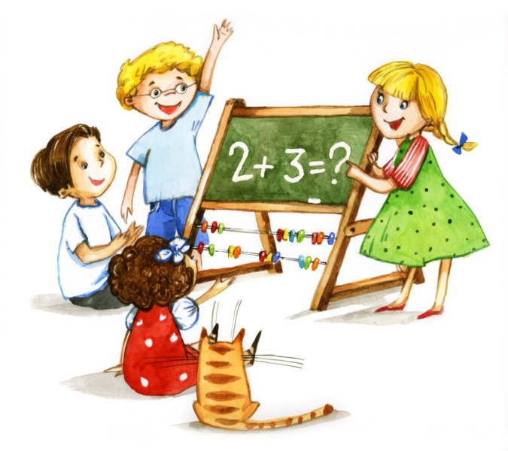
242- masala
Qaysi kasr 1 ga yaqin:
$$1) \frac{5}{6} yoki \frac{6}{7}$$
$$2) \frac{6}{7} yoki \frac{8}{9}$$
$$3) \frac{9}{10} yoki \frac{17}{18}$$
$$4) \frac{20}{21} yoki \frac{11}{12} ?$$

Slide 5
YECHISH
$$1) \frac{5}{6} yoki \frac{6}{7}$$
Yechish:
5 ∙ 7 = 35, 6 ∙ 6 = 36
$$\frac{5}{6} < \frac{6}{7}$$
$$\frac{6}{7}$$
Javob:
$$2) \frac{6}{7} yoki \frac{8}{9}$$
$$1−\frac{6}{7}=\frac{7}{7} − \frac{6}{7}=\frac{1}{7},$$
Yechish:
$$\frac{1}{7} > \frac{1}{9}$$
$$\frac{8}{9}$$
$$1−\frac{8}{9}= \frac{1}{9},$$
Javob:

Slide 6
YECHISH
$$3) \frac{9}{10} yoki \frac{17}{18}$$
$$1−\frac{9}{10}=\frac{1}{10},$$
Yechish:
$$1−\frac{17}{18}=\frac{1}{18},$$
$$\frac{1}{10} > \frac{1}{18}$$
$$\frac{17}{18}$$
Javob:
$$4) \frac{20}{21} yoki \frac{11}{12}$$
$$1−\frac{20}{21}=\frac{1}{21},$$
Yechish:
$$\frac{1}{21} < \frac{1}{12}$$
$$\frac{20}{21}$$
$$1−\frac{11}{12}= \frac{1}{12},$$
Javob:

Slide 7
240- masala
243- masala
Kasrlarni suratlarini tenglab, so‘ngra taqqoslang:
$$1) \frac{5}{8} va \frac{15}{18}$$
$$2) \frac{28}{29} va \frac{7}{8}$$
$$3) \frac{2}{13} va \frac{14}{75}$$
$$4) \frac{12}{5} va \frac{4}{3}$$

Slide 8
YECHISH
$$1) \frac{5}{8} va \frac{15}{18}$$
$$\frac{5}{8}=\frac{5∙3}{8∙3}=\frac{15}{24}$$
Yechish:
$$\frac{15}{24} < \frac{15}{18},$$
$$\frac{5}{8} < \frac{15}{18}$$
Javob:
$$2) \frac{28}{29} va \frac{7}{8}$$
$$\frac{7}{8}=\frac{7∙4}{8∙4}=\frac{28}{32}$$
Yechish:
$$\frac{28}{29}> \frac{28}{32},$$
$$\frac{28}{29} > \frac{7}{8}$$
Javob:

Slide 9
244- masala
Agar a = 1, 2, 3, 4, 5, 6 bo‘lsa, ko‘rinishdagi kasrlarni o‘sib borish tartibida yozing.
$$\frac{7−a}{a+2}$$
Yechish:
$$\frac{7−a}{a+2}=\frac{7−1}{1+2}=\frac{6}{3}=2$$
a = 1,
$$\frac{7−a}{a+2}=\frac{7−2}{2+2}=\frac{5}{4}=1\frac{1}{4}$$
a = 2,

Slide 10
YECHISH
$$\frac{7−a}{a+2}=\frac{7−3}{3+2}=\frac{4}{5}$$
a = 3,
$$\frac{7−a}{a+2}=\frac{7−4}{4+2}=\frac{3}{6}=\frac{1}{2}$$
a = 4,
$$\frac{7−a}{a+2}=\frac{7−5}{5+2}=\frac{2}{7},$$
$$\frac{7−a}{a+2}=\frac{7−6}{6+2}=\frac{1}{8}$$
a = 5,
a = 6,
$$\frac{1}{8}, \frac{2}{7}, \frac{1}{2}, \frac{4}{5}, 1\frac{1}{4}, 2$$
Javob:

Slide 11
245- masala
$$1) \frac{b}{6} <1;$$
$$2) \frac{b}{7} ≤1;$$
$$3) \frac{b}{4} <2;$$
b ning:
tengsizliklarni qanoatlantiruvchi barcha
natural qiymatlarini yozing.
$$4) \frac{b}{12} ≤2$$

Slide 12
YECHISH
$$1) \frac{b}{6} <1$$
b = 1, 2, 3, 4, 5 yoki b < 6
$$2) \frac{b}{7} ≤1$$
b = 1, 2, 3, 4, 5, 6, 7 yoki b $≤7$
$$3) \frac{b}{4} <2$$
b = 1, 2, 3, 4, 5, 6, 7 yoki b < 8
$$4) \frac{b}{12} ≤2$$
b = 1, 2, 3, … 24
yoki b $≤$24

Slide 13
246- masala
$$\frac{1}{36}<a<\frac{1}{6}$$
a ning qo‘sh tengsizlik to‘g‘ri bo‘ladigan bir nechta qiymatini toping. Bunday qiymatlar nechta?
$$\frac{1}{6}=\frac{6}{36},$$
$$\frac{1}{36}<a<\frac{6}{36}$$
Yechish:
$$a=\frac{2}{36}, \frac{3}{36}, \frac{4}{36}, \frac{5}{36}$$
Javob:

Slide 14
250- masala
Tenglamani yeching:
2)
3)
$$\frac{3}{5}=\frac{9}{x+6}$$
$$\frac{2}{7}=\frac{x+5}{28}$$
$$\frac{15}{x−3}=\frac{3}{5}$$

Slide 15
YECHISH
$$\frac{3}{5}=\frac{9}{x+6}$$
$$\frac{2}{7}=\frac{x+5}{28}$$
1)
2)
$$\frac{3}{5}=\frac{9}{15} ,$$
$$\frac{9}{15}=\frac{9}{x+6}$$
$$\frac{2}{7}=\frac{8}{28},$$
$$\frac{8}{28}=\frac{x+5}{28}$$
x + 6 = 15
x = 15 - 6
x = 9
x + 5 = 8
x = 8 – 5
x = 3

Slide 16
MUSTAQIL BAJARISH UCHUN TOPSHIRIQLAR:
Darslikdagi 251-, 252-, 253-, 256-masalalarni yechish (46-bet).

