Slide 1
MATEMATIKA
6- sinf
MAVZU: MASALALAR YECHISH

Slide 2
KASRNI QISQARTIRISH
Kasrni surat va maxrajini ularning 1 dan farqli umumiy ko‘paytuvchisiga bo‘lish kasrni qisqartirish deyiladi:
$$\frac{a∙n}{b∙n}=\frac{a}{b}$$
Bunda, a, b , n – natural sonlar
Agar kasrning surat va maxraji bir xil natural songa bo‘linsa, u holda kasrning qiymati o‘zgarmaydi.

Slide 3
YODINGIZDA SAQLANG

Slide 4
192- masala
Kasrlar orasidan qisqaradiganlarini ajratib oling va qisqartiring:
$\frac{10}{40}, \frac{9}{20}, \frac{72}{90}, \frac{17}{5}, \frac{177}{177}, \frac{12}{30}$, $\frac{42}{56}$, $\frac{85}{102}, \frac{180}{210}$, $\frac{525}{105}$
1
8
Yechish:
$$\frac{10}{40}$$
$$= \frac{1}{4}$$
$$\frac{72}{90}$$
= $\frac{8}{10}$ = $\frac{4}{5}$
$\frac{177}{177}$ =1
4
10
6
18
5
$$\frac{42}{56}$$
= $\frac{6}{8}$
= $\frac{3}{4}$
$$\frac{180}{210}$$
= $\frac{18}{21}$
= $\frac{6}{7}$
$$\frac{525}{105}$$
= $5$
8
21
1

Slide 5
195- masala
n ning qanday natural qiymatlarida kasr natural son bo‘ladi?
$$\frac{24}{n}$$
Yechish:
24 ning bo‘luvchilari: 1, 2, 3, 4, 6, 8, 12, 24
Demak, n = 1; 2; 3; 4; 6; 8; 12; 24 da
kasr natural son bo‘ladi.
$$\frac{24}{n}$$

Slide 6
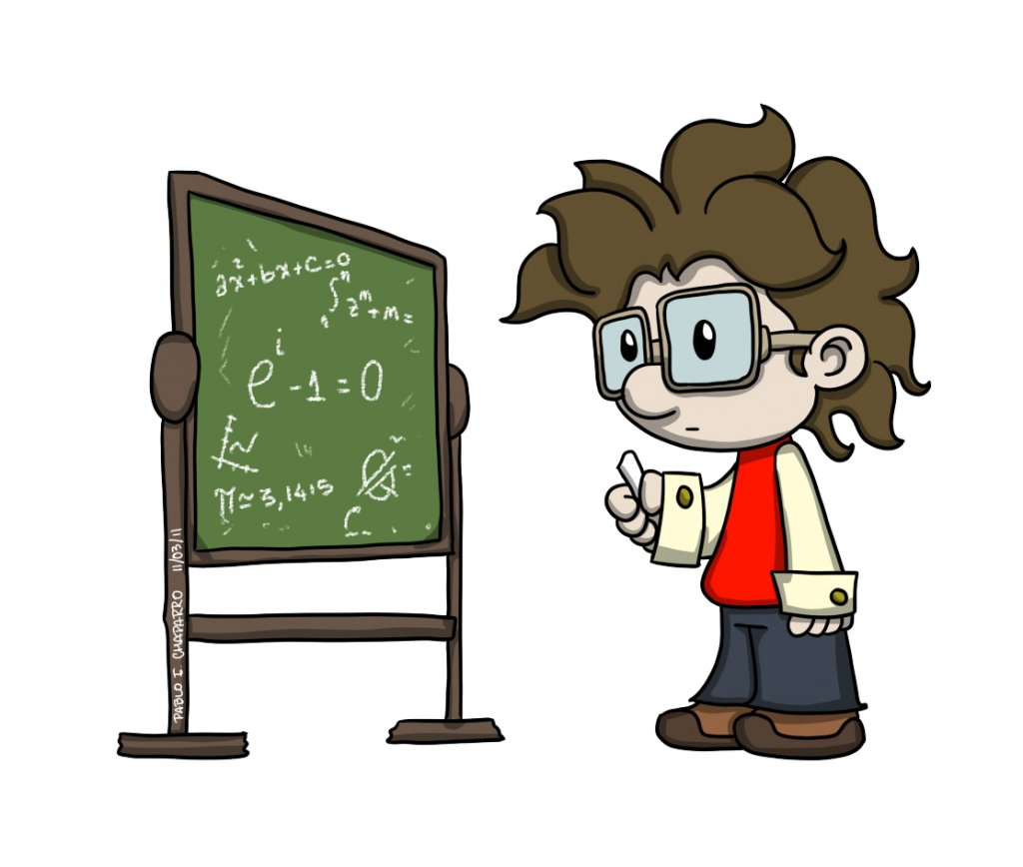
196- masala
n ning qanday natural qiymatlarida kasr:
1) natural son bo‘ladi; 2) qisqaradi; 3) qisqarmas kasr bo‘ladi?
$$\frac{12}{n}$$

Slide 7
YECHISH
1) 12 ning bo‘luvchilari: 1, 2, 3, 4, 6, 12
n = 1; 2; 3; 4; 6; 12 da kasr natural son bo‘ladi
$$\frac{12}{n}$$
2) n = 2k; 3k; 4k; 6k; 12k (k – natural son)
bo‘lganda kasr qisqaradi
$$\frac{12}{n}$$
$$\frac{12}{n}$$
3) EKUB (12, n) = 1 bo‘lganda
kasr qisqarmaydi.

Slide 8
197- masala
Javobni qisqarmas kasr ko‘rinishida bering:
25 cm; 50 cm; 90 cm metrning qanday qismini tashkil qiladi?
Yechish:
$$1) 25cm=$$
$\frac{25}{100}m$= $\frac{1}{4} m$
$$2) 50cm=$$
$\frac{50}{100}m$= $\frac{1}{2} m$
$$3) 90cm=$$
$\frac{90}{100}m$= $\frac{9}{10} m$

Slide 9
197- masala
2) 60 g, 200 g, 750 g kilogrammning qanday qismini tashkil qiladi?
Yechish:
$$1) 60 g=$$
$\frac{60}{1000}$ kg = $\frac{3}{50}$kg
$$2) 200 g=$$
$\frac{200}{1000 }$ kg = $\frac{1}{5}$kg
$$3) 750 g=$$
$\frac{750}{1000}$ kg = $\frac{3}{4}$kg

Slide 10
198- masala
Ifodaning son qiymatini toping:
$$1) \frac{8+12}{24}$$
$$2) \frac{51}{84−16}$$
$$3) \frac{45 −15}{3\text{•}13+6}$$
Yechish:
1) $\frac{8+12}{24}$ = $\frac{20}{24}$
= $\frac{5}{6}$
2) $\frac{51}{84−16}$ = $\frac{51}{68}$
= $\frac{3}{4}$

Slide 11
200- masala
Bo‘linuvchi bo‘luvchidan 6 marta katta, bo‘luvchi esa bo‘linmadan 6 marta katta. Bo‘linuvchi, bo‘luvchi va bo‘linma nimaga teng?
Bo‘luvchini a desak, bo‘linuvchi 6a ga teng.
Yechish:
$\frac{6a}{a}$ =
$$6$$
, masala shartiga ko‘ra, bo‘luvchi a = 6$\text{•}\text{ 6 = 36}$
Bo‘linuvchi 6a = 6 $\text{•}$ 36 = 216
Javob: 216, 36, 6

Slide 12
MASALA
Kasrni qisqartiring:
$$\frac{8∙9∙30}{18∙27∙10}$$
1
4
1
5
Yechish:
$$\frac{8∙9∙30}{18∙27∙10}$$
$$= \frac{4}{9}$$
3
3
5
1
$$\frac{4}{9}$$
Javob:

Slide 13
MUSTAQIL BAJARISH UCHUN TOPSHIRIQLAR:
Darslikdagi 206-, 207,- 208-,
209- masalalarni yechish (38-bet).

