Slide 1
MATEMATIKA
6- sinf
MAVZU: KASRLARNI QISQARTIRISH

Slide 2
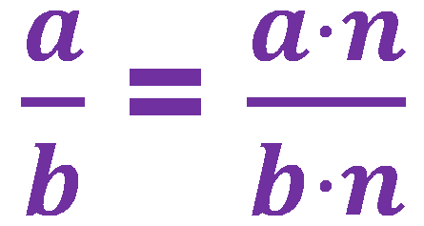
KASRNING ASOSIY XOSSASI
$$\frac{a∙n}{b∙n}=\frac{a}{b}$$
Bunda, a, b , n – natural sonlar

Slide 3
KASRNI QISQARTIRISH
Kasrni surat va maxrajini ularning 1 dan farqli umumiy ko‘paytuvchisiga bo‘lish kasrni qisqartirish deyiladi:
$$\frac{a∙n}{b∙n}=\frac{a}{b}$$
Bunda, a, b , n – natural sonlar

Slide 4
KASRNING ASOSIY XOSSASI
$\frac{3}{9}$ = $\frac{3:3}{9:3}=\frac{1}{3}$
$\frac{30}{45}$ = $\frac{30:5}{45:5}=\frac{6}{9}$
Masalan,
Agar kasrning surat va maxraji bir xil natural songa bo‘linsa, u holda kasrning qiymati o‘zgarmaydi.
Kasrlar qisqartirgandan so‘ng ularga
teng, lekin surat va maxraji kichikroq
bo‘lgan kasr hosil bo‘ladi.

Slide 5
QISQARMAS KASR
$$\frac{8}{9}$$
- qisqarmas kasrlar.
Berilgan kasrga qisqarmas kasrni hosil qilish uchun:
1- qadam. Kasrning surat va maxrajining EKUBi topiladi.
2- qadam. Kasrning surat va maxraji shu EKUBga bo‘linadi.
$$\frac{5}{7},$$

Slide 6
MISOL
$$\frac{496}{620}$$
kasrni qisqartiring.
Yechish : 1) EKUB (496, 620)
496 = 2⁴ $∙$ 31 , 620 = 2² $∙$ 5 $∙$ 31
EKUB (496, 620) = 2² $∙$ 31 = 124
$$\frac{496}{620}=\frac{496 :124}{620 :124}=\frac{4}{5}$$
2)
4
$$\frac{496}{620}$$
$$=\frac{4}{5}$$
$$\frac{4}{5}$$
Javob:
5

Slide 7
MISOL
$$\frac{72}{84}$$
kasrni qisqartiring.
Yechish :
$$\frac{72}{84}=\frac{36 }{42}=\frac{18}{21}=\frac{6}{7}$$
$$\frac{6}{7}$$
Javob:

Slide 8
185- masala
Kasrlarni qisqartiring:
$$1) \frac{3∙5}{8∙3}$$
$$2) \frac{7∙2}{2∙15}$$
$$3) \frac{4∙9}{4∙11}$$
$$4) \frac{21∙8}{4∙70}$$
Yechish:
$$=\frac{5}{8}$$
$$2) \frac{7∙2}{2∙15}$$
$$=\frac{7}{15}$$
$$1) \frac{3∙5}{8∙3}$$
3
2
1
$$4) \frac{21∙8}{4∙70}$$
$$= \frac{3∙2}{10}$$
$$= \frac{3}{5}$$
1
10
5

Slide 9
186- masala
$\frac{6}{12}, \frac{24}{18}, \frac{18}{24}, \frac{30}{36}, \frac{60}{120}$, $\frac{96}{108}$, $\frac{54}{78}$, $\frac{66}{42}$
kasrlarning surat va maxrajini 6 ga bo‘ling. Hosil bo‘lgan mos tengliklarni yozing.
Yechish:
$\frac{6}{12}$ = $\frac{1}{2}$
$\frac{24}{18}$ = $\frac{4}{3}$
$\frac{18}{24}$ = $\frac{3}{4}$
$\frac{30}{36}$ = $\frac{5}{6}$

Slide 10
186- masala
$\frac{6}{12}, \frac{24}{18}, \frac{18}{24}, \frac{30}{36}, \frac{60}{120}$, $\frac{96}{108}$, $\frac{54}{78}$, $\frac{66}{42}$
kasrlarning surat va maxrajini 6 ga bo‘ling. Hosil bo‘lgan mos tengliklarni yozing.
Yechish:
$\frac{60}{120}$ = $\frac{10}{20}$
$\frac{96}{108}$ = $\frac{16}{18}$
$\frac{54}{78}$ = $\frac{9}{13}$
$\frac{66}{42}$ = $\frac{11}{7}$

Slide 11
187- masala
Har bir kasrning surati va maxrajini ularning EKUBiga bo‘ling:
$\frac{5}{10}, \frac{10}{100}, \frac{15}{55}, \frac{34}{38}, \frac{32}{40}$, $\frac{33}{110}$, $\frac{102}{180}$, $\frac{28}{70}$
Yechish:
1) $\frac{5}{10}$ =
$$\frac{1}{2}$$
$\frac{10}{100}$ =
$$\frac{1}{10}$$
2)
EKUB (5, 10) = 5
EKUB (10, 100) = 10

Slide 12
YECHISH
$$\frac{15}{55}$$
= $\frac{3}{11}$
$$\frac{34}{38}$$
= $\frac{17}{19}$
3)
4)
15= 3 • 5, 55 = 5 • 11
34 = 2 • 17, 38 = 2 • 19
EKUB (15, 55) = 5
EKUB (34, 38) = 2
$$\frac{32}{40}$$
= $\frac{4}{5}$
$\frac{33}{110}$ =
$$\frac{3}{10}$$
5)
6)
33 = 3 • 11, 110 = 2 • 5 • 11
32= 2⁵ , 40 = 2³ • 5
EKUB (32, 40) = 8
EKUB (33, 110) = 11

Slide 13
191- masala
Oddiy kasr ko‘rinishida yozing va agar mumkin bo‘lsa, qisqartiring: 0,6; 0,9; 0,07; 0,08; 0,25; 0,36; 0,75; 0,125.
0,6 = $\frac{6}{10}$ = $\frac{3}{5}$
0,9 = $\frac{9}{10}$
0,07 = $\frac{7}{100}$
Yechish:
0,08 = $\frac{8}{100}$ = $\frac{2}{25}$
0,25 = $\frac{25}{100}$ = $\frac{1}{4}$
0,36 = $\frac{36}{100}$ = $\frac{9}{25}$
0,125 = $\frac{125}{1000}$ = $\frac{1}{8}$

Slide 14
194- masala
Kasrlarni qisqartiring va ularning butun qismini ajrating:
$\frac{40}{16}, \frac{72}{60}, \frac{1080}{18}, \frac{168}{96}, \frac{236}{40}$, $\frac{488}{80}$, $\frac{140}{60}$, $\frac{144}{64}, \frac{150}{45}$
Yechish:
$\frac{40}{16}$ = $\frac{5}{2}=2\frac{1}{2}$
$\frac{72}{60}$ = $\frac{12}{10}=\frac{6}{5}=1\frac{1}{5}$
$\frac{236}{40}$ = $\frac{59}{10}=5\frac{9}{10}$
$\frac{488}{80}$ = $\frac{61}{10}=6\frac{1}{10}$

Slide 15
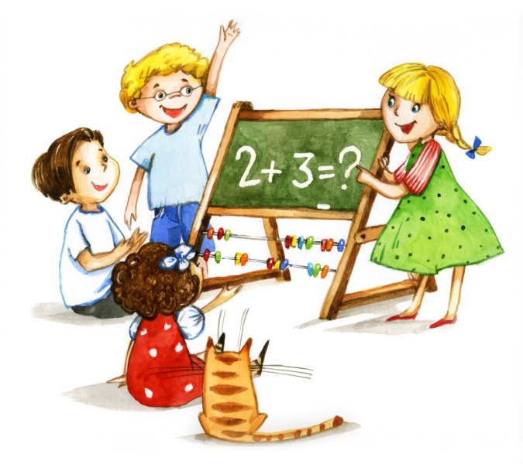
MUSTAQIL BAJARISH UCHUN TOPSHIRIQLAR:
Darslikdagi 201-, 203,- 204-,
205- masalalarni yechish (37-bet).

