Slide 1
MATEMATIKA
6- sinf
MAVZU: MASALALAR YECHISH

Slide 2
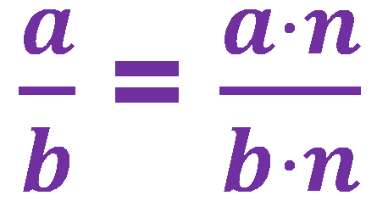
Kasrning asosiy xossasi
Agar kasrning surat va maxraji ayni bir natural songa ko‘paytirilsa, kasrning qiymati o‘zgarmaydi, ya’ni avvalgisiga teng kasr hosil bo‘ladi.
Bunda, a, b , n – natural sonlar

Slide 3
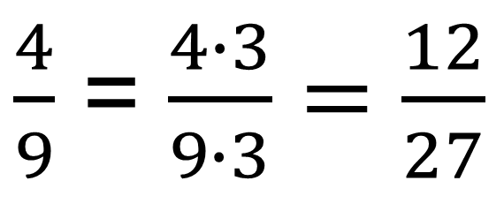
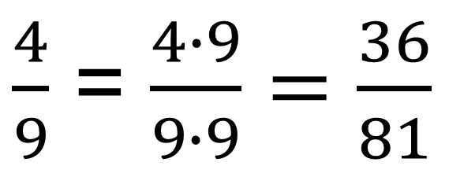
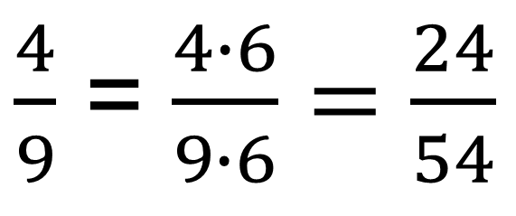
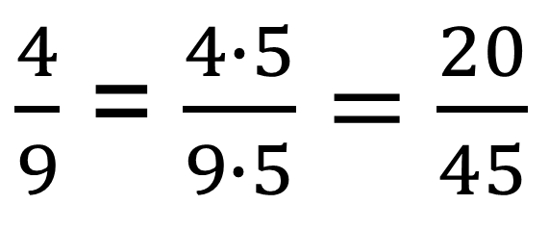
166- masala
Surati va maxraji $\frac{4}{9}$ kasrning surati va maxrajidan katta, ammo shu kasrga teng bo‘lgan to‘rtta kasr yozing.
Yechish:
$\frac{4}{9}$ = $\frac{4∙3}{9∙3}=\frac{12}{27}$
$\frac{4}{9}$ = $\frac{4∙5}{9∙5}=\frac{20}{45}$
$\frac{4}{9}$ = $\frac{4∙6}{9∙6}=\frac{24}{54}$
$\frac{4}{9}$ = $\frac{4∙9}{9∙9}=\frac{36}{81}$

Slide 4
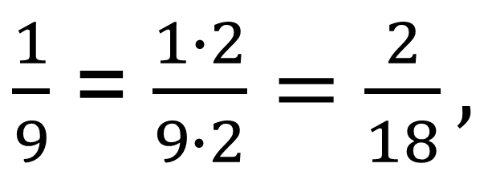

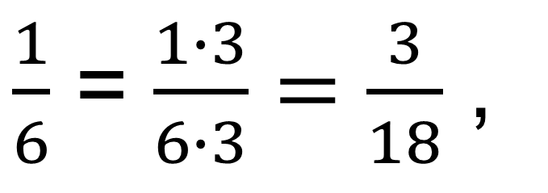

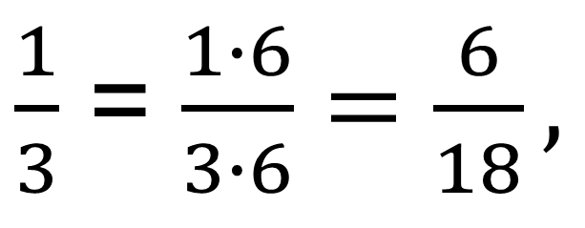


167- masala
$$\frac{1}{3},$$
$$\frac{1}{6},$$
$$\frac{1}{9}$$
$$\frac{1}{18}$$
sonlarining har birida nechta
ulush bor?
$\frac{1}{3}$ = $\frac{1∙6}{3∙6}=\frac{6}{18},$
$\text{6 }\text{ta} \frac{1}{18}$ ulush bor
Yechish:
$\frac{1}{6}$ = $\frac{1∙3}{6∙3}=\frac{3}{18}$ ,
$\text{3} \text{ta} \frac{1}{18}$ ulush bor
$\frac{1}{9}$ = $\frac{1∙2}{9∙2}=\frac{2}{18},$
$\text{2} \text{ta} \frac{1}{18}$ ulush bor

Slide 5


169- masala
Tenglamani yeching:
2)
$$\frac{3}{4}=\frac{15}{x+7}$$
$$\frac{5}{9}=\frac{x−3}{27}$$

Slide 6
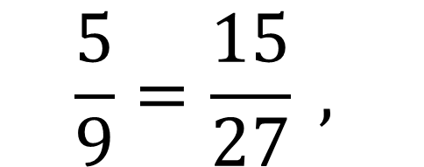
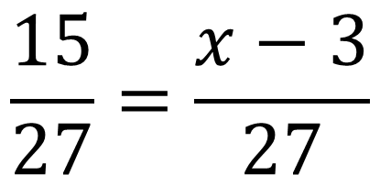
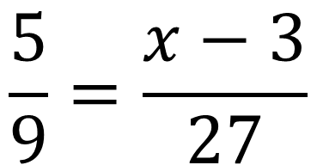
YECHISH
$$\frac{5}{9}=\frac{x−3}{27}$$
2)
$$\frac{5}{9}=\frac{15}{27} ,$$
$$\frac{15}{27}=\frac{x−3}{27}$$
x – 3 = 15
x = 15 + 3
x = 18

Slide 7
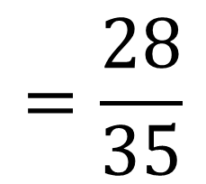
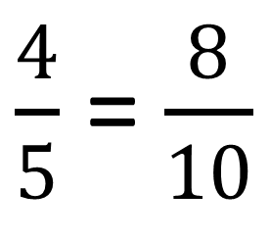
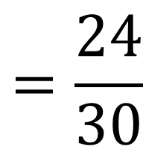
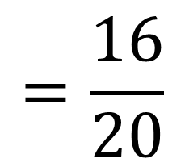
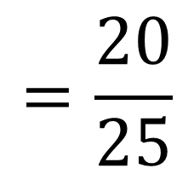
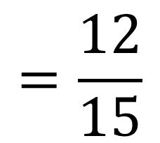
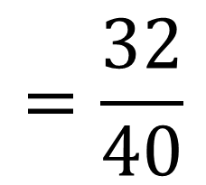
170- masala
Yozuvni tiklang:
$$\frac{4}{5}=\frac{∗}{10}=\frac{∗}{15}=\frac{∗}{20}=\frac{∗}{25}=\frac{∗}{30}=\frac{∗}{35}=\frac{∗}{40}$$
Yechish:
$\frac{4}{5}$ = $\frac{8}{10}$
$$=\frac{12}{15}$$
$$=\frac{16}{20}$$
$$=\frac{20}{25}$$
$$=\frac{24}{30}$$
$$=\frac{28}{35}$$
$$=\frac{32}{40}$$

Slide 8
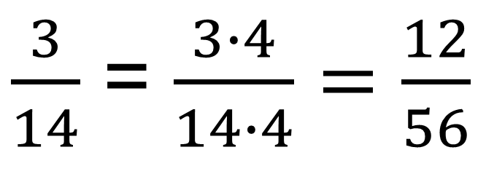
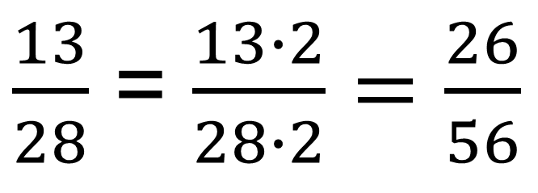
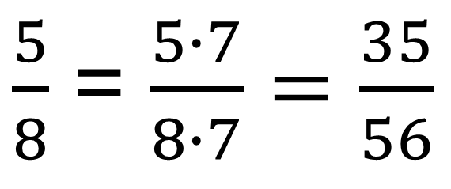
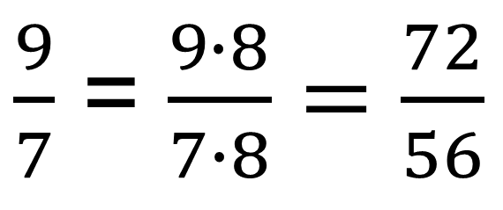
171- masala
$$\frac{3}{14}, \frac{9}{7}, \frac{9}{15}, \frac{5}{8}, \frac{13}{28}$$
kasrlar ichidan
56 maxrajga keltiriladiganlarini ayting.
Yechish: 56 : 14 = 4, 56 : 7 = 8, 56 : 8 = 7, 56 : 28 = 2
$\frac{3}{14}$ = $\frac{3∙4}{14∙4}=\frac{12}{56}$
$\frac{9}{7}$ = $\frac{9∙8}{7∙8}=\frac{72}{56}$
$\frac{5}{8}$ = $\frac{5∙7}{8∙7}=\frac{35}{56}$
$\frac{13}{28}$ = $\frac{13∙2}{28∙2}=\frac{26}{56}$

Slide 9
172- masala
“Agar a + b yig‘indi 7 ga bo‘linsa, u holda aba ko‘rinishdagi uch xonali natural sonlar ham 7 ga bo‘linadi” degan mulohaza to‘g‘rimi? Javobingizni asoslang. Aytilgan mulohaza o‘rinli bo‘lsa, barcha yechimlarini toping.
Yechish:
aba = 100a + 10b + a =
= 90a +10a+ 10b +a = 10(a + b) + 91a
$$∙$$
91 = 7 13 , a + b yig‘indi ham 7 ga karrali
a + b = 1 + 6 = 2 + 5 = 3 + 4
Javob:
161, 616, 252, 525, 343, 434

Slide 10

173- masala
m harfi biror sonni bildiradi. Faqat m suratli bitta noto‘g‘ri kasr mavjudligi ma’lum. m harfi bilan qanday son belgilangan?
Yechish:
m = 1, chunki - noto‘g‘ri kasr.
Surati birga teng bo‘lgan faqat bitta noto‘g‘ri kasr mavjud.
$$\frac{1}{1}$$
Javob: 1

Slide 11
174- masala
Ko‘p xonali tub son qanday raqam bilan tugashi mumkin?
A) 1 yoki 3, yoki 5, yoki 7, yoki 9
B) 1 yoki 3, yoki 5
D) 1 yoki 3, yoki 7, yoki 9
E) Ixtiyoriy
Javob: D

Slide 12

TEST
va 1 sonlari orasida maxraji 33 ga teng bo‘lgan nechta kasr son bor?
A) 2 B) 1 D) 5 E) 6
$$\frac{9}{11}$$
Javob: D

Slide 13
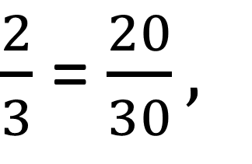

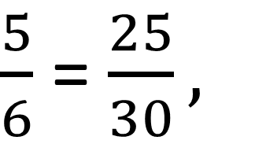

TEST
va sonlari orasida maxraji 30 ga teng bo‘lgan nechta kasr son bor?
A) 1 B) 4 D) 2 E) 5
$$\frac{2}{3}$$
$$\frac{5}{6}$$
Yechish:
$\frac{2}{3}$ = $\frac{20}{30},$
$\frac{5}{6}$ = $\frac{25}{30},$
$$\frac{21}{30}, \frac{22}{30}, \frac{23}{30}, \frac{24}{30}$$
Javob: B

Slide 14
MUSTAQIL BAJARISH UCHUN TOPSHIRIQLAR:
Darslikdagi 177,- 178-, 179-,
180- masalalarni yechish (33-bet).

